Slide 1
caGrid Infrastructure and Tools in the Future
Scott Oster, Ohio State University
caBIG® Architecture/Vocabularies & Common Data Elements Workspaces
Joint Face-to-Face Meeting
Northwestern University, Evanston, Illinois
October 27-29, 2008

Slide 2
Agenda
The state of the grid, today
caGrid 1.3 release
In the future there will be…
  more metadata
  better metadata
  better use of metadata
The plan forward

Slide 3
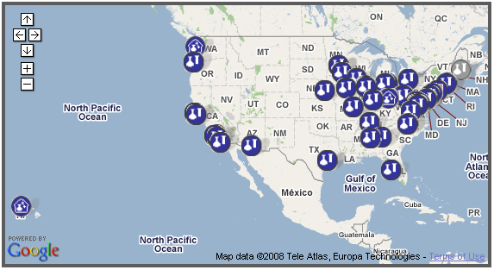
The state of the grid, today
With the successful efforts of the community, the Deployment team, and the caBIG Application Bundles, there are over 100 registered services on the production grid, running across the country
Building upon these and other deployments, a movement towards further collaborations and real world data sharing will follow, driving new requirements in functionality and scalability

Slide 4
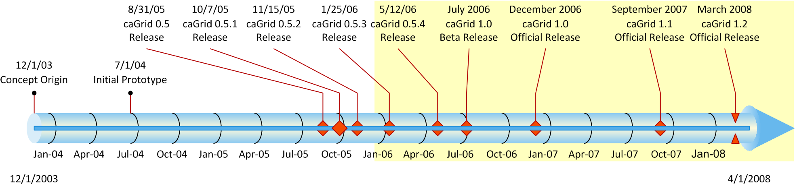
caGrid Releases
Last stable release of caGrid was caGrid 1.2 in March of 2008
Next stable release, caGrid 1.3, planned for first quarter 2009 will maintain the 1.x line of compatibility
Following release currently expected to be caGrid 2.0, with no current release date set

Slide 5
caGrid 1.3 Highlights
CBIIT 2008 Future Technology Stack Support
Significant feature enhancements to federated query support including support for ws-notification, delegation, transfer and ws-enumeration of results
Significant improvements to global model exchange including support for any schema/namespace, update/delete, include/redefine, imports cycles, and grid service overhaul
caCORE SDK 4.1 integration
Numerous security enhancements to Introduce and generated APIs
Support for multiple authentication profiles (such as one time password), and secure discovery of identity providers
Certificate/Credential enhancements including use of short term certificates to support document signing
WebSSO improvements including “single sign out” and additional supported clients (acegi)
Numerous bug fixes and minor feature requests addressed

Slide 6

And now…

Slide 7

In the future there will be… more metadata

Slide 8
Beyond Data Semantics
Today:
  Current emphasis in caBIG is on the semantics of the data itself
    provides a programmatic means to discover and query for data of interest
  Processing of retrieved data is done either locally via tools/applications or on the grid via analytical services
    analytical services can be discovered by many aspects, including input data types, and are formally described
  It is possible to automatically discover and construct a workflow which queries for data from one data service and passes the results as input into an operation provided by another service, and know the data is syntactically and semantically interoperable
What’s missing?
  There’s really no way to programmatically determine if that workflow “make’s sense” (or build a tool that automatically creates “meaningful workflows”)
Future:
  Services and their operations could be annotated by a rich ontology describing “what” the service/operation does (and potentially how it does it); this is actually supported in the current metadata model but not used
    Enabling not only discovery, but composition

Slide 9
Uncompromising Performance
Today:
  To overcome inherent performance and scalability inefficiencies in XML and SOAP for large data sets, a variety of alternate transfer mechanisms are provided
    GridFTP, ws-enumeration, transfer service
What’s missing?
  Semantic metadata is anchored from the XML view of data, when transferring data in “binary,” this connection is no longer explicit
Future:
  Emerging standards like Data Format Description Language (DFDL) can formally define non-XML formats (like binary or compact text), as annotations on XML schemas
    Parsers can be used to seamlessly convert or interpret either form
  Such descriptions can be advertised as metadata about the data being transferred (such as via transfer), and as part of the definition of the data model
  Data elements in a binary stream can carry just as much semantics as their XML form (via transitive association in the XML Schema)

Slide 10

In the future there will be… better metadata

Slide 11
Quality over Quantity
  Today:
    Anyone with data or analytics of value is encouraged to provide it as a resource to the community though most (not all!) of the available services are from funded participants or projects
    The hardware requirements for most services are fairly simple given their modest use
  What’s missing?
    As the community, resources available, and number of users grow
      some resources will be in much higher demand (think google or wikipedia of the www)
      it will be more difficult to distinguish between the plethora of resources
  Future:
    Social networking, “friend of a friend”, peer rating technologies, and/or comprehensive statistics may be useful to help find quality resources on the grid, probably via computable assertions
    Formal service level agreements may be desirable for high demand resources; third party computing providers may be necessary to meet demand

Slide 12

In the future there will be… better use of metadata

Slide 13
  Higher order APIs (reasoning, query formulation, S-MDS)
  Tooling fully leveraging semantics (workflow assist, etc)
    External integration (Semantic Web Technologies (OWL, SWRL, SAWSDL, SPARQL ), .NET, myGrid services)

Slide 14
Other stuff?
  Integration into other communities, globally, within practice
  Decentralized metadata registries

Slide 15
KC to drive community road map

