Slide 1
Identity provider
Architecture and Design
(Vinay Kumar, SemanticBits)

Slide 2
Motivation
Need for federated model for authentication, where the respective participating organizations will be able to leverage their existing authentication infrastructure.

Slide 3
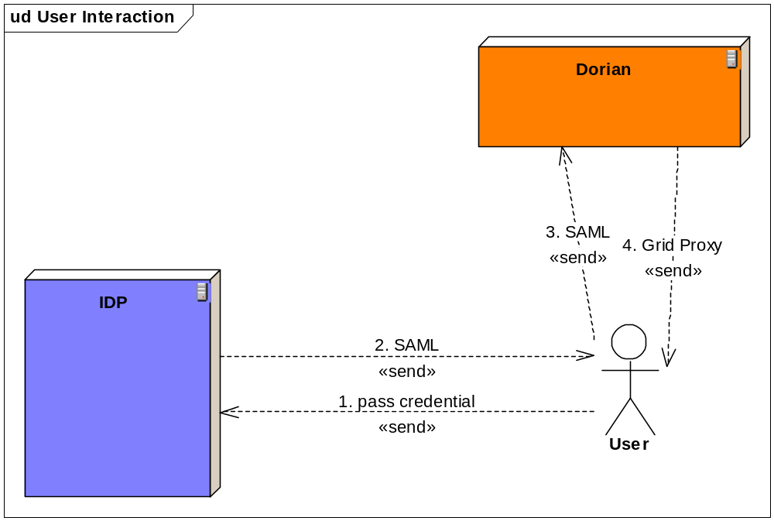
Authentication on Grid

Slide 4
Authentication Steps
User sends it local credential to the IDP
IDP invokes the local login module (authentication mechanism) and depending upon the success or failure gets back some of users attributes (last name, first name and email Id). Using this information IDP prepares SAML and sends it back to the user.
Once user receives, the user sends this SAML instance to Dorian.
Dorian consumes the SAML and issues a Grid Proxy.

Slide 5
Identity Provider’s Role
The identity provider will have following responsibility
Consumes user’s credentials
Returns digitally signed (implicit) SAML to user.

Slide 6
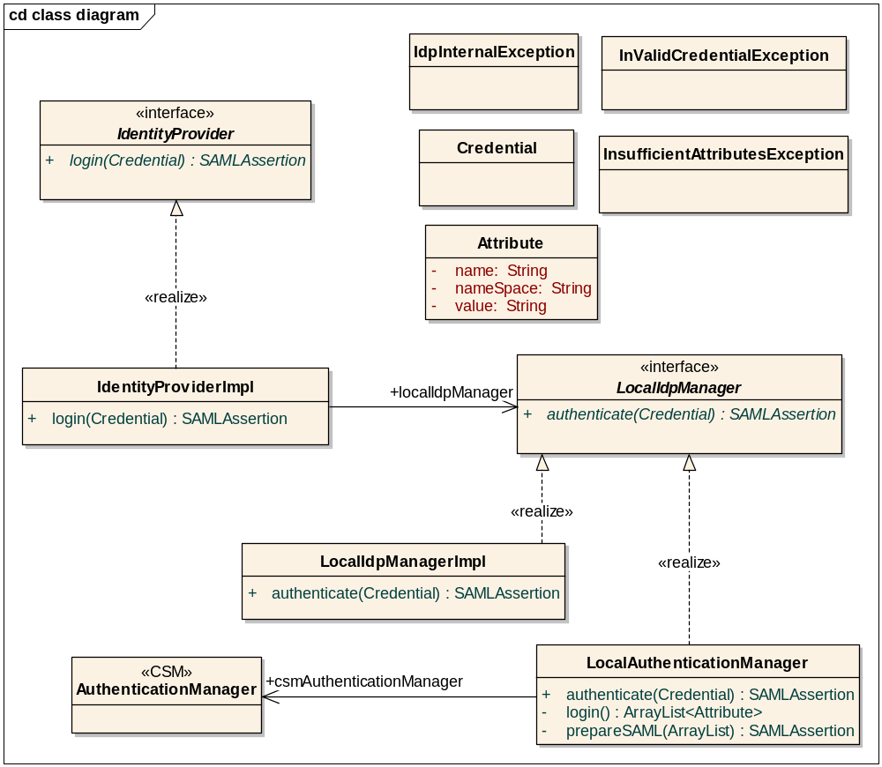
Class diagram

Slide 7
Classes
The IdentityProvider interface:
public interface IdentityProvider {
public SAMLAssertion login(credentials Credential) throws InValidCredentialException, InsufficientAttributesException, IdpInternalException,RemoteException;
}
InValidCredentialException will be thrown when the credentials (typically userid/password ) are not valid.
InsufficientAttributesException will be thrown when enough information (lastname, firstname and emailed) for a user can’t be extracted from the local system.
IdpInternalException will be thrown when something goes wrong internally with local system.

Slide 8
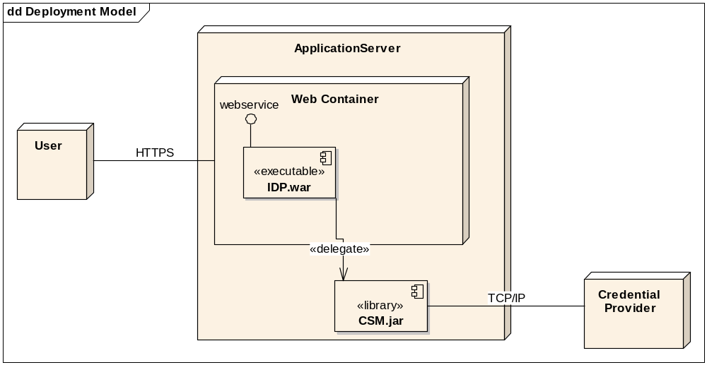
Deployment

Slide 9
Questions
  ???

