Slide 1
caGrid 1.1 Security
Grid Authentication and Authorization with Reliably Distributed Services (GAARDS)
Oracle Strategic Engagement
October 05, 2007
Stephen Langella
Ohio State University
langella@bmi.osu.edu

Slide 2
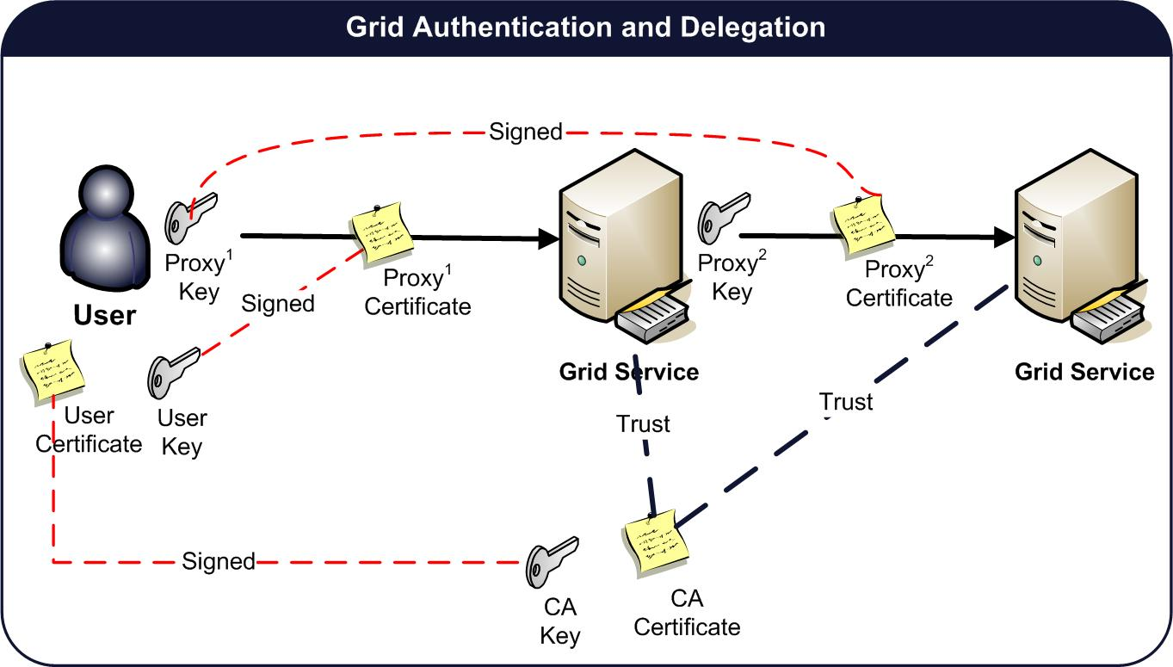
Grid Security Authentication
Based on X.509 End Entity Certificates and X.509 Proxy Certificates
User Credentials
  Long term X.509 Certificate and Private Key.
  Clients authenticate to the grid using a grid proxy.
  Grid Proxy consists of a private key and proxy certificate signed by the user’s long term private key.
    Extension of X.509 Identity Certificates
    Short Lifetime
    Asserts Identity of users and services.
    Enables single sign-on
    Delegation
Service Credentials
  Long term X.509 Certificate and Private Key.

Slide 3
GAARDS Overview
Grid Authentication and Authorization with Reliably Distributed Services (GAARDS)
  GAARDS provides services and tools for the administration and enforcement of security policy in an enterprise Grid.
  Developed on top of the Globus Toolkit
  Extends the Grid Security Infrastructure (GSI)
  Provide enterprise services and administrative tools for:
    Grid User Management
    Identity Federation
    Trust management
    Group/VO management
    Access Control Policy management and enforcement
    Integration between existing security domains and the grid security domain.

Slide 4
GAARDS Components
Dorian
  Grid User Account Management
  Integration point between external security domains and the grid.
  Allows accounts managed in external domains to be federated and managed in the grid.
  Dorian allows users to use their existing credentials (external to the grid) to authenticate to the grid
Grid Trust Service (GTS)
  Creation and Management of a federated trust fabric.
  Supports applications and services in deciding whether or not signers of digital credentials/user attributes can be trusted.
  Supports the provisioning of trusted certificate authorities and corresponding CRLS.
Grid Grouper
  Group management service for the grid
  Provides a group-based authorization solution for the Grid
  Enforce authorization policy based on membership to groups

Slide 5
GAARDS Components
Authentication Service
  Integrates existing credentials providers into the grid.
  Provides a uniform grid interface for authenticating to existing credential providers.
  Applications can communicate with any credential provider.
Common Security Module (CSM)
  Provides a centralize approach to managing and enforcing access control policy authorization.
Security Metadata
  Ensures communication interoperability between grid services

Slide 6
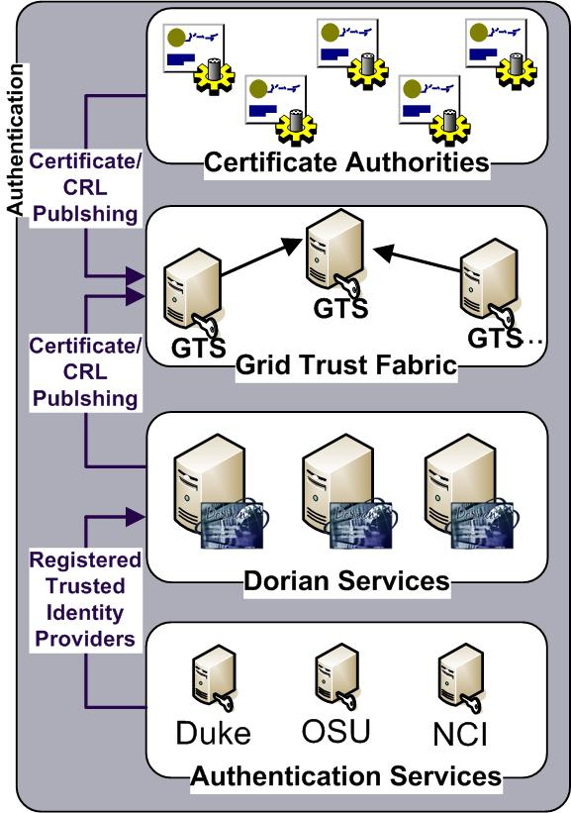
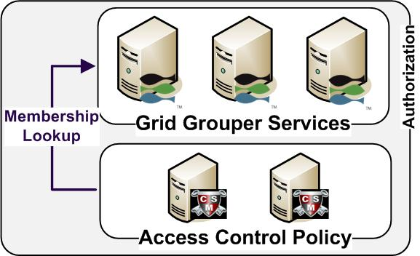
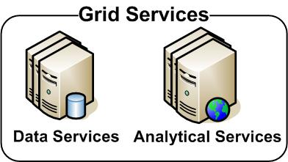
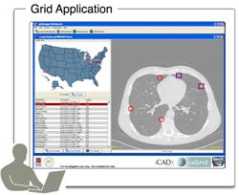
GAARDS in Action

Slide 7
GAARDS in Action
Authenticate with
Local Credential Provider
User authenticates to local credential provider using your everyday user credentials
SAML Assertion

Slide 8
GAARDS in Action
SAML Assertion
Application obtains grid credentials from Dorian using SAML provided by the local provider.
Grid
Credentials

Slide 9
GAARDS in Action
Application uses grid credentials to invoke secure grid services.
Grid
Credentials

Slide 10
GAARDS in Action
Should I trust the
credential signer?
Grid Service authenticates the user by asking the GTS whether or not the signer of the credential should be trusted.

Slide 11
GAARDS in Action
Authorization
Grid Service asks CSM or their access control policy enforcer whether or not the user can perform X and resource Y.
Is
Authorized?

Slide 12
GAARDS in Action
Is member of?
Authorization
Alternative
Grid Service can enforce local policy based on user membership to groups maintained in Grid Grouper.

Slide 13
GAARDS Team
Ohio State University
  Stephen Langella
  Shannon Hastings
  Scott Oster
  David Ervin
  Tahsin Kurc
  Joel Saltz
Argonne National Labs
  Frank Siebenlist
Semantic Bits
  Joshua Phillips
  Vinay Kumar
NCICB
  Avinash Shanbhag
Booze Allen Hamilton
  Arumani Manisundaram

