Slide 1
Enabling the Provisioning and Management of a Federated Grid Trust Fabric
6th Annual PKI R&D Workshop
Gaithersburg, MD
April 19, 2007
Stephen Langella
Ohio State University
langella@bmi.osu.edu

Slide 2
Agenda
caBIG
caGrid
caGrid Security Overview (GAARDS)
Grid Trust Service
More Information

Slide 3





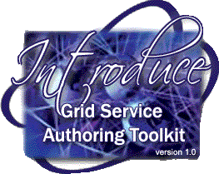



Cancer Biomedical Informatics Grid (caBIGTM)
Need: Enable investigators and research teams nationwide to combine and leverage their findings and expertise in order to meet NCI 2015 Goal.
Strategy: Create scalable, actively managed organization that will connect members of the NCI-supported cancer enterprise by building a biomedical informatics network
  National Cancer Institute Initiative
  Over 800 Participants
  Over 80 Organizations
  Over 70 Projects

Slide 4
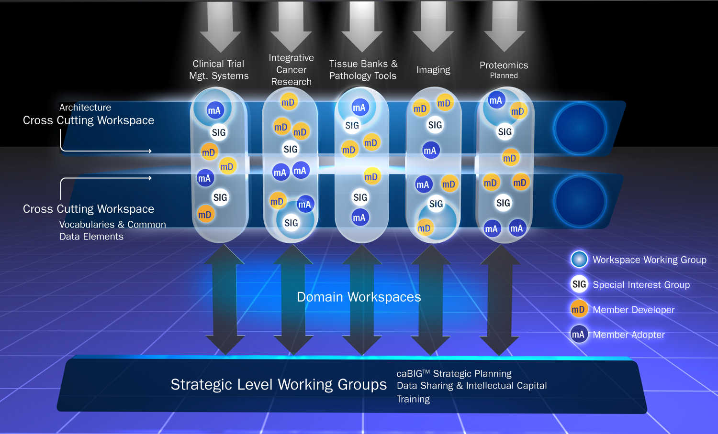
caBIG Community Organization

Slide 5
caGrid
Grid Infrastructure for caBIG
Enterprise Level Grid Components
caGrid Components
  Grid Service Graphical Development Toolkit (Introduce)
  Metadata
  Advertisement and Discovery
  Semantic Services
  Data Service Infrastructure
  Analytical Service Infrastructure
  Identifiers
  Workflow
  Security

Slide 6
GAARDS Overview
Grid Authentication and Authorization with Reliably Distributed Services (GAARDS)
  Security Infrastructure for caGrid
  GAARDS provides services and tools for the administration and enforcement of security policy in an enterprise Grid.
  Developed on top of the Globus Toolkit
  Extends the Grid Security Infrastructure (GSI)
  Provide enterprise services and administrative tools for:
    Grid User Management
    Identity Federation
    Trust management
    Group/VO management
    Access Control Policy management and enforcement
    Integration between existing security domains and the grid security domain.

Slide 7
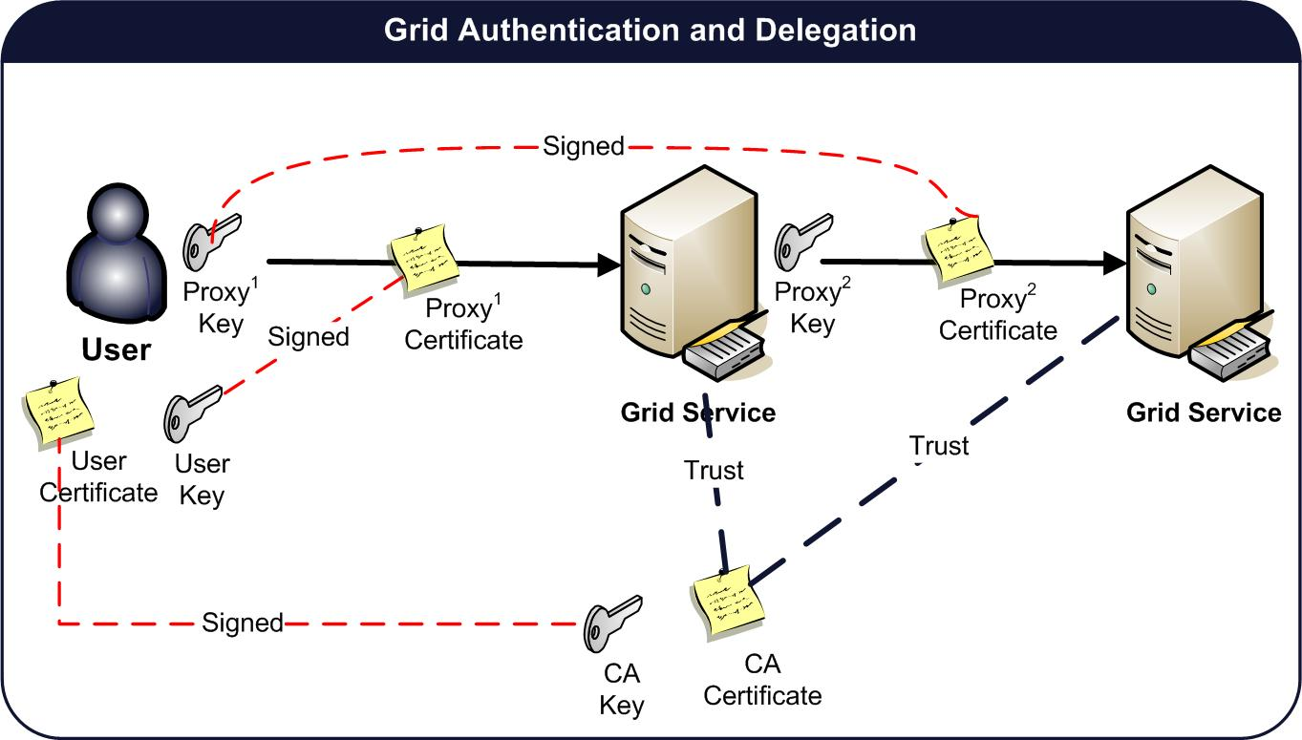
Grid Security Authentication
Based on X.509 End Entity Certificates and X.509 Proxy Certificates
User Credentials
  Long term X.509 Certificate and Private Key.
  Clients authenticate to the grid using a grid proxy.
  Grid Proxy consists of a private key and proxy certificate signed by the user’s long term private key.
    Extension of X.509 Identity Certificates
    Short Lifetime
    Asserts Identity of users and services.
    Enables single sign-on
    Delegation
Service Credentials
  Long term X.509 Certificate and Private Key.

Slide 8
Problem
How does the grid clients/services know which CA certificates to trust?
Should I trust this CA?
Should I trust this CA?

Slide 9
Traditional Approach
Traditional Approach (Globus, caGrid 0.5)
  Service Container and or Service can be configured by specifying a trusted ca certificates directory in the server/service configuration directory
  Credentials are accepted if they are signed by a ca certificate in the trusted ca directory.
  Drawbacks
    Hard for grid administrators to manage
    Difficult to provision trusted authorities
    Every time a new trusted authority comes on line, all the services in the grid must re-configured to trust that authorities.
    Difficult to provision CRLs
    Impossible to keep trusted CA list current
    Trust is configured at the container level, not at the service level
    Trust Fabric in the hands of users
    Potential Serious Security Risk

Slide 10
Certificate Validation Profiles
Locally Stored Locally Validated Profile (LSLV)
  Trusted Certificates are locally stored.
  Revocation Lists Store Locally
  Certificates received are validated against locally stored trusted certificates.
  Equivalent to XKMS Tier 0
  Pros
    Almost no infrastructure required
  Cons
    Impossible to keep trusted CA list current
    Trust Fabric in the hands of users
    Potential Serious Security Risk

Slide 11
Certificate Validation Profiles
Remotely Retrieved Locally Validated Profile (RRLV)
  Trusted Certificates exist and are managed by a Trust Service
  Certificates received are validated against trusted certificates retrieved from a trust service
  Equivalent to XKMS Tier 1
  Pros
    Authentication performed against the current trust fabric
    Validation done locally, specialized validation requirements can be enforced.
  Cons
    Validation done locally, poor enforcement could lead to a potential security risk.
    Relies on bootstrapping from the Trust Service

Slide 12
Certificate Validation Profiles
Remotely Stored Remotely Validated Profile (RSRV)
  Trusted Certificates exist and are managed by a Trust Service
  Certificates received are sent to a Trust Service to be validated
  Equivalent to XKMS Tier 2
  Pros
    Authentication performed against the current trust fabric
    Validation done remotely and enforced globally.
    Local deployment no longer responsible for validation
    Certificate Path Discovery Managed.
    Enforcement of CA Signing Policies
  Cons
    Network Overhead

Slide 13
Certificate Validation Profile Support
Locally Stored Locally Validated Profile (LSLV)
  Supported by Globus 4.0.3
  Directory of Trusted Certificates
  Certificate Validation against certificates in directory of Trusted Certificates
Remotely Retrieved Locally Validated Profile (RRLV)
  Use trust service to obtain trusted CA certificates and CRLS and store them in the Globus Trusted Certificate directory.
  Trust Service client manages the Globus Trusted Certificate directory for Globus, keeping it up to date.
  Only minor changes to Globus required.
Supporting Remotely Stored Remotely Validated Profile (RSRV)
  Globus contacts Trust Service during authentication to determine if the credentials in question are signed by a Trusted CA
  Trust Service performs all validation and enforces revocation lists.
  Support requires SIGNIFICANT changes to the Globus Toolkit

Slide 14
Grid Trust Service Approach
Design and Implement a Grid Trust Service
  Support for the Remotely Retrieved Locally Validated Profile (RRLV).
    Provide plug-in for the existing Globus Toolkit
  Supporting the Retrieved Remotely Validated Profile (RRRV)
    Work with Globus team to develop a validation interface abstracting validation in Globus.
    Future versions of Globus can be configured with a custom validation interface

Slide 15
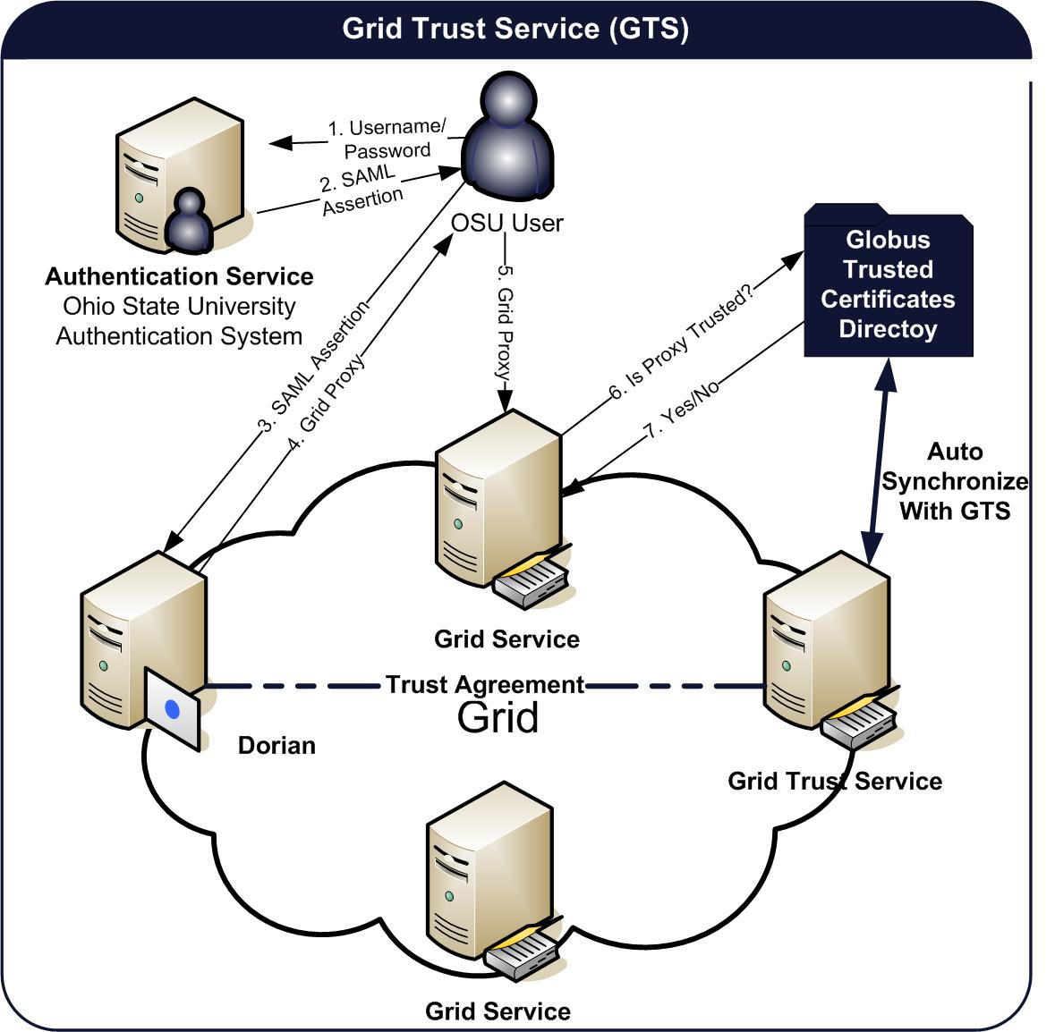
Grid Trust Service (GTS)
Grid Trust Service (GTS)
  WSRF Grid Service
  Define and manage levels of assurance.
  Provides Support for Managing Trusted Certificate Authorities
  Administrator register/manage certificate authorities and CRLS with GTS
  Client tools synchronize Globus Trust Framework with GTS
    Remotely Retrieved Locally Validated Profile (RRLV)
    Globus is authenticating against the current trust fabric
  Distributed GTS, Enabling the creation of a scalable trust fabric.

Slide 16
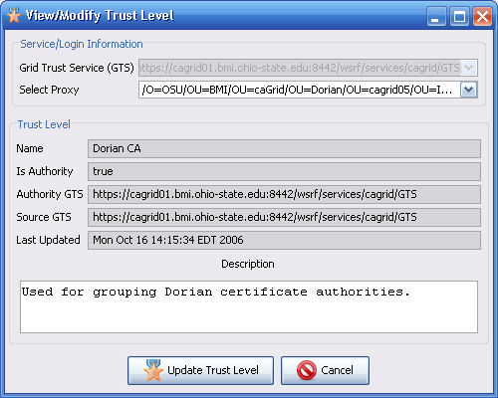
Grid Trust Service (GTS)
Levels of Assurance
  ex. Passport vs. Library Card
  GTS provides a mechanism for defining and managing Levels of Assurance or Trust Levels.
  GTS Administrators can Add/Update/Remove Trust Levels
    Requires grid credentials (GTS Administrator)
  Each Trusted Authority can be associated with a set of trust levels.
  Certificate Authorities can be queried by level of assurance.

Slide 17
Grid Trust Service (GTS)
Trusted Authorities
  GTS manages a set of certificate authorities that are trusted in the grid to sign grid credentials.
  Trusted Authority – A certificate authority trusted by the GTS.
    Name (Subject of the CA Certificate)
    Trust Level (s) – The level(s) of Trust associated with the CA.
    Status – The current status of the CA (Trusted or Suspended)
    Certificate – The ca certificate that corresponds to the private key that is used by the ca to sign certificates. (credentials).
    Certificate Revocation List (CRL) – CA signed list of revoked credentials.
    Is Authority – Specifies whether or not the GTS listing this Trusted Authority is the authority for it.
    Authority GTS – The authoritative GTS for the Trusted Authority
    Source GTS – The GTS from where the current GTS obtained the Trusted Authority from.
    Expiration – The date at which after this Trusted Authority should no longer be trusted.

Slide 18
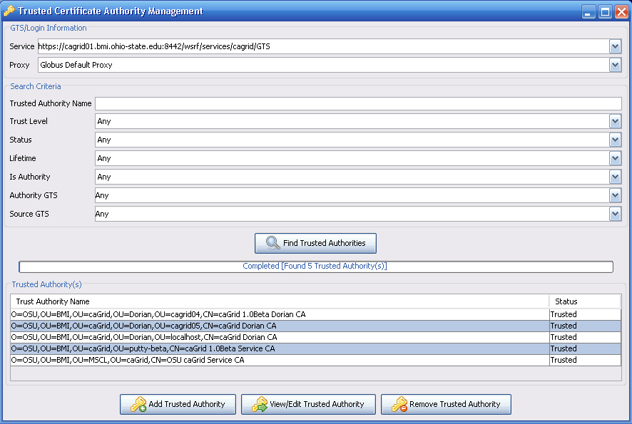
Grid Trust Service (GTS)
Querying for Trusted Authorities
  GTS provides a public mechanism for discovering/querying the Trusted Certificate Authorities.
  Query interface enables synchronization tools to be built to synchronize authorities trusted be Globus with those trusted by the GTS
  GTS Provides a Java Search Client API
  GTS Provides a GUI built on top of the Search Client API.
  Query Criteria
    Name
    Trust Level (s)
    Status (Trusted, Suspended)
    Lifetime (Valid, Expired)
    Is Authority
    Authority GTS
    Source GTS

Slide 19
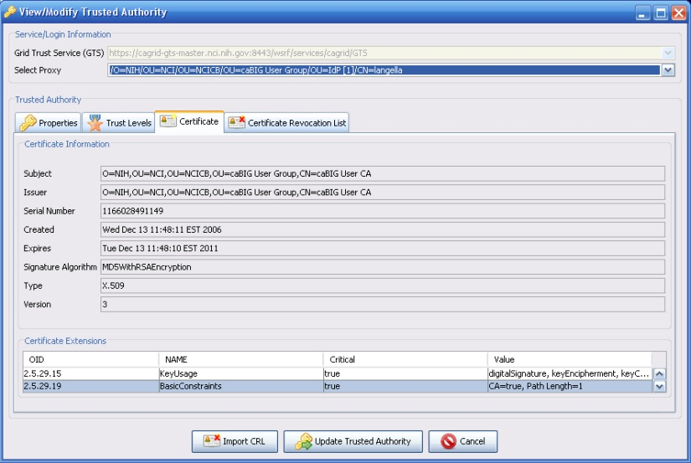
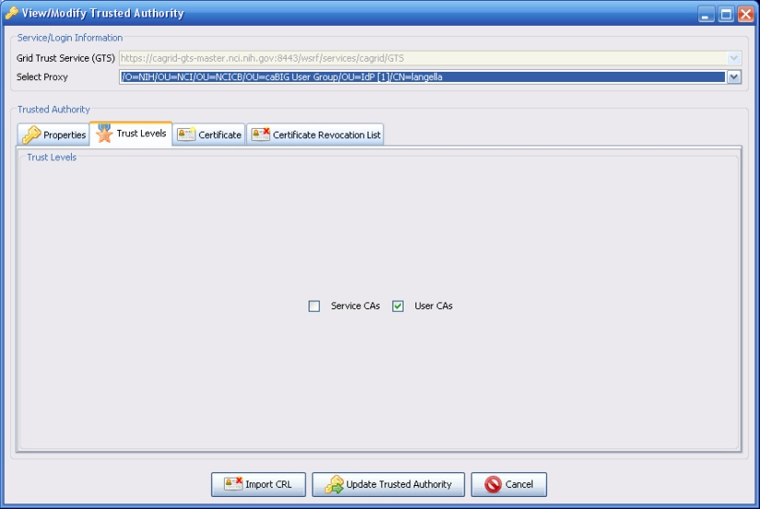
Grid Trust Service (GTS)
Managing Trusted Authorities
  GTS provides support for adding/updating /removing Trusted Authorities through its Grid Service Interface.
  Requires Grid Credentials or Proxy Certificate of a GTS Administrator
  GTS Provides an administrative Java Client API
  GTS Provides an administrative GUI.

Slide 20
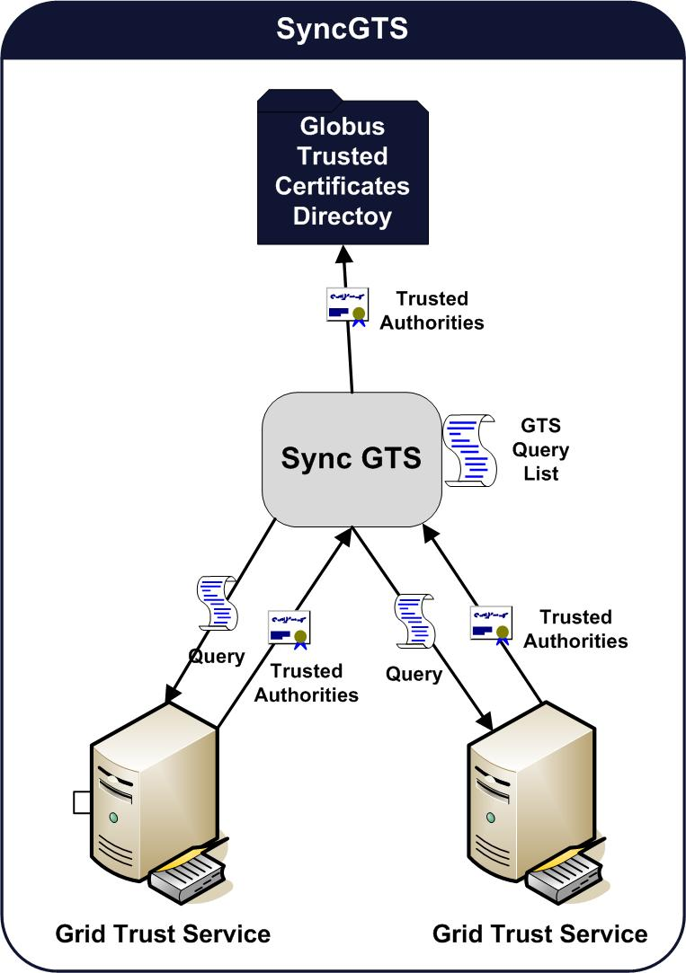
SyncGTS
Toolkit used for synchronizing client and service containers with the GTS
Takes a set of GTS Queries and executes them on a GTS, synchronizing the results of the queries with the Globus Trusted Certificates Directory.
Supports multiple execution mechanisms.
  Grid Service in a grid service container
  Embedded in a client or service
  Command Line

Slide 21
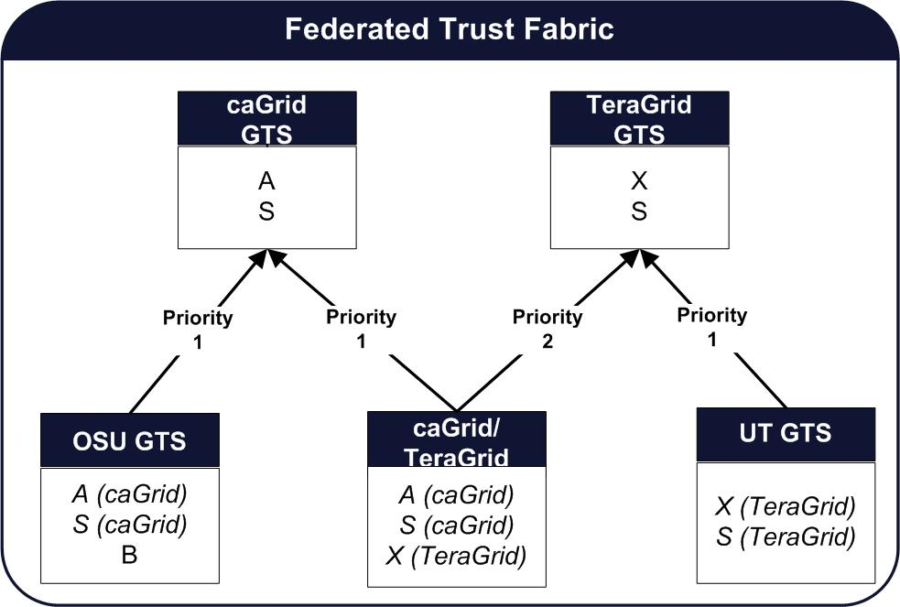
Grid Trust Service (GTS) Federation
GTS Federation
  A GTS can inherit Trusted Authorities and Trust Levels from other Grid Trust Services
  Allows one to build a scalable Trust Fabric.
  Allows institutions to stand up their own GTS, inheriting all the trusted authorities in the wider grid, yet being to add their own authorities that might not yet be trusted by the wider grid.
  A GTS can also be used to join the trust fabrics of two or more grids.

Slide 22
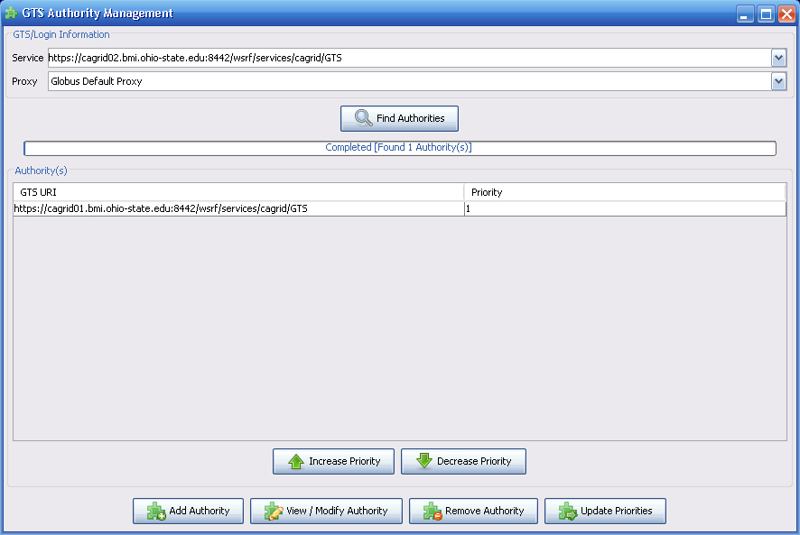
Grid Trust Service (GTS) Federation
Each GTS has a set of Authoritative GTSs
The GTS can be configured how often to sync with its authorities.
On syncing a GTS will obtain all valid Trusted Authorities and Trust Levels (if specified) from each authority GTS and organize them locally base on priority.
Managing GTS Authorities for a GTS
  GTS provides support for adding/updating /removing GTS Authorities through its Grid Service Interface.
  Requires Grid Credentials or Proxy Certificate of a GTS Administrator
  GTS Provides an administrative Java Client
  GTS Provides an administrative GUI.

Slide 23
Project Resources and Communication
www.cagrid.org
  Download Software
  Documentation
  Tutorials
  Technical Paper and Presentations
caGrid 1.0 GForge Home
  Feature Requests
  Bug Reports
  Downloads / Source Repository
  http://gforge.nci.nih.gov/projects/cagrid-1-0/
caGrid Users Mailing List
  https://list.nih.gov/archives/cagrid_users-l.html
  cagrid_users-l@list.nih.gov

Slide 24
GTS Team
Ohio State University
  Stephen Langella
  Shannon Hastings
  Scott Oster
  David Ervin
  Tahsin Kurc
  Joel Saltz
Argonne National Labs
  Frank Siebenlist
NCICB
  Avinash Shanbhag
Booze Allen Hamilton
  Arumani Manisundaram

