Slide 1
caBIG Security Challenges and Solutions
Authentication
Stephen Langella
langella@bmi.osu.edu
June 2008

Slide 2
The caBIG™ Initiative
caBIG™ Vision
A virtual network of interconnected data, individuals, and organizations that whose goal is to redefine how research is conducted, care is provided, and patients/participants interact with the biomedical research enterprise.
caBIG™ Goals
  Connect the cancer research community through a shareable, interoperable electronic infrastructure
  Deploy and extend standard rules and a common language to more easily share information
  Build or adapt tools for collecting, analyzing, integrating and disseminating information associated with cancer research and care
Notes:
caBIG™ is an information network enabling all constituencies in the cancer community – researchers, clinicians, patients – to share data and knowledge to accelerate the discovery of new diagnostics and therapeutics, and improve patient outcomes.
NOTE THAT the caBIG VISION IS NOT UNIQUE TO CANCER AND EXTENDS TO ALL OF BIOMEDICAL RESEARCH AND PATIENT-CENTRIC APPROACHES TO MOLECULAR MEDICINE.

Slide 3
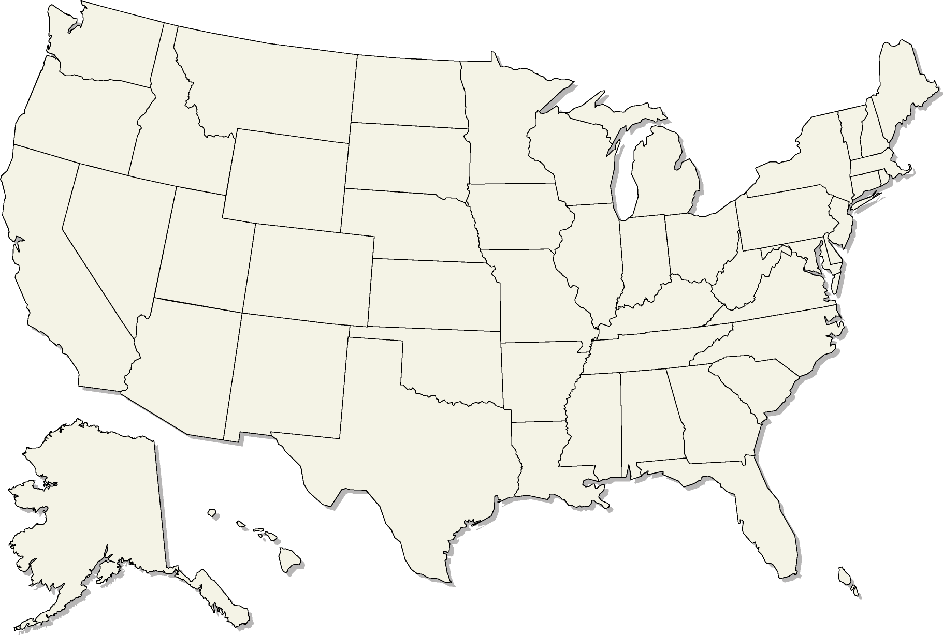
caBIG™ Progress to Date
caBIG™ provides:
  40+ applications in discovery, clinical trials management, biospecimen management, etc.
  Available through:
    Clinical Trials Compatibility Framework
    Life Sciences Distribution
    Data Sharing and Security Framework
  A connectivity infrastructure (caGrid)
caBIG™ adoption is unfolding in:
  46 NCI-designated
  Cancer Centers
  16 NCI Community
  Cancer Centers
caBIG™ being integrated into federal health architecture to connect National Health Information Network
NCI-Designated Cancer Centers and Community Cancer Centers

Slide 4

What is caGrid?
A grid based software infrastructure consisting of services, toolkits, APIs, and applications
A production grid deployment of the core services provided by that infrastructure
A community of developers leveraging that grid and infrastructure to provide applications and services to the cancer research community

Slide 5
Infrastructure Focus Areas
Leveraging Grid technologies and standards as an interoperability platform
Metadata Infrastructure
  Surfacing wealth of existing caBIG data-oriented metadata on the grid
  Providing new service-oriented metadata
Security
  Integrating existing systems and applications with Grid security
  Lowering burden of implementation of grid-wide and local policy
Service Developer Tooling
  Powerful platform for bringing applications and data to the grid
Facilitating Grid wide operations
  Federated query, workflow execution, resource discovery
Making the Grid more accessible
  Graphical installation and configuration, higher-level object-oriented APIs, web portals, graphical administrative applications
Quality
  Comprehensive testing infrastructure, automated builds and test execution on multiple platforms, dashboard with historical archive

Slide 6
Security presents many challenges…

Slide 7
Today we will focus on Authentication…

Slide 8
Grid Authentication
We need to be able to control who is given access to Public Health Information (PHI)
Consumers of PHI will need a mechanism of proving who they are to PHI providers.
To electronically consume PHI, consumers will require an electronic credential in order to prove their identity to providers.
It is estimated the caBIG™community will be made up of tens of thousands of users.
  POLICY CHALLENGE: How will be vet the identity of tens of thousands of users?

Slide 9
Grid Authentication
Most Grid technologies use Public-key Infrastructure (PKI) for authentication.
Users authenticate using PKI credentials (X.509 certificate and private key)
  TECHNICAL CHALLENGE: How do we issue PKI credentials to tens of thousands of users?
Authenticating with PKI credentials is more complex than traditional authentication mechanisms (username and password).
  TECHNICAL CHALLENGE: How do we hide the complexities of using PKI from users?

Slide 10
Grid Authentication
There are multiple credential providers, each have different policies for issuing credentials.
Consumers of Grid credentials will have varying levels of trust in credential providers. (i.e. Library Card vs Driver’s License)
  POLICY CHALLENGE: How do we distinguish between credential providers based on their policies and procedures for issuing credentials?
  TECHNICAL CHALLENGE: How do we organize and publish trusted credential providers?

Slide 11
Grid Authentication
To authenticate users Grid resources need to maintain a list of credential provider that they accept credentials from.
For each provider in the list they must maintain a list of compromise/revoked credentials to ensure that those credentials are not accepted.
  TECHNICAL CHALLENGE: How will we distribute and keep up to date the list of credential providers trusted by the federation to grid resources?

Slide 12
Summary of Authentication Challenges
Policy Challenges
  How will be vet the identity of tens of thousands of users?
  How do we distinguish between credential providers based on their policies and procedures for issuing credentials?
Technical Challenges
  How do we issue PKI credentials to tens of thousands of users?
  How do we hide the complexities of using PKI from users?
  How do we organize and publish trusted credential providers?
  How will we distribute and keep up to date the list of credential providers trusted by the federation to grid resources?

Slide 13
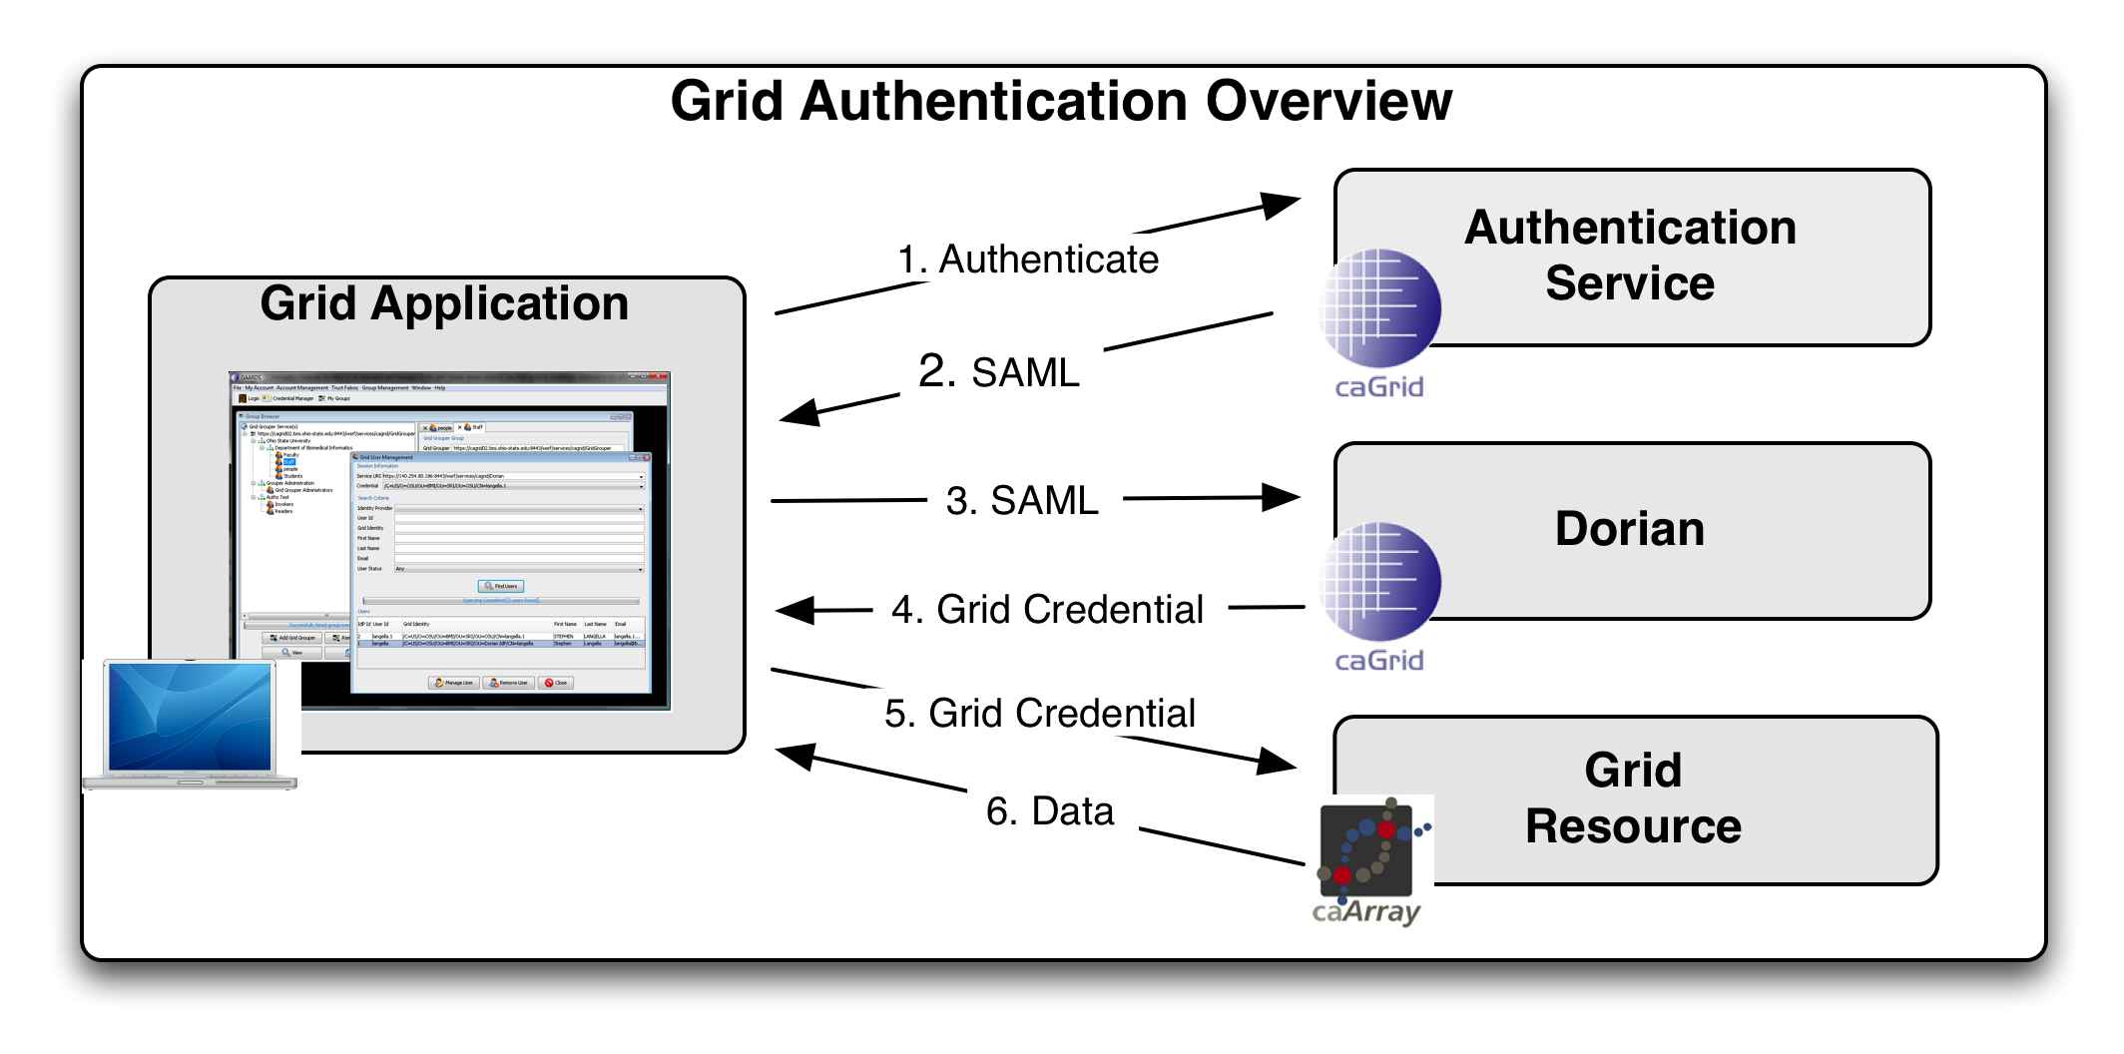
Grid Account Provisioning
Leverage existing organization identity providers to access the Grid
Users can use their existing credential to access grid resources.
Dorian
  Grid Account Management Service
  Issues PKI credentials to users that are bound to organizational identities.
Authentication Service
  Uniform interface for interacting with organizational identity providers on the Grid.

Slide 14

Summary of Authentication Challenges
Policy Challenges
  How will be vet the identity of tens of thousands of users?
  How do we distinguish between credential providers based on their policies and procedures for issuing credentials?
Technical Challenges
  How do we issue PKI credentials to tens of thousands of users?
  How do we hide the complexities of using PKI from users?
  How do we organize and publish trusted credential providers?
  How will we distribute and keep up to date the list of credential providers trusted by the federation to grid resources?

Slide 15
Authentication: Levels of Assurance
Federal E-Authentication Initiative
http://www.cio.gov/eauthentication/
Levels of assurance (Different Requirements)
  Level 1 – e.g., no identity vetting (LOA1)
  Level 2 – e.g., specific identity vetting requirements (LOA2)
  Level 3 – e.g., cryptographic tokens required (LOA3)
  Level 4 – e.g., cryptographic hard tokens required (LOA4)
Credential Assessment Framework Suite (CAF)
Federal Bridge Certification Authority (FBCA)
  http://www.cio.gov/fbca/
  The FBCA is an information system that facilitates an entity accepting certificates issued by another entity for a transaction.

Slide 16
Summary of Authentication Challenges
Policy Challenges
  How will be vet the identity of tens of thousands of users?
  How do we distinguish between credential providers based on their policies and procedures for issuing credentials?
Technical Challenges
  How do we issue PKI credentials to tens of thousands of users?
  How do we hide the complexities of using PKI from users?
  How do we organize and publish trusted credential providers?
  How will we distribute and keep up to date the list of credential providers trusted by the federation to grid resources?

Slide 17
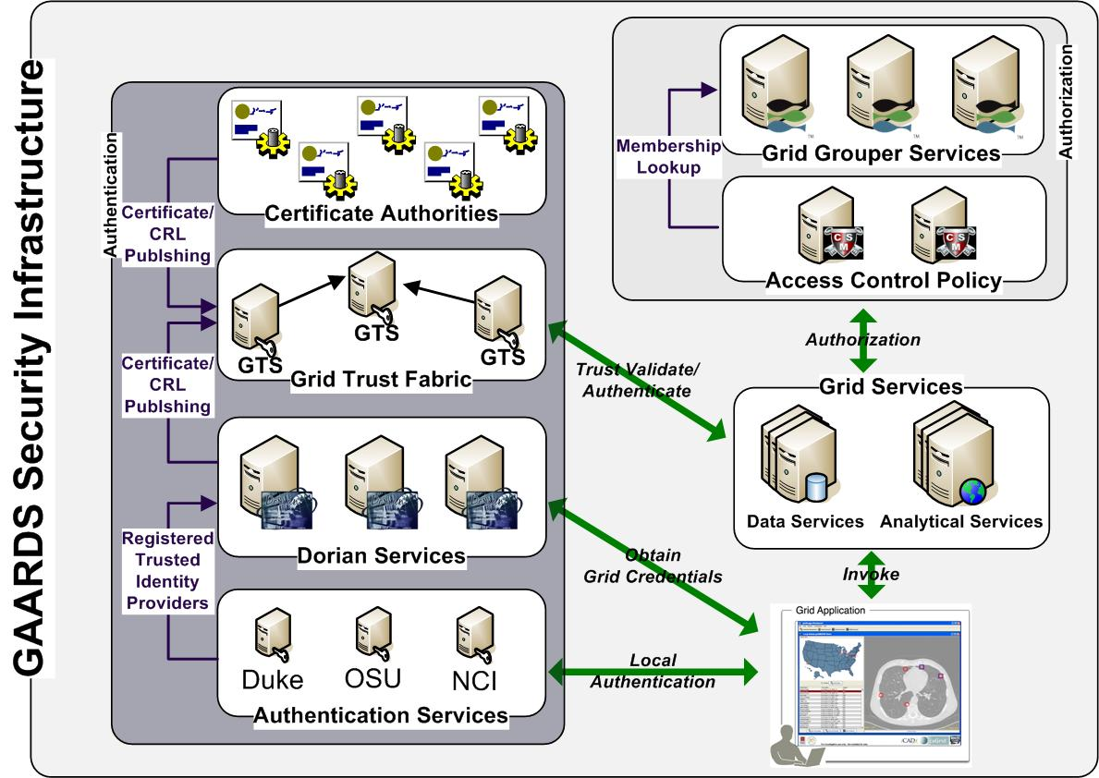
Grid Trust Fabric
Grid Trust Service (GTS)
  Creation and Management of a federated trust fabric.
  Supports applications and services in deciding whether or not signers of digital credentials can be trusted.
  Supports the provisioning of trusted certificate authorities and corresponding CRLS.
Trust Fabric Organization
  Credential Providers are organized by the NIST e-Authentication Level of Assurance that they meet.
  Grid resources the levels assurance they require.
  GTS distributes list of credential providers to grid resources based on their requirements

Slide 18
Summary of Authentication Challenges
Policy Challenges
  How will be vet the identity of tens of thousands of users?
  How do we distinguish between credential providers based on their policies and procedures for issuing credentials?
Technical Challenges
  How do we issue PKI credentials to tens of thousands of users?
  How do we hide the complexities of using PKI from users?
  How do we organize and publish trusted credential providers?
  How will we distribute and keep up to date the list of credential providers trusted by the federation to grid resources?

Slide 19











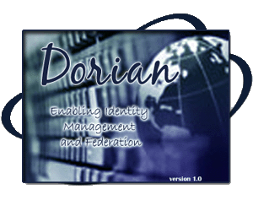





The Big Picture
Authentication Service
Authentication Service
Authentication Service
Authentication Service
Authentication Service
Authentication Service
Level of Assurance 1
Grid Credential Provider ABC
Level of Assurance 3
Level of Assurance 2
Grid Credential Provider XYZ
Level of Assurance 4
Level of Assurance 3
Grid Trust Service Federation (Trust Fabric)
Secure Grid Resources

Slide 20
Current Status
GAARDS Security Infrastructure in place.
  Authentication Service
  Dorian
  Grid Trust Service
  Credential Delegation Service (CDS)
  Grid Grouper
  Common Security Module (CSM)
  Web Single Sign On
Level of Assurance 1 Grid credentials available to all users.
In process of integrating Level of Assurance 2 identity providers.

Slide 21
Inter-Federation Project
University of Texas (16 sites) will integrate at LOA2
  NIH will rely on the GSA E-Authentication Credential Assessment Framework (CAF) as the standard for determining whether the UT Federation SAML assertions meet OMB/NIST LOA 2.
  NIH and UT will agree how and by whom the CAF assessment will be performed.
Develop and test an open-source interface for sending SAML assertions between and an institutional Shibboleth identity provider (IdP) and Dorian.
This integration will provide the roadmap and technical infrastructure for integrating other organizations that are members of InCommon.
InCommon Federation
  Over 50 participating organizations
  Over 1.7 million end users.

Slide 22
Additional Challenges
Many identity providers DO NOT currently meet the federal e-Authentication guidelines.
Varying levels of commitment in meeting these guidelines and with integrating with the technical infrastructure.
  Limited Resources
  Limitations in technical ability.
  Commitment within the organization.
Meeting LOA3 and LOA4
  Financial Limitations
  Social Limitations
  Technical Limitations

Slide 23
Additional Information
caBIG™
  Website: https://cabig.nci.nih.gov/
caBIG™ Architecture Workspace
  Website: https://cabig.nci.nih.gov/workspaces/Architecture
  Mailing List: CABIG_ARCH-L@LIST.NIH.GOV
caGrid
  Website: http://www.cagrid.org
  Mailing List: CAGRID_USERS-L@LIST.NIH.GOV

