Slide 1
caGrid
Identifiers
Architecture
caBIG™ Arch VCDE Face 2 Face
August 6-8th, 2007
Shannon hastings(hastings@bmi.osu.edu) - Ohio State University

Slide 2
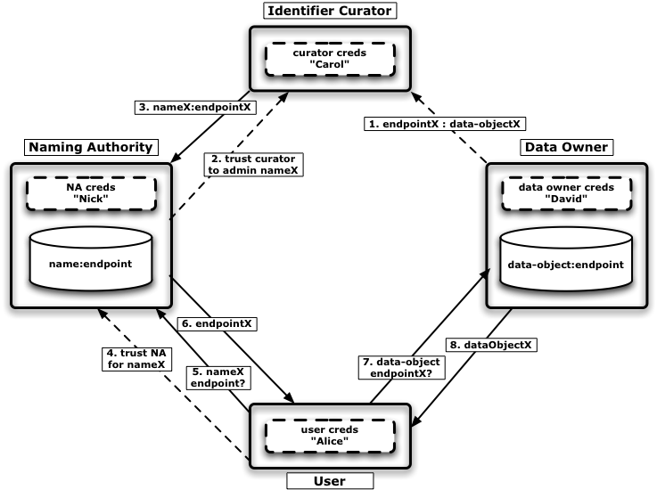
Conceptual Identifier Framework

Slide 3
Conceptual Identifier Framework
4 Main Components
  Data Owner
    Owns the data and wishes to have identifiers available for the data.
  Identifier Curator
    Trusted to bind the new or modified data objects to a newly created identifier and access mechanism and place the binding information into the Naming Authority.
  Naming Authority
    Authority for housing and resolving an identifier to it’s data object access mechanism.
  User
    Uses client to find the Naming Authority which can provide the information about the identifier and resolve it to an access mechanism.

Slide 4
caGrid Identifier Framework
4 Main Components
  Data Owner
    Has EPRs (end point references) which point to data object access interface.
  Identifier Curator
    Takes the EPRs and creates new identifiers for them and places them in the Naming Authority
  Naming Authority (caGridIdentifierService)
    Authority for housing and resolving an identifier to it’s EPR. Provides an interface utilizing the WS-Naming specification for clients to use in resolution.
  User (caGridIdentifierService Client)
    Utilizes client to find the Naming Authority which can provide the information about the identifier and resolve it to an access mechanism. Talks to the Naming Authority using the WS-Naming interface. Accesses data using access mechanism.

Slide 5
caGrid
Identifiers
Architecture
caBIG™ Arch VCDE Face 2 Face
August 6-8th, 2007
Shannon hastings(hastings@bmi.osu.edu) - Ohio State University

