Slide 1
Overview of caGrid 1.0 Data Services
Scott Oster

Slide 2
Agenda
Overview of grid services
Overview of caGrid 1.0 infrastructure
  High-level architecture and caGrid Components
  Metadata (GME, caDSR etc)
  Advertisement and Discovery (Index service)
  Data types in caGrid
Data services
  Overview
  CQL
  Implementation Details (query(..) method, CQLQueryProcessor etc)
Introduce Toolkit
  Developing data services (Pre-requisites etc)
    caCORE SDK generated systems
    non caCORE SDK generated systems
    Introduce generated code (Client API etc)
  DEMO

Slide 3
What is caGrid?
Development project of Architecture Workspace, aimed at helping define and implement Gold Compliance
No requirements on implementation technology will be necessary for Gold compliance
  Specifications will be created defining requirements for interoperability
  caGrid provides core infrastructure, and tooling to provide “a way” to achieve Gold compliance
Gold compliance creates the G in caBIG
  Gold => Grid => connecting Silver Systems

Slide 4
What is Grid?
A lot of different things to a lot of different people
Evolution of distributed computing to support sciences and engineering
Some common themes prevail:
  Sharing of resources (computational, storage, data, etc)
  Secure Access (global authentication, local authorization, policies, trust, etc)
  Open Standards
  Virtualization
“The real and specific problem that underlies the Grid concept is coordinated resource sharing and problem solving in dynamic, multi-institutional virtual organizations.”
  I. Foster, C. Kesselman, S. Tuecke. International J. Supercomputer Applications, 15(3), 2001.
A good general overview can be found here: http://gridcafe.web.cern.ch/gridcafe/

Slide 5
caGrid Overview
Requirements:
  Support scientific requirements: Use cases from cancer research community
  Support functional requirements: identifiers, workflow, query, etc
  Support non-functional requirements: security, reliability, performance, etc
Principles:
  Driven by cancer research community requirements
  caBIG Principles
    Open Source, Open Access, Open Development
    Federated
    Syntactic and Semantic Interoperability
  Services-Oriented Architecture
  Metadata driven and implements Virtualization
  Standards based

Slide 6






caGrid Conceptual View
Analytical Service
Grid-Enabled Client
Gene
Database
Tool 1
caArray
Tool 2
Research
Center
NCICB
Grid Services Infrastructure
(Metadata, Registry, Query,
Invocation, Security, etc.)
Protein Database
Grid Data Service
Tool 3
Tool 4
Image
Grid Portal
Microarray
Tool 2
Research
Center
Tool 3

Slide 7
caGrid Components
Leverage existing technologies:
  caDSR, EVS, Mobius GME: Common data elements, controlled vocabularies, schema management
  Globus Toolkit (currently version 4.0.1)
    Core grid services infrastructure
    Service deployment, service registry, invocation, base security infrastructure
Additional Core Infrastructure
  Higher-level security services
  Grid service access to metadata components (caDSR, GME, etc)
  Workflow, Identifier services
Service Provider Tooling (Introduce)
  Graphical service development and configuration environment
  Abstractions from service infrastructure for Data and Analytical services
  Deployment wizards
Client Tooling
  High-level APIs for interacting with core components and services
  Graphical Tools

Slide 8
caGrid Metadata Infrastructure
Cancer Data Standards Repository (caDSR)
  caBIG projects register their data models as Common Data Elements (CDEs) which are semantically harmonized and then centrally stored and managed the caDSR
Enterprise Vocabulary Services (EVS)
  EVS is set of services and resources that address the need for controlled vocabulary
  Thesaurus: a biomedical thesaurus
  Metathesaurus: based on NLM's Unified Medical Language System Metathesaurus supplemented with additional cancer-centric vocabulary
Global Model Exchange (GME)
  GME is a DNS-like data definition registry and exchange service that is responsible for storing and linking together data models in the form of XML schema.
Globus Information Services
  The Globus Information Services infrastructure provides a generic framework for aggregation of service metadata, a registry of running Grid services, and a dynamic data-generating and indexing node, suitable for use in a hierarchy or federation of services

Slide 9
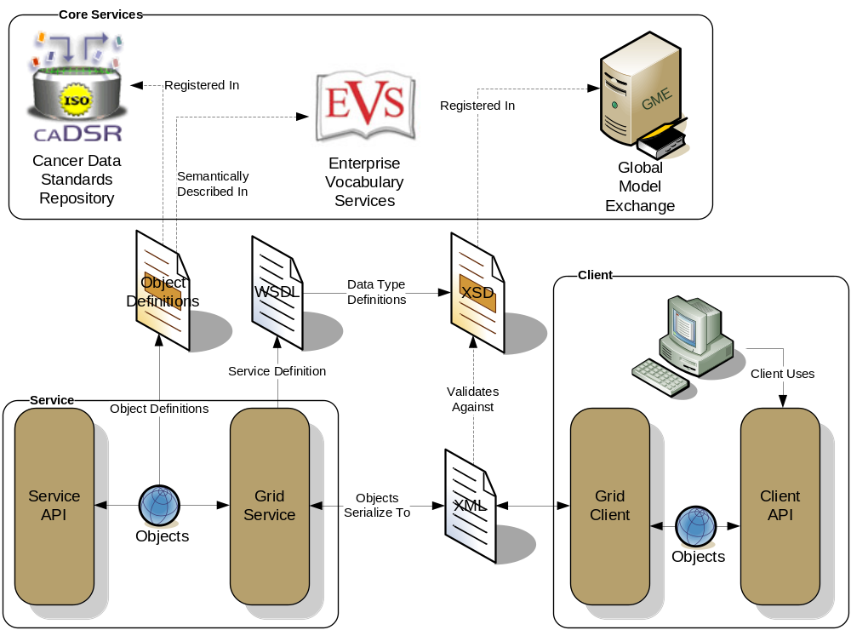
caGrid Data Description Infrastructure
Client and service APIs are object oriented, and operate over well-defined and curated data types
Objects are defined in UML and converted into ISO/IEC 11179 Administered Components, which are in turn registered in the Cancer Data Standards Repository (caDSR)
Object definitions draw from vocabulary registered in the Enterprise Vocabulary Services (EVS), and their relationships are thus semantically described
XML serialization of objects adhere to XML schemas registered in the Global Model Exchange (GME)

Slide 10
caGrid exposing caDSR data
In caDSR, nearly all items can be individually versioned, but a specific Project version represents a curated collection of Packages, Classes, and Attributes with consistent semantics
Data is exposed in caGrid as instances defined in a specific Project
  Data Services expose instance data as a subset of Classes from a given Project
  Analytical Services operate over instances of Classes from potentially numerous Projects

Slide 11
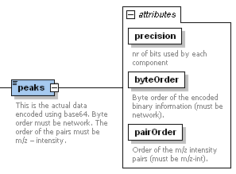
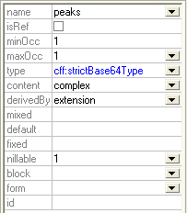
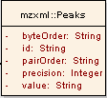
Connecting the caDSR and GME
As the caDSR ensures semantic interoperability, the GME ensures programmatic data exchange (syntactic) interoperability
Many applications need to work at both the CDE level and the XML level
Names different
Attribute or element?
What about Collection associations
?

Slide 12
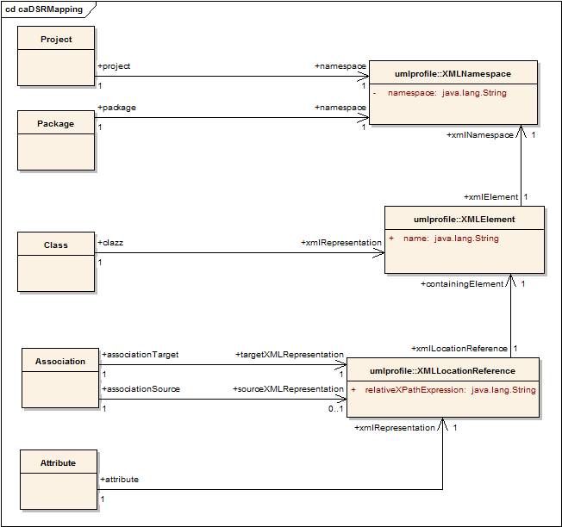
caDSR/UML to GME/XML
Planned definition of mapping rules specify how a given UML entity is represented in XML over the grid

Slide 13
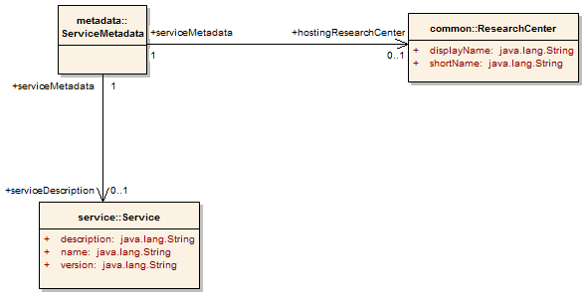
caGrid 1.0 Service Metadata
All caGrid Services are expected to publish a set of standard metadata which draws heavily from the metadata registered in caDSR and EVS
It details the functionality of the service, and the institution providing it

Slide 14
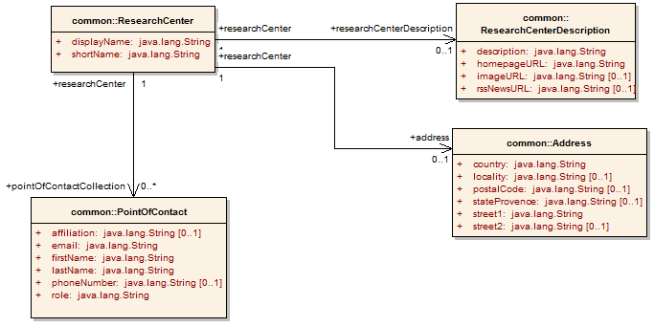
caGrid 1.0 Research Center Metadata
Associated from a Service’s Metadata, the Research Center information describes the service/data provider

Slide 15
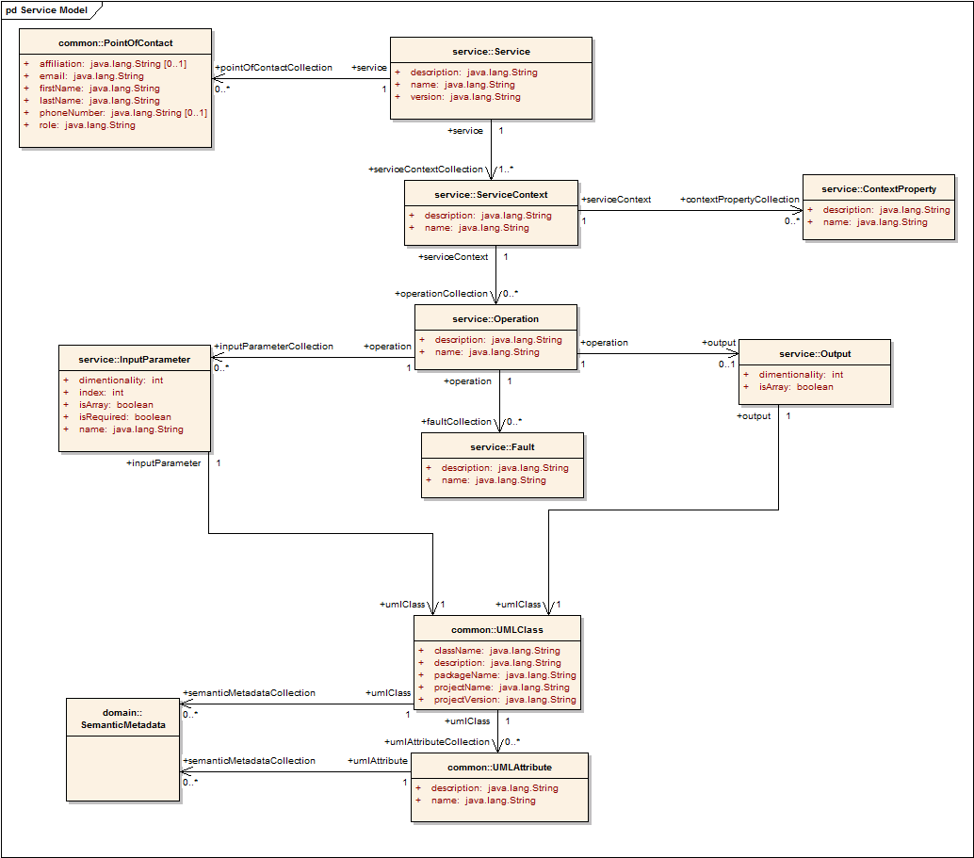
caGrid 1.0 Service Metadata
The Service’s operations are defined and their inputs and outputs link to Classes in caDSR and semantics from EVS
Contains Semantic Information from EVS

Slide 16
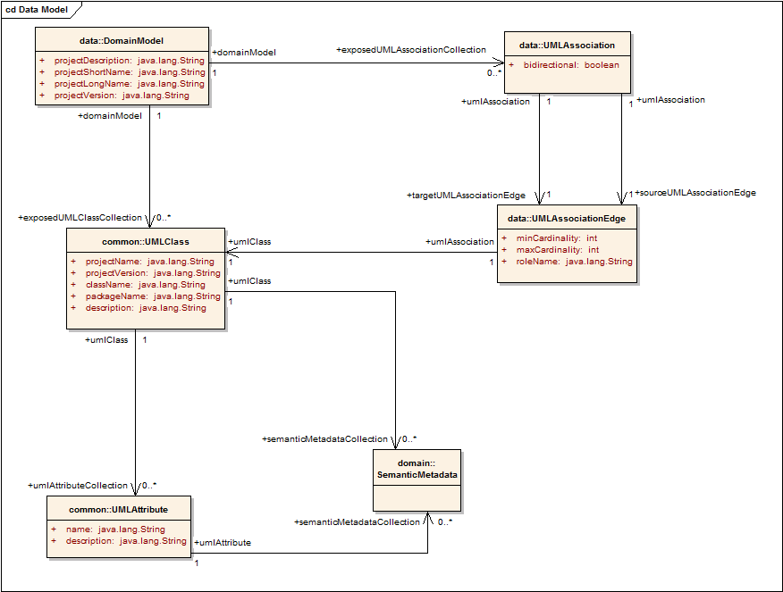
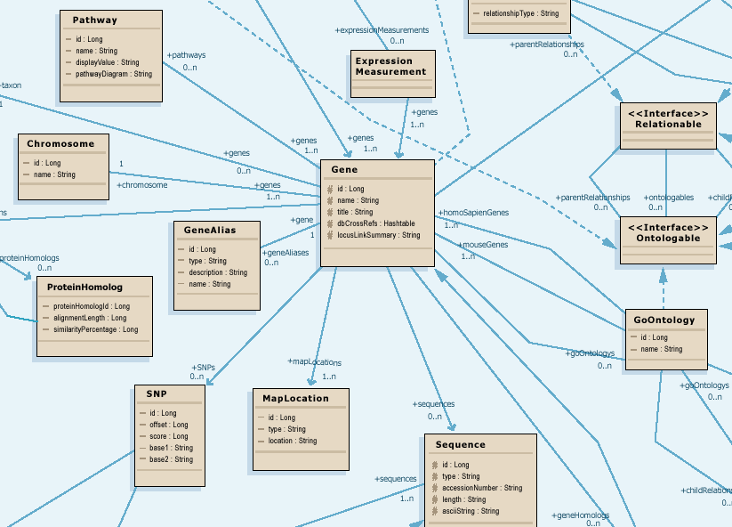
caGrid 1.0 Data Service Metadata
Standard metadata exposed by all Data Services describes the UML model being exposed, and contains links to semantic underpinnings
Provides information needed to formulate the Object-Oriented Query
Contains Semantic Information from EVS

Slide 17
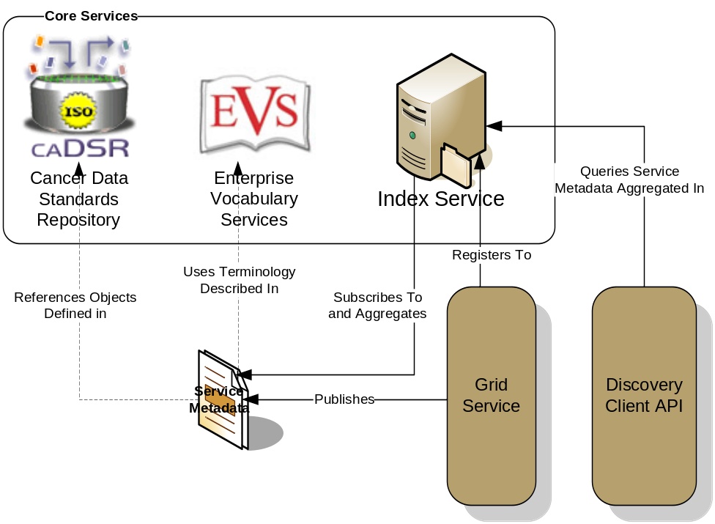
caGrid Advertisement and Discovery
All services register their service location and metadata information to an Index Service
The Index Service subscribes to the standardized metadata and aggregates their contents
Clients can discover services using a discovery API which facilitates inspection of data types
Leveraging semantic information in EVS (from which service metadata is drawn), services can be discovered by the semantics of their data types

Slide 18
Service Discovery Process
Clients formulate a query over the caGrid standard metadata
  Examples:
    “Find me all the services from Cancer Center X”
    “Which Analytical services take Genes as input?”
    “Which Data services expose data relating to lung cancer?”
    “Find me all the services with some metadata mentioning the string ‘macromolecules’”
This query is sent to the caGrid Index Service which returns the Address of the services satisfying the query
The client can then further interrogate the satisfying services by asking for all of their metadata or service descriptions
Finally the client invokes the desired services as appropriate

Slide 19
caGrid Workflow: What is workflow?
High-level scripting for frequently tasks
  Often automates a manually driven sequence
Bioinformatics pipeline
  A common pattern that motivates this work
Canonical pattern for service workflows
  receive – input message and trigger to start
  declare variables – all local to the workflow
  Invoke services, assign variables, loops, etc
  Return final results.

Slide 20

Accessing caGrid workflow - Design
Data Service
@ uchicago.edu
BPEL
Workflow
Doc
Workflow
inputs
Workflow
Mgmt
Service
BPEL
Engine
Analytic service
@ duke.edu
Workflow
Results
Analytic service
@ osu.edu
Workflow management service
  Sharing workflows
  Get workflow status

Slide 21

Workflow demo overview
CQL
5x
Argonne
Data Service
Duke
5x
5x
interpolate
removeBG
denoise
align
normalize
plot
iterate
10x
10x
OSU
10x
5x
5x
interpolate
removeBG
denoise
align
normalize
iterate
5x

Slide 22
Data Service Overview
Specialization of caGrid grid services to expose data through a common query interface
Present an object view of data sources
Exposed objects are registered in caDSR and their XML representation in GME
Queries made with CQL Query objects
Results returned as objects (or identifiers) nested in a CQL Query Result Set

Slide 23
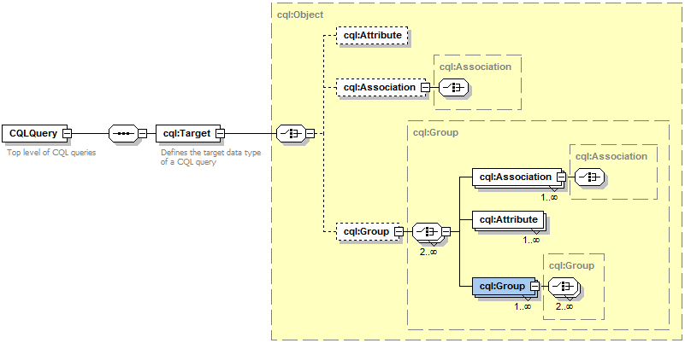
Data Service Query Language
Specifies a target object (result) type and selects the instances which satisfy the specified properties and nested object properties
Allows path navigation
Provides logical grouping
Provides name/predicate/value filtering on properties of objects
Recursively defined
Examples in CQL.doc

Slide 24
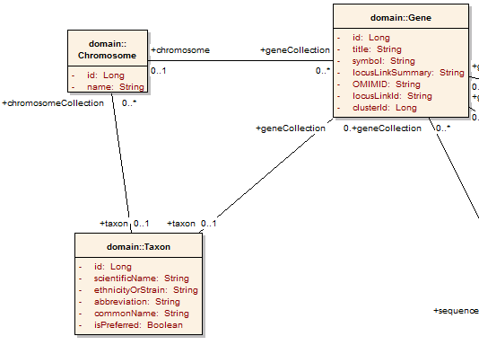
Example CQL Query
Return all Genes with a symbol beginning with BRCA and have an associated Taxon with an id equal to 6:

Slide 25
Example CQL Query
Return all Genes with a symbol beginning with BRCA and have an associated Taxon with an id equal to 6:
<Object name="gov.nih.nci.cabio.domain.Gene"> </Object>

Slide 26
Example CQL Query
LIKE “BRAA%”
Return all Genes with a symbol beginning with BRCA and have an associated Taxon with an id equal to 6:
<Object name="gov.nih.nci.cabio.domain.Gene"> <Attribute name="symbol" predicate="LIKE“ value="BRCA%"/> </Object>

Slide 27
Example CQL Query
LIKE “BRAA%”
Return all Genes with a symbol beginning with BRCA and have an associated Taxon with an id equal to 6:
<Object name="gov.nih.nci.cabio.domain.Gene"> <Group logicRelation="AND"> <Attribute name="symbol" predicate="LIKE“ value="BRCA%"/> <Association roleName="taxon“ name="gov.nih.nci.cabio.domain.Taxon"> </Association> </Group> </Object>

Slide 28
Example CQL Query
LIKE “BRAA%”
Return all Genes with a symbol beginning with BRCA and have an associated Taxon with an id equal to 6:
<Object name="gov.nih.nci.cabio.domain.Gene"> <Group logicRelation="AND"> <Attribute name="symbol" predicate="LIKE“ value="BRCA%"/> <Association roleName="taxon“ name="gov.nih.nci.cabio.domain.Taxon"> <Attribute name="id" predicate=“EQUAL“ value="6"/> </Association> </Group> </Object>
= 6

Slide 29
Data Service Interface
public abstract CQLQueryResults processQuery(CQLQuery cqlQuery)
throws MalformedQueryException, QueryProcessingException;
Data Provider’s only responsibility is to implement CQL over their local data resource
  A default implementation will be provided for caCORE SDK created systems
caGrid provides grid service implementation to invoke provider’s CQL implementation
Service provides all features necessary for compliance, such as advertisement of data service metadata, and security integration

Slide 30
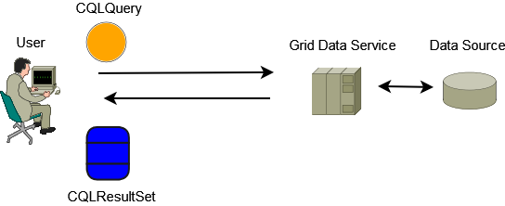
Data Service Query Scenario
Client builds a CQL Query
CQL Query is serialized and submitted to the Grid Data Service
Grid Data Service deserializes the CQL Query Object and processes it
Data Source is queried by the Grid Data Service
Grid Data Service Builds a CQL Result Set
Result Set is serialized and returned to the client
Client deserializes result set
Result set is iterated with client tools to retrieve objects

Slide 31
Data Service Features Under Development
Componentized library being developed to facilitate limited federating and aggregating queries
Service-side Query Result Management (remote cursor, data transfer, etc)
caGrid Identifiers Integration (return grid identifiers in place of materialized objects)
Result Delivery Specification (possible support for association traversal, attribute returns, range/limit operations)

Slide 32
Data Service Client Tooling
APIs provided to discover available data services on the grid based on client-defined criteria (such exposed data models and concepts)
Object-Oriented API for building queries, querying a given data service, and processing the results
Client tools available to iterate query result sets
  Object iterator deserializes XML into registered objects (deserialization controlled by client configuration)
  XML iterator simply returns XML documents

Slide 33
Data Services Service Tooling
Data services can be built via an Introduce Toolkit extension
Extension adds functionality to both service creation and modification
  Creation adds query operation
  Modification adds CQL implementation, selected data model, and appropriate metadata
  Specialized client configured to support necessary custom serialization and security settings
    Generic Data Service Client can be used to communicate with ANY data service, but a service-specific client knows what security the service is configured with, and any non-default serialization it may make use of

Slide 34
Introduce Goals
A framework which enables fast and easy creation of caGrid compatible services whether they are data, analytical, custom, or core services.
Provide easy to use graphical service authoring tools.
Hide all “grid-ness” from the developer so that they can concentrate on the domain expert implementation.
Utilize best practice layered grid service architectures.
Handle all service architecture requirements of the caGrid.
  Strong service interface data typing
  Metadata and service registration
  Grid security integration

Slide 35
Addressing the Requirements
Grid Services
  We will be fulfilling the requirement that each operation is available through grid services by utilizing the Globus 4.0 toolkit as well as utilizing best practice extensions.
  Tool providers will describe the grid service interface they wish to provide.
  We will be using the Globus toolkit during creation, registration, discovery, and invocation of these service operations as grid services
    Clients will be using the operation through a grid service interface and will not need to be aware of any implementation specific details of the grid service

Slide 36
Addressing the Requirements (cont)
Strongly typed interfaces:
  Introduce will enable schema extraction from a GME so that the wsdl, beans, and service metadata can be automatically populated so the service will be using strongly typed and publicly accessible data types.
  Data model schema, and any referenced schemas, are extracted and placed in the schema directory of the analytical build skeleton
    types can be used at service build time to generate the language binding objects and create strongly-typed grid service interfaces

Slide 37
Addressing the Requirements (cont)
Providing Client Side Object API
  Globus build process will automatically generate a client side object oriented API
  We will generate a wrapper for this API which matches the service interface to make a clean mapping from client to service.
    This wrapper will handle auto boxing of the parameters into document literal form.

Slide 38
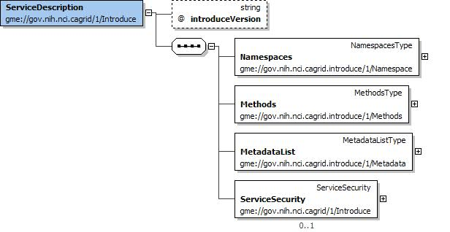
Model Driven Architecture
Introduce uses an XML document to describe the data types used, service interface, metadata, and security requirements
Introduce Toolkit uses it this document for service generation and synchronization

Slide 39
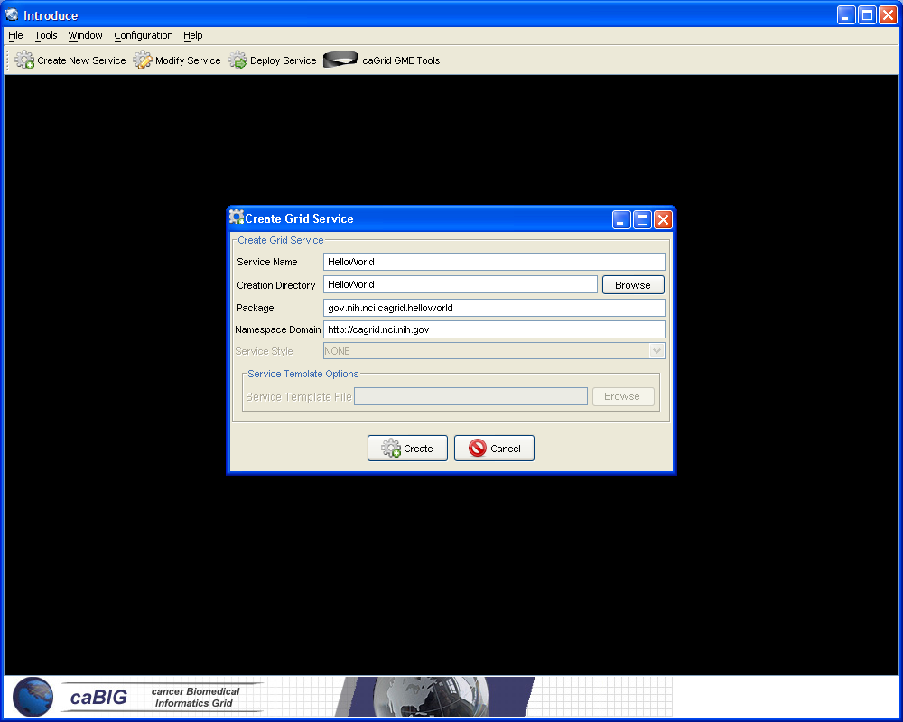
Introduce Portal Service Creation
Populate required variables for service creation
  Name = published service name
  Creation Direction = directory to create the skeleton
  Package = the java package you wish to use for your service
  Namespace Domain = the namespace to be used to define the service interface and types

Slide 40
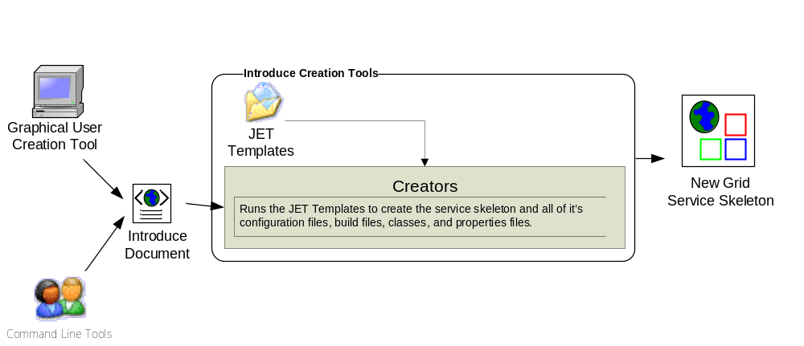
Introduce Service Creation Architecture

Slide 41
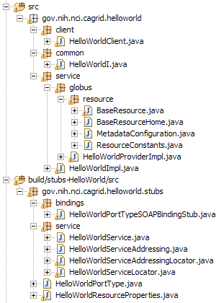
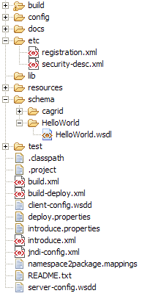
Created Skeleton Layout
= generated
= built
= developers
contribution

Slide 42
Created Skeleton Layout (cont)
= implements the developer
defined interface and calls into
the generated client port type
stub.
= the developer defined grid
service interface
= manages the resources
of this grid service
= implements the port type
and calls into the actual
clean unboxed interface
the developer defined.
= developers implementation
of the defined interface.

Slide 43
Created Skeleton Layout (cont)
= service metadata registration configuration
= describes the services security configuration
= services WSDL file for axis
= configuration files for eclipse development
= ant build files
= client configuration file for axis
= deployment time service properties
= introduce representation of service
= JNDI service resources configuration
= namespace mappings for axis
= server configuration file for axis

Slide 44
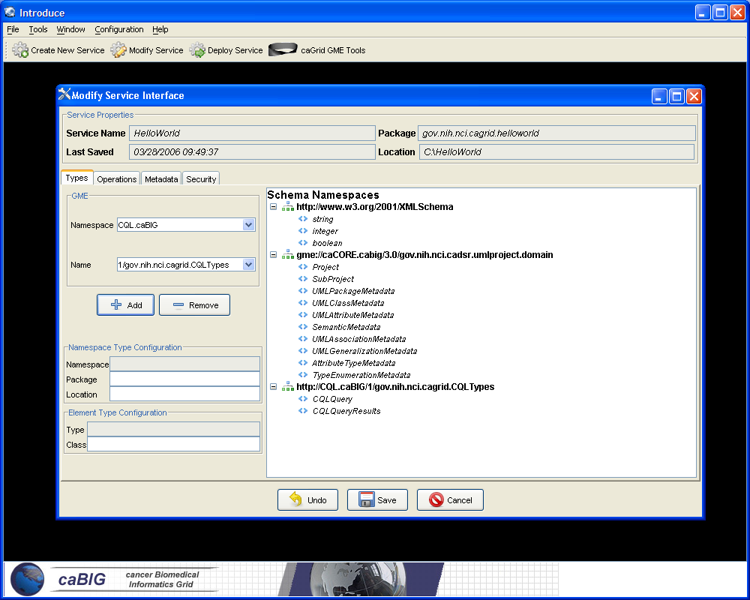
Introduce Service Modification Tool
Graphical tool to automatically create source code, configuration files, and build process for new analytical services
Developer defines the operations of the service and just has to focus on the implementation of them
Generated service is caBIG compliant in its mechanisms to register, advertise, and secure

Slide 45
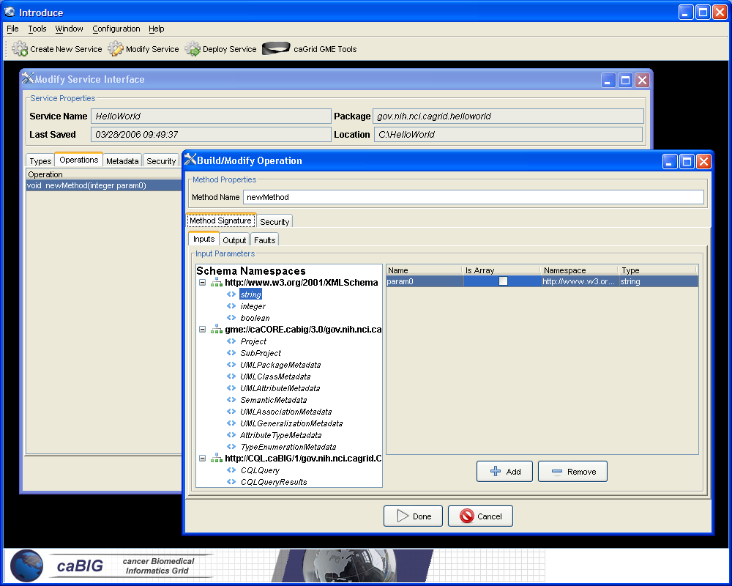
Introduce Service Modification Tool cont.
Input and output parameters can be discovered from GME or caDSR
Schema types can be automatically downloaded and configured as operation parameters
Specified types are used to create necessary Java Objects using Axis/Globus behind the scenes

Slide 46
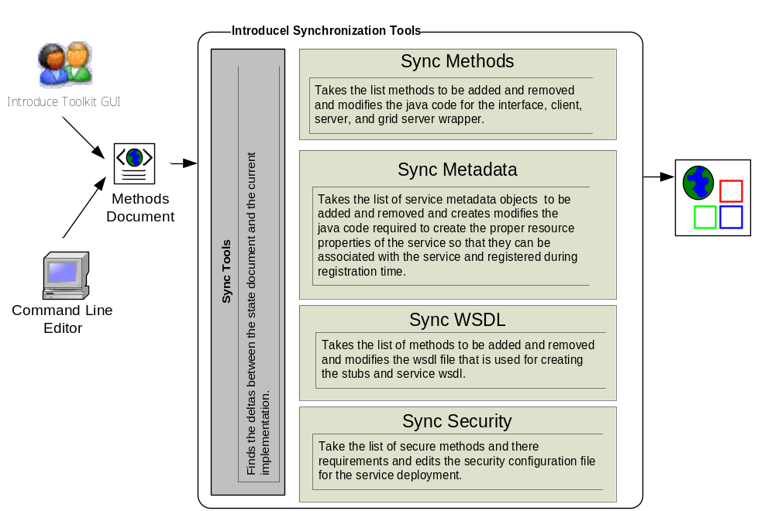
Skeleton Synchronization Process

Slide 47
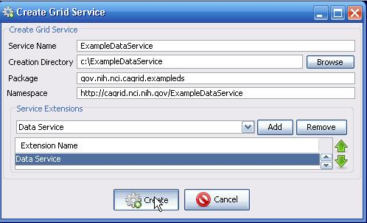
Creating a Data Service with Introduce
Once the data extensions to Introduce are installed (ant installIntroduceExtensions from data project), a Data Service can be created by selecting the “Data Service” extension, when creating a Service

Slide 48
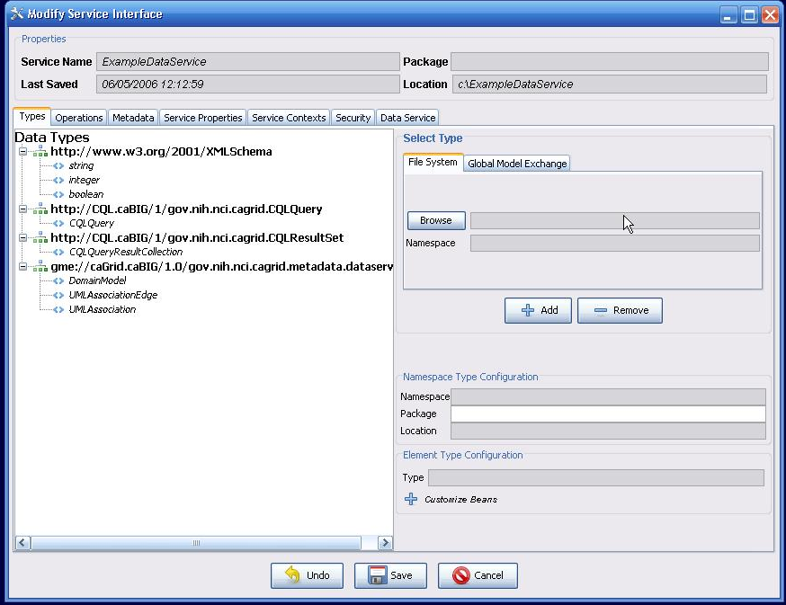
Creating a Data Service with Introduce cont.
The created Service has the necessary schemas for the data service inputs, outputs, and metadata

Slide 49
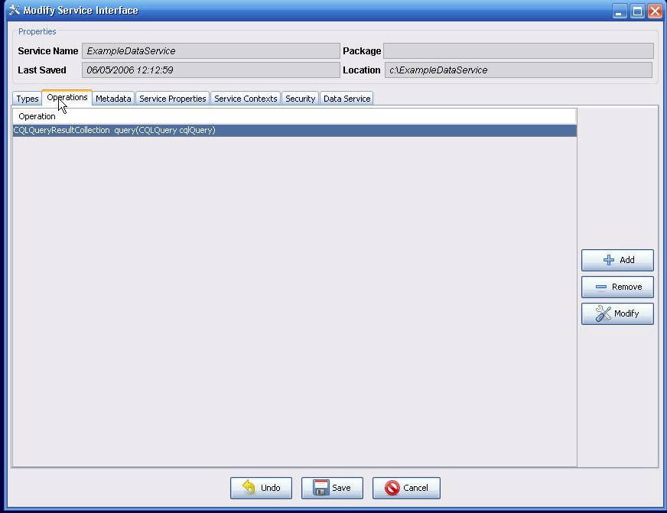
Creating a Data Service with Introduce cont.
The necessary “query” method is defined for the Data Service

Slide 50
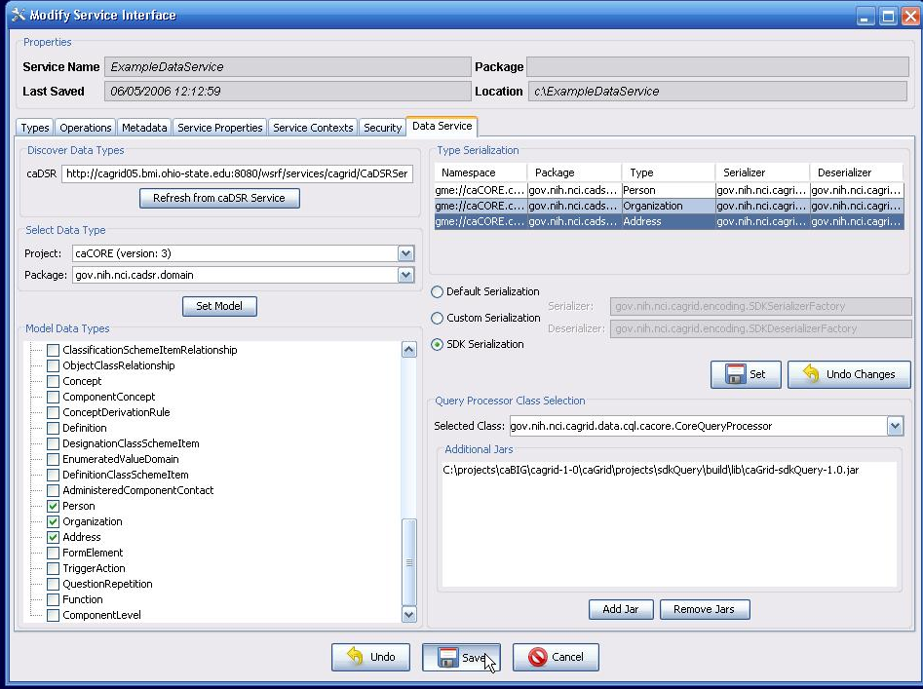
Creating a Data Service with Introduce cont.
The Data Service tab allows definition of the exposed model, and query implementation being used

Slide 51
Live Demo:
Using Introduce to build a Data Service

Slide 52
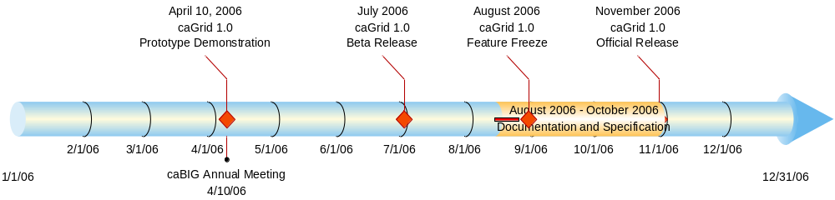
caGrid 1.0 Timeline

Slide 53
Project Resources and Communication
caGrid 1.0 GForge Home:
  Feature Requests
  Bug Reports
  Discussion Forums
  Public Wiki
  Downloads / Source Repository
  http://gforge.nci.nih.gov/projects/cagrid-1-0/
caGrid Users Mailing List
  https://list.nih.gov/archives/cagrid_users-l.html
  cagrid_users-l@list.nih.gov
Architecture Workspace
  Community direction from Working Groups
  Report out and feedback during WS calls

Slide 54
Overview of caGrid 1.0 Data Services
Scott Oster

