Slide 1
caBIG High-level Review
Dialogue Workshop II
February 9-10, 2006
Scott Oster
oster@bmi.osu.edu
Multiscale Computing Laboratory
Department of Biomedical Informatics
The Ohio State University

Slide 2






caGrid
Analytical Service
Grid-Enabled Client
Gene
Database
Tool 1
caArray
Tool 2
Research
Center
NCICB
Grid Services Infrastructure
(Metadata, Registry, Query,
Invocation, Security, etc.)
Protein Database
Grid Data Service
Tool 3
Tool 4
Image
Grid Portal
Microarray
Tool 2
Research
Center
Tool 3

Slide 3
caBIG Principles
Model-driven
Aimed at achieving both syntactic and semantic interoperability
Open source, access, development
Federated

Slide 4
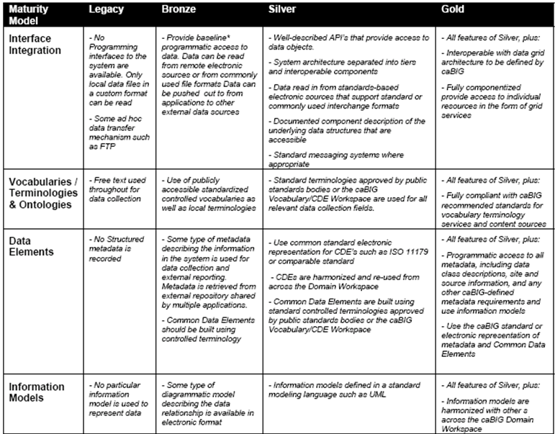
caBIG Compatibility Guidelines

Slide 5
Getting to the Grid (Gold)
To get to Silver:
  caCORE SDK
  Custom-built
  Hybrid
    Reverse Engineer UML from existing DB, then run SDK
    Etc.
caGrid provides tools to go from Silver to Gold
  Service Metadata for service Advertisement
  Service Interfaces for service Access
  Identification of Data Instances
  Trusted Identity/Credentials for secure access
  Communication Mechanisms and Protocols
  Data transport representation

Slide 6
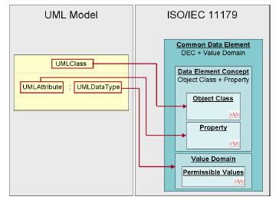
Semantic Metadata – UML to caDSR Mapping
UML Class is mapped to an Object Class
Attribute of a UML Class is mapped to a Property
Combination of UML Class and Attribute is mapped to Data Element Concept
Combination of UML Class, Attribute and it’s Datatype is mapped to Data Element (CDE)
UML Class and it’s attribute are based on EVS concepts
UML Model/Project is mapped to Classification Scheme
Packages are mapped to classification scheme items

Slide 7
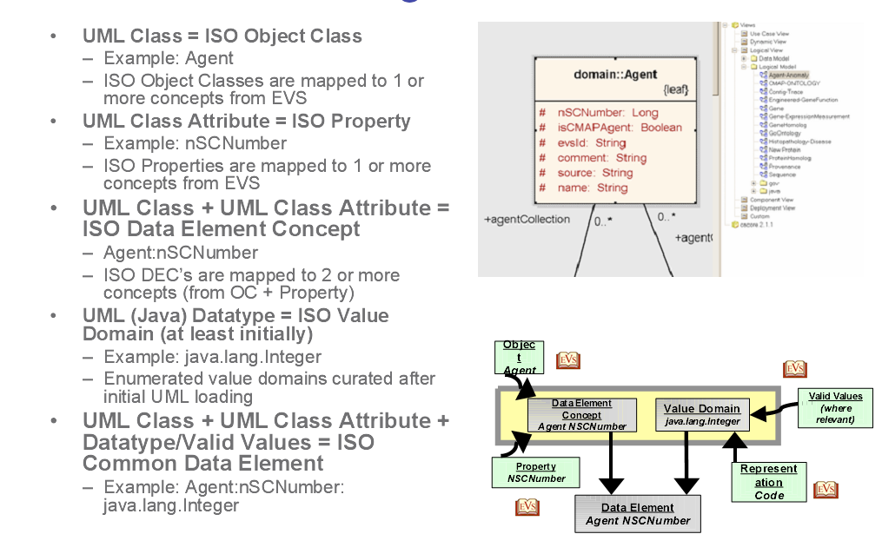
Semantic Metadata Examples

Slide 8
Services related to Service Metadata
Cancer Data Standards Repository (caDSR)
  caBIG projects register their data models as Common Data Elements (CDEs) which are semantically harmonized and then centrally stored and managed the caDSR
Enterprise Vocabulary Services (EVS)
  EVS is set of services and resources that address the need for controlled vocabulary
  caDSR data models are defined by terminology in the EVS
  Thesaurus: a biomedical thesaurus
  Metathesaurus: based on NLM's Unified Medical Language System Metathesaurus supplemented with additional cancer-centric vocabulary
Global Model Exchange (GME)
  GME is a DNS-like data definition registry and exchange service that is responsible for storing and linking together data models in the form of XML schema.
  caDSR data objects which travel the grid as XML do so in the format described in GME-registered schemas
Globus Information Services (Index Service)
  The Globus Information Services infrastructure provides a generic framework for aggregation of service data, a registry of Grid services, and a dynamic data-generating and indexing node, suitable for use in a hierarchy or federation of services

Slide 9
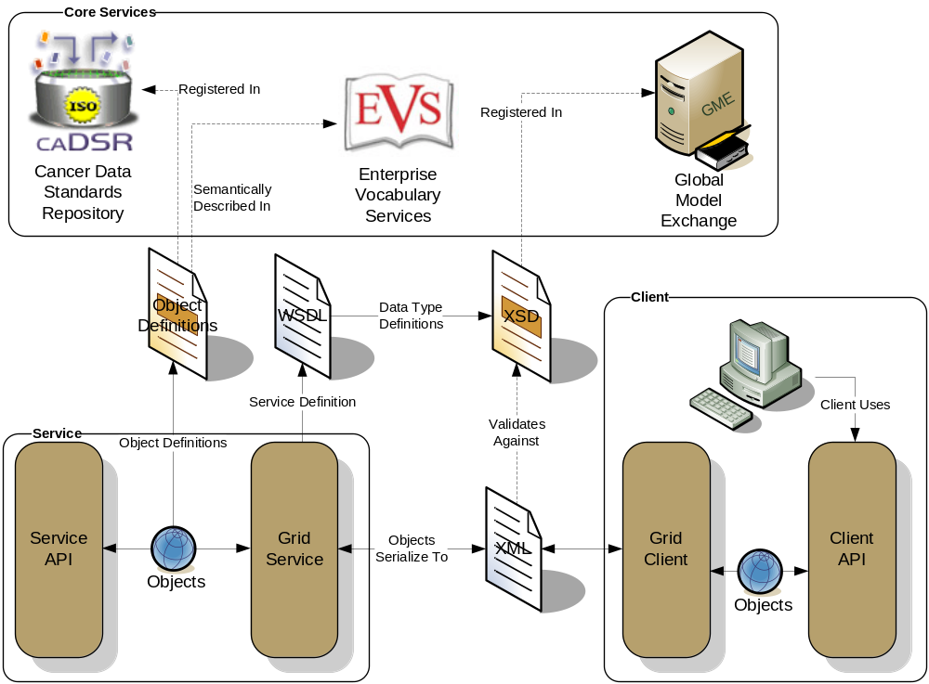
caGrid – Metadata and Data Description
Client and service APIs are object oriented, and operate over well-defined and curated data types
Objects are defined in UML and converted into Administered Components, which are in turn registered in the Cancer Data Standards Repository (caDSR)
Object definitions draw from vocabulary registered in the Enterprise Vocabulary Services (EVS), and their relationships are thus semantically described
XML serialization of objects adhere to XML schemas registered in the Global Model Exchange (GME)
  All data in caGrid travel between services and between client and services as XML documents that conform to well-defined schemas stored in GME

Slide 10
Discovery Process
Standard Metadata
  Common Metadata describes generic information about service providing Cancer Center
  Data Service Metadata describes the data exposed using terminology and objects from caDSR/EVS
  Analytical Service Metadata describes the supported operations and their inputs and outputs using terminology and objects from caDSR/EVS
Clients formulate a query over the caGrid standard metadata
  Examples:
    “Find me all the services from Cancer Center X”
    “Which Analytical services take Genes as input?”
    “Find me all the services with some metadata mentioning the string ‘macromolecules’”
This query is sent to the caGrid Index Service which returns the address of the services satisfying the query.

Slide 12
Metadata Backup Slides

Slide 13
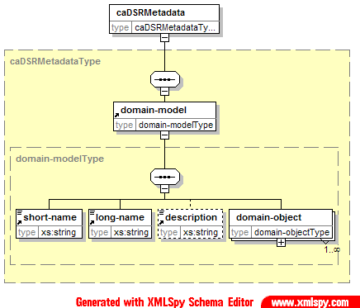
Domain Model Metadata - caDSR
Unique Identifier: public ID and version
Short Name: Acronym of the project to which the domain model belongs to
Long Name: Full name of the project
Detailed description of the project

Slide 14
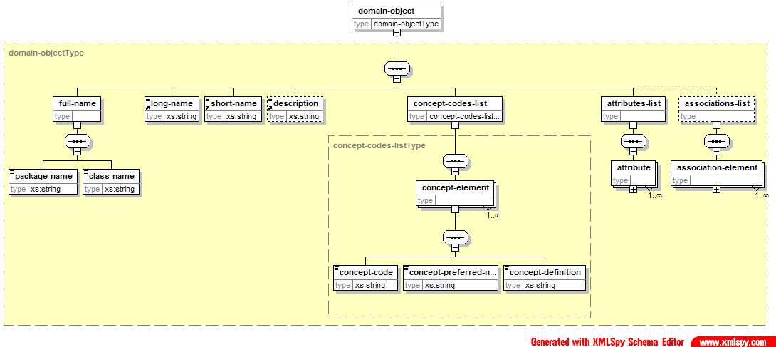
Domain Object Metadata - caDSR
Unique identifier consisting of public ID and version
Package qualified domain object name, long name and description based on EVS concepts
EVS concepts it is based on
  Concept Code, Concept Preferred Name, Concept Definition

Slide 15
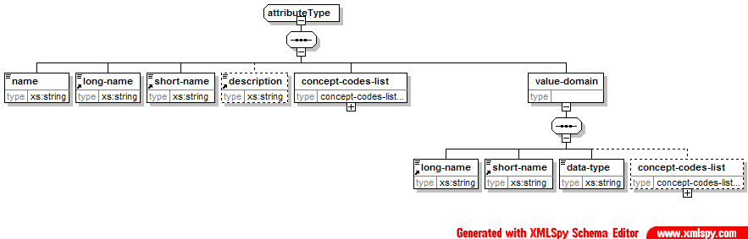
Domain Object Attribute Metadata - caDSR
Unique identifier consisting of public ID (CDE ID) and version
Attribute Name, Long Name and Description based on EVS concepts
EVS concept codes it is based on
Value Domain information
  Datatype
  Permissible Values
  Concept codes
List contained within each Domain Object

Slide 16
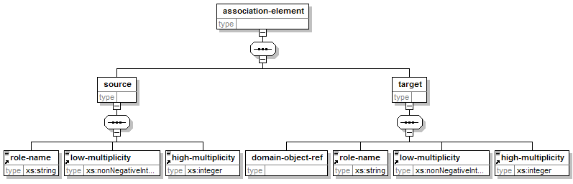
Domain Object Association Metadata - caDSR
Describes a named relationship (source -> target) between two Domain Objects
Uses references to domain object unique identifier(public ID and version) instead of value copy
List contained within each Domain Object

Slide 17
Snippet of caDSR Metadata Extract
<?xml version="1.0" encoding="UTF-8"?>
<caDSRMetadata xmlns="http://cagrid.nci.nih.gov/1/caDSRMetadata"
xmlns:xsi="http://www.w3.org/2001/XMLSchema-instance"
xsi:schemaLocation="http://cagrid.nci.nih.gov/1/caDSRMetadata
http://localhost:/ogsa/schema/cagrid/types/Common/caDSRMetadata.xsd">
<domain-model id="2262164" version="3.0">
<short-name>caCORE</short-name>
<long-name>caCORE</long-name>
<description>caCORE Description</description>
<domain-object id="2223329" version="1.0">
<full-name>
<package-name>gov.nih.nci.cabio.domain</package-name>
<class-name>DiseaseOntologyRelationship</class-name>
</full-name>
<long-name>DiseaseOntologyRelationship</long-name>
<short-name>C45371</short-name>
<concept-codes-list>
<concept-element order="0">
<concept-code>C45371</concept-code>
<concept-preferred-name>
DiseaseOntologyRelationship
</concept-preferred-name>
<concept-definition>
The disease relationship specifies the relationship among diseases.
</concept-definition>
</concept-element>
</concept-codes-list>
<attributes-list>
<attribute id="2223846" version="3.0">
<name>id</name>
<long-name>Identifier</long-name>
<short-name>C25364</short-name>
<concept-codes-list>
<concept-element order="0">
…

Slide 19
caCORE SDK Backup Slides

Slide 20
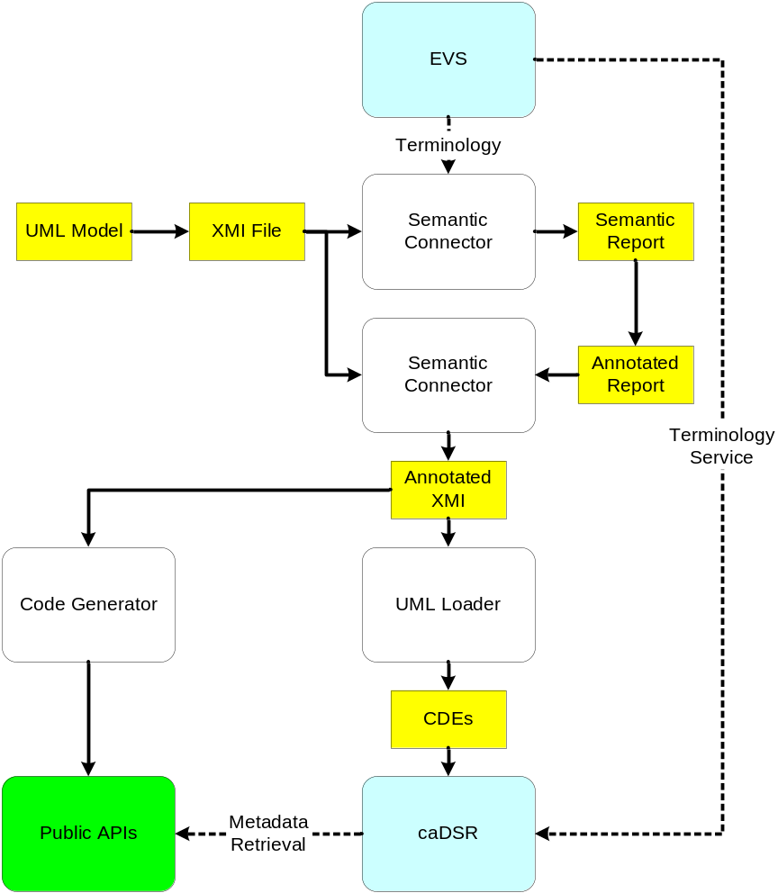
SDK Workflow
Design system and draw model
(UML tool)
Annotate model
(Semantic Connector)
Register metadata
(UML Loader)
Generate and deploy system (Code Generator)
❶
❷
❹
❸
SDK components in white
External systems in blue
Artifacts in yellow
Generated code in green

Slide 21
