Slide 1
caGrid 1.0 Security
Stephen Langella langella@bmi.osu.edu
Architecture/VCDE Workspaces
Joint Face to Face
February 1st-2nd, 2006

Slide 2
Overview
General Update
Federated Identity Management
Authorization
Trust Management
Secure Communication
Host / Service Credentials
Virtual Organizations

Slide 3
General Update

Slide 4
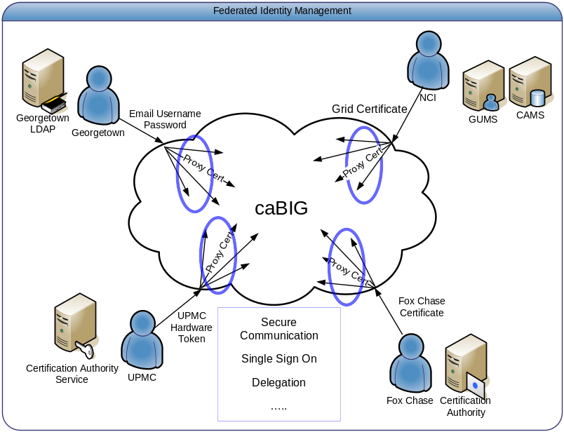
Federated Identity Management - Overview
Major Focus of the caBIG Security Evaluation White Paper
Enable users to use their institution provided identity for authenticating to the Grid.
User should be able to authenticate to the Grid using their institution’s existing mechanisms.
Image taken from the caBIG Security Evaluation White Paper

Slide 5
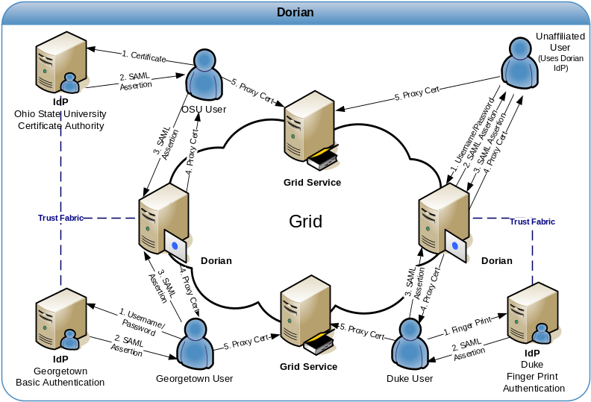
Federated Identity Management – Current Status
Dorian
  Formerly GUMS, redesigned to address Federated Identity Management Requirement.
  WSRF Compliant Grid Service
  Manages User’s Grid Credentials
  Enables Users to authenticate and create grid proxies via their institution’s Identity Provider (IdP)
  Internal Dorian IdP allows unaffiliated users or small institutions access to the grid.
  Internal Certificate Authority / Ability to integrate with existing Certificate Authorities
  Administration Interface
    Configurable/Extensible User Policies
    User Management
    Trusted IdP Management
  Full Client API / Administrative Portal

Slide 6
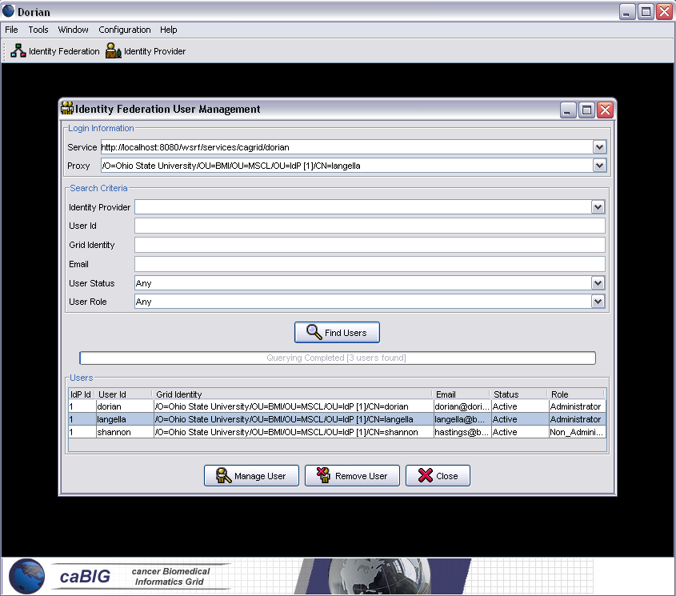
Federated Identity Management
Dorian Current Status
  Initial Service Implementation Completed
  Initial Administration Portal Completed
  Integrated with Ohio State IdP
  Dorian Technical Paper Completed.
Community Participation Needed
  Community Standardization of the SAML authentication assertions.
  Early adopters needed
    Integration between Cancer Center IdPs and Dorian

Slide 7
Authorization - Overview
Authorization is finding out if the person, once identified, is permitted to have the resource. Authorization is equivalent to checking the guest list at an exclusive party, or checking for your ticket when you go to the opera.
Authorization Mechanisms
  Host/Domain Authorization
  Identity Authorization
  Attribute Based Authorization
  Integration with existing Authorization Systems.
  Many others…………
In caGrid we do not want to restrict how service providers authorize users.
We will provide a callout mechanism which service providers can implement for providing custom authorization.
We will also facilitate Attribute Based Authorization at the architectural layer.
Authorization decisions WILL be made by local service providers and NOT by the Grid Infrastructure.
  The Grid Infrastructure will provide services which service providers may leverage to help make an authorization decision (attribute based authorization)

Slide 8
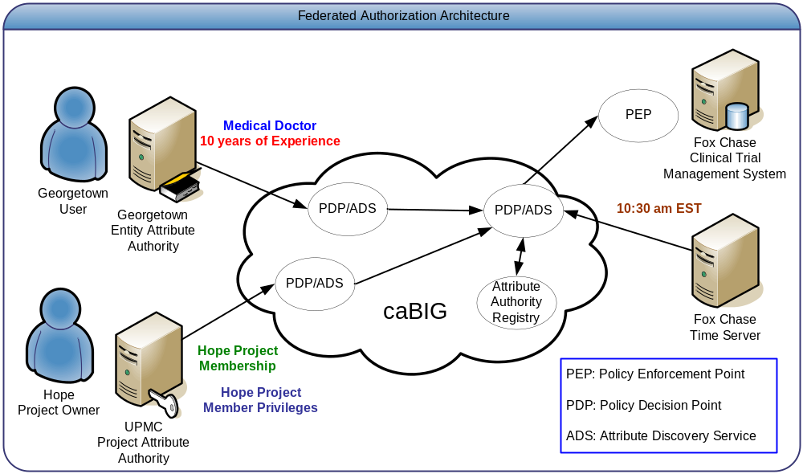
Attribute Based Authorization
Services use available user attributes for determining authorization.
Service obtain attributes from an attribute authority.
Image taken from the caBIG Security Evaluation White Paper

Slide 9
Attribute Based Authorization
Issues
1.0 Attribute Standardization
    1.1 What is the process for standardizing attributes?
    1.2 What attributes are required for all users?
  2.0 Attribute Management
  2.1 Who will be responsible for persisting user attributes? Institutions? Grid? Both?
  2.2 How and when will attributes be created? What if they already exist?
  2.3 Is their a need to be able to create/update attributes through the Grid?
  2.4 How will access to attributes be controlled?
  2.5 Can there be multiple attribute authorities for a given user?
  3.0 Attribute Discovery and Resolution?
  3.1 How will a service provider determine where to get a particular attribute from?
  (This can get very complicated if users have multiple attribute authorities)
  *** Community Participation will be Critical in Solving these Issues ***
  (We recommend forming a working group tasked with resolving these issues.)

Slide 10
Trust Management
PKI (Public Key Infrastructure) is the cornerstone of grid security; grid users authenticate themselves to the grid via certificates.
Grid Services accept certificates as valid credentials if they are signed by trusted authorities.
Grid services must be configured to trust certificate authorities
Current Approach (Globus, caGrid 0.5)
  Service Container and or Service can be configured by specifying a trusted ca certificates directory in the server/service configuration directory.
  Drawbacks
    Hard for grid administrators to manage.
    Every time a new trusted authority comes on line, all the services in the grid must re-configured to trust that authority

Slide 11
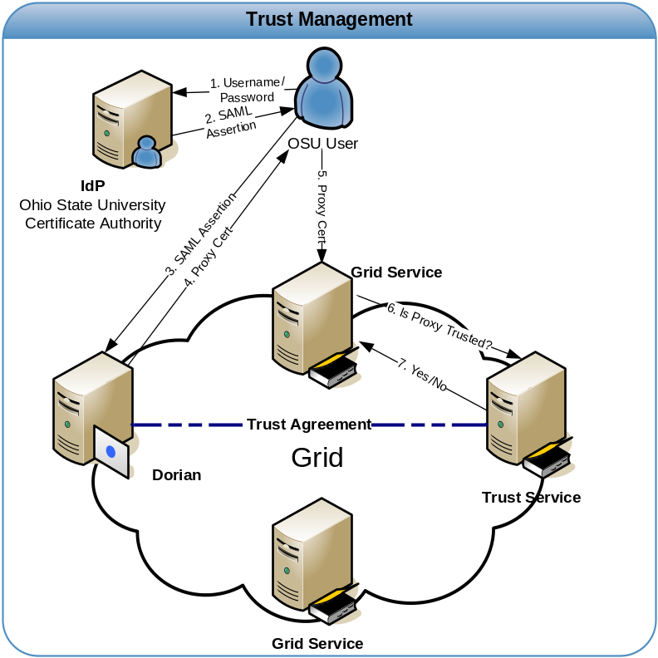
Trust Management
Current Thinking

