Slide 1
caGrid Infrastructure: Overview and Roadmap
Scott Oster, Ohio State University
GlobusWorld 2010
Emory University, Atlanta, GA
October 20th-22nd, 2009

Slide 2

Agenda
caBIG / caGrid Overview
caGrid 1.4
caGrid 2.0

Slide 3

What is caBIG?
Common, widely distributed infrastructure that permits the cancer research community to focus on innovation
Shared, harmonized set of terminology, data elements, and data models that facilitate information exchange
Collection of interoperable applications developed to common standards
Cancer research data available for mining and integration

Slide 4
Driving needs: cancer Biomedical Informatics Grid
A multitude of “legacy” information systems, most of which cannot be readily shared between institutions
An absence of tools to connect different databases
An absence of common data formats
A huge and growing volume of data must be collected, analyzed, and made accessible
Few common vocabularies, making it difficult, if not impossible, to interlink diverse research and clinical results
Difficulty in identifying and accessing available resources
An absence of information infrastructure to share data within an institution, or among different institutions

Slide 5

What is caGrid?
A grid based software infrastructure consisting of services, toolkits, APIs, and applications
A production grid deployment of the core services provided by that infrastructure
A community of developers leveraging that grid and infrastructure to provide applications and services to the cancer research community

Slide 6
caGrid Infrastructure Focus Areas
Leveraging Grid technologies and standards as an interoperability platform
Metadata Infrastructure
  Surfacing wealth of existing caBIG data-oriented metadata on the grid
  Providing new service-oriented metadata
Security
  Integrating existing systems and applications with Grid security
  Lowering burden of implementation of grid-wide and local policy
Service Developer Tooling
  Powerful platform for bringing applications and data to the grid
Facilitating Grid wide operations
  Federated query, workflow execution, resource discovery
Making the Grid more accessible
  Graphical installation and configuration, higher-level object-oriented APIs, web portals, graphical administrative applications
Quality
  Comprehensive testing infrastructure, automated builds and test execution on multiple platforms, dashboard with historical archive

Slide 7
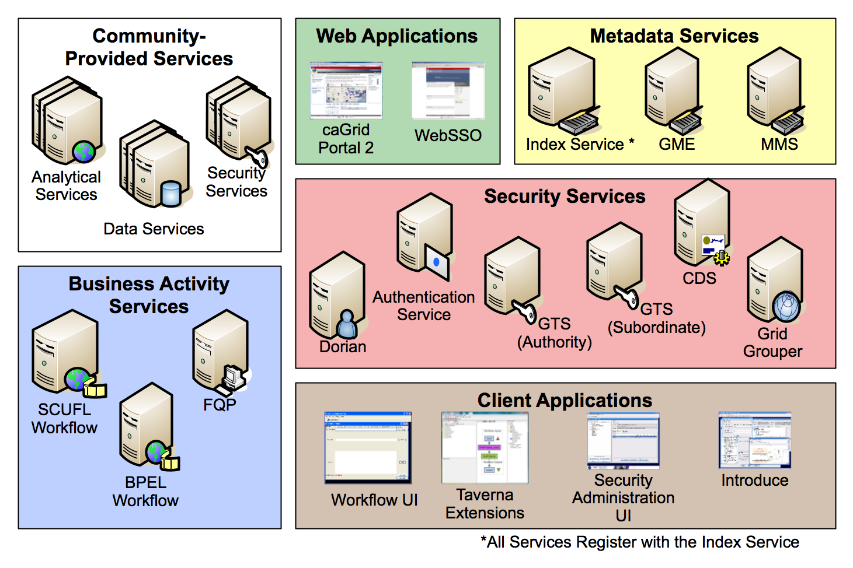
caGrid Production Environment

Slide 8
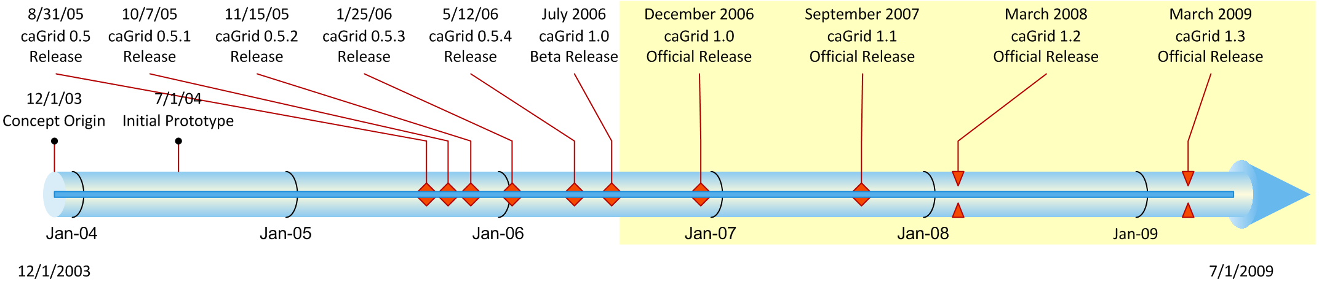
caGrid Release Timeline
Last major release: caGrid version 1.3 released March 2009
Next major release: caGrid 1.4 -- planned for Q1/Q2 2010 -- will maintain backwards compatibility with previous 1.x releases
caGrid 2.0 expected to be released subsequent to 1.4

Slide 9
Why caGrid 2.0?
While adding significant new features, each caGrid 1.x release aimed for backwards compatibility of service interfaces and provided automatic service migration tooling.
While this greatly eased the evolution of services and applications, there are two impeding factors that require a change in strategy moving forward:
  Infrastructure is out-of-date, and in some cases no longer supported.
    Globus 4.x ws-core, the underlying framework used by caGrid, has been deprecated by the Globus team. Globus and caGrid depend upon Axis 1.2, which has significantly less performance and scalability than modern SOAP engines. Industry standards have evolved and emerged.
  Evolving scope of the community
    Significant community drivers towards a more federated and agile approach and scope to metadata (future caBIG® semantic architecture, other community’s approaches such as OpenMDR), and an anticipation of wider deployment (e.g. the BIG Health Consortium and CTSAs) across multiple technologies.

Slide 10
Why caGrid 1.4?
Though development on version 2.0 has begun we do not anticipate a release until late 2010. In the mean time, our community has a number of requirements which need to be met
The forthcoming caGrid 1.4 is expected to be the final major 1.x release (patch releases will still be made as necessary), adding several currently-needed key features to the current infrastructure

Slide 11
New Features in caGrid 1.4
Introduction of CQL 2 Data Services, and DCQL 2 support in FQP
  CQL 2 is a superset of CQL 1, and will include a query translator
  FQP will support both DCQL 1 and 2, and will make a best effort translation to support CQL 1 and 2 Data Services
Grid Identifiers
  Framework for secure identification, resolution, and retrieval of objects across the grid
Introduce
  Service Upgraders support 1.2 -> 1.4 and 1.3 -> 1.4
Security
  Dorian White Pages – allows non-admins to lookup users and hosts, facilitating authorization provisioning

Slide 12
New Features in caGrid 1.4 (cont’d)
Workflow
  New CQL Query Builder
  Repackaging of caGrid Plug-ins for Taverna for easier install /upgrade
  End-to-end QA Testing of a sanctioned Taverna Workbench release
  Workflow Service will support and use Credential Delegation Service
ISO 21090 Datatypes Support
  Initial support for ease of use of health care standards in service/application developement

Slide 13
caGrid Identifiers
Specification, extensible interfaces, grid service, web application, and client tooling for “referencing” data
Aims to be extremely flexible, general, and useful “outside the grid”
Features:
  Decentralized
  Globally unique
  Resolvable
  Web Friendly
  Flexible deployment model

Slide 14
caGrid Deprecation Policy
Keeping with the deprecation policy published in 2008, the caGrid Team will publish a deprecation plan prior to the release of caGrid 1.4 and 2.0 – from the policy:
  “A deprecation plan will be published prior to each caGrid release, beginning with 1.3. The deprecation plan will specify:
    Stable APIs
    Retired or backwards-incompatible Services
    Grid protocol changes”
caGrid Service developers should carefully review the deprecation plan and asses its impact to their project.

Slide 15
caGrid 1.4 Deprecation Highlights
Plan Finalized February 12th 2010
  https://cagrid.org/display/caGrid13/caGrid+1.4+Deprecation+Plan
Deprecated in caGrid 1.4 (to be removed in a caGrid 2.x release)
CQL1 / DCQL1 – Transition to CQL2 / DCQL2
GridFTPAuthz - No recent adoption
Authz - No adoption; CSM aspects obsolete
Legacy Dorian/ Authentication Service Client APIs - superseded
Removed in caGrid 1.4 (deprecated in caGrid 1.3)
Data Service support for caCORE SDK 3.1, 3.2, 3.2.1
  caCORE 4.0, 4.1.1, 4.2 supported
Bulk Data Transfer (BDT)
  ws-transfer, gridFTP ill-adopted, replaced by caGrid Transfer
BPEL Workflow Service
  De-supported in favor of Taverna/SCUFL solution
Introduce 1.1 Service Upgrader
  Per standard Introduce policy, two major versions back are supported (1.2, 1.3)

Slide 16
caGrid 2 Architectural Principles
Business logic centric
  Decouple implementation from infrastructure via use of annotations, dependency injection, and java standards
Grid focused, but not exclusive
  Enable multiple “frontends” to services, including REST
  ESB-friendly
  ws-security for end to end security
Standards based, above and below service interface
  (continue to) leverage useful web service standards
  Leverage java implementation standards for implementation portability and longevity
    JAX-RS: Java API for RESTful (Representational State Transfer) Web Services
    JAX-WS: Java API for XML Web Services
    JAXB: Java Architecture for XML Binding

Slide 17
caGrid 2 Technologies
Apache CXF (http://cxf.apache.org/)
  Open source apache project supporting a wide variety of web service standards
  Focused on high performance, ease of use, and extensibility
  Spring configuration/construction on both client and service
  Bus architecture where multiple front ends and implementations can be connected
  Flexible deployment (standalone, EBI, J2EE container, spring, etc)
  Commercial support available (akin to Redhat model)
Globus Crux
  Evolution of Globus ws-core addressing limitations
  Collection of services and components implementing common patterns in service-oriented science (such as state management, persistence, notification, monitoring)
caGrid 1.x services and tooling migrated
Eclipse (OSGi) platform for Introduce development

Slide 18
SHANNON INTRODUCE AND ARCH SLIDES HERE

Slide 19
STEVE SECURITY DIRECTION SLIDES HERE

Slide 20
caGrid Infrastructure: Overview and Roadmap
Scott Oster, Ohio State University
GlobusWorld 2010
Emory University, Atlanta, GA
October 20th-22nd, 2009

