Slide 1
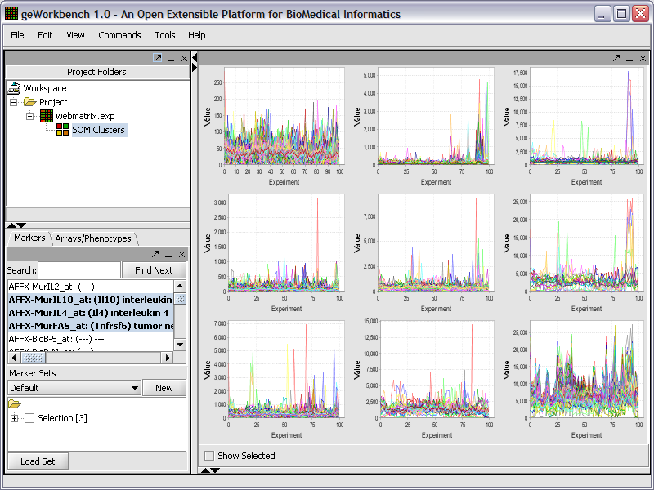
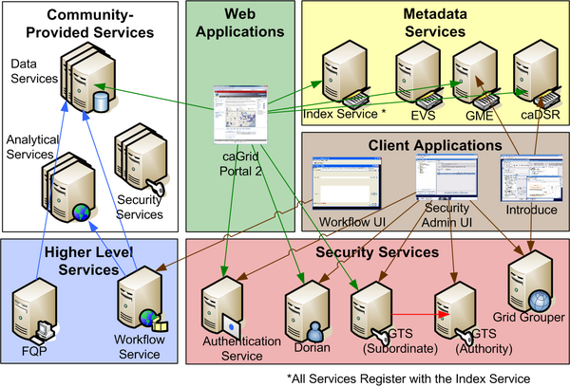
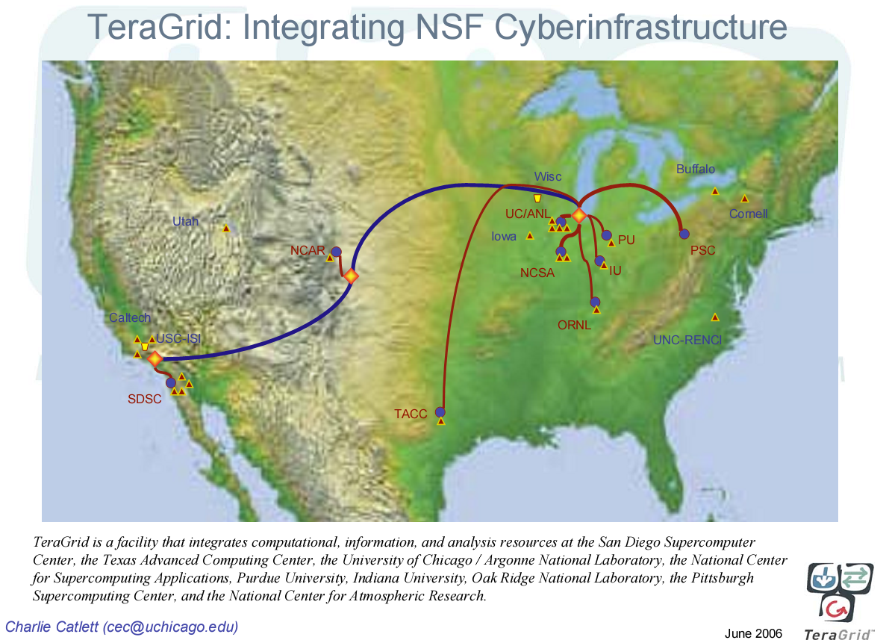
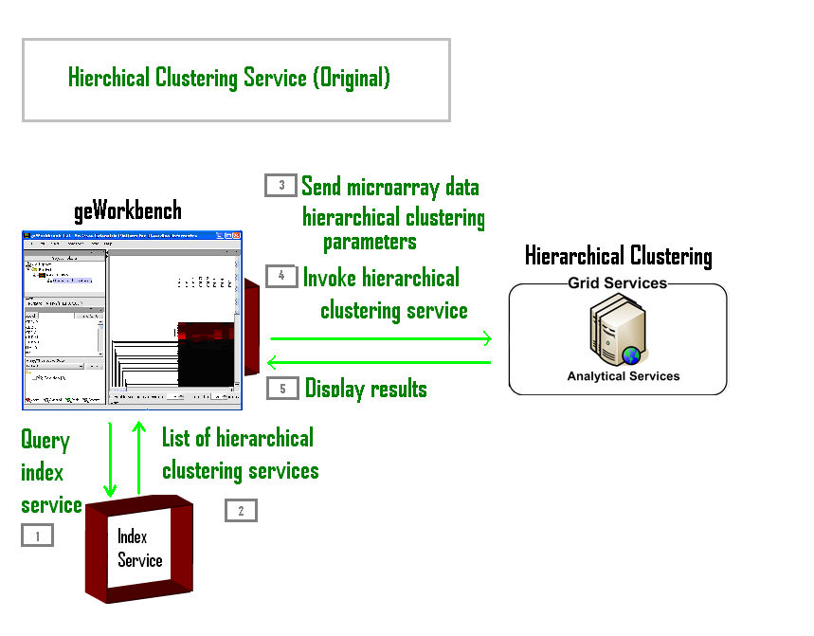
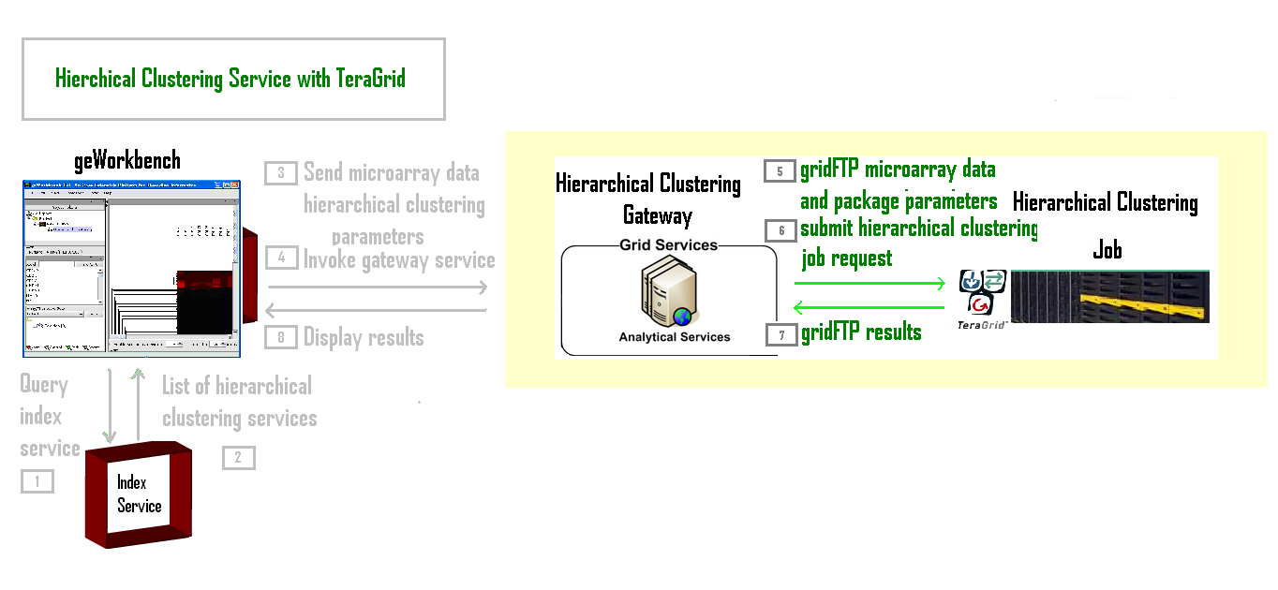
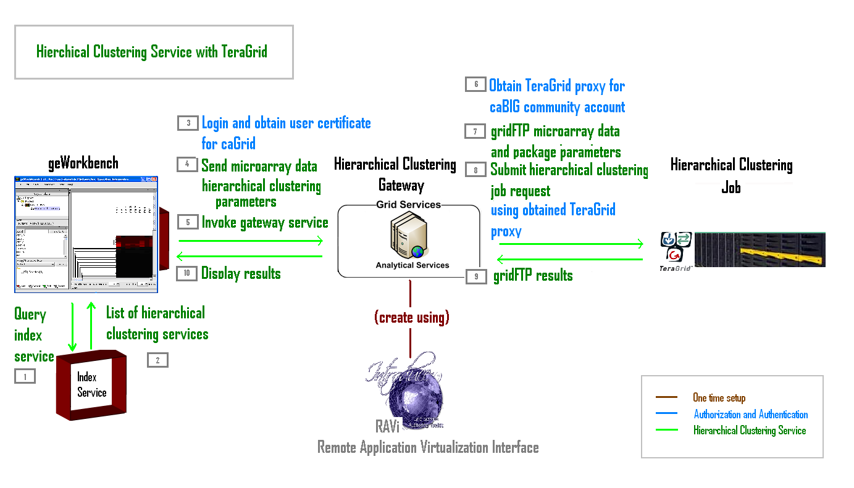
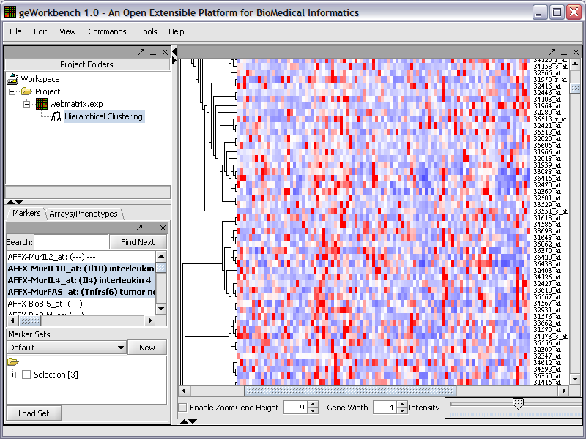
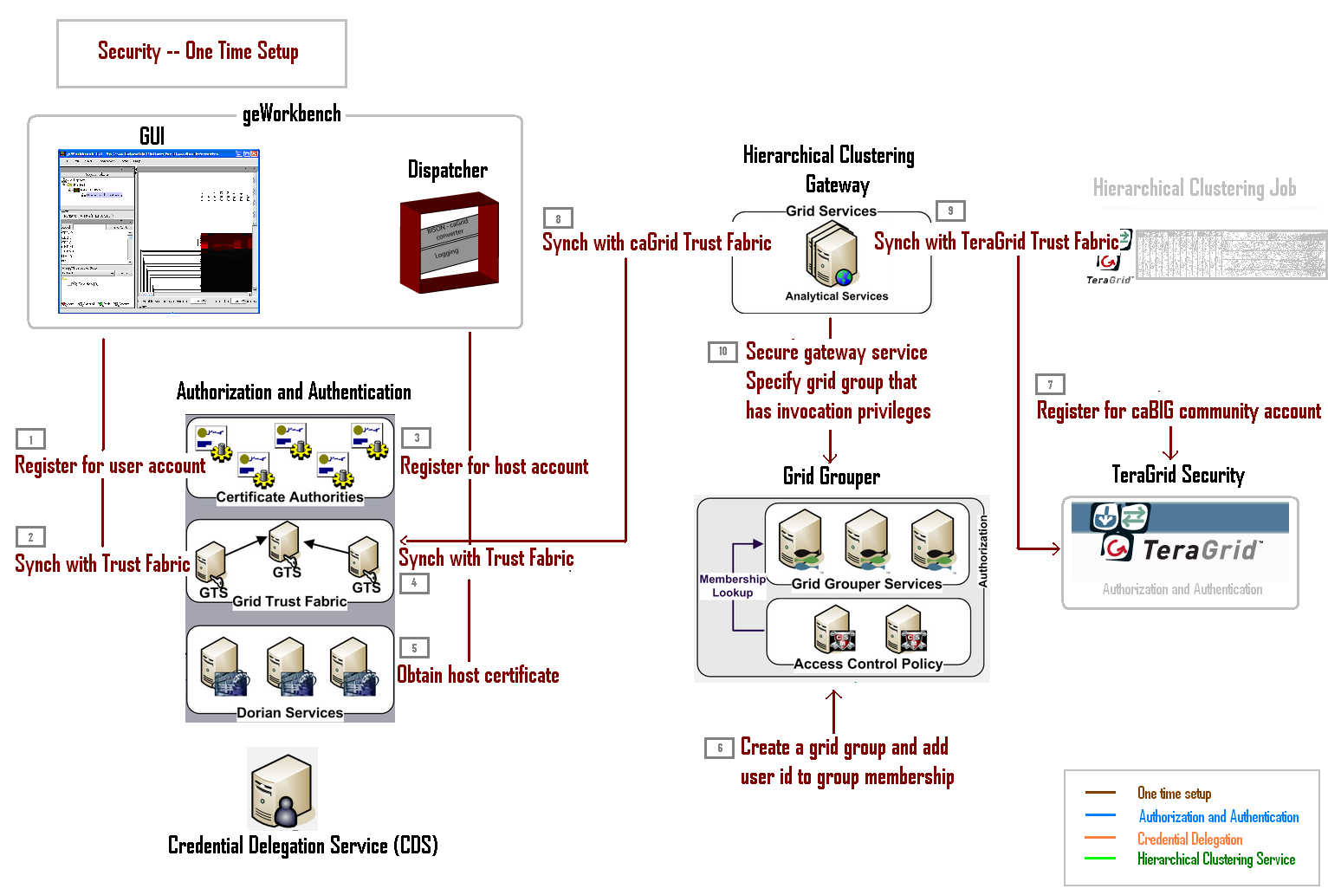
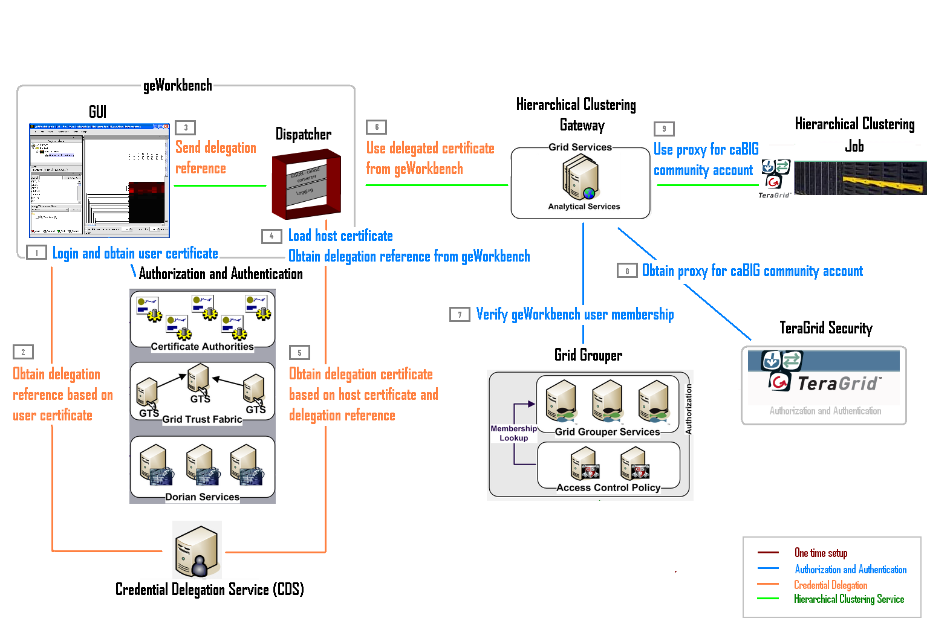

geWorkbench/caGrid/TeraGrid Integration
Christine Hung¹, Michael Keller⁴, Kiran Keshav¹, Steve Langella², Ravi Madduri³, Stuart Martin³, Patrick McConnell⁵, Scott Oster², Avinash Shanbhag³, Nancy Wilkins-Diehr⁶, Aris Floratos¹
¹Columbia University (Center for Computational Biology and Bioinformatics), ²Ohio State University (Department of Bioinformatics), ³Argonne National Laboratory (Mathematics and Computer Science Division)
⁴Booz Allen Hamilton, ⁵Duke University, ⁶San Diego Supercomputer Center
OVERVIEW
geWorkbench
caGrid
TeraGrid
geWorkbench is a modular software platform for integrative genomics that allows individually developed plug-ins to be configured into complex bioinformatic applications. At present there are more than 50 plug-ins supporting the visualization and analysis of gene expression, sequence, interaction, structure and other types of data.
To support the practical execution of long running or data-intensive tasks, geWorkbench utilizes grid technologies to outsource processing to remote servers. In this work we demonstrate how several middleware layers were bridged to seamlessly access to the substantial computational power of the TeraGrid infrastructure.
The cancer Biomedical Informatics Grid, or caBIG™, is an informatics infrastructure that connects data, research tools, scientists, and organizations to
leverage their combined strengths and expertise in an open federated environment with widely accepted standards and shared tools. caGrid is the service-oriented infrastructure that supports caBIG. It provides technology that enables institutions to share information and analytical resources efficiently and securely. caGrid is built on top of Globus 4, the leading grid middleware software.
geWorkbench leverages caGrid’s support for analytical services to provide access to grid-enabled remote computational services, thus enabling researchers with limited local resources to benefit from public infrastructure which otherwise would have been out of their reach or would have required a nontrivial level of technical know-how.
TeraGrid integrates high-performance computing resources at eleven major experimental facilities into an open, persistent computational resource for scientific discovery. Its high speed network connections allow sharing of large compute clusters and a variety of data and algorithmic resources.
TeraGrid resources include more than 750 teraflops of computing capability and more than 30 petabytes of online and archival data storage, with rapid access and retrieval over high-performance networks. Researchers can also access more than 100 discipline-specific databases. With this combination of resources, the TeraGrid is the world's largest, most comprehensive distributed cyber-infrastructure for open scientific research.
Web Resources:
Integration Effort: http://wiki.c2b2.columbia.edu/informatics/index.php/TeraGrid
geWorkbench: http://www.geworkbench.org/
caBIG: http://www.cagrid.org/mwiki/index.php?title=CaGrid
TeraGrid: http://www.teragrid.org/index.php
CONCEPT
Originally, the Hierarchical Clustering Service in geWorkbench was run as a traditional caGrid analytical service. The integration effort transformed the service into a TeraGrid-aware gateway so that the Hierarchical Clustering analysis can run on TeraGrid via a job submit request from its caGrid Gateway. As far as the communications protocol is concerned, nothing changed: geWorkbench still invokes a caGrid service.
geWorkbench users first contact the caGrid Index Service to find out which analytical services are available. They then choose one of those services to run, in this case Hierarchical Clustering. geWorkbench then sends the appropriate data and parameters to the gateway service. The gateway, in turn, transfers the data and parameters to TeraGrid and submits the Hierarchical Clustering job request. When TeraGrid responds with the results, the gateway passes it onto geWorkbench which then displays the results.
IMPLEMENTATION
Hierarchical Clustering Service (Original)
Hierarchical Clustering Gateway (TeraGrid-Aware)
Hierarchical Clustering with TeraGrid
SECURITY
The caGrid and TeraGrid nodes are run as secure services. Securing the Hierarchical Clustering Gateway requires (1) an one-time setup, and (2) run-time actions executed each time the service is invoked.
One-time setup includes:
Obtaining caGrid and TeraGrid accounts for the Hierarchical Clustering Service along with the appropriate proxy certificates.
Synchronizing the gateway service with the caGrid and TeraGrid trust fabrics.
Adding the caGrid account to the caGrid Grid Grouper and setting the gateway service to permit the specified grid group to invoke its submit-job call.
At run-time, geWorkbench passes its caGrid certificate to the gateway. The gateway verifies that the certificate represents the appropriate membership in the permitted grid group before sending the job request to TeraGrid. This task is carried out by the geWorkbench Dispatcher process. The caGrid Certificate Delegation Service delegates the geWorkbench certificate to the Dispatcher securely to prevent outside tampering. The gateway then uses a caBIG community account on TeraGrid to transfer data and submit jobs.
geWorkbench Result
First, the hierarchical clustering algorithm is staged at the TeraGrid community software area. The gateway is set up as a caGrid analytical service and created using caGrid software tools specifically developed to facilitate this process (Introduce and RAVi (http://www-unix.mcs.anl.gov/~neillm/ravi/). These tools take care of implementing caGrid protocols and security requirements -- for example, verifying group membership.
When geWorkbench invokes the Hierarchical Clustering Gateway, it performs the following tasks:
Uses gridFTP to transfer input data and parameters from geWorkbench to TeraGrid. The data passing between geWorkbench and the gateway is caDSR compliant.
Invokes the staged algorithm.
User gridFTP to retrieve the results from TeraGrid into geWorkbench.
One-time Setup
Run-time Authentication, Authorization, and Delegation

