Slide 1
Enterprise Group and Privilege Management in caBIG
Building a Distributed Access Management Infrastructure
Denver, Colorado
November 7, 2006
Stephen Langella
langella@bmi.osu.edu
Department of Biomedical Informatics
The Ohio State University

Slide 2









Cancer Biomedical Informatics Grid (caBIGTM)
The cancer Biomedical Informatics Grid (caBIG™), is a voluntary network or grid connecting individuals and institutions to enable the sharing of data and tools, creating a World Wide Web of cancer research. The goal is to speed the delivery of innovative approaches for the prevention and treatment of cancer. The infrastructure and tools created by caBIG™ also have broad utility outside the cancer community.
  National Cancer Institute Initiative
  Over 800 Participants
  Over 80 Organizations
  Over 70 Projects

Slide 3
Application Development in caBIG
caCORE
  Provides a common data management framework which streamlines the informatics development throughout the cancer community.
  Open source group of software products
  Developed by the National Cancer Institutes Center for Biomedical Informatics (NCICB)
Most caBIG applications are built using caCORE.
caCORE pre-dates caBIG
  Focus on semantic interoperability
  Not focused on application interoperability
    Security
    Network
    Workflow
    Etc.

Slide 4
caGrid
Grid Infrastructure for caBIG
Focuses on providing middleware for enabling the interoperability between caBIG applications.
caGrid Components
  Grid Service Graphical Development Toolkit (Introduce)
  Metadata
  Advertisement and Discovery
  Semantic Services
  Data Service Infrastructure
  Analytical Service Infrastructure
  Identifiers
  Workflow
  Security

Slide 5
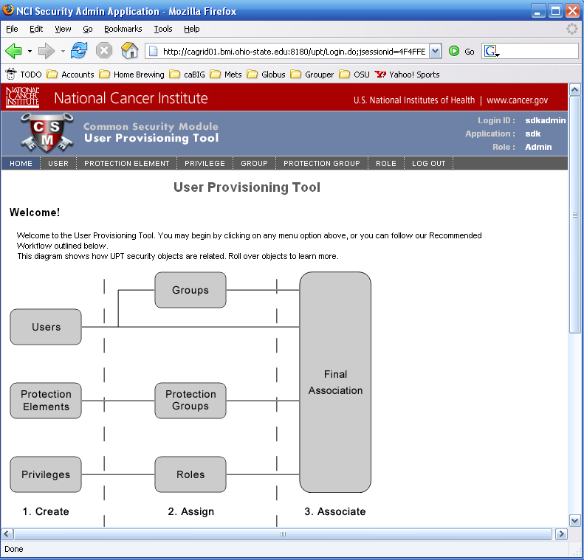
Authentication and Authorization in caCORE
Common Security Module (CSM)
  Authentication – Username/Password Based
    Integrated with existing credential providers LDAP, Relational Database Management Systems etc
  Authorization – Provides a mechanism for creating, managing, and enforcing access control policies within an application.

Slide 6


Integrating caCORE Applications to the Grid
Basic Security Integration Goals
  Goal 1 - “Gridified caCORE Applications” must be able to authenticate users based on grid credentials.
  Goal 2 - Existing access control policies must be enforceable in the grid.
  There are more…………
Infrastructure
  Dorian (Goal 1)
    Grid User Account Management
    Integration point between external security domains and the grid.
    Enables federation of existing identities to the grid.
  Grid Grouping Architecture / Grid Grouper (Goal 2)

Slide 7
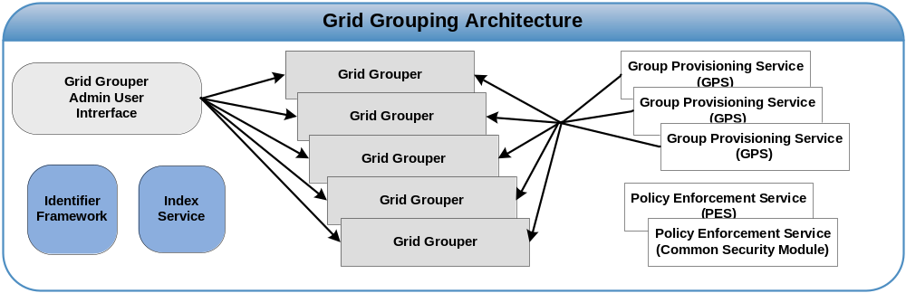
Grid Grouping Architecture
Grid Grouper
  Grid Service for creating and managing groups at the grid level.
  Services and Applications enforce access control policies based on membership to groups existing in a Grid Grouper.
  Grid Grouper provides a public API for determining a user’s membership in a group and for group discovery.
  Grid Grouper provides an administrative API for creating, removing, and administering groups.
Grid Grouper Admin UI
  Administrative UI for administering groups in Grid Grouper.

Slide 8
Grid Grouping Architecture
Group Provisioning Service (GPS)
  Provides a mechanism for autonomously managing groups within Grid Grouper
  For example an instance of a Grid Grouper may use attributes defined in federation for adding and removing users from groups.
Policy Enforcement Service (PES)
  Provides the ability to centrally create and enforce access control policies based on membership in groups defined in a Grid Grouper
  This is not a requirement, application can maintain and enforce local policies if they wish.
  e.g Common Security Module (CSM)

Slide 9
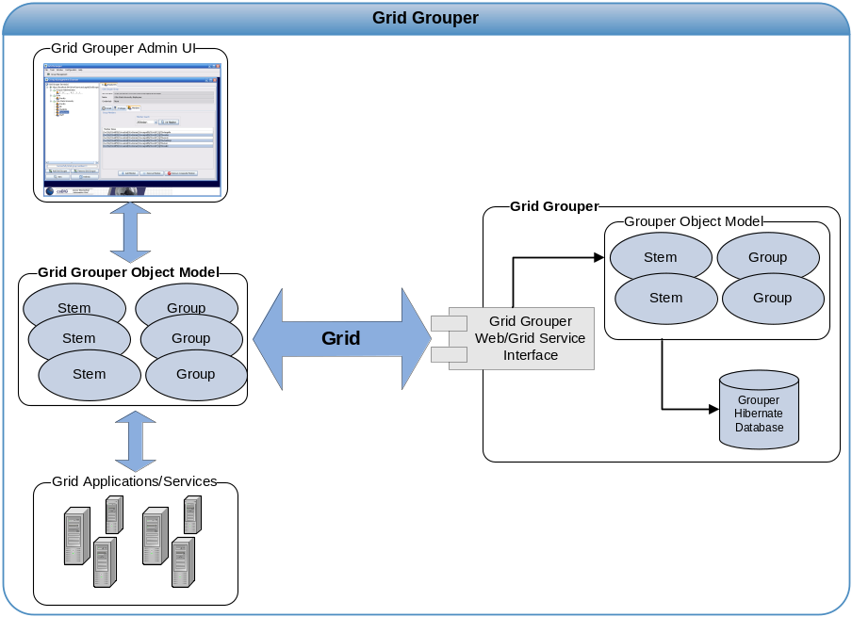
Grid Grouper
Grid Grouper grid enables Grouper
  WSRF Compliant Web Service
  Enables Grid access to Groups
  Allows management of Groups from the Grid
Grid Grouper Object Model
  Java API for accessing and managing groups over the grid.
  Similar to Grouper’s Object Model
  Applications/Service leverage Grid Grouper Object model in a similar fashion to leveraging the Grouper Object Model.
Grid Grouper Admin UI
  Graphical User Interface for accessing and administrating groups in Grid Grouper.

Slide 10
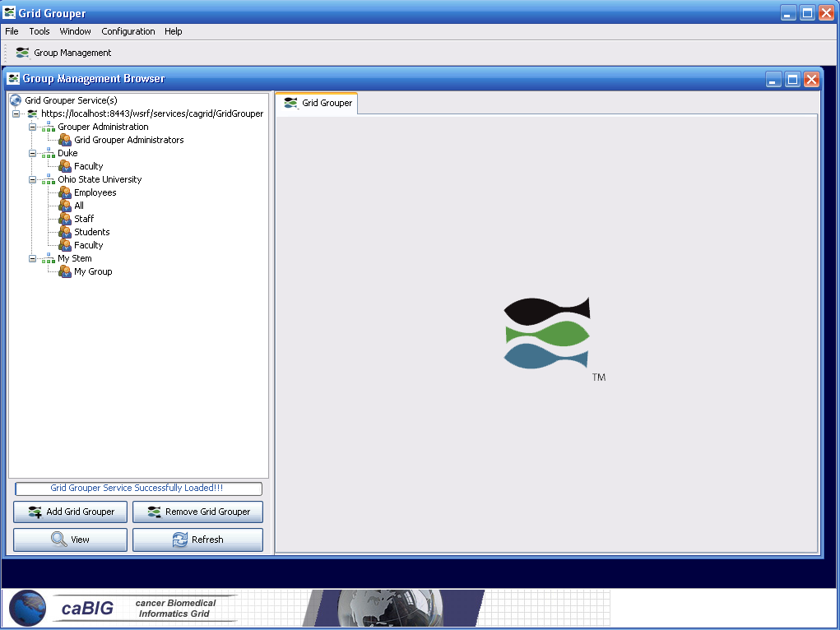
Grid Grouper Admin UI

Slide 11
Questions?

