Slide 1
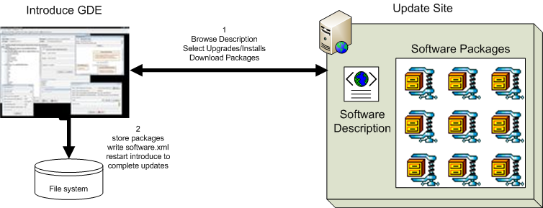
Introduce 1.1 Software Updater
New update support enables introduce to role updates out and move to newer versions of itself and it’s extensions.

Slide 2
Introduce 1.1 Service Migration
New Introduce Service Migration Framework enables introduce and it’s extensions to provide upgraders which can run against services built with older versions of introduce and/or it’s extensions and migrate the services forward.
  1.0 services and forward will now be able to be migrated to work with newer versions of introduce with very little effort on the developers part.

Slide 3
Introduce 1.1 Service Security
Now using Globus Policy Decision Point (PDP) based authorization.
  Introduce by default will generate the PDP authorization class from the requirements selected by the service creator using GridGrouper and/or CSM.
  Developer has the choice to use a custom PDP class which will enable them to create custom authorization login and use other external attribute or group authorities.
  Much more flexible and actually enables authorization policy to be applied to imported operations which 1.0 did not as well as directly to dynamically created resources.

Slide 4
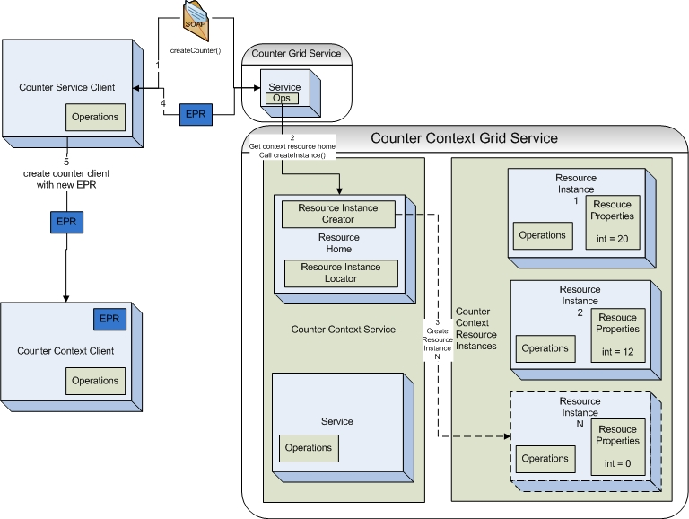
Introduce 1.1 Service Resource Contexts
Enhanced Resource Pattern Support
  now supports automated code generation of resource creation.
  Many bug fixes to support dynamic factory patterns to be created for creating and managing resources.

Slide 5
Introduce 1.1 Service Documentation
Introduce now enables descriptions and or comments to be added to virtually every aspect of the service.
  Descriptions are used to comment the generated API and to describe better the service metadata.

