Slide 1
Identifier Services Framework
Architecture/Design Overview,
First Results & Next Steps
caBIG Architecture/Vocabularies and Common Data Elements Workspaces
Ohio State University - July 12-14, 2006
Frank Siebenlist - franks@mcs.anl.gov

Slide 2
caGrid’s Identifiers - Content
Identifier Service Framework Intro
GGF’s ID&EPR resolution requirements
GGF’s WS-Naming Specifications
Handle System Leverage
caBIO Integration effort
Next Steps
Acknowledgements

Slide 3
caGrid’s Identifier Services Framework
Identifier
  “Naming” of individual Data-Objects
  Globally Unique Name for each Data-Object
Services
  Create/modify/delete name-object bindings
  Resolve name to data-object
Framework
  Provide for Trust Fabric => Binding Integrity
  Policy-driven Administration => Curator Model
  Fully Integrated with caGrid’s Architecture and Implementation

Slide 4
Why (Standardized) Data-Object Identifiers?
Efficiency
  Passing by reference vs by value
  (Data-Object can be many Mbytes)
  Data-Object Equality test through String comparison
  (inequality test is no requirement…)
Consistency
  Standardized way of referencing objects
  Standard identifier => data-object resolution mechanism
  Meta-data binding to standard object reference
  Well-known primary/foreign key for (distributed) JOINs
  Name for policy expression for data-object access
  Name for audit entries about data-object related activities
  …
  Possible correlation of all of the above…

Slide 5
Data-Object Identifier Properties
Identifier is a String
Identifier is a forever globally unique name for single Data-Object
Identifier can be (globally) resolved to associated Data-Object
Data-Objects are immutable, almost immutable or mutable…
Identifier value “meaningless” opaque string for consumer
Resolution information embedded in Identifier Name
  Only meaningful for resolution service related components
Identifier is a Universal Resource Identifier (URI)
URI-schema will be made completely transparent from Identifier producing applications and consumers.
  ”bigid:” - at least until we have learned more about its usage…
  (… and to avoid distracting schema-choice discussions)

Slide 6
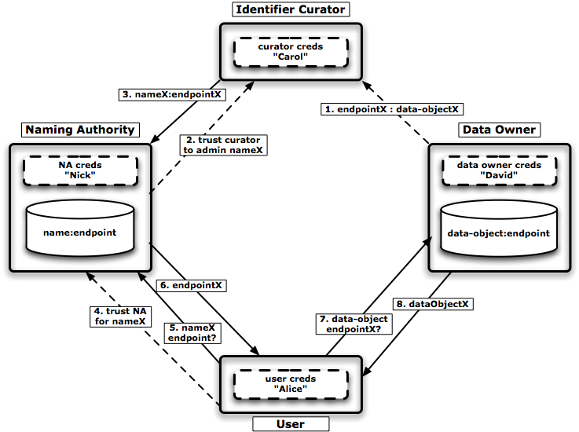
Identifier Usage Model

Slide 7
Naming Authority, Identifier Curator,
Data Owner and Identifier User
Naming Authority (NA)
  Guards integrity of identifier namespace & bindings
  Maintains identifier to data-object’s endpoint mapping
  Conceptually equivalent to caDSR…
Identifier Curator/Administrator
  Understands semantics/access of data owner’s objects
  Trusted by NA to administer binding for certain identifiers
  Administers identifier to data-object’s endpoint binding
Data Owner
  Provides access to data-objects through “endpoint-references”
Identifier User/Consumer
  Trusts an NA for certain identifier bindings
  Uses 2-step resolution to obtain data-object
  (identifier => endpoint => data-object)
  (In-)Directly trusts Data Owner for data-object integrity

Slide 8
Identifier Services Framework Requirements
Fully integrate with caGrid Architecture and Implementation
WS-Interface specifications and implementations:
  Naming Authority, Identifier Curator and Data Owner Services
In practice, co-location option of Curator/Data- or NA/Curator/Data Services makes sense
  Java APIs to accommodate co-located functionality
Abstract as much as possible of framework intrinsics, resolution, and naming schema from identifier producers and consumers
  Ideally it should be a transparent infrastructure service
Support (secure) Data-Object migration, replication, caching…
  All requirements for truly distributed deployment
Solid Trust Fabric for Identifier Administration and Resolution
  Success stands or falls with integrity of the underlying framework…
Leverage existing Identifier framework implementation
  where possible and where it makes sense (Handle System, LSID)

Slide 9
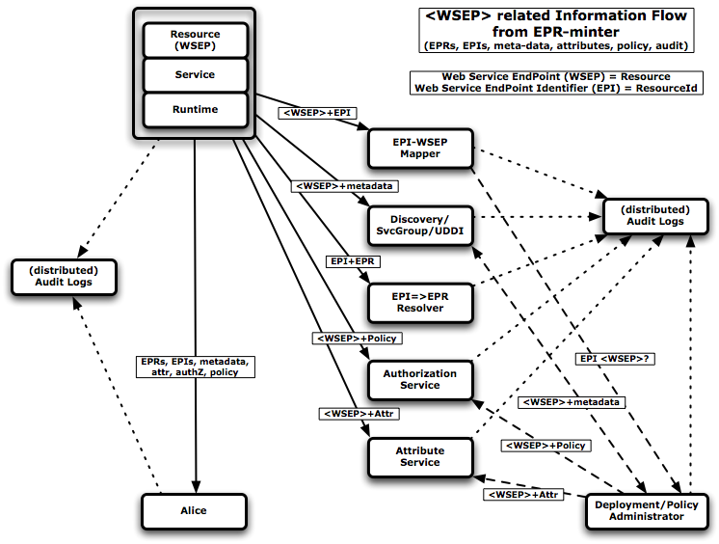
GGF&OGSA’s WS-Naming Requirements
EPR Minter & Endpoint Identifiers
Notes:
This slides shows that GGF’s OGSA has identified a requirement for globally unique identifiers for resources.
In other words, the EPRs are not enough and URI-based identifiers are needed to bind policy, location, EPRs, attributes, audit, etc.
These requirements are very similar to caBIG’s, but come from a different angle.
We first show in Figure 1 the information flows that may occur when an EPR-minter or WSEP-owner creates a WSEP (resource) or has to issue a new EPR for an existing resource. We show the actual resource as being hosted and front-ended by a service and runtime component. Many service implementations have this clear separation, which allows much of the policy to be enforced inside of the runtime, transparently from the application-level components that manage the resource-specific code and state. Furthermore, the message is dispatched at various levels. The EPR-minter component itself could reside in the runtime, service or application level, depending on the implementation and tooling. The EPR-minter has a clear notion of the resource and the program structure, which is used to construct an EPR with the correct dispatch information such that messages created according to that recipe are routed to the right state and code.
Information about the new resource’s WSEP and/or updated EPR may need to be communicated to different parties, including one or more of each of the following:
Direct consumer(s) (aka Alice). A client may obtain information about the new resource directly or via a discovery service. In subsequent steps, we will examine the information flows that occur when a client first discovers and then invokes operations on the new endpoint.
EPI→EPR resolver service(s). A resource may migrate, in which case its EPR becomes invalid. A resolver service addresses this problem by allowing for the registration of an EPR associated with an EPI. The EPI can then be used to refer to the WSEP, and be resolved to an EPR when communication with the WSEP is needed.
EPI→WSEP mapping service(s). There may, in some cases, be more than one identifier for an endpoint, and thus there is a need to maintain the mapping of all the identifiers that are associated with the same endpoint. A mapping service allows for the registration of such associations; it can then answer to questions concerning whether or not identifiers refer to the same endpoint.
Discovery service(s). A range of discovery-like services may exist that allow resources to be registered, along with metadata, and then allow references to those resources to be obtained through a reverse lookup.
Authorization service(s). The EPR-minter may dynamically administer the applicable access control policy rules to allow certain clients access to its new resource.
Authorization assertions. The EPR-minter may annotate the resource by dynamically managing applicable attribute bindings with attribute services.
We also see in the figure that each party may maintain its own audit log concerning this and subsequent interactions; all such logs will refer to the same WSEP.
Lastly, Figure 1 identifies a Deployment/Policy Administrator, who is responsible for assigning attributes to the resource, for managing access control policy rules associated with that resource, and for annotating the resource with metadata for discovery. Note that any or all of those operations may require log entries for audit purposes.

Slide 10
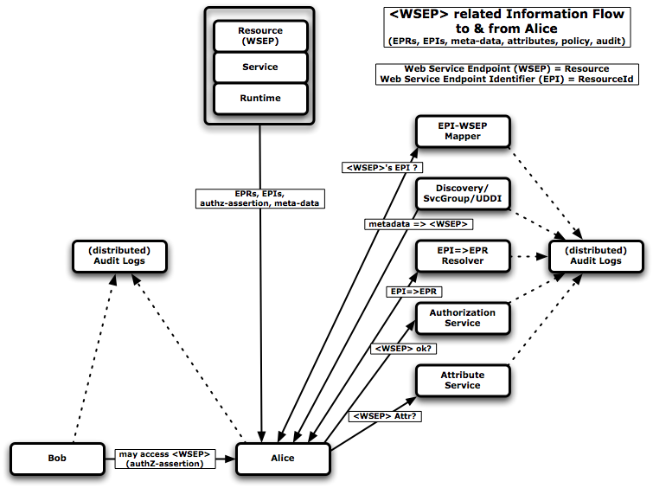
GGF&OGSA’s WS-Naming Requirements
EPR & Identifier Consumer
Notes:
Figure 2 illustrates the information flows that occur when Alice as a consumer determines whether to access the WSEP. We see:
Direct consumer interaction (aka Alice). A client may obtain information about the new resource directly from the EPR-minter possibly through some factory or search application pattern. The Service may have annotated the EPR with metadata, or such policy information may be communicated through separate assertions. In all cases, those claims should clearly pertain to the endpoint in question
Discovery service(s). The client may obtain a reference or identifier for the resource through a discovery service interaction. Depending on the retruned endpoint information an additional resolution step may be required.
EPI→EPR resolver service(s). When the client has received the endpoint information as an identifier, then an additional resolution step is required to obtain the EPR needed for message construction and delivery.
EPI→WSEP mapping service(s). If the client obtains endpoint annotations that use different identifiers for the same resource, then it may need a mapping service to federate the different claims.
Attribute services(s). The client may need to obtain attribute information associated with the endpoint to evaluate the policy decisions and matching criteria.
Authorization service(s). The client may need to consult the authorization services that maintain the client-domain’s access policy to determine whether interaction with that resource is allowed.
Authorization assertions. A third party, Bob, provides Alice with an authorization assertion indicating that Alice may access the specified WSEP (UC: Assertion Target).
Again, we also see in the figure that each party may maintain its own audit log concerning this and subsequent interactions; all such logs will refer to the same WSEP.

Slide 11
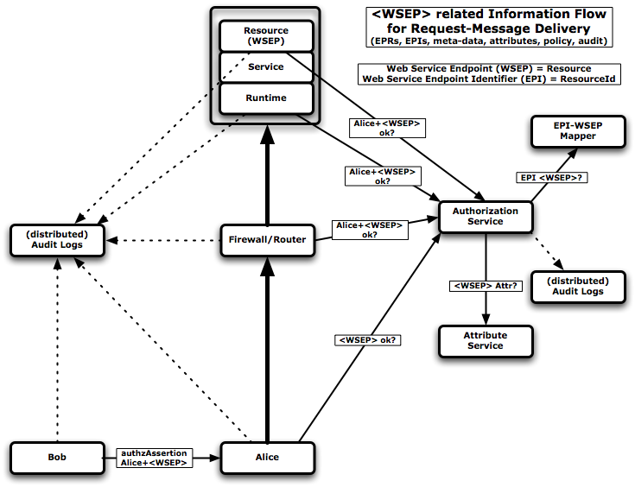
GGF&OGSA’s WS-Naming Requirements
EPR, EPI and Message
Notes:
Finally, Figure 3 illustrates the information flows that may occur when the client, Alice, dispatches a request to the resource. We see the following steps:
Client authorization. Alice (perhaps armed with an authorization assertion from Bob) dispatches the request.
Intermediate policy enforcement. This request is intercepted by a firewall or router, which consults an authorization service to determine whether Alice is allowed to access the specified WSEP.
Container-level authorization. Assuming successful authorization at the firewall, the request is forwarded to the relevant Web Service container, which itself may consult an authorization service to determine whether the incoming request is authorized.
Application-level authorization. Assuming successful container-level authorization, the request is dispatched to the resource, which itself may consult an authorization service to perform a further authorization check.
Attribute service(s). At any step, an authorization service may consult with attribute service(s) to determine properties of the WSEP.
Mapping service(s). At any step, when the endpoint identifiers used in the message, policy rules or attribute bindings are different, a mapping service can be used to federate the claims.
As before, audit log entries may be generated by the various components involved (UC: Audit Label).

Slide 12
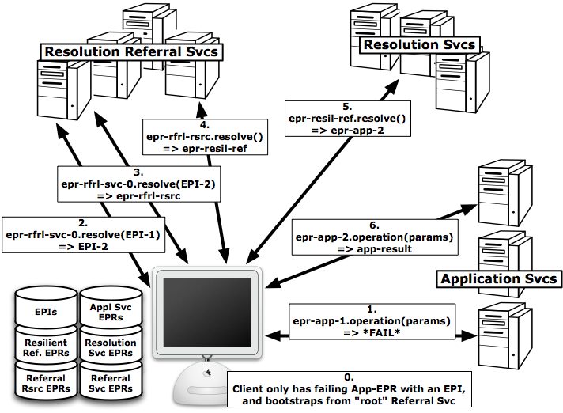
GGF’s WS-Naming Requirements
EPR Resolution Svcs (all)

Slide 13
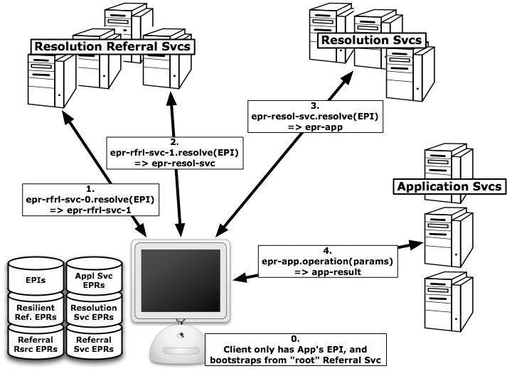
GGF’s WS-Naming Requirements
EPR Resolution Svcs (from EndPoint Identifier)

Slide 14
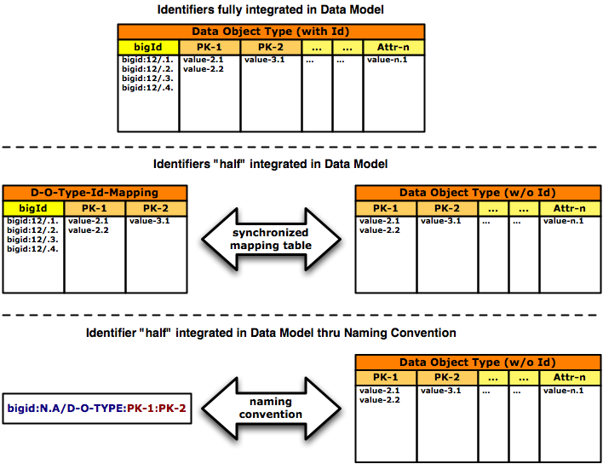
Identifier & Data Object Model

Slide 15
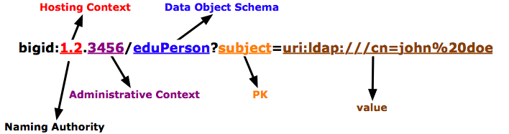
caBIG-IRI Naming Convention
Or a “random” suffix without semantics:
bigid://1.2.2456/MRTU4PDCC4HC6MQ4WSEZ2WZOARVRKPEM
Identifiers are opaque to applications - they shouldn’t care!!!
(implementation choice based on deployment considerations)

Slide 16
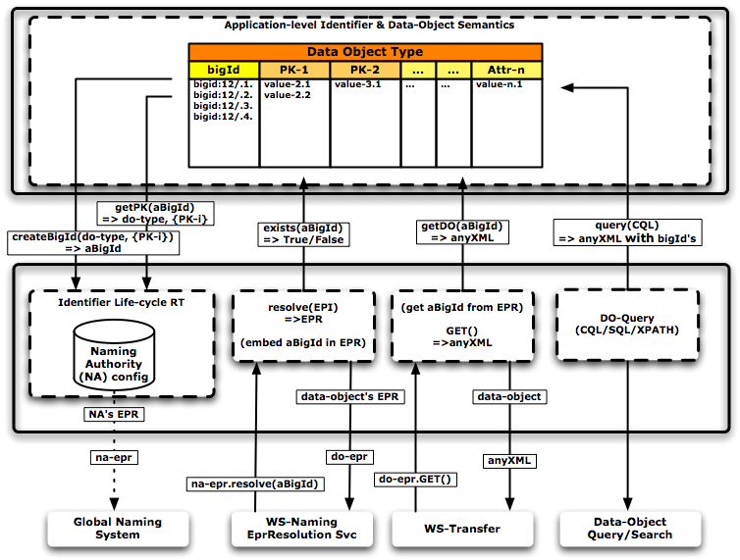
Identifier & Data-Service

Slide 17
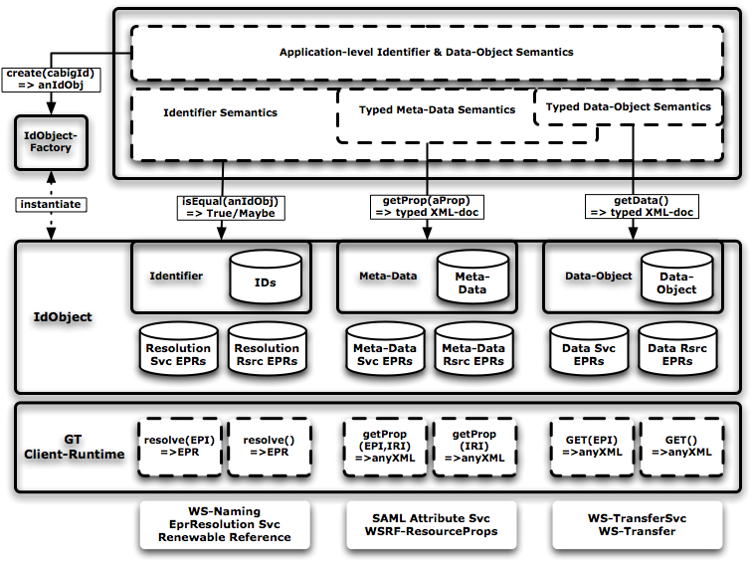
Identifier Consumer

Slide 18
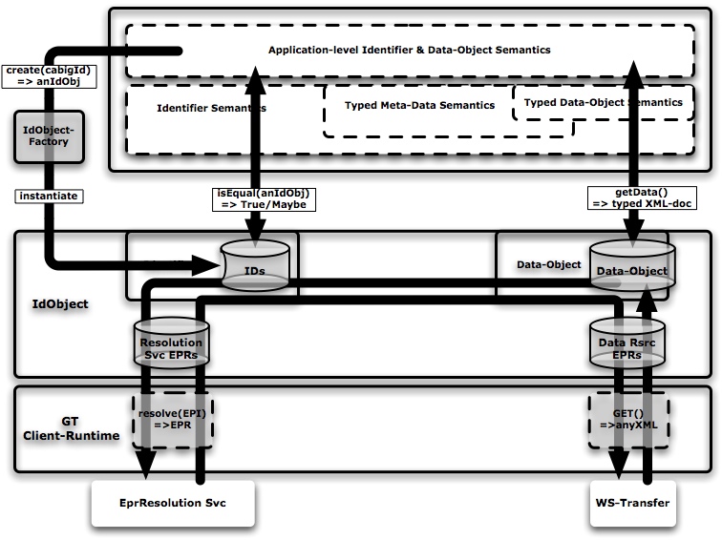
Identifier Consumer First Step

Slide 19
Data Object Versioning…
Complicated…
Should it be reflected in the Identifier?
NO
Versioning should be part of Data Modeling
  “version” part of primary key
  Use cases determine how the versions are used
  Consumer needs interfaces to reflect usage
    Hide consumer from implementation

Slide 20
Handle System Integration
CNRI’s Handle System leveraged for the following:
  Global name prefix assignment
  (similar to dns-ip-name/ip-address registration)
  Global resolution infrastructure
  (how to find the resolution svcs)
  Identifier’s meta-data repository
  (context, identification, creation, …, type, etc.)
  Integrated security model
  (trust fabric for Naming Authorities, ACL-based admin)
  The open source Handle server code is enhanced to accommodate pluggable co-location with DataSvc
  (caBIO has >200million data-objects regenerated every 2 weeks…)

Slide 21
caBIO & Identifiers Requirements (1)
caBIO creates/regenerates 20-200 million data-object every 2 weeks
  data used from many different sources
  24 hour regeneration process
Every (re-)generated data-object should be (re-)assigned an identifier
  Without affecting the regeneration process “too much”
Same regenerated data-object should be assigned the same identifier as before
  Requires us to bind some data-object identification to the identifier to match-up regenerated data-objects with their previously assigned IDs

Slide 22
caBIO & Identifiers Requirements (2)
Anticipate that over their life-time, some data-objects will move to other servers
  To different administrative domain or organization
  Most probably based on “type” or ownership of data-objects
Some data-objects will not be regenerated
  End of their life-cycle…
  But associated identifiers will live forever
Existing caBIO query tools should work as before
  But researcher should be able to query specifically for the identifiers
Given a identifier, a caGrid-client should be able to resolve this ID to the associated data-object
  Global resolution
  Transparent, simple retrieval mechanism

Slide 23
caBIO & Identifiers Implementation (1)
Identifiers part of the data-object’s data-model
  Full-fledged attribute with standard name/type
  Existing query tools continue to work
Application must specify a “data object context”
  Needed at identifier creation time
  administrative “grouping” of IDs for potential moving of data-objects
Applications must specify “data-object identification info”
  Needed at identifier creation time
  Allows IdSvc-runtime to reassign same ID to same data-object
Given a identifier, application can ask for associated “data object context” and “data-object identification info”
  Helper function to aide application to locate associated data-object

Slide 24
caBIO & Identifiers Implementation (2)
Identifier Service Naming Authority co-located
  Co-located in same JVM & uses same (Oracle) database for ID metadata
  Essential to meet the performance goal of not affecting the re-generation process “too much”
WS-Naming resolution service implementation
  Allows clients to “find” the data-objects through an identifier
  Based on “emerging” GGF WS-Naming specification
WS-Transfer GET implementation
  Simple data-object retrieval mechanism
  Based on “emerging” W3C WS-Transfer specification
Resolution and transfer services implemented through caCore SDK
  Essentially proxied to the caBIO application
Lightweight registration/call-back pattern used between (caBIO-)application and resolution/transfer implementation
  Minimizes dependencies and improves modularity

Slide 25
caBIO & Identifiers Integration Results
Small part of caBIO application has been modified to create IDs
  Data-model has been extended for Gene Domain Object
  IdSvc interfaces used to create/get IDs
  Resolution/transfer functions implemented
Identifier were created and added to caBIO’s database tables
Client resolved data-objects through the identifiers
(results were achieved last Monday&Tuesday…)

Slide 26
caBIO & Identifiers Integration Next Steps
caBIO-IdSvc Implementation Guide
Identification of all the unique keys in each of the caBIO data tables
Improving performance of identifier creation
Deployment/packaging of the grid identifier framework
Improving of JavaDocs and development guide
Global referral/resolution protocol implementation & standardization
  Not fully implemented yet
  GGF is looking at this caBIG effort for “guidance”

Slide 27
Identifier Service’s Next Victim: Workflow
Addresses the use case where the Naming Authority is not co-located with the data-objects
  More “conventional” usage pattern
Requires webservices interface for identifier creation
Requires webservice administrative interface for identifier-location binding
Requires access/admin policy enforcement
  Co-location made this easy
caBIO and Workflow are expected to provide the basic usage patterns for most of caBIG’s Identifier deployment

Slide 28
Identifier Services Framework: Next Steps
High Level Architecture and Design Document (80%)
Implementation Design Document - (in progress)
Implementation of WS-Applications, Java APIs & Libraries (80%)
Documentation & Tutorials (in progress)
caBIO Integration
  Taking it from prototype to complete integration by 1Q07
Workflow Integration
  Much “easier” than caBIO from engineering point of view
  Should be able to use IdSvc facilities by Sep/Oct

Slide 29
Acknowledgements (non-complete…)
Rachana Ananthakrishnan and Raj Kettimuthu from ANL for the resolution/transfer services
Lars Olson (UIUC/CNRI) and Sam Sun (CNRI) for the identifier service runtime components
George Komatsoulis, Doug Mason, Manav Kher, Vinay Kumar, and the rest of the caBIO team for the integration work
Our caGrid colleagues for advise and suggestions
Avinash and Arumani for keeping us on-track…
Finally… Scott Oster for giving this presentation!
(and note that we only just started ;-) )

