Slide 1
Results of caGRID Interviews on Usage and Usability in January 2009
February 3, 2009
Marguerite Autry
Celeste Lyn Paul
Erin Nomiyama
mautry@user-centereddesign.com
cpaul@user-centereddesign.com
enomiyama@user-centereddesign.com
(703) 729-0998
User-Centered Design • www.user-centereddesign.com

Slide 2
Overview
User-Centered Design (UCD) conducted a series of 11 interviews with 13 caGRID Portal users
This briefing covers findings and recommendations from these interviews
Each interview involved a UCD human factors engineer and a UCD designer who took notes
User-Centered Design • www.user-centereddesign.com

Slide 3
Information about the Interviews
  Participants
    Total of 13 individuals from a variety of research organizations were involved in 11 interviews (one participant asked two colleagues to join him). Using a caGRID-based categorization:
      6 were considered Deployment Leads
      3 were workspace participants (one had a Deployment Lead and a System Analyst in a trio for the interview)‏
      1 each was identified as an NCI employee and as a “pundit”
  Interview format
    Conducted remotely using a conference call-in number and conferencing software
    Covered what participants do on the site
      Participants talked through their typical actions while facilitator mirrored the described actions on the site
      Participants used the conferencing tool and facilitator and observer watched the actions
    Lasted approximately 40 minutes each
  Data collected
    Participant comments and behavior
User-Centered Design • www.user-centereddesign.com

Slide 4
Results Summary
Participants who used the site to verify that their service was up and functioning correctly were very pleased with it.
Those who were thinking beyond IT needs (including Deployment Leads)
  Agreed that the site worked well for verifying that their services were up and functioning correctly
  Felt the site is difficult to know and understand—even for most IT folks
    Locating the correct Service if it was not their own
    Running queries (especially federated ones involving more than one site)
  Were aware that the site (and grid) had not yet matured enough to provide a way for researchers to share resources
    High learning curve
    Non-intuitive interface
    Language and organization is IT based, not in the “plain language” of science
User-Centered Design • www.user-centereddesign.com

Slide 5
Issues about the Portal Overall
User-Centered Design • www.user-centereddesign.com

Slide 6
Typical Concerns
Most interviewees used the site infrequently. Rationales included
  Difficult to use because of the high learning curve
  Little to do on the site (so far)
  Queries can be run more easily on other or associated sites
  Site is extremely slow
Many interviewees had no training on the site and had learned by trial and error
  Some felt training would be helpful (or at least someone showing them the ropes once)‏
  Others wanted documentation
    It was not clear if they were aware of the caGRID Portal Users Guide.
User-Centered Design • www.user-centereddesign.com

Slide 7
Other Concerns
Many clicks are needed to get to important information
Design seems to assume users know the caBIG structure
Desire for less scattered information about caBIG, caGRID, etc.
  Communication found in listserv, gForge, Portal, website, wiki
  Message doesn’t seem to be coherent or perhaps information is just not maintained
Desire for an easier transition between caDSR and caGRID
User-Centered Design • www.user-centereddesign.com

Slide 8
Possible Modifications for Consideration
Consider promoting and otherwise “advertising” the availability of the Guide
Consider requesting feedback on the Guide
  Modifications might better address users’ need for help
Consider making training (for caGRID Portal and caBIG) available to those who want it
  One interviewee indicated that he trained new users—perhaps this capability simply needs to be advertised‏
Consider providing a link to the caBIG documentation which describes the relationship between all of the tools
Consider creating a diagram to show the relationship between a user and caBIG, caGRID, the caGRID portal, caDSR, and all the ca-“Services”
Consider ways of optimizing the system to increase speed
User-Centered Design • www.user-centereddesign.com

Slide 9
Services: Finding and Using
User-Centered Design • www.user-centereddesign.com

Slide 10
Users Use “Services”
Most interviewees (both IT folks and Deployment Leads) primarily used the service to determine that their own service was up and performing satisfactorily
  Typically used
    Just after deployment
    When an error is reported
  Viewed as an aid for doing QA on a service and thus was greatly appreciated
  These users were pleased with the Service Diagnostics area (it was new to some)‏
User-Centered Design • www.user-centereddesign.com

Slide 11
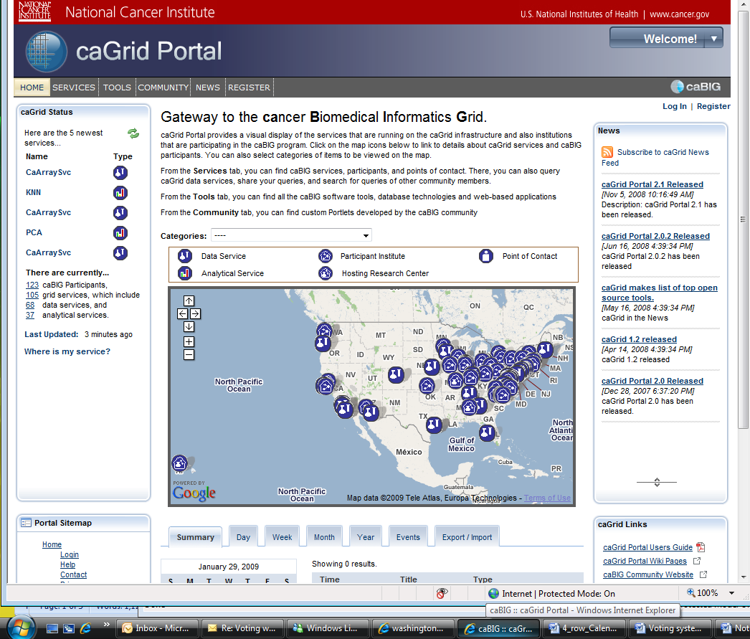
Home Page Map for Finding Services
Many used the map on the Homepage to find information about other Services
  Many felt the map was easy to use
  Some thought the concentration of symbols on the map made it difficult to use
  Some saw the map as “simply” PR
User-Centered Design • www.user-centereddesign.com

Slide 12
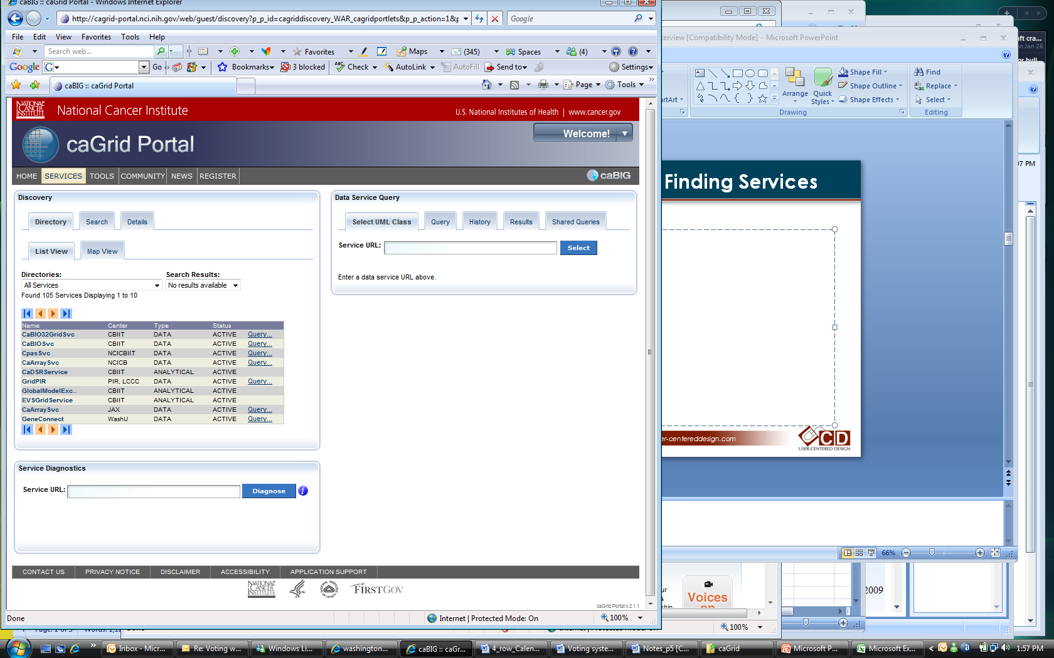
Services Tab: Discovery-Finding Services
Services List
User-Centered Design • www.user-centereddesign.com

Slide 13
Directory List for Finding Services
Interviewees were disgruntled with the atypical, hard-to-use Services listing
  A Service’s position in the services list is based on unclear rationale.
  The listing doesn’t sort by column selection.
  As a user pages through the listing, the site’s refresh is very slow.
  Users had difficulty determining “which listing is which” from the metadata available under the Center label.
User-Centered Design • www.user-centereddesign.com

Slide 14
Metadata in Directory Listing
“Center” metadata is not standardized despite being critical to locating a service. Entries may include:
  A department where the service is provided
  A university
  An institution
  All Center entries seem to be acronyms or abbreviations
The Directory pull-down listing on the Services page is confusing.
  Users want to limit the number of search results
  Some users are unaware that on the selection pull down list only listings from the Services and its subcategories (not Participants or POCs) will provide a URL for a Services query
  Although this pull-down is similar to the Categories pull-down on the Home page, here there is no way to limit the number of Service entities. (On the Home page, the number of services can be limited by physically changing the map’s focus –by moving in closer or by moving to the east, or west, etc.)‏
User-Centered Design • www.user-centereddesign.com

Slide 15
Missing from the Services Area
Interviewees indicated that they felt certain data was missing from the Services listing
  What data is in the service?
  What are the size and names of their data ?
  What kind of data is there? (any real data?)‏
  What are the size and names of the projects?
Interviewees wanted a way to determine why a Service wasn’t available.
User-Centered Design • www.user-centereddesign.com

Slide 16
Possible Modifications for Consideration
Consider providing further subcategories to the Services listing so users can limit the number of results. (For example, list only the caArray Service providers)
Consider reformatting the table listing the Services so that it can be sorted, typically by selecting a column to serve as the criterion
Consider optimizing for faster load times
Consider increasing the number of entities displayed on each page within the Service listing to allow users to get through all the information more quickly.
Consider displaying more complete and more accurate metadata on the Services listing—especially in the Center column. If necessary, gather metadata from each institution again and insist that they follow specific guidelines for consistency.
User-Centered Design • www.user-centereddesign.com

Slide 17
Use of Search
User-Centered Design • www.user-centereddesign.com

Slide 18
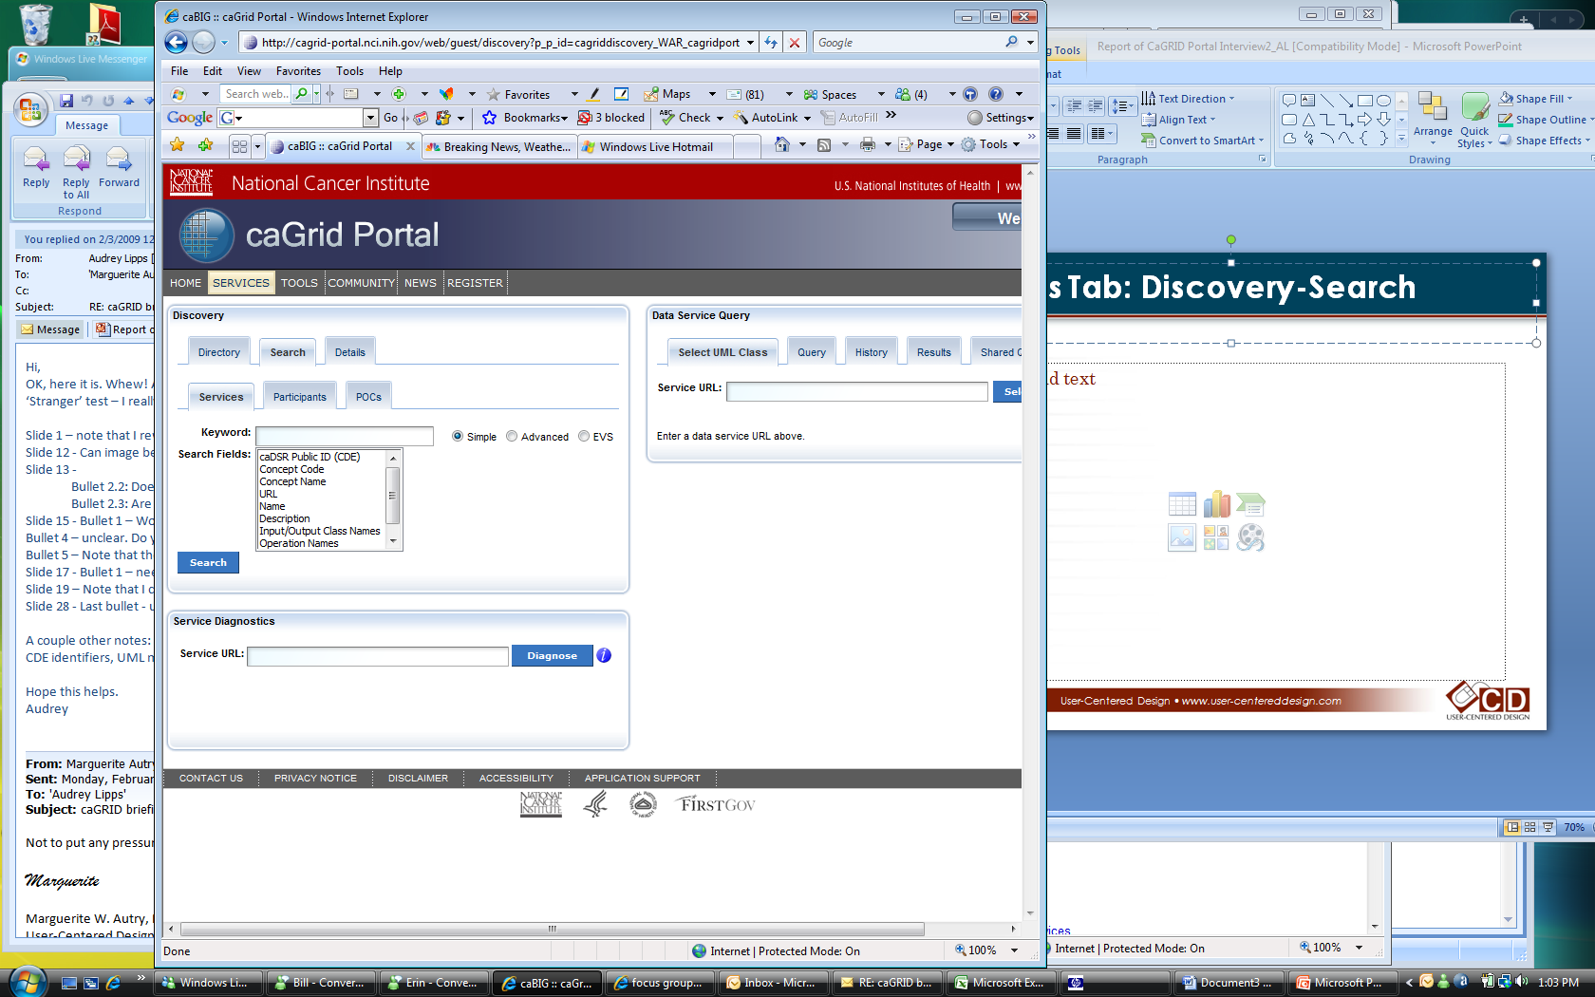
Services Tab: Discovery-Search
Search
Keyword
Search Fields
User-Centered Design • www.user-centereddesign.com

Slide 19
Interviewees Used and Discussed Search
The relationship between the Search Keywords and the various Search Fields was not clear
  How to use EVS terminology (Enterprise Vocabulary Servies)
Concern was expressed for non-technical or inexperienced technical users who might need to understand the differences between the variable names in the Search Fields (e.g., Concept Code, Concept Name, Name)‏
Consider providing a simple prepackaged search in which users need only adjust one variable (i.e., for the most used Search Field)
User-Centered Design • www.user-centereddesign.com

Slide 20
Queries
User-Centered Design • www.user-centereddesign.com

Slide 21
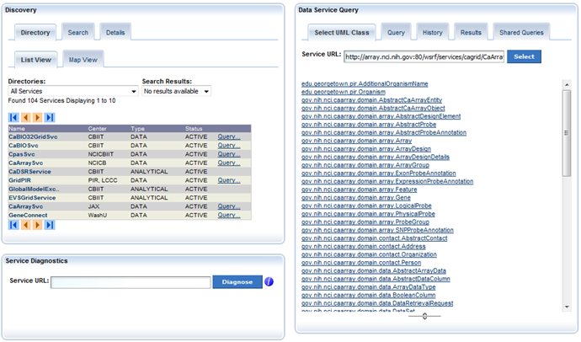
Services Tab: Query Results
User-Centered Design • www.user-centereddesign.com

Slide 22
Queries Considered Central to Site
Current implementation of the Query is thought to be designed for IT use
  The default query (how many in the database) is useful to IT in determining that the service is working correctly
  Terminology is IT based
However, users wanted to use the Query for federated queries
  These queries are difficult to run because
    User (rather than the portal) must determine other services to list and it’s difficult to find appropriate listings
    Frequently the process times out
    Error listings are not understood
  For pragmatic reasons, many users felt limited to running simple (i.e., narrow) queries on the portal
User-Centered Design • www.user-centereddesign.com

Slide 23
Problems for IT Users
Not even all IT folks can use the Query system
  Knowledge of the UML (Unified Modeling Language) model is needed
  Not intuitive for many
Not obvious “what to do next” when a query completes
Strange that the user must select from drop down after a query completes—instead expect to have results
Results should be a list of obvious joint points instead of an extensive listing of cryptic variable names (Service names can be cryptic too)‏
  Display needs to show the relationship between entities (e.g., gene and protein)—either visually or graphically
  Needs to use standard EVS vocabulary and unique CDE (common data elements) identifiers
User-Centered Design • www.user-centereddesign.com

Slide 24
Queries and Workflows Made Available
Multiple requests were made for canned or saved queries (and Searches)‏
  Queries that have been previously used can be documented, advertised, and reviewed
  Queries can be re-used by others
Requests were made for users to have the ability to compose workflows between services
  Used workflows could be stored for others to see and use
User-Centered Design • www.user-centereddesign.com

Slide 25
Queries Seem Challenging for Others’ Use
Most other users are thought to be “scientists,” but IRB members, regulatory boards, and technicians might also have a use for queries (“Scientist” is used as a convenient shorthand for this group.)‏
Present implementation is not intuitive for scientists
Scientists would need training to use it and most have neither the time nor the desire for “training”
  Not presently meeting a scientist’s need to find something specific, e.g., How to find braca1?
    Plain language query needed for scientists
  Scientists would also benefit from a query that is geared to a domain (tissue, specimen, etc.)
  Scientists might not want to learn to use the tool or write their own queries
Present Query implementation seems like the “advanced” version
  This version is needed within the portal, but not as the face of the portal query
User-Centered Design • www.user-centereddesign.com

Slide 26
Several Recommended Tools
Interviewees indicated they knew of tools that had functionality or ideas that might serve well as a model for caGRID purposes
  Saverna grid (My Grid) - a portal engine from the UK
  The CDE browser
  The LSD browser (Life Services Distribution) which is in plain language: what organism, what cancer type, what information wanted (tissue, data, clinical trials)‏
  caBench-to-Bedside (caB2B) although not web based, has a more intuitive interface for scientists
Interviewees recommended a “Quick Guide” for the steps needed to get to and use the Query capability.
  A capability to move a URL from the left area of Discovery to the right area for the Query without using cut and paste would be appreciated.
User-Centered Design • www.user-centereddesign.com

Slide 27
Possible Modifications for Consideration
Create a library of queries
Create a library of workflows
Create a wizard for query generation
Create “canned” natural language queries for scientists. All the variables would be available in pull down lists so that the correct names are given.
  For example: How many [type specimen] of [type organism] of [type cancer] are available and where are they?
If redesigning, consider using the tools that these caGRID Portal users suggested as models for caGRID purposes
Consider these easy fixes
  Create a “Quick Guide to Queries”
  Move URL’s on the Services page from the left Search area to the right query area [It was noted 2/2/09 that this capability had been added.]
User-Centered Design • www.user-centereddesign.com

Slide 28
Other Tabs: Tools, Community, News, Register
User-Centered Design • www.user-centereddesign.com

Slide 29
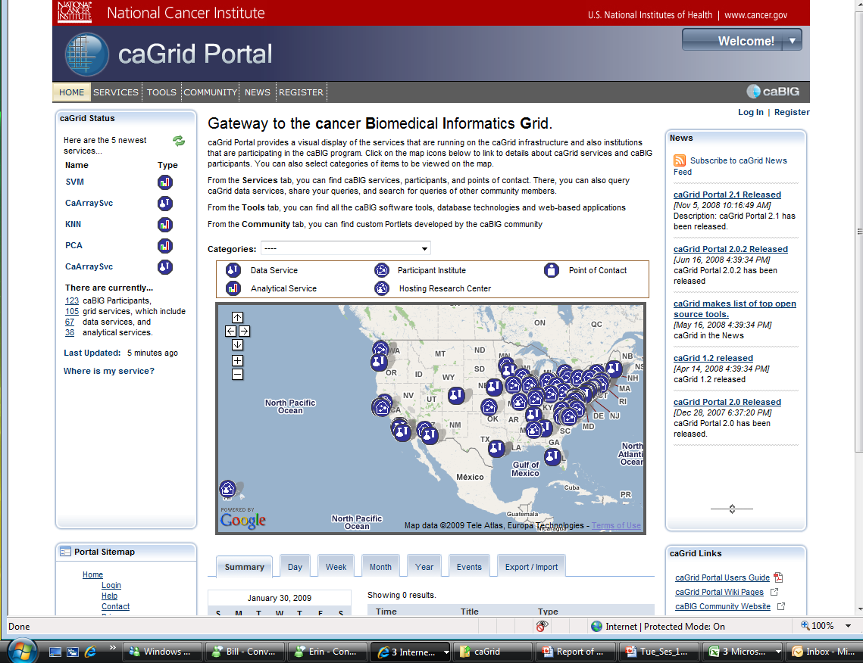
Tabs on caGRID Portal
Tabs:
  Home
  Services
  Tools
  Community
  News
  Register
User-Centered Design • www.user-centereddesign.com

Slide 30
Responses from Interviewees about Tools
Few interviewees used the information on the Tools tab
  Information in Tools is static information
  Details of information seems the same as that found on caBIG
  Names of Service providers would be helpful on the Tools page
  A connection from Services on the map (and possibly from the Service Directory listing too) to the tool used would be helpful
User-Centered Design • www.user-centereddesign.com

Slide 31
Other Tabs
Names of some tabs were thought by interviewees to be non-intuitive. Few, if any, had read the descriptions of the tabs on the home page.
  The first two tabs, Services and Tools, are standard for those within the caBIG community but need to be explained to new comers.
  The contents of the Community tab will probably be overlooked. Generally, this term indicates a forum or discussion area. Therefore users do not expect this area on the caGRID Portal to be for custom Portlets developed by the caBIG community.
  No one interviewed used the News area. One interviewee said that he got news related to caBIG from other sources.
  There were no issues associated with the Register page or with the process of registration.
User-Centered Design • www.user-centereddesign.com

Slide 32
Possible Modifications for Consideration
Consider providing links from the services on the map and in the services listing to the tool described.
Consider updating the tools information to include providers.
Consider renaming the Community tab to a more descriptive, less confusing title. Perhaps “New Portlets,” if its purpose will remain the same.
Since the only material presently in the News area is also on the Home page as News, consider
  Removing the News tab
  Alternatively, providing a link to the caBIG related news page
User-Centered Design • www.user-centereddesign.com

Slide 33
Purpose of caGRID Portal
User-Centered Design • www.user-centereddesign.com

Slide 34
Understanding of the Portal’s Purpose
Interviewees understood that the purpose of the portal was to put scientific data onto the grid so that it could be used by others. Benefits include
  Reducing the latency in data dissemination by using the grid
  Sharing information between similar projects
Presently, the portal seems geared toward use by computer technical folks but it was felt that the eventual use was to be by the scientific community.
  Presently also used for QA by programmers
  Concern by Deployment Leads about the lack of accommodation for scientists
Desire to eventually run tools through the Portal
User-Centered Design • www.user-centereddesign.com

Slide 35
Purpose of a Deployment Lead
One Deployment Lead explained his role relative to caGRID portal as a salesman.
  He needs to sell the idea to scientists at his institution that they should put their data on caGRID for use by others
    This is worthwhile because by allowing their data to be used by others, they would have access to much more data than they can generate locally. Thus, they could advance science and their own work.
    However, right now all he can use is the idea, because presently the caGRID portal has nothing to show that makes sense to the scientists.
      Needs a plain language interface (in scientific plain language), etc.
An associated situation: These Deployment Leads know that many scientists have concerns about data security. Although the data is theoretically secure, they seem to want assurance that an appropriate level of authorization has been verified for those using the data.
User-Centered Design • www.user-centereddesign.com

Slide 36
Next Steps
caGRID portal stakeholders and UCD will decide how to move on the recommendations presented on slides 8, 16, 19, 27, and 32.
User-Centered Design • www.user-centereddesign.com

