Slide 1
caGrid Security Overview
The Trust Fabric
caGrid Knowledge Center
knowledge@osu-citih.org
May 20, 2010

Slide 2
Topics
The Challenge
Trust Fabric Overview
GTS, Dorian, and SyncGTS
Training Grid Trust Fabric Configuration
Authentication Process
Grid of Grids

Slide 3
The Challenge
To facilitate secure access to distributed biomedical resources that are owned by multiple institutions
A number of problems naturally occur in this scenario
  The need to establish trust among parties that are sharing sensitive information, including PHI
  The need to actively manage the set of institutions that are able to share data, especially in the event of a security breach
  The need to use existing institutional authentication systems in a federated manner
  The need to vary access to data according to the sensitivity of that data
  The need to provide accounts for users not affiliated with a participating institution

Slide 4
Topics
The Challenge
Trust Fabric Overview
GTS, Dorian, and SyncGTS
Training Grid Trust Fabric Configuration
Authentication Process
Grid of Grids

Slide 5
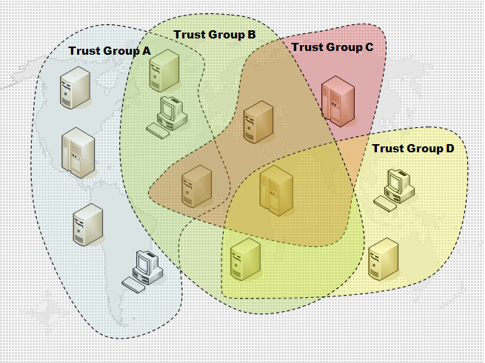
caGrid Trust Fabric Overview (1)
What is the Grid Trust Fabric?
A conceptual view of the arrangement of mutual trust among users and services in a trust group.

Slide 6
caGrid Trust Fabric Overview (2)
How is this implemented?
  The trust fabric is established for a trust group by first agreeing upon a set of trusted certificate authorities and arranging them according to established levels of assurance. After this foundational step, three caGrid services are utilized in concert to create the trust fabric.
  GTS maintains the master list of trusted Certificate Authorities and CRLs for various levels of assurance.
  SyncGTS is a Grid service that is deployed by the caGrid installer to a chosen grid service container. The service periodically synchronizes with a target GTS service.
  Dorian manages user accounts and authenticates users, federates institutional identities to the Grid, and issues user and host certificates via a built-in CA.

Slide 7
Topics
The Challenge
Trust Fabric Overview
GTS, Dorian, and SyncGTS
Training Grid Trust Fabric Configuration
Authentication Process
Grid of Grids

Slide 8
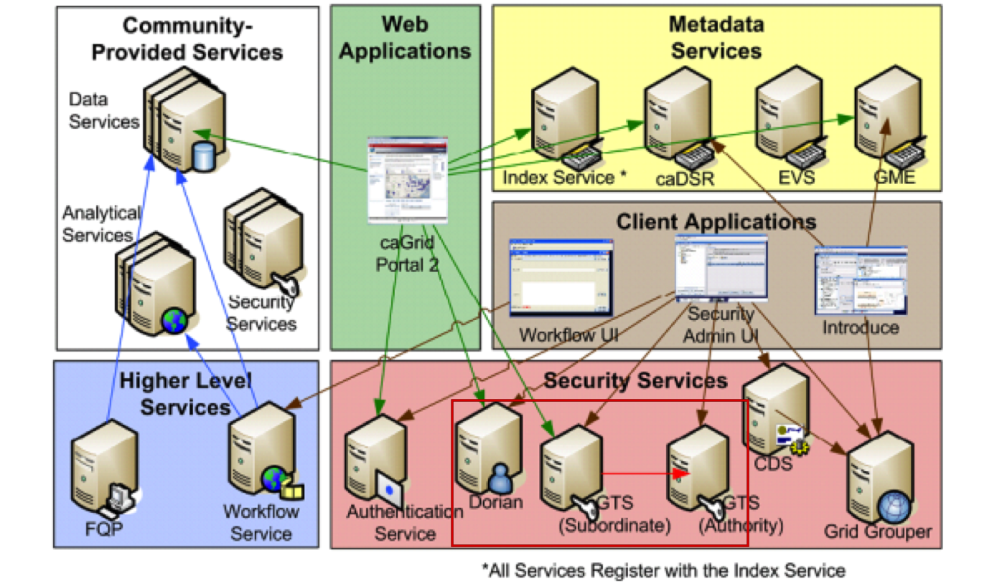
GTS, Dorian, and SyncGTS

Slide 9
GTS Details
The Grid Trust Service (GTS) is a caGrid service enabling the provisioning and management of a grid trust fabric. The features of the GTS can be summarized as follows:
It provides a complete Grid enabled federated solution for registering and managing trusted certificate authorities and their certificate revocation lists (CRLs).
It allows the definition and management of levels of assurance, allowing Grid administrators to group CAs appropriately into levels of assurance.
Supports retrieval of the current state of the trust fabric

Slide 10
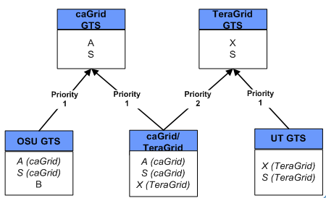
GTS Details (2)
GTS services can be federated or “chained” in a fashion that is similar to DNS on the Internet

Slide 11
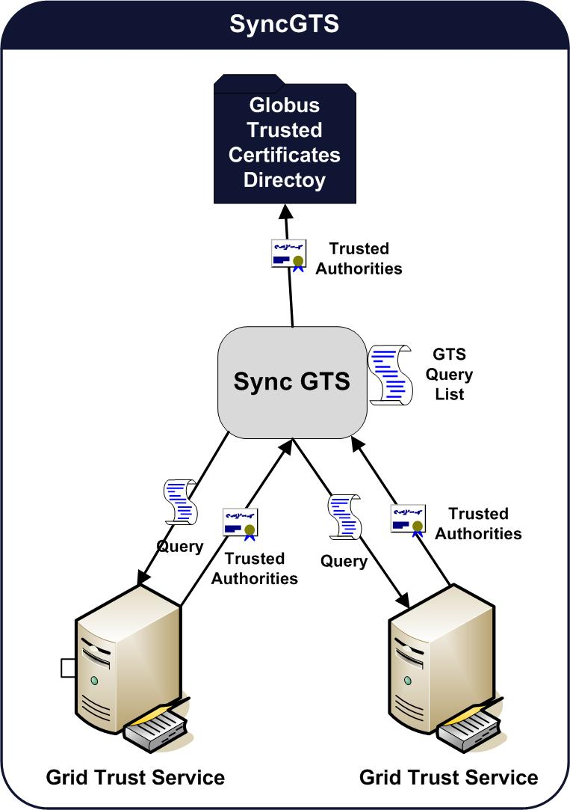
SyncGTS
The SyncGTS Service:
Is installed by the caGrid installer to every grid container.
Is responsible for keeping the local trust store for each client and service updated. Thus, every Grid node has an up-to-date view of the trust fabric, including a current list of trusted CAs and corresponding CRLs
The local trust store is the ~/.globus/certificates directory

Slide 12
Dorian
Identity Provider
  Creation and management of user accounts
  Issue Security Assertion Markup Language (SAML) Assertions as proof of authentication
  Certificate Authority to sign SAML Assertions
Identify Federation Service
  Manages trusted identity providers
  Manages Grid users
  Manages host certificates
  Issues Grid credentials (X.509 Certificates)
  Manages internal Dorian groups (i.e., Dorian administrators)

Slide 13
Topics
The Challenge
Trust Fabric Overview
GTS, Dorian, and SyncGTS
Training Grid Trust Fabric Configuration
Authentication Process
Grid of Grids

Slide 14
Training Grid Trust Fabric
The order of caGrid service installation displays the foundational nature of GTS and Dorian. The installation of these services is referred to as “bootstrapping” the grid trust fabric.
caGrid Install order:
Master GTS
Slave GTS
Dorian

Slide 15
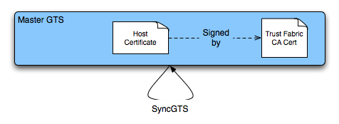
Master GTS Configuration
Master GTS:
The Trust Fabric Certificate Authority is created as one of the first steps of the grid installation.
The master GTS uses a host certificate signed by the Trust Fabric CA.
Is installed to a secure grid container.
Is installed with SyncGTS configured to sync with itself.

Slide 16
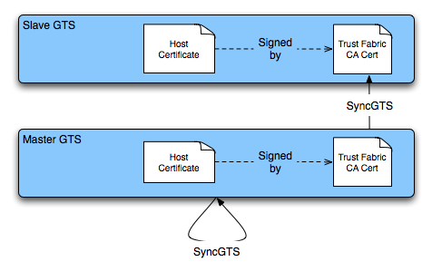
Slave GTS Configuration
Slave GTS:
Has a host certificate signed by the Trust Fabric CA.
Is installed to a secure grid container.
Is installed with SyncGTS configured to sync with Master GTS.

Slide 17
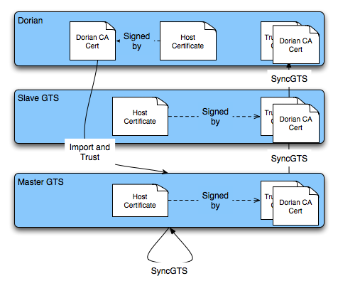
Dorian Configuration
Has a built-in Certificate Authority.
Has a host certificate signed by the built-in CA.
Is installed to a secure grid container.
Is installed with SyncGTS configured to sync with Slave GTS.
Dorian CA Certificate is added to GTS.

Slide 18
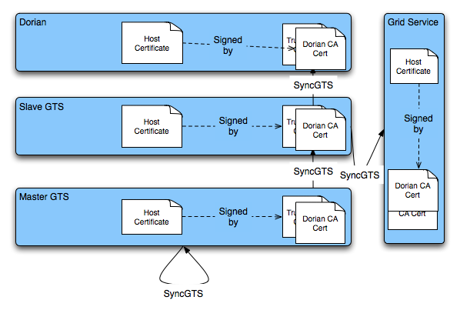
Grid Service

Slide 19
Grid Certificate Info
Host Certificate signed by Training Dorian:
Subject : O=caBIG,OU=caGrid,OU=Training,OU=Services,CN=Fuji
Issuer: O=caBIG,OU=caGrid,OU=Training,CN=caGrid Training CA
start date: Thu Sep 10 15:29:18 EDT 2009
end date: Wed Sep 10 15:29:18 EDT 2014
User Certificate signed by Dorian:
Subject : O=caBIG,OU=caGrid,OU=Training,OU=Dorian,CN=wistephens
Issuer : O=caBIG,OU=caGrid,OU=Training,CN=caGrid Training CA
start date : Tue May 18 22:45:40 EDT 2010
end date : Wed May 19 10:45:50 EDT 2010
* Viewed using $GLOBUS_LOCATION/bin/grid-cert-info

Slide 20
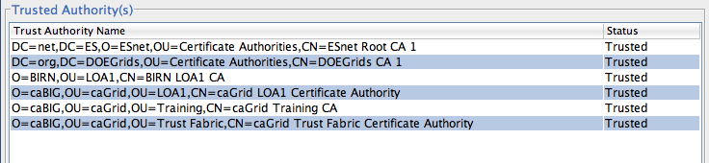
Training Trust Fabric
The Training Grid trust fabric currently contains several Certificate Authorities:
The Training Grid GTS CA and Dorian CA
caBIG Production Dorian CA
Biomedical Informatics Research Network (BIRN)
Department of Energy
  DOEGrids
  Energy Science Network (ESNet)

Slide 21
Topics
The Challenge
Trust Fabric Overview
GTS, Dorian, and SyncGTS
Training Grid Trust Fabric Configuration
Authentication Process
Grid of Grids

Slide 22
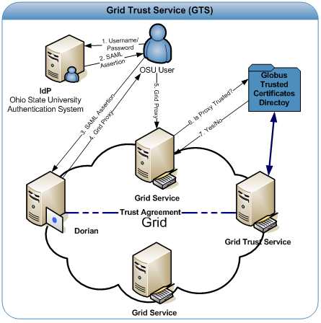
Authentication Process

Slide 23
Topics
The Challenge
Trust Fabric Overview
GTS, Dorian, and SyncGTS
Training Grid Trust Fabric Configuration
Authentication Process
Grid of Grids

Slide 24
Grid of Grids
CVRG and caBIG Grid of Grids Purpose:
Provide caBIG users with the capabilities to invoke select CVRG Grid services.
Provide CVRG users with the capabilities to invoke select caBIG Grid services.
The caBIG and CVRG service authentication and authorization requirements will not be altered.
Implementation:
Installation of a Grid of Grids Master and Slave GTS
Grid of Grids Master GTS will have both the caBIG GTS and the CVRG GTS specified as trusted authorities.
Grid of Grids Slave GTS will distribute the caBIG and CVRG CA certificates.

Slide 25
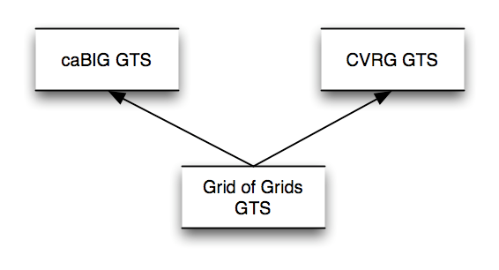
Grid of Grids

