Slide 1
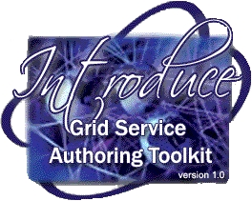
Introduce:
Grid Service Authoring Toolkit

Slide 2
Introduce Generated Service Features
Dynamic discovery and use of published data types
Creates WSDL2.0 / WSRF Compliant Services
Supports Creating Multiple Resource/Services using the WSRF
Globus GSI Security Configuration
Grid Map and GridGrouper Authorization Support
Resource Property Configuration and Index Service Registration
Rich extension/plug-in framework for creating custom services or adding custom functionality to Introduce
Features
Dynamic discovery and use of published data types
Creates WSDL2.0 / WSRF Compliant Services
Supports Creating Multiple Resource/Services using the WSRF
Globus GSI Security Configuration
Grid Map and GridGrouper Authorization Support
Resource Property Configuration and Index Service Registration
Rich extension/plug-in framework for creating custom services or adding custom functionality to Introduce
Features
Dynamic discovery and use of published data types
Creates WSDL2.0 / WSRF Compliant Services
Supports Creating Multiple Resource/Services using the WSRF
Globus GSI Security Configuration
Grid Map and GridGrouper Authorization Support
Resource Property Configuration and Index Service Registration
Rich extension/plug-in framework for creating custom services or adding custom functionality to Introduce
Features
Dynamic discovery and use of published data types
Creates WSDL2.0 / WSRF Compliant Services
Supports Creating Multiple Resource/Services using the WSRF
Globus GSI Security Configuration
Grid Map and GridGrouper Authorization Support
Resource Property Configuration and Index Service Registration
Rich extension/plug-in framework for creating custom services or adding custom functionality to Introduce
Features
Dynamic discovery and use of published data types
Creates WSDL2.0 / WSRF Compliant Services
Supports Creating Multiple Resource/Services using the WSRF
Globus GSI Security Configuration
Grid Map and GridGrouper Authorization Support
Resource Property Configuration and Index Service Registration
Rich extension/plug-in framework for creating custom services or adding custom functionality to Introduce

Slide 3
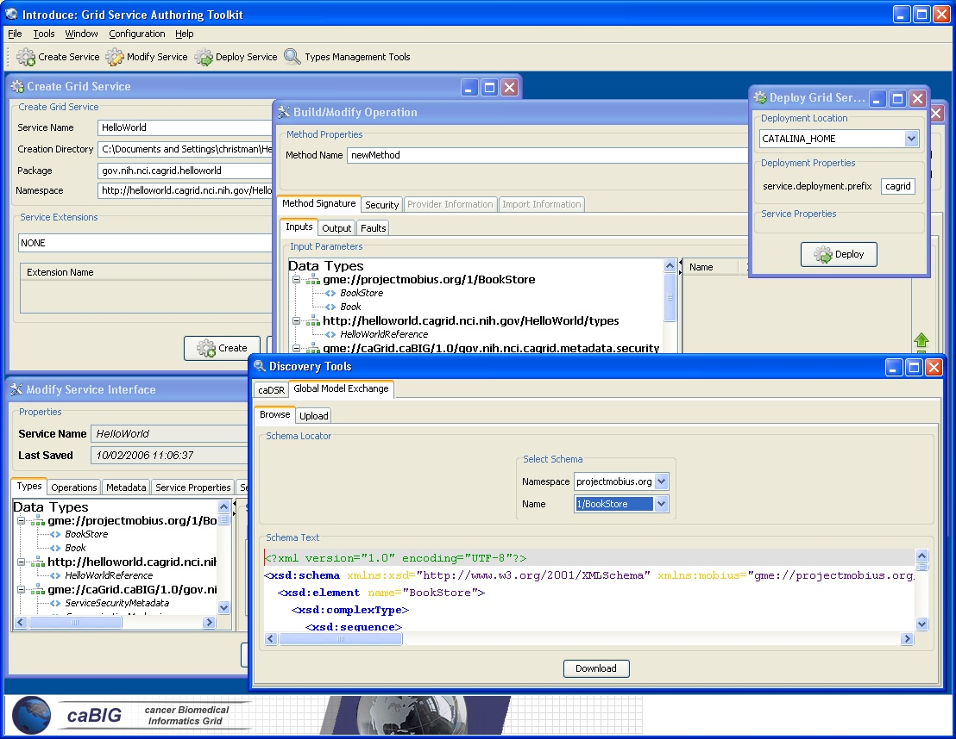
Introduce Graphical Authoring Environment

Slide 4
Introduce Toolkit Architecture
Service Model maintains the complete representation of the services, methods, resources, resource properties, data types, security configuration. Index service registration, etc.
Graphical Development Environment modifies service model and passes the modified model to the engine.
Introduce Engine re-syncs the service with changes with the modified model.
Use of Java Emitter Templates (JET) for creation and modification of source code and configuration files required in the service
Auto generation of unboxed complete client and stubbed service implementation.

Slide 5
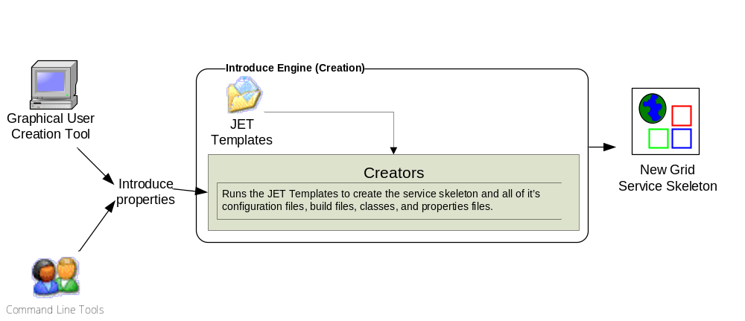
Introduce Service Creation Architecture
The Introduce Service Properties are a set if base properties
required for creating this service such as desired location to
create the service, namespace to use, package name to use,
and service name.

Slide 6
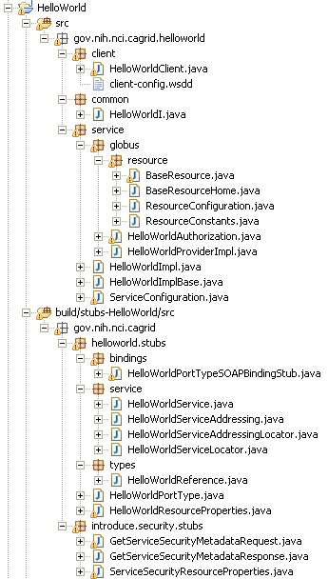
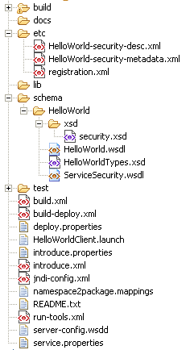
Generated Service Skeleton
= introduce generated
= globus/axis generated
= developers contribution

Slide 7
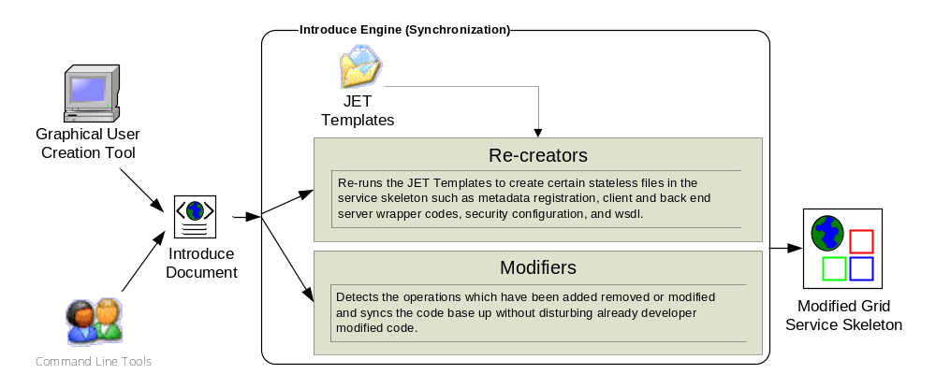
Introduce Service Modification Architecture
The Introduce Service Description document is the input
to the introduce engine. The user can hand craft this
document and call the engine via command line or API
or can use the Introduce GDE to modify this document
and execute the engine

