Slide 1
Service Development Tools to Support NCI CBIIT Localization of ISO 21090 Datatypes
Satish Patel
patelsat@mail.nih.gov

Slide 2
Introduction
Integrated Release of the Service Development Tools to Support the NCI CBIIT Localization of ISO 21090 Data Types
  Common library for NCI CBIIT localization of ISO 21090 datatypes (v2.1)
  caCORE SDK (v4.3)
  caCORE Workbench (v0.1.2)
  caAdapter MMS (v4.4)
  caGrid Introduce Toolkit (v1.3.0.2)

Slide 3
ISO 21090 Standard
According to the published international standard, ISO 21090
  provides data type definitions for representing and exchanging basic concepts that are commonly encountered in healthcare environments in support of information exchange in the healthcare environment, [and]
  specifies a collection of healthcare-related data types suitable for use in a number of health related information environments.

Slide 4
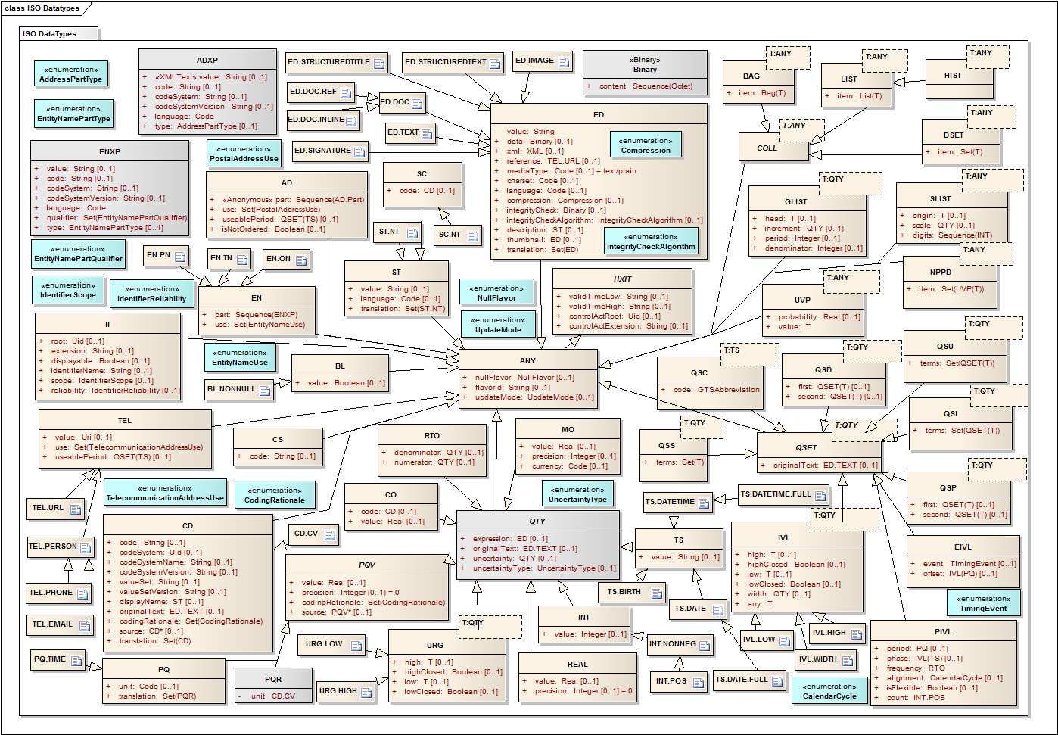

Slide 5
ISO Datatypes Categories
Basic Data Types – ANY, BL
Text And Binary Data Types – ED, ST, SC
Coded Data types (Terminology) – CD
Identification and Location Data Types – II, TEL
Name and Address Data Types – AD, EN
Quantity Data Types – QTY, PQ, TS, REAL
Collections Of Data Types – COLL, DSET
Continuous Set Data Types – QSET, IVL
Uncertainty Datatypes – UVP, NPDD, URG
Structured Text – StrucDoc.*

Slide 6
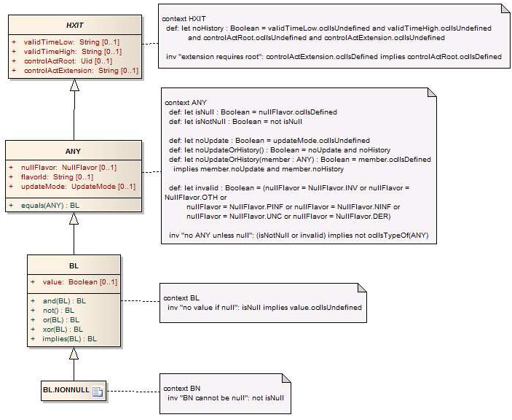

Slide 7
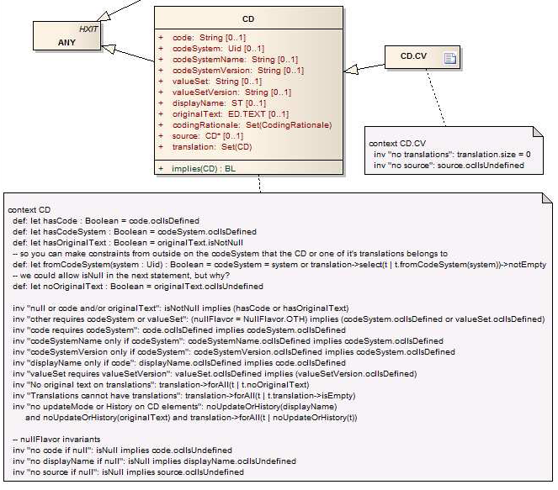

Slide 8
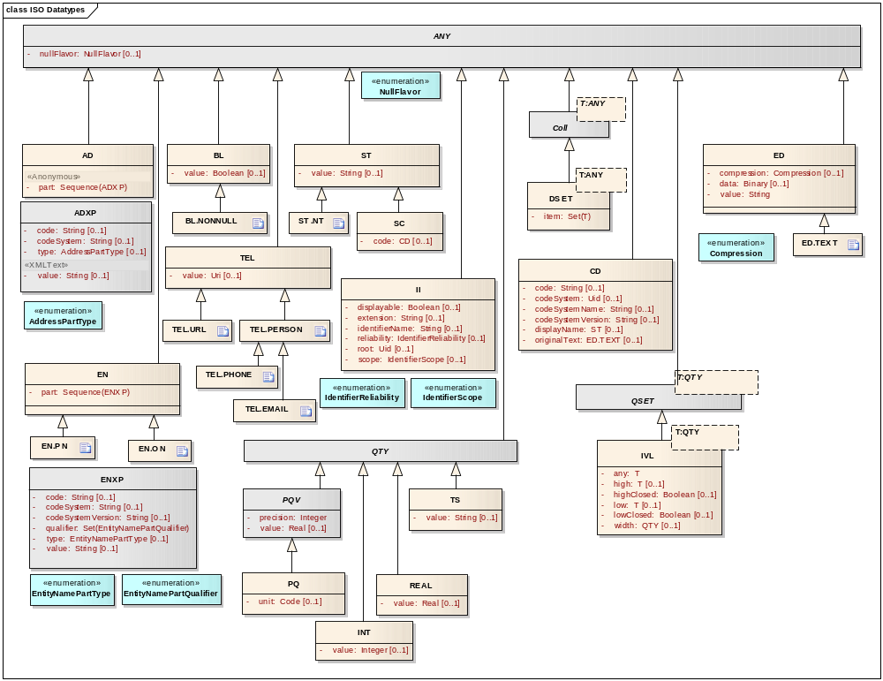
ISO 21090 Localization

Slide 9
ISO 21090 Localization
Specialized/constrained version of the ISO 21090 Data Types Standard
Relationship to the ISO Standard
  This version refers to ISO 21090 (2007-09-24)
  When a new version is available, conformance to the new version may be needed
Conformance and Compliance - Indirect Conformance
  Mappings between internal data types and the Standard
  Inward mapping, outward mapping, no mapping
  XML representation

Slide 10

NCI Localization –
Typical Application Architecture
XML
JAXB Java Representation
NCI Localized ISO 21090 Java Classes
Relational Database
JAXB
Transformers
Hibernate
Application developed by the end user exchanges information with the other application using ISO 21090 datatypes based XML messages
Internal to the application, the XML message is converted into JAXB representation which is then mapped to the NCI’s localized ISO 21090 Java classes using a set of custom transformers
Application can internally map these NCI’s localized ISO 21090 Java classes to the database using Hibernate framework

Slide 11
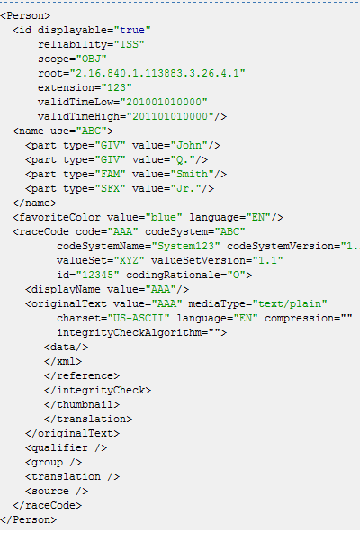
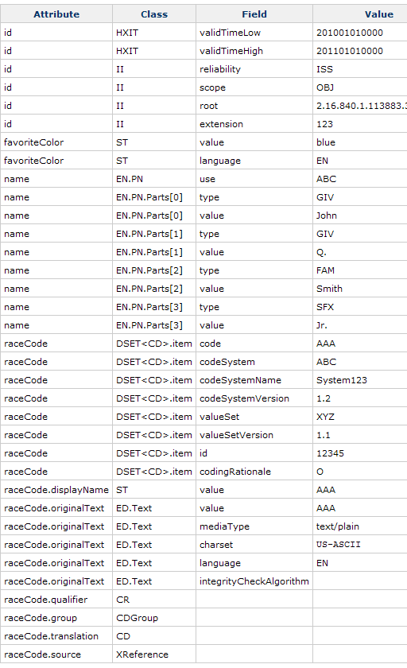
Incoming XML Representation
JAXB Representation

Slide 12
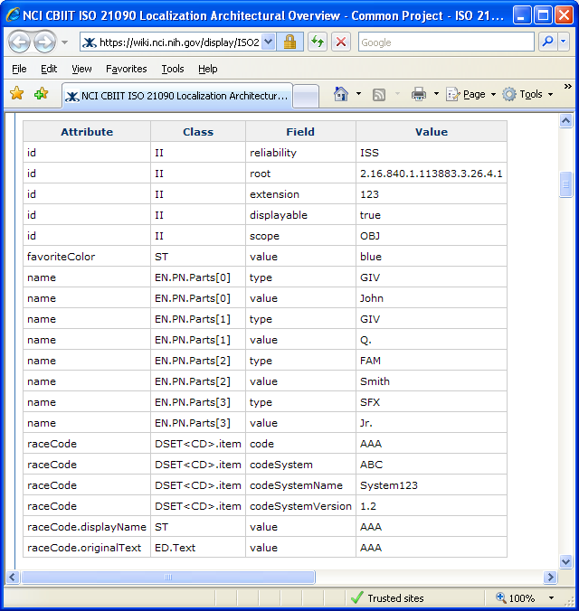
JAXB Representation
NCI Localization Representation

Slide 13
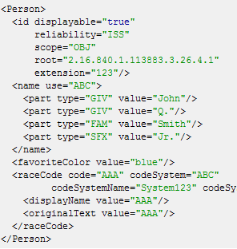
Outgoing XML Representation
JAXB/NCI Localization Representation

Slide 14
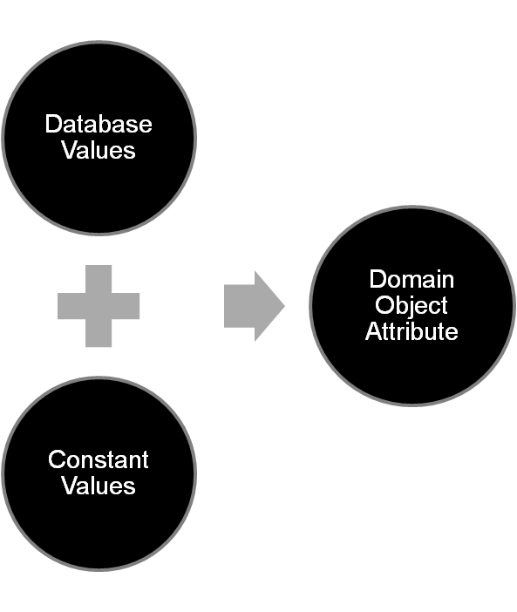
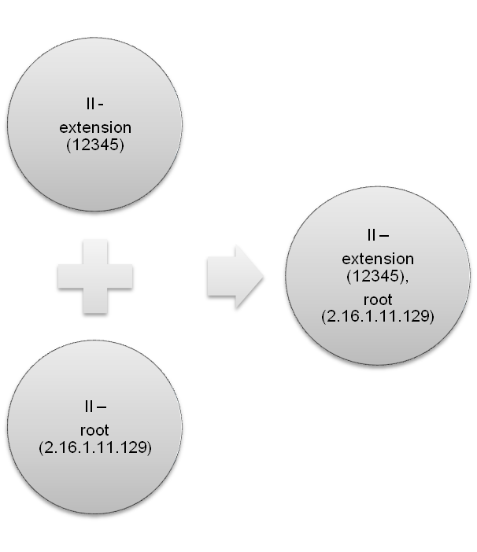
Constants Usage in
ISO 21090 Datatypes
Constant Binding Process
Constant Binding Example

Slide 15
ISO 21090 Localization Resources
NCI Localization List: https://wiki.nci.nih.gov/x/_5SPAQ
NCI Localization Architecture: https://wiki.nci.nih.gov/x/qjpyAQ
NCI Localization PIM: https://ncisvn.nci.nih.gov/WebSVN/filedetails.php?repname=ISO21090&path=%2Fbranches%2Fv2_1%2Fdocuments%2FPIM_21090.pdf

Slide 16
Service Development Tools
Analytical Service
  Introduce - Analytical service creation capabilities
Data Service
  Enterprise Architect/ArgoUML – UML Modeling capabilities
  caAdapter - Object model to data model mapping
  caCORE SDK - Code generator and caCORE-like middleware system
  Introduce – Data service creation capabilities
  CQL – Standard query language for data services

Slide 17
Service Development Tools Support
Overarching Goal
Provide tooling support for automated creation and deployment of services using ISO 21090 data types compliant with SAIF and ECCF to ease adoption of ISO 21090 data types
Short Term Goal
Provide support for NCI localizations of ISO 21090 data types in caCORE SDK, caAdapter, and Introduce for service creation and deployment on the caGrid Infrastructure

Slide 18



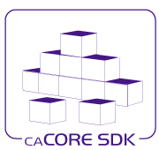

Service Development Tools:
Data Service

Slide 19
Major Enhancements in Data Service
UML Modeling
  Users can continue to use the primitive datatypes in the UML models in addition to the ISO 21090 datatypes
caAdapter MMS
  It recognizes the ISO 21090 datatypes and allows mapping them to the relational database
caCORE SDK
  Generates caCORE-like middleware system with the ISO 21090 datatypes
  Uses JAXB to manage XML serialization process
CQL
  Allows users to construct the queries for ISO 21090 datatype enabled data service

Slide 20
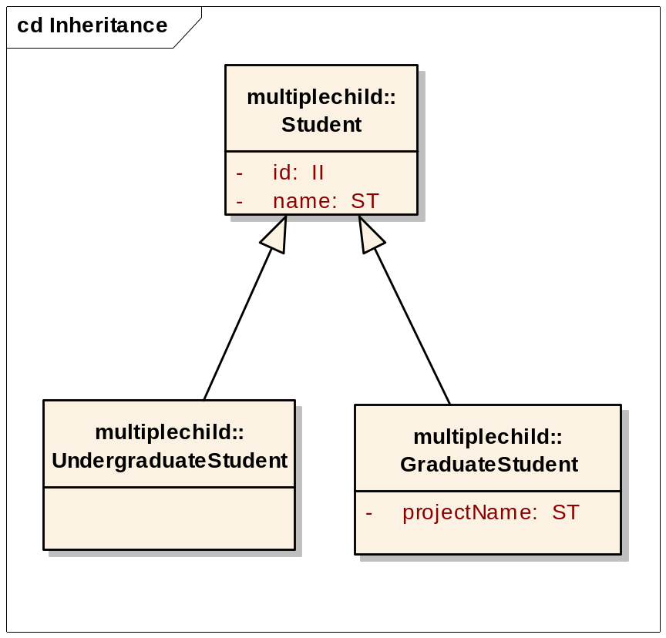
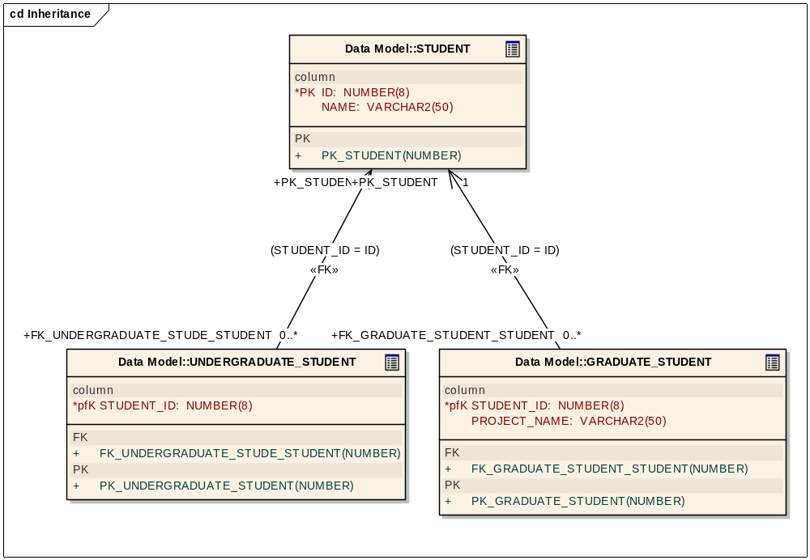
UML Modeling (EA or ArgoUML)

Slide 21
Model Mapping (caAdapter)
Input – XMI file with Object Model and Data Model
Process – Annotate XMI file with the Model Mapping information needed by the caCORE SDK
Output – Annotated XMI file

Slide 22
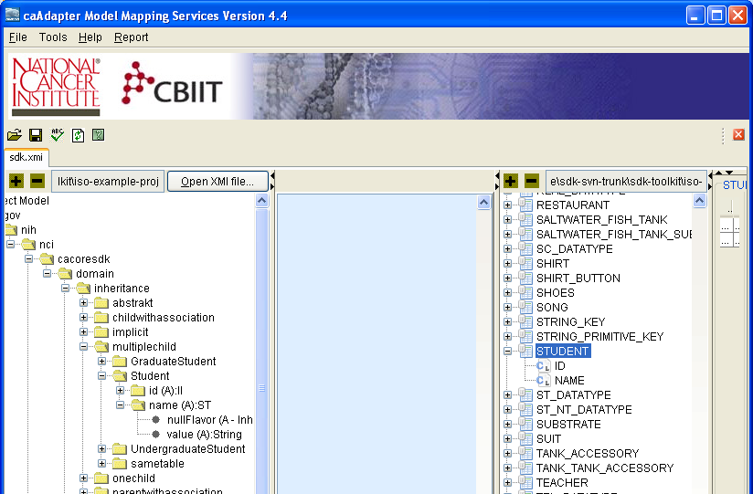
Model Mapping (caAdapter)

Slide 23
caCORE-like System Generation
(caCORE SDK / Workbench)
Input
  Annotated XMI file with Object Model and Data Model
  Code generation settings
Process –
  Generate caCORE-like system from the annotated XMI file with the characteristics as described by the code generation settings
Output –
  caCORE Like System
    Local Java API
    Remote Java API
    SOAP based web service
    RESTful XML service
    RESTful JSON service
    RESTful HTML service

Slide 24
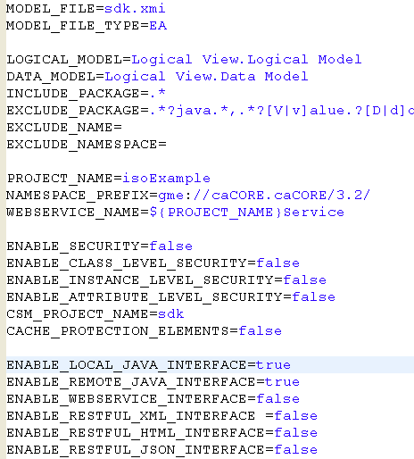
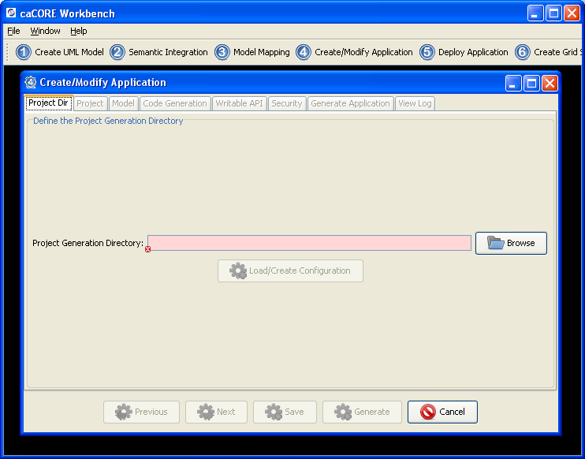
caCORE-like System Generation
(caCORE SDK / Workbench)

Slide 25
Service Development Tools Resources
Documentation: https://wiki.nci.nih.gov/x/Pol-AQ

Slide 26
Acknowledgements
NCI-CBIIT/SAIC-F Management
  Sichen Liu
  Avinash Shanbhag
  Sreenath Nampally
Project Management
  Satish Patel (Ekagra)
  John Eisenschmidt (Lantern Three)
  Ye Wu (SAIC)
  Elizabeth Prince (Sapient)
Architecture
  Satish Patel (Ekagra)
  Ye Wu (SAIC)
  Scott Oster (OSU/Inventrio)
  Raghu Chintalapati (Ekagra)
caCORE SDK Team
  Satish Patel (Ekagra)
  Vijay Parmar (Ekagra)
  Santhosh Garmilla (Ekagra)
  Dan Dumitru (Ekagra)
  Prasad Konka (SAIC)
caAdapter Team
  Ye Wu (SAIC)
  Eugene Wang (SAIC)
caGrid Team
  Scott Oster (OSU/Inventrio)
  Shannon Hastings (OSU/Inventrio)
  David Ervin (OSU)
  Justin Permar (OSU)
  Calixto Melean (OSU)
QA Team
  Ye Wu (SAIC)
  Aynur Abdurazik (SAIC)
  Xiaoling Chen (SAIC)
Documentation
  John Eisenschmidt (Lantern Three)
  Ann Wiley
  Bronwyn Gagne
  Carolyn Klinger
  Jill Hadfield
  Kelley Hunsecker

Slide 27

Questions

