Slide 1
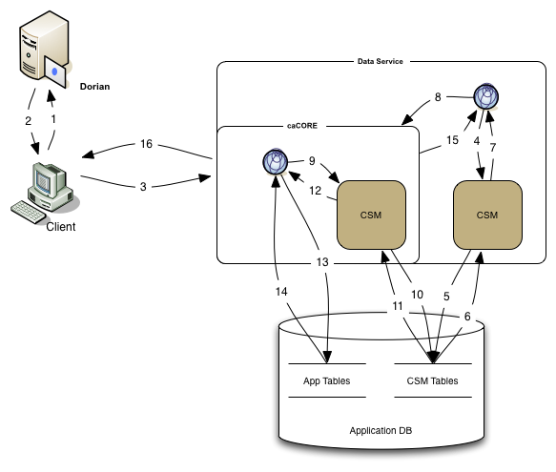
caGrid Data Service using CSM Authorization
The client authenticates to the Dorian Server
Dorian returns the grid credential to user
The client send a Query Request to the caGrid Data Service

Slide 2
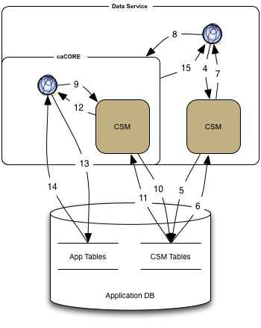
caGrid Data Service using CSM Authorization
The dataservice uses CSM to determine if the user is authorized to use the requested method
CSM performs a look-up on the CSM tables.
CSM processes the resultset to determine if the user is authorized
If the user is authorized to access the service, control is returned to the service. Else an AccessDenied Exception is throw.
The dataservice uses the caCORE local application interface to perform the query

Slide 3
caGrid Data Service using CSM Authorization
caCORE uses CSM to check the authorization of the user.
Retrieve instance level filter code. Retrieve which attributes the user is authorized to view.
CSM processes the resultset to determine if the user is authorized
CSM Authorization resultset
caCORE queries the application tables with the client’s query.
caCORE processes the database resultset
Return the caCORE resultset to the dataservice
Return the caGrid resultset to the client

