Slide 1
caGrid Identifiers
An Overview
Scott Oster (scott.oster@osumc.edu)
Calixto Melean (calixto.melean@osumc.edu)
October, 2009

Slide 2
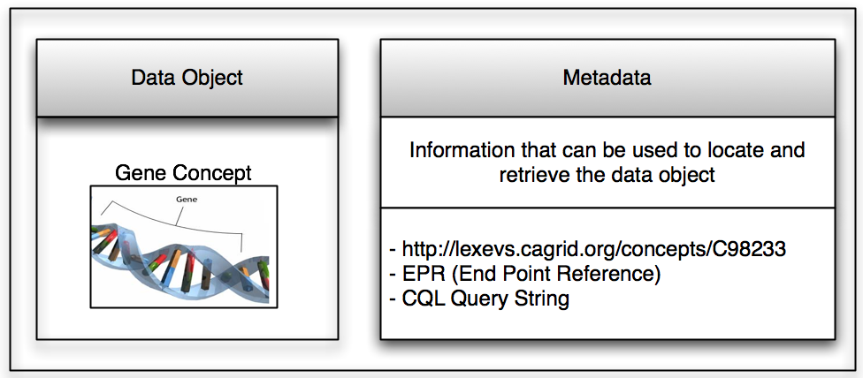
What’s an identifier?
Globally identifies content in the grid
Bound to object data and metadata
Identifier X
Notes:
A data object represents a Gene concept. We want to be able to assign an identifier to it. So any grid entity or application that knows the identifier, will always retrieve this specific gene concept.
An identifier will always produce metadata that will be used to retrieve the corresponding object from the owner’s space.

Slide 3
Core Requirements
Opaque - No meaning is attached to the identifier string
Unique - Global uniqueness in a particular deployment
Permanent - Once created, exists forever
Migratable - Could be moved without changing ID string
Resolvable - Consistent process to retrieve data referred to by identifiers
Federated - Distributed resolution process
Web Friendly – Identification scheme should play nicely with the semantic web

Slide 4
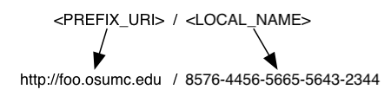
Identification Scheme
Identifiers follow a HTTP URI scheme
Use of existing web standards and protocols
Since the identifier is an URI itself, no special knowledge is needed to know how to resolve it
Simple resolution: Identifier can be resolved by simply “following it”
Notes:
This enables the use of existing web standards and protocols, and so we believe it provides a natural approach to identifier resolution.
Identifiers look like normal URLs that are expected to return “something” when they are followed, using a browser or any http client.

Slide 5
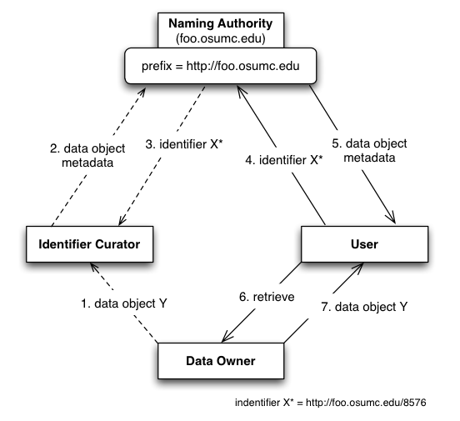
Conceptual Model
Naming Authority
Creates and manages
identifiers
Data Owner
Data objects space
Identifier Curator
Creates identifiers on behalf
of data owner
User
Retrieves data objects using
identifier
Notes:
Naming Authority, Data Owner (how is do we access data), Identifier Curator (knows domain & how to access data), User
- The prefix URI identifies the naming authority. The NA creates identifiers of the form <prefix_uri>/<local_name> as shown.
- One “issue” with this model is that the identifiers depend on the naming authority URL. If this URL changes (NA is moved), all identifiers would have to be re-named so that they continue to resolve.

Slide 6
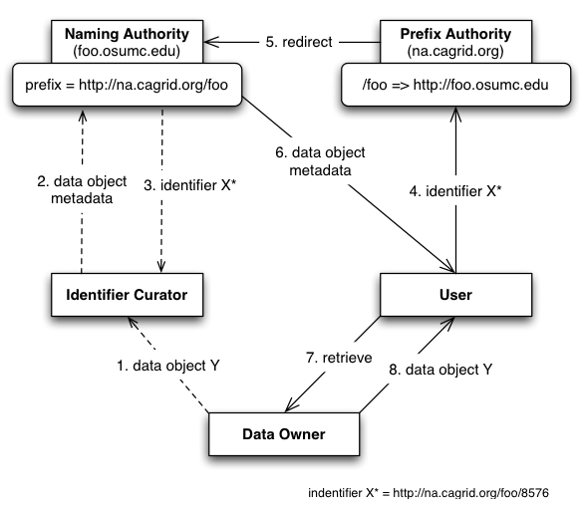
Conceptual Model (Revised)
Naming Authority
Creates and manages
identifiers
Data Owner
Data objects space
Identifier Curator
Creates identifiers on behalf
of data owner
User
Retrieves data objects using
identifier
Prefix Authority
Binds an identifier domain/
prefix to a Naming Authority
Notes:
A prefix authority (PA) binds a prefix to a naming authority. The prefix is now the PA’s URL plus a domain that maps to an specific NA.
If NA is moved, identifiers don’t change. The PA mapping must be updated.
- Multiple naming authorities can now be deployed and mapped using the prefix authority.

Slide 7
Resolution and Retrieval
Resolution
Given an identifier, locate naming authority and retrieve identifier values (metadata).
Retrieval
Given identifier values (metadata), retrieve the target object from the data owner space.

Slide 8

Identifier Resolution (HTTP GET)
foo.osumc.edu
/foo =>
http://foo.osumc.edu:8080
(2) redirect
Naming Authority prefix = http://na.cagrid.org/foo
(3) Read Identifier Values
HTTP (8080)
PURL
Server na.cagrid.org
http://foo.osumc.edu:8080/c2581947
Identifiers
(1) Identifier
(HTTP GET)
(4) Identifier Values (EPR, CQL, etc.)
http://na.cagrid.org/foo/c2581947
From the client perspective, resolving an
identifier is as simple as “following” it.
Client (IF Util)
Identifier values can be served in either
HTML or XML as per client request
Notes:
Default NA implementation serves identifier values (metadata) via HTTP. Client can request values as HTML (default) or serialized as XML, using HTTP request header (Accept).

Slide 9
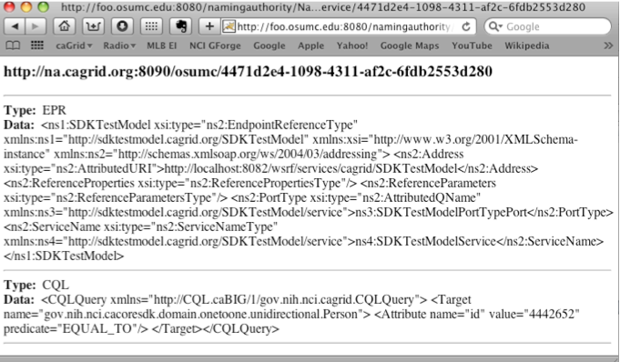
Identifier Resolution: HTML

Slide 10
Identifier Resolution (Grid Service)
foo.osumc.edu
/foo =>
http://foo.osumc.edu:8080
Naming Authority
prefix = http://na.cagrid.org/foo
(5) Read Identifier Values
(2) redirect
HTTP (8080)
PURL
Server na.cagrid.org
Grid Service
Identifiers
(3) HTTP Get Grid Svc Info
(1) config URL*
(HTTP GET)
(4) getValues( identifier* )
Client (IF Util)
(6) Identifier Values (EPR, CQL, etc.)
* config URL: http://na.cagrid.org/foo/c2581947?config
* identifier: http://na.cagrid.org/foo/c2581947
Notes:
Grid service URL is determined by retrieving NA’s configuration (see config URL*)
Grid service provides a fine-grained read API (TBD), and an administration interface (create, update, etc). It also implements security/authorization requirements (TBD).

Slide 11
Use Case: Creating Identifier
Naming Authority
prefix = http://na.cagrid.org/foo
(6) Create Identifier
Grid Service
Identifiers
(7) Identifier
(5) Create Identifier (CQL, EPR)
Data Owner
TestModel Curator
(1) Create Person X
Grid Data Service
(2) Create Person X
caCORE
TestModel
(8) Write Identifier*
(3) Build EPR to Data Service
(4) Build CQL to retrieve
Person X
* http://na.cagrid.org/foo/c2581947
Notes:
- Naming authority uses a database to store identifiers and metadata

Slide 12
Data Retrieval
Driven by “retrieval profiles” supported by the identifiers framework client toolkit
Types of values (metadata) associated with the identifier dictates which profile can be used for data retrieval
For example, the CQL profile requires at least two values:
  Endpoint reference (Data service “URL”)
  CQL query string to be executed

Slide 13
Use Case: Using Identifier
foo.osumc.edu
Naming Authority
prefix = http://na.cagrid.org/foo
(4) Read Identifier Values
HTTP (8080)
/foo=>
http://foo.osumc.edu:8080
(3) redirect
Grid Service
Identifiers
PURL
Server na.cagrid.org
(5) Identifier Values
(6)
Deserialize Identifier Values
Deserialize CQL String
Deserialize EPR
(2) Identifier
Data Owner
IF Toolkit
(7) query(CQL)
Grid Data Service
(8) Load Person X
(9) CQL Results
caCORE SDKTestModel
(1) Identifier
(10) results
TestModel Curator
* http://na.cagrid.org/foo/c2581947
Notes:
1-5 Resolution

Slide 14
Use Case: caDSR/LexEVS
Identifiers look like <URL_PREFIX>/<resource:id:version>
    http://na.cagrid.org/LexEVS/SNOWMED:C0006826:3
    http://na.cagrid.org/caDSR/DE:100006826:3
Use of custom naming authority
  Does not store identifiers or metadata
  During resolution, an algorithm uses information in the identifier itself to retrieve metadata information from remote location

Slide 15
Identifier Framework Extensions
Support for different naming authority implementations
Support for different metadata/data retrieval profiles
<bean id="NamingAuthority”
class="org.cagrid.identifiers.namingauthority.impl.NamingAuthorityImpl”>
<property name="configuration”>
<bean class="org.cagrid.identifiers.namingauthority.impl.NamingAuthorityConfigImpl">
<property name="prefix" value="http://na.cagrid.org:8090/osumc" />
<property name="gridSvcUrl"
value="http://localhost:8081/wsrf/services/cagrid/IdentifiersNAService" />
</bean>
</property>
</bean>
<bean id="CQLRetriever" class="org.cagrid.identifiers.retriever.impl.CQLRetriever">
<property name="requiredTypes">
<util:list>
<value>CQL</value>
<value>EPR</value>
</util:list>
</property>
</bean>
<bean id="RetrieverFactory" class="org.cagrid.identifiers.retriever.impl.DefaultRetrieverFactory">
<constructor-arg>
<util:map>
<entry key="CQLRetriever">
<ref local="CQLRetriever"/>
</entry>
</util:map>
</constructor-arg>
</bean>

Slide 16
Questions?
Identifiers Wiki: https://cagrid.org/display/identifiers/Home
  Requirements
  Design
  Use cases
Email feedback to Calixto.Melean@osumc.edu, Scott.Oster@osumc.edu

Slide 17
Additional Material

Slide 18
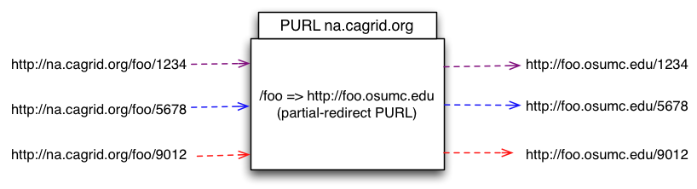
PURL Server as Prefix Authority
PURL server hides true naming authority location so it can seamlessly move along with identifiers to a different location.
PURL uses HTTP semantics (redirects) to point the client to the right information.

Slide 19
The Naming Authority
Deployed as a web application in a servlet container.
Manages identifiers and their metadata.
Identifier metadata is any information loaded with the identifier when it is created. This is the information necessary to retrieve the corresponding object from the data owner space.
The conceptual data model for identifiers metadata can be described as a hash of arrays, where each entry key is a “data type”, and the entry value is list of values of that particular data type.
“URL” => [“http://osumc.edu/flu.html”, “http://osu.edu/illness.html#flu”]
“EPR” => [“<EndpointRerenceType…>”]

Slide 20
identifiers-namingauthority-context
<bean id="NamingAuthority”
class="org.cagrid.identifiers.namingauthority.impl.NamingAuthorityImpl”>
<property name="configuration”>
<bean class="org.cagrid.identifiers.namingauthority.impl.NamingAuthorityConfigImpl">
<property name="prefix" value="http://na.cagrid.org:8090/osumc" />
<property name="gridSvcUrl"
value="http://localhost:8081/wsrf/services/cagrid/IdentifiersNAService" />
</bean>
</property>
<property name="identifierGenerator">
<bean class="org.cagrid.identifiers.namingauthority.impl.IdentifierGeneratorImpl"/>
</property>
<property name="database">
<bean class="org.cagrid.identifiers.namingauthority.util.Database">
<property name="dbUrl" value="jdbc:mysql://localhost/identifiers" />
<property name="dbUser" value="root" />
<property name="dbPassword" value=”dxfsadf4r" />
</bean>
</property>
</bean>

Slide 21
Client Toolkit: Resolution and Retrieval
// Resolution
IdentifierValues ivs = ResolverUtil.resolveHttp( identifierStr );
// Data Retrieval
RetrieverFactory factory = new RetrieverService().getFactory();
Retriever retriever = factory.getRetriever( “CQLRetriever” );
CQLQueryResults results = (CQLQueryResults) retriever.retrieve( ivs );
Or, a simplified way:
// Resolution
IdentifierValues ivs = ResolverUtil.resolveHttp( identifierStr );
// Data Retrieval
CQLQueryResults results =
(CQLQueryResults) new RetrieverService().retrieve( “CQLRetriever”, ivs );

Slide 22
Client Toolkit: Retriever Factory
package org.cagrid.identifiers.retriever;
import org.cagrid.identifiers.namingauthority.impl.IdentifierValuesImpl;
public interface RetrieverFactory {
Retriever getRetriever( IdentifierValuesImpl ivs ) throws Exception;
Retriever getRetriever( String name ) throws Exception;
}

Slide 23
Client Toolkit: Retriever
public abstract class Retriever {
private String[] requiredTypes;
public abstract Object retrieve( IdentifierValuesImpl ivs ) throws Exception;
public String[] getRequiredTypes();
public void setRequiredTypes( String[] types );
protected void validateTypes( IdentifierValuesImpl ivs );
}

Slide 24
identifiers-client-context
<!-- CQLRetriever Retriever Profile -->
<bean id="CQLRetriever" class="org.cagrid.identifiers.retriever.impl.CQLRetriever">
<property name="requiredTypes">
<util:list>
<value>CQL</value>
<value>EPR</value>
</util:list>
</property>
</bean>
<!-- End of Profiles -->
<bean id="RetrieverFactory" class="org.cagrid.identifiers.retriever.impl.DefaultRetrieverFactory">
<constructor-arg>
<util:map>
<entry key="CQLRetriever">
<ref local="CQLRetriever"/>
</entry>
</util:map>
</constructor-arg>
</bean>

Slide 25
Client Toolkit: Default Retriever Factory
package org.cagrid.identifiers.retriever.impl;
import java.util.Map;
import org.cagrid.identifiers.namingauthority.impl.IdentifierValuesImpl;
import org.cagrid.identifiers.retriever.Retriever;
import org.cagrid.identifiers.retriever.RetrieverFactory;
public class DefaultRetrieverFactory implements RetrieverFactory {
private Map<String, Retriever> retrievers;
public DefaultRetrieverFactory(Map<String, Retriever> retrievers);
public Retriever getRetriever( IdentifierValuesImpl ivs );
public Retriever getRetriever( String name );
}

Slide 26
Client Toolkit: CQLRetriever
  package org.cagrid.identifiers.retriever.impl;
  public class CQLRetriever extends Retriever{
  public Object retrieve( IdentifierValuesImpl ivs ) throws Exception {
  String[] eprStrs = ivs.getValues(“EPR”);
  String[] cqlStrs = ivs.getValues(“CQL”);
  // Deserialize EPR
  StringBufferInputStream bis = new StringBufferInput( eprStrs[0] );
  EndpointReferenceType endpoint = (EndpointReferenceType)
  ObjectDeserializer.deserialize(new InputSource(bis), EndpointReferenceType.class);
  // Deserialize query
  gov.nih.nci.cagrid.cqlquery.CQLQuery query = (gov.nih.nci.cagrid.cqlquery.CQLQuery)
  gov.nih.nci.cagrid.common.Utils.deserializeObject(
  new java.io.StringReader(cqlStrs[0]), gov.nih.nci.cagrid.cqlquery.CQLQuery.class);
  String endpointUrl = endpoint.getAddress().toString();
  String portName = endpoint.getPortType().getLocalPart();
  return query( query, endpointUrl, portName );
  }
  private static gov.nih.nci.cagrid.cqlresultset.CQLQueryResults
  query(gov.nih.nci.cagrid.cqlquery.CQLQuery cqlQuery, String url, String portName) throws Exception { … }
  }

