Slide 1
Gold Compatibility Review
Architecture/VCDE Workspaces
Joint Face to Face
February 1st–2nd, 2006
Scott Oster (oster@bmi.osu.edu)
Department of Biomedical Informatics
Ohio State University

Slide 2
Overview
Characteristics of Gold Compliance
From Silver to Gold with caGrid
Defining Gold Compliance

Slide 3
caBIG Gold Compatibility Review
Gold compliance creates the G in caBIG
  Gold => Grid => connecting Silver Systems
No requirements on implementation technology will be necessary for Gold compliance
  Specifications will be created defining requirements for interoperability
Gold Compatibility requires additional standardization:
  Service Metadata for service Advertisement
  Service Interfaces for service Access
  Identification of Data Instances
  Trusted Identity/Credentials for secure access
  Communication Mechanisms and Protocols
  Data transport representation

Slide 4
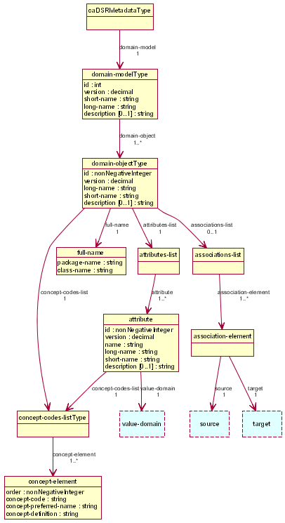
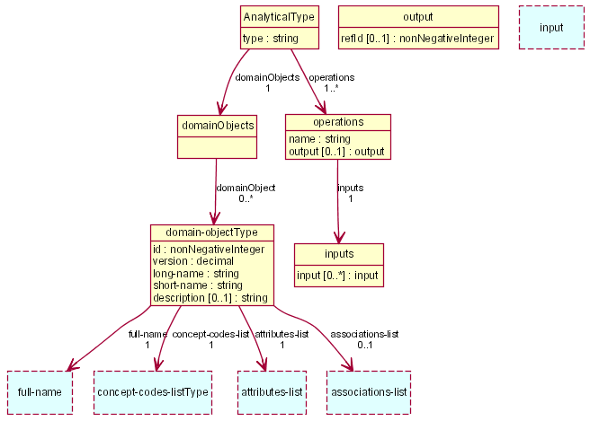
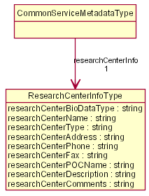
1) Service Metadata for service Advertisement
Advertised standard metadata is needed for service discovery
Current metadata standards:
  Common Metadata describes generic information about service providing Cancer Center
  Data Service Metadata describes the data exposed using terminology and objects from caDSR/EVS
  Analytical Service Metadata describes the supported operations and their inputs and outputs using terminology and objects from caDSR/EVS
Need to enhance to add more information and for core services
  Register in caDSR, bind to semantic concepts
Data
Service
Metadata
Common
Service
Metadata
Analytical
Service
Metadata

Slide 5
2) Service Interfaces for service Access
WS-ResourceProperties Oasis standards for accessing service metadata
Data providers accessed by single service interface, using common query language
Analytical routines accessed through strongly typed service interfaces
  Discussion of registering and harmonizing signatures in caDSR

Slide 6
3) Identification of Data Instances
Unified approach to identifying data instances on the grid
Standardized
Grid-unique
Universally resolvable

Slide 7
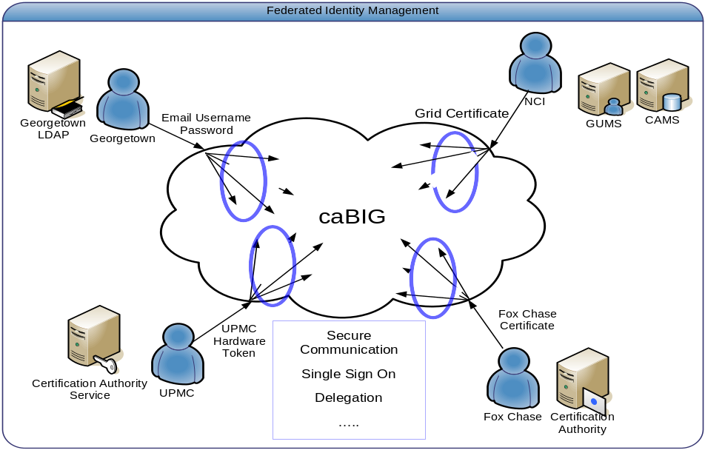
4) Trusted Identity/Credentials for secure access
Single Sign On
Grid Identity through public certificates signed by trusted Certificate Authority (PKI-based)
Standardized SAML assertions

Slide 8
5) Communication Mechanisms and Protocols
Clients and services communicate using open, platform and language independent technologies
Web/Grid Services
  WSDL (Web Service Definition Language) – abstractly defines service interfaces; specifies bindings to concrete network protocols (description)
  Simple Object Access Protocol (SOAP) – RPC using XML payload, agnostic of transport (messaging)
  HTTP/HTTPS – network communication used with SOAP (transport)

Slide 9
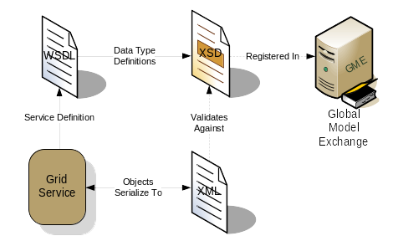
6) Data transport representation
Objects travel as XML
  Text-based structured documents
XML structure is registered in GME
  Globally, authoritatively managed

Slide 10
From Silver to Gold in caGrid
caGrid provides tooling to facilitate the process
  1) Service Metadata for service Advertisement
    Provided service infrastructure implements advertisement of standard metadata
  2) Service Interfaces for service Access
    Provided service infrastructure implements standard Grid services and provides higher-level “interface” users are expected to implement
  3) Identification of Data Instances
    Infrastructure to create and resolve grid unique identifiers

Slide 11
From Silver to Gold in caGrid cont.
  4) Trusted Identity/Credentials for secure access
    Dorian facilitates management and integration
    Underlying Globus toolkit provides security enforcement
  5) Communication Mechanisms and Protocols
    Underlying Globus toolkit provides tools and implementation
  6) Data transport representation
    GME authoritatively manages structural representation
    Underlying Globus toolkit provides tools for object-xml mapping

Slide 12
Defining Gold Compliance
VCDE/Arch to standardize service metadata
caGrid 1.0 to define service specifications
Migration of caGrid checklists
Formalize relationship between caDSR and GME
  “External” types
  Complex mappings
Create review process

Slide 13
Gold Compatibility Review
Architecture/VCDE Workspaces
Joint Face to Face
February 1st–2nd, 2006
Scott Oster (oster@bmi.osu.edu)
Department of Biomedical Informatics
Ohio State University

Slide 15
caGrid 0.5 checklist
Common:
  caBIG Silver compliant
  Service hosted on a machine with public, DNS-resolvable IP, and has firewall port open for service container's port (default port 8080)
  Provides populated CommonServiceMetadata SDE, adhering to CommonServiceMetadata.xsd
  Service implements ogsi:GridService
  Service implements ogsi:NotificationSource
  Service performs soft state registration to NCI's Index Service
  NCI's Index Service successfully aggregates service's standard SDEs
Secure Service:
  Service runs with credentials signed by NCI's CA
  Service configured to trust users with credentials signed by NCI's CA
  Service uses GSI integrity or privacy for secure methods
  Service is configured with no security for ogsi:findServiceData, ogsi:createService, and ogsi:subscribe (can use gov/nih/nci/cagrid/common/ogsi/default-security-config.xml)

Slide 16
caGrid 0.5 checklist cont.
Data Service:
  Provides populated caDSRMetadata SDE, adhering to caDSRMetadata.xsd
  All exposed objects are defined in the caDSRMetadata SDE
  Service implements gdsf:GridDataServiceFactoryPortType
  Service configured with the caBIGXMLQuery Activity
  Service accepts perform documents using the caBIGXMLQuery Activity
Analytical Service:
  Provides populated Analytical SDE, adhering to AnalyticalServiceMetadata.xsd
  All operations are defined in the Analytical SDE, and use appropriate caDSR objects for inputs and outputs

Slide 17
