Slide 1
Architecture of caGrid 1.0
caBIG Annual Meeting
April 9th-11th, 2006

Slide 2
Agenda
caGrid Overview
High-level Architecture
Component Designs
  Service Infrastructure and Tools
  Metadata Management
  Data Service Enhancements
  Security Infrastructure Enhancements
  Object Identifiers
  Workflow Middleware
  caGrid 1.0 Portal/Monitor

Slide 3
caGrid Overview
Requirements:
  Support scientific requirements: Use cases from cancer research community
  Support functional requirements: identifiers, workflow, query, etc
  Support non-functional requirements: security, reliability, performance, open source, etc
Principles:
  Driven by cancer research community requirements
  Focus on solving a business problem, not a technology problem
  Services-Oriented Architecture
  Metadata driven and implements Virtualization
    Expose objects, not backend databases
    Standards, compatibility, and community acceptance
    OGSA / OGSI / WS-RF Standards – Specifications

Slide 4






caGrid Conceptual View
Analytical Service
Grid-Enabled Client
Gene
Database
Tool 1
caArray
Tool 2
Research
Center
NCICB
Grid Services Infrastructure
(Metadata, Registry, Query,
Invocation, Security, etc.)
Protein Database
Grid Data Service
Tool 3
Tool 4
Image
Grid Portal
Microarray
Tool 2
Research
Center
Tool 3

Slide 5
Data Description Infrastructure – Service Description
Cancer Data Standards Repository (caDSR)
  NCI has a broad initiative to standardize the metadata used for cancer research. These Common Data Elements (CDEs) are developed by various NCI-sponsored organizations, then centrally stored and managed the caDSR
Enterprise Vocabulary Services (EVS)
  EVS is set of services and resources that address the need for controlled vocabulary
  Thesaurus: a biomedical thesaurus
  Metathesaurus: based on NLM's Unified Medical Language System Metathesaurus supplemented with additional cancer-centric vocabulary
Global Model Exchange (GME)
  GME is a DNS-like data definition registry and exchange service that is responsible for storing and linking together data models in the form of XML schema.
Globus Information Services
  The Globus Information Services infrastructure provides a generic framework for aggregation of service data, a registry of Grid services, and a dynamic data-generating and indexing node, suitable for use in a hierarchy or federation of services

Slide 6
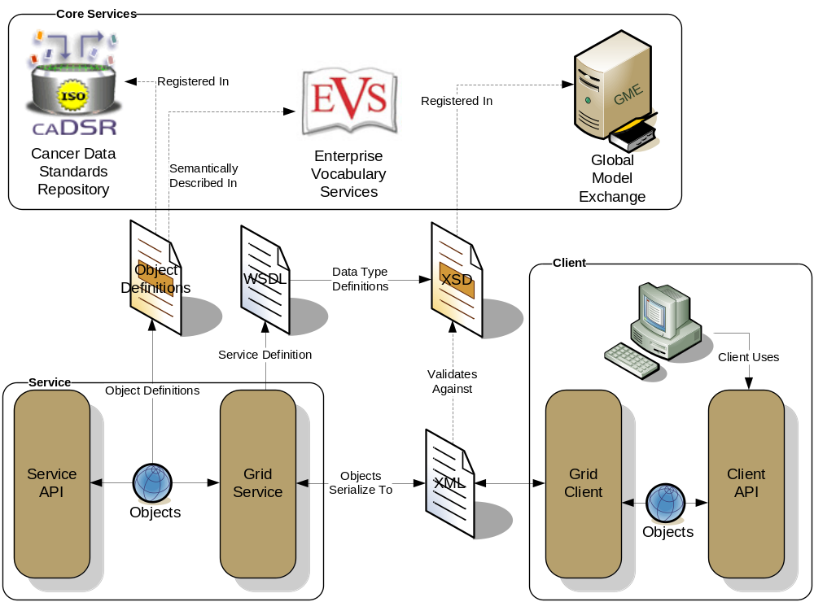
Data Description Infrastructure – Overview
Client and service APIs are object oriented, and operate over well-defined and curated data types
Objects are defined in UML and converted into ISO/IEC 11179 Administered Components, which are in turn registered in the Cancer Data Standards Repository (caDSR)
Object definitions draw from vocabulary registered in the Enterprise Vocabulary Services (EVS), and their relationships are thus semantically described
XML serialization of objects adhere to XML schemas registered in the Global Model Exchange (GME)

Slide 7
More on Metadata

Slide 8
introduce

Slide 9
Data services

Slide 10
security

Slide 11
identifiers

Slide 12
workflow

Slide 13
portal

Slide 14
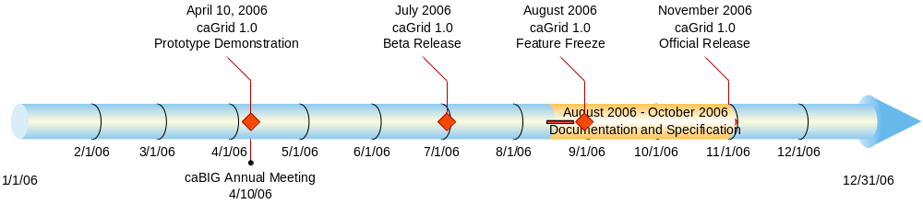
caGrid 1.0 Timeline

Slide 15
Project Resources and Communication
caGrid 1.0 GForge Home:
  Feature Requests
  Bug Reports
  Discussion Forums
  Public Wiki
  Downloads / Source Repository
  http://gforge.nci.nih.gov/projects/cagrid-1-0/
caGrid Users Mailing List
  https://list.nih.gov/archives/cagrid_users-l.html
  cagrid_users-l@list.nih.gov
Architecture Workspace
  Community direction from Working Groups
  Report out and feedback during WS calls

Slide 16
caGrid Team

