Slide 1
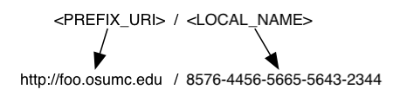
Identifier Framework: HTTP Scheme
HTTP URI identification scheme.
Since the identifier is an URI itself, no special knowledge is needed to know how to resolve it.
Identifier can be resolved by simply “following it”.

Slide 2
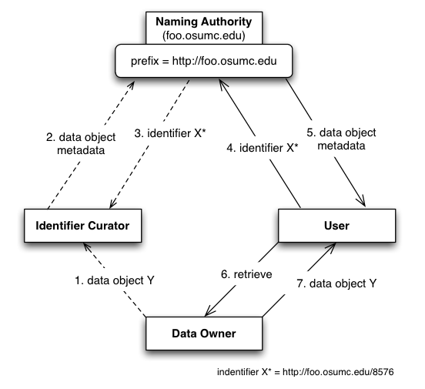
Conceptual Model
Notes:
- The prefix URI identifies the naming authority. The NA creates identifiers of the form <prefix_uri>/<local_name> as shown.
- One “issue” with this model is that the identifiers depend on the naming authority URL. If this URL changes (NA is moved), all identifiers would have to be re-named so that they continue to resolve.

Slide 3
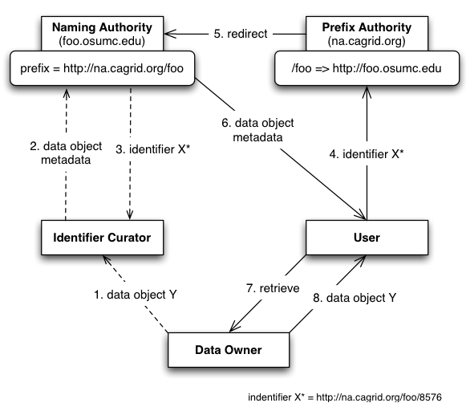
Adding a Prefix Authority
Notes:
A prefix authority (PA) binds a prefix to a naming authority. The prefix is now the PA’s URL plus a domain that maps to an specific NA.
If NA is moved, identifiers don’t change. The PA mapping must be updated.

Slide 4
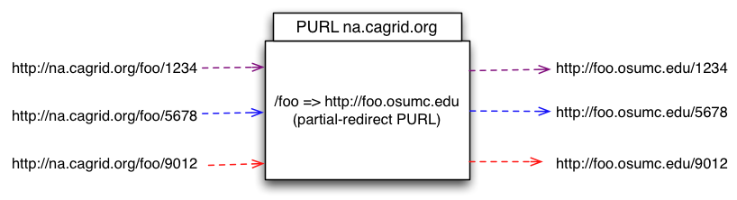
PURL Server as Prefix Authority
PURL server hides true naming authority location so it can seamlessly move along with identifiers to a different location.
PURL uses HTTP semantics (redirects) to point the client to the right information.
Notes:
Partial-redirect PURLs match as much as possible of the source URL and append the unmatched portion to the end of the target URL.

Slide 5
The Naming Authority (NA)
Deployed as a web application in a servlet container.
Manages identifiers and their metadata.
Identifier metadata is any information loaded with the identifier when it is created. This is the information necessary to retrieve the corresponding object from the data owner space.
The conceptual data model for identifiers metadata can be described as a hash of arrays, where each entry key is a “data type”, and the entry value is list of values of that particular data type.
“URL” => [“http://osumc.edu/flu.html”, “http://osu.edu/illness.html#flu”]
“EPR” => [“<EndpointRerenceType…>”]

Slide 6
Resolution and Retrieval Processes
Identifier Resolution
Given an identifier, locate naming authority and retrieve identifier values (metadata).
Data Object Retrieval
Given identifier values (metadata), retrieve the target object from the data owner space.

Slide 7
Identifier Resolution: HTTP
/foo =>
http://foo.osumc.edu:8080
(2) redirect
Naming Authority foo.osumc.edu
(3) Read Identifier Values
HTTP (8080)
PURL
Server na.cagrid.org
http://foo.osumc.edu:8080/c2581947
Identifiers
(1) Identifier
(HTTP GET)
(4) Identifier Values (EPR, CQL, etc.)
http://na.cagrid.org/foo/c2581947
Client (IF Util)
Notes:
Default NA implementation serves identifier values (metadata) via HTTP. Client can request values as HTML (default) or serialized as XML, using HTTP request header (Accept).

Slide 8
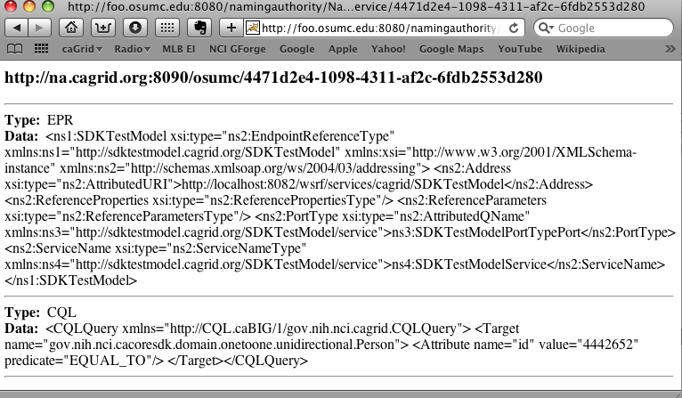
Identifier Resolution: HTML

Slide 9
Identifier Resolution: Grid Service
foo.osumc.edu
/foo =>
http://foo.osumc.edu:8080
Naming Authority
(5) Read Identifier Values
(2) redirect
HTTP (8080)
PURL
Server na.cagrid.org
Grid Service
Identifiers
(3) HTTP Get Grid Svc Info
(1) config URL*
(HTTP GET)
(4) getValues( identifier* )
Client (IF Util)
(6) Identifier Values (EPR, CQL, etc.)
* config URL: http://na.cagrid.org/foo/c2581947?config
* identifier: http://na.cagrid.org/foo/c2581947
Notes:
Grid service URL is determined by retrieving NA’s configuration (see config URL*)
Grid service provides a fine-grained read API (TBD), and an administration interface (create, update, etc). It also implements security/authorization requirements (TBD).

Slide 10
Use Case: Creating Identifier
Naming Authority
(6) Create Identifier
Grid Service
Identifiers
(7) Identifier
(5) Create Identifier (CQL, EPR)
Data Owner
TestModel Curator
(1) Create Person X
Grid Data Service
(2) Create Person X
caCORE
TestModel
(6) Write Identifier*
(3) Build EPR to Data Service
(4) Build CQL to retrieve
Person X
* http://na.cagrid.org/foo/c2581947

Slide 11
Data Retrieval
Driven by “retrieval profiles” supported by the identifiers framework client toolkit
Types of values (metadata) associated with the identifier dictates which profile can be used for data retrieval
For example, the CQL profile requires at least two values:
  Endpoint reference (Data service “URL”)
  CQL query string to be executed

Slide 12
Use Case: Using Identifier
Naming Authority
foo.osumc.edu
(4) Read Identifier Values
HTTP (8080)
/foo=>
http://foo.osumc.edu:8080
(3) redirect
Grid Service
Identifiers
PURL
Server na.cagrid.org
(5) Identifier Values
(6)
Deserialize Identifier Values
Deserialize CQL String
Deserialize EPR
(2) Identifier
Data Owner
IF Toolkit
(7) query(CQL)
Grid Data Service
(8) Load Person X
(9) CQL Results
caCORE SDKTestModel
(1) Identifier
(10) results
TestModel Curator
* http://na.cagrid.org/foo/c2581947
Notes:
1-5 Resolution

Slide 13
Use Case: Co-located Naming Authority
Data owner could run naming authority locally using existing database to host identifiers table.
Framework’s interface should be able to be extended to allow different naming authority implementations.
  E.g. Provide/resolve identifiers directly from domain objects themselves (such as via a “bigid” attribute).
Grid Data Service
Naming Authority
caCORE TestModel
Persons
Addresses
Identifiers

Slide 14
Supporting Material

Slide 15
NA: identifiers-namingauthority-context
<bean id="NamingAuthority”
class="org.cagrid.identifiers.namingauthority.impl.NamingAuthorityImpl”>
<property name="configuration”>
<bean class="org.cagrid.identifiers.namingauthority.impl.NamingAuthorityConfigImpl">
<property name="prefix" value="http://na.cagrid.org:8090/osumc" />
<property name="gridSvcUrl"
value="http://localhost:8081/wsrf/services/cagrid/IdentifiersNAService" />
</bean>
</property>
<property name="identifierGenerator">
<bean class="org.cagrid.identifiers.namingauthority.impl.IdentifierGeneratorImpl"/>
</property>
<property name="database">
<bean class="org.cagrid.identifiers.namingauthority.util.Database">
<property name="dbUrl" value="jdbc:mysql://localhost/identifiers" />
<property name="dbUser" value="root" />
<property name="dbPassword" value=”dxfsadf4r" />
</bean>
</property>
</bean>

Slide 16
NA: Naming Authority Loader
package org.cagrid.identifiers.namingauthority;
import org.springframework.context.ApplicationContext;
import org.springframework.context.support.ClassPathXmlApplicationContext;
public class NamingAuthorityLoader {
private ApplicationContext appCtx;
private NamingAuthority namingAuthority;
public NamingAuthorityLoader() {
init( new String[] {
"/resources/spring/identifiers-namingauthority-context.xml”},
"NamingAuthority");
}
public NamingAuthorityLoader( String[] contextList, String authorityName ) {
init( contextList, authorityName );
}
private void init( String[] contextList, String authorityName ) {
appCtx = new ClassPathXmlApplicationContext( contextList );
namingAuthority = (NamingAuthority) appCtx.getBean( authorityName );
}
public NamingAuthority getNamingAuthority() {
return namingAuthority;
}
}

Slide 17
NA: Naming Authority
package org.cagrid.identifiers.namingauthority;
public abstract class NamingAuthority {
public NamingAuthorityConfig getConfiguration();
public void setConfiguration( NamingAuthorityConfig config );
public String generateIdentifier();
public IdentifierGenerator getIdentifierGenerator();
public void setIdentifierGenerator( IdentifierGenerator generator );
public abstract void initialize();
public abstract void processHttpRequest(HttpServletRequest, HttpServletResponse);
public abstract IdentifierValues resolveIdentifier(Object identifier);
public abstract Object createIdentifier(IdentifierValues);
}

Slide 18
NA: Naming Authority Interfaces
package org.cagrid.identifiers.namingauthority;
public interface NamingAuthorityConfig {
public String getPrefix();
public String getGridSvcUrl();
}
public interface IdentifierGenerator {
String generate( NamingAuthorityConfig config );
}
public interface IdentifierValues {
}

Slide 19
Client Toolkit: Resolution and Retrieval
// Resolution
IdentifierValues ivs = ResolverUtil.resolveHttp( identifierStr );
// Data Retrieval
RetrieverFactory factory = new RetrieverService().getFactory();
Retriever retriever = factory.getRetriever( “CQLRetriever” );
CQLQueryResults results = (CQLQueryResults) retriever.retrieve( ivs );
Or, a simplified way:
// Resolution
IdentifierValues ivs = ResolverUtil.resolveHttp( identifierStr );
// Data Retrieval
CQLQueryResults results =
(CQLQueryResults) new RetrieverService().retrieve( “CQLRetriever”, ivs );

Slide 20
Client Toolkit: Retriever Factory
package org.cagrid.identifiers.retriever;
import org.cagrid.identifiers.namingauthority.impl.IdentifierValuesImpl;
public interface RetrieverFactory {
Retriever getRetriever( IdentifierValuesImpl ivs ) throws Exception;
Retriever getRetriever( String name ) throws Exception;
}

Slide 21
Client Toolkit: Retriever
public abstract class Retriever {
private String[] requiredTypes;
public abstract Object retrieve( IdentifierValuesImpl ivs ) throws Exception;
public String[] getRequiredTypes();
public void setRequiredTypes( String[] types );
protected void validateTypes( IdentifierValuesImpl ivs );
}

Slide 22
Client Toolkit: Retriever Service
public class RetrieverService {
private ApplicationContext appCtx;
private RetrieverFactory factory;
public RetrieverService() {
init( new String[] {
"/resources/spring/identifiers-resolver-context.xml”},
"RetrieverFactory");
}
public RetrieverService( String[] contextList, String factoryName ) {
init( contextList, factoryName );
}
private void init( String[] contextList, String factoryName ) {
appCtx = new ClassPathXmlApplicationContext( contextList );
factory = (RetrieverFactory) appCtx.getBean( factoryName );
}
public RetrieverFactory getFactory() {
return factory;
}
}

Slide 23
Client Toolkit: identifiers-resolver-context
<!-- CQLRetriever Retriever Profile -->
<bean id="CQLRetriever" class="org.cagrid.identifiers.retriever.impl.CQLRetriever">
<property name="requiredTypes">
<util:list>
<value>CQL</value>
<value>EPR</value>
</util:list>
</property>
</bean>
<!-- End of Profiles -->
<bean id="RetrieverFactory" class="org.cagrid.identifiers.retriever.impl.DefaultRetrieverFactory">
<constructor-arg>
<util:map>
<entry key="CQLRetriever">
<ref local="CQLRetriever"/>
</entry>
</util:map>
</constructor-arg>
</bean>

Slide 24
Client Toolkit: Default Retriever Factory
package org.cagrid.identifiers.retriever.impl;
import java.util.Map;
import org.cagrid.identifiers.namingauthority.impl.IdentifierValuesImpl;
import org.cagrid.identifiers.retriever.Retriever;
import org.cagrid.identifiers.retriever.RetrieverFactory;
public class DefaultRetrieverFactory implements RetrieverFactory {
private Map<String, Retriever> retrievers;
public DefaultRetrieverFactory(Map<String, Retriever> retrievers);
public Retriever getRetriever( IdentifierValuesImpl ivs );
public Retriever getRetriever( String name );
}

Slide 25
Client Toolkit: CQLRetriever
  package org.cagrid.identifiers.retriever.impl;
  public class CQLRetriever extends Retriever{
  public Object retrieve( IdentifierValuesImpl ivs ) throws Exception {
  String[] eprStrs = ivs.getValues(“EPR”);
  String[] cqlStrs = ivs.getValues(“CQL”);
  // Deserialize EPR
  StringBufferInputStream bis = new StringBufferInput( eprStrs[0] );
  EndpointReferenceType endpoint = (EndpointReferenceType)
  ObjectDeserializer.deserialize(new InputSource(bis), EndpointReferenceType.class);
  // Deserialize query
  gov.nih.nci.cagrid.cqlquery.CQLQuery query = (gov.nih.nci.cagrid.cqlquery.CQLQuery)
  gov.nih.nci.cagrid.common.Utils.deserializeObject(
  new java.io.StringReader(cqlStrs[0]), gov.nih.nci.cagrid.cqlquery.CQLQuery.class);
  String endpointUrl = endpoint.getAddress().toString();
  String portName = endpoint.getPortType().getLocalPart();
  return query( query, endpointUrl, portName );
  }
  private static gov.nih.nci.cagrid.cqlresultset.CQLQueryResults
  query(gov.nih.nci.cagrid.cqlquery.CQLQuery cqlQuery, String url, String portName) throws Exception { … }
  }

Slide 26
Identifier Framework
Identifier
  Globally identify a data object
  Bound to object data and metadata
Some Benefits
  Universally identify content in the grid
  Allow applications to compare objects in a global context without having the data-object itself
  Metadata allows applications to reason about the data-object and help decide whether it should be retrieved or not

Slide 27
Identifier Basic Requirements
Opaque - No meaning is attached to the identifier string
Unique - Global uniqueness in a particular deployment
Permanent - Once created, exists forever
Migratable - Could be moved without changing ID string
Resolvable - Consistent process to retrieve data
Federated - Distributed resolution process
Secure - Framework operations must be able to be secured

Slide 28
Common Terms
Naming Authority
  Maintains bindings between identifiers and data objects.
  Stores any necessary information that would help locate and retrieve the data object. This could be an “end point reference”, a URL, a WSDL doc, etc…
Data Owner
  Provides access to data objects through “end point references”.
  Uses identifier framework to create/modify/delete id-object bindings
User/Consumer
  Utilizes identifier framework to resolve identifiers

