Slide 1
caBIG
Semantic Interoperability
Joel Saltz, Denise Warzel, Shannon Hastings, Scott Oster
NIH Natcher Center October 18, 2007

Slide 2
Interoperability
The ability of multiple systems to exchange information
and to be able to use the information that has been exchanged.
Semantic
interoperability
Syntactic
interoperability

Slide 3
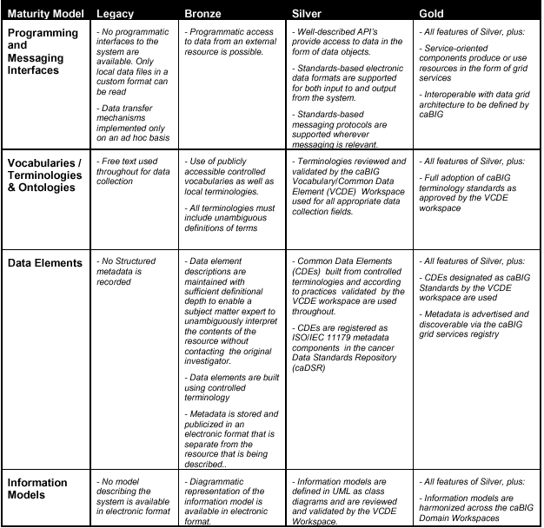
SYNTACTIC
SEMANTIC
SEMANTIC
caBIG Compatibility Guidelines
SEMANTIC

Slide 4
Modeling for Interoperability
Class diagram models target domain
Logical model is basis for semantic integration
Focus on attributes and relationships of domain objects

Slide 5
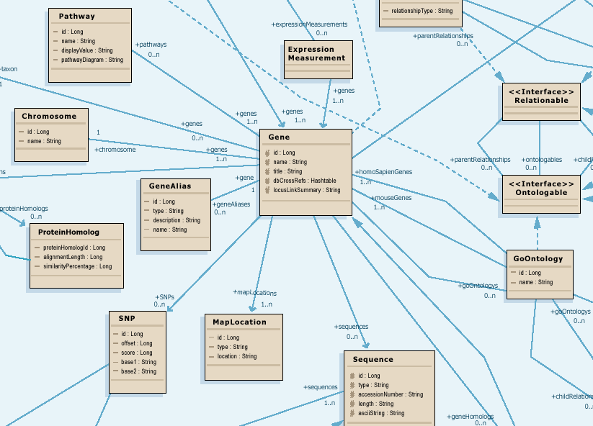
Example UML Class Model

Slide 6
Data Model Meaning
What do all those data classes and attributes actually mean, anyway?
Data descriptors or “semantic metadata” required
Computable, commonly structured, reusable units of metadata are “Common Data Elements” or CDEs
NCI uses the ISO/IEC 11179 standard for metadata structure and registration

Slide 7
The ISO/IEC 11179 Standard
Specifies the kind and quality of metadata necessary to describe data, and it specifies the management and administration of that metadata in a metadata registry (MDR).
Applies to the formulation of data representations, concepts, meanings, and relationships between them, independent of the organization that produces the data.
Does NOT apply to the physical representation of data as bits and bytes at the machine level.
Provides the rules and guidelines for naming and identification of data elements. It defines the identifying attributes, describes the relationship of the attributes to each other and includes principles by which naming conventions can be developed.

Slide 8
ISO Terms and Definitions
Data Element: A unit of data for which the definition, identification, representation and permissible values are specified by means of a set of attributes
Data Element Concept: An idea that can be represented in the form of a data element, described independently of any particular representation
Data Element Representation: The part of a data element having a value domain, data type and other representational specifications
Representation Class: Classification of data elements based on the type of representational form
Conceptual Domain: A set of possible value meanings of a data element expressed without representation
Value Domain: A set of attributes describing representational characteristics of instance data with or without permissible values
Value Meaning: A member of the set of finite allowed inventory of notions that can be categorized for a conceptual domain
Permissible Value: An expression of a value meaning in a specific value domain

Slide 9

Cancer Data Standards Repository
Implementation of ISO/IEC 11179 Registry for Common Data Elements – units of semantic metadata
Client for Enterprise Vocabulary: metadata constructed from controlled terminology and annotated with concept codes
  Binds the structural data objects to their underlying semantics
Precise specification of Classes, Attributes, Data Types, Permissible Values: Strong typing of data objects.
Tools:
  UML Loader: automatically register UML models as metadata components
  CDE Curation: Fine tune metadata and constrain permissible values with data standards
  Form Builder: Create standards-based data collection forms
  CDE Browser: search and export metadata components

Slide 10
Details of a Concept
Name
Code (Concept Unique Identifier)
Properties
  Definition (s)
  Synonym (s)
  Preferred name: the term NCI recommends for use in written and oral communication
  Links to use or related information in other, external resources, such as UMLS
Roles
  Relationships with other concepts
  Taxonomy / Hierarchy
    Superconcepts / More General Concepts / Parents
    Subconcepts / More Specific Concepts / Children

Slide 11

Enterprise Vocabulary Services (EVS)
Controlled vocabulary resources for cancer research community
  Manages the concepts
NCI Thesaurus
  NCI reference terminology (public domain, open source)
  46,000 concepts covering agents, anatomy, biological processes, diseases, genes, gene products, and techniques/equipment
  Built using description logic
  Designed for application development: database coding, searching, and data mining
NCI Metathesaurus
  Online dictionary and thesaurus
  Adaptation of National Library of Medicine’s Unified Medical Language System (UMLS) Metathesaurus
  930,000+ concepts; 2,200,000 terms and phrases
  Built using lexical matching
  Designed for term mapping and document indexing across vocabularies

Slide 12
What can EVS do?
Check and compare dictionary definitions
Find synonyms
Determine relationships to other concepts/terms
Identify and evaluate potential options when curating new CDEs or adding terms to permissible value lists
Provide links to related research publications

Slide 13
Why do you need semantic metadata?
Class/ Attribute | Example Object Data | CIA Metadata | NCI Metadata
Agent |  | A sworn intelligence agent; a spy | Chemical compound administered to a human being to treat a disease or condition, or prevent the onset of a disease or condition
Agent nSCNumber | 007 | Identifier given to an intelligence agent by the National Security Council | Identifier given to chemical compound by the US Food and Drug Administration Nomenclature Standards Committee
Agent name | Taxol | CIA code name given to intelligence agents | Common name of chemical compound used as an agent
Notes:
The segue from here is so how do we utilize this to provide semantic interoperability?

Slide 14
Computable Interoperability
Agent
C1708
Drug
C1708
name
id
nSCNumber
C1708:C41243
NDCCode
CTEPName
approvalDate
FDAIndID
approver
IUPACName
fdaCode
C1708:C41243
My model
Your model

Slide 15
What is caGrid?
Development project of Architecture Workspace, aimed at helping define and implement Gold Compliance (the highest level of caBIG compatibility)
No requirements on implementation technology is necessary for Gold compliance
  Specifications will be created defining requirements for interoperability
  caGrid provides core infrastructure, and tooling to provide “a way” to achieve Gold compliance

Slide 16






caGrid Conceptual View
Analytical Service
Grid-Enabled Client
Gene
Database
Tool 1
caArray
Tool 2
Research
Center
NCICB
Grid Services Infrastructure
(Metadata, Registry, Query,
Invocation, Security, etc.)
Protein Database
Grid Data Service
Tool 3
Tool 4
Image
Grid Portal
Microarray
Tool 2
Research
Center
Tool 3

Slide 17
caGrid Components
Leverage existing technologies:
  caDSR, EVS, Mobius GME: Common data elements, controlled vocabularies, schema management
  Globus Toolkit (currently version 4.0.1)
    Core grid services infrastructure
    Service deployment, service registry, invocation, base security infrastructure
Additional Core Infrastructure
  Higher-level security services
  Grid service access to metadata components (caDSR, GME, etc)
  Workflow, Identifier services
Service Provider Tooling (Introduce)
  Graphical service development and configuration environment
  Abstractions from service infrastructure for Data and Analytical services
  Deployment wizards
Client Tooling
  High-level APIs for interacting with core components and services
  Graphical Tools

Slide 18
caGrid exposing caDSR data
In caDSR, nearly all items can be individually versioned, but a specific Project version represents a curated collection of Packages, Classes, and Attributes with consistent semantics
Data is exposed in caGrid as instances defined in a specific Project
  Data Services expose instance data as a subset of Classes from a given Project
  Analytical Services operate over instances of Classes from potentially numerous Projects

Slide 19
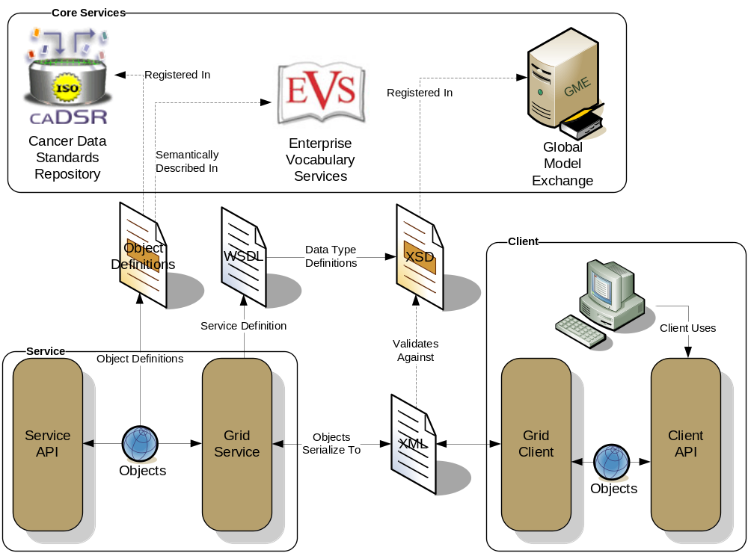
caGrid Data Description Infrastructure
Client and service APIs are object oriented, and operate over well-defined and curated data types
Objects are defined in UML and converted into ISO/IEC 11179 Administered Components, which are in turn registered in the Cancer Data Standards Repository (caDSR)
Object definitions draw from vocabulary registered in the Enterprise Vocabulary Services (EVS), and their relationships are thus semantically described
XML serialization of objects adhere to XML schemas registered in the Global Model Exchange (GME)

Slide 20
From caDSR to GME
In caDSR, each Project (application) has its own Classification Scheme (e.g. caCORE)
A Project may define a subproject/package, which is represented as a Classification Scheme Item (CSI) (e.g. caBIO)
caGrid requires that each CSI/Package has its own XML schema which is published into the caGrid GME service

Slide 21
caGrid Standard Service Metadata
All caGrid Services are expected to publish a set of standard metadata which draws heavily from the metadata registered in caDSR and EVS
  Common Metadata describes generic information about service providing Cancer Center, points of contact, etc
  The Service’s operations are defined and their inputs and outputs link to Classes in caDSR and semantics from EVS
  Data Services additionally describe the domain Model they are exposing
    Associations between classes
    Semantics of the model itself

Slide 22
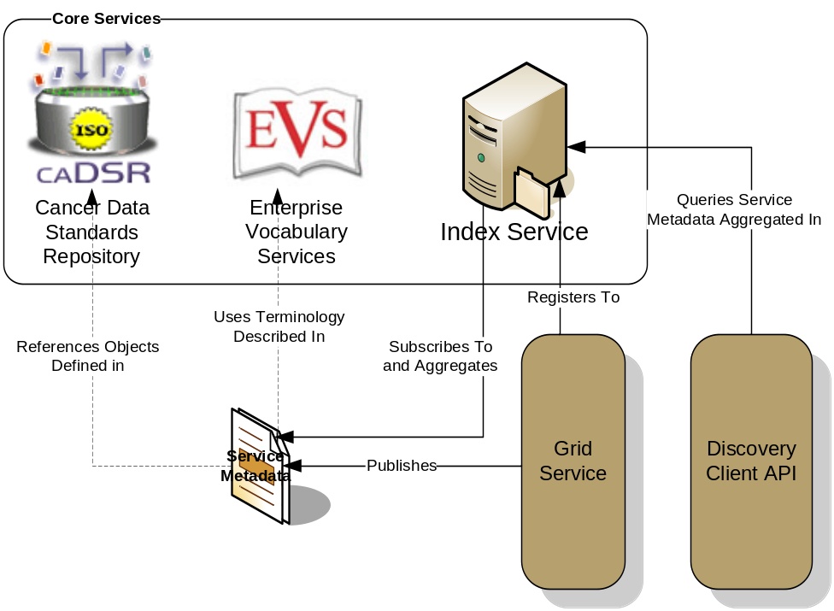
caGrid Advertisement and Discovery
All services register their service address and metadata information to an Index Service
The Index Service subscribes to the standardized metadata and aggregates its contents
Clients can discover services using a discovery API which facilitates query and inspection of metadata
Leveraging semantic information in EVS (from which service metadata is drawn), services can be discovered by the semantics of their data types

Slide 23
Service Discovery Process
Clients formulate a query over the caGrid standard metadata
  Examples:
    “Find me all the services from Cancer Center X”
    “Which Analytical services take Genes as input?”
    “Which Data services expose data relating to lung cancer?”
    “Find me all the services with some metadata mentioning the string ‘macromolecules’”
This query is sent to the caGrid Index Service which returns the Address of the services satisfying the query
The client can then further interrogate the satisfying services by asking for all of their metadata or service descriptions
Finally the client invokes the desired services as appropriate

Slide 24
Data Service Overview
Specialization of caGrid grid services to expose data through a common query interface
Present an object view of data resources
Exposed objects are registered in caDSR and their XML representation in GME
Queries made with CQL (Common Query Language)
Results returned as objects (or identifiers) nested in a CQL Query Result Set

Slide 25
Introduce
A framework which enables fast and easy creation of caGrid compatible services
Provide easy to use graphical service authoring tools
Hides all “gridness” from the developer so that they can concentrate on the application domain implementation
Makes use of caDSR and GME for data type discovery (for operation input and output)

