Slide 1
Introduce
Grid Service Authoring Toolkit
Shannon Hastings
hastings@bmi.osu.edu
Multiscale Computing Laboratory
Department of Biomedical Informatics
The Ohio State University

Slide 2
Outline
Driving requirements
What can it do?
Architecture
Toolkit
Future work

Slide 3
caGrid Service Overview
Accessing data in caBIG will not be enough. The data will need to be processed, transformed, analyzed, integrated, etc
It should be very easy for service providers to deliver these services
The services will take in and return strongly typed and semantically harmonized data types
These services will need to be easily discovered and invoked

Slide 4
caGrid Service Requirements
All services must be presented to the caBIG as Grid Services
They must have strongly typed interfaces using types which are registered in the caDSR and can be verified by an XML schema registered in the caGrid GME.
Must provide CommonServiceMetadata as well as service specific metadata.
The service must register itself and it’s metadata to a caGRID Index Service
The service must provide object oriented client API for locating and invoking the service

Slide 5
Introduce Goals
A framework which enables fast and easy creation of caGrid compatible services whether they are data, analytical, or core services.
Provide easy to use graphical service authoring tool.
Hide all “grid-ness” from the developer.
Utilize best practice layered grid service architecture.
Handle all service architecture requirements of the caGrid.

Slide 6
Addressing the Requirements
Grid Services
  We will be fulfilling the requirement that each operation is available through grid services by utilizing the Globus 4.0 toolkit
  Tool providers will describe the grid service interface they wish to provide.
  We will use the Globus toolkit for creating, registering, discovering, and invoking these service operations as grid services
    Client will be using the operation through a grid service interface and will not need to be aware of any implementation specific details of the grid service

Slide 7
Addressing the Requirements (cont)
Strongly typed interfaces:
  Introduce will enable schema extraction from a GME so that the wsdl, beans, and service metadata can be automatically populated and the service will be using strongly typed and publicly accessible data types.
  Data model schema, and any referenced schemas, extracted and placed in the schema directory of the analytical build skeleton
    types can be used at service build time to generate the objects and create strongly-typed grid service interfaces

Slide 8
Addressing the Requirements (cont)
Providing Service Metadata:

Slide 9
Addressing the Requirements (cont)
Index Service Registration

Slide 10
Addressing the Requirements (cont)
Security:

Slide 11
Addressing the Requirements (cont)
Providing Client Side Object API
  Globus build process will automatically generate a client side object oriented API
  We will generate a wrapper for this API which matches the service interface to make a clean mapping from client to service.
    This wrapper will handle auto boxing of the parameters into document literal form.

Slide 12
Core caGrid Service Architecture

Slide 13
Introduce Service Creation Toolkit
Toolkit for creating and manipulating caGrid compliant analytical services
  Command line and GUI tools for service skeleton generation and automatic service/client code generation
Utilizes other caGrid services and architecture components
  GME for schemas of caDSR registered data types
  Security service architecture (GSI, DORIAN, CAMS)
  Advertisement and Registration configuration and caGrid Index Service for discovery

Slide 14
Introduce Service Creation Toolkit Portal
GUI for creating and manipulating a caGrid compliant analytical service
  Provides means of simple creation of service skeleton that a developer can then implement, build, and deploy
  Automatic code generation of complete caBIG compliant grid service which is configured to provide:
    Security
    Advertisement
    Discovery
    Complete Client API
  Provides a set of tools which enable the developer to add/remove/modify methods of the service
    Automatic code generation of all the required code, Globus grid service code/configuration, service configuration, implementation of the client, and stubbed implementation of the service

Slide 15
Introduce Command Line Service Creation
Creation tool – tool to enable the easy creation of a new service skeleton
  Will prompt for input on name, package, directory, namespace, etc
  Can take in a properties file instead
  Can be called with ant “ant createServiceSkeleton”
Sync tools – set of tools which enable the modification of caGrid compliant grid services
    Keeps mirror of service interface in a configuration/state document and regenerates the grid service skeleton upon changes
      Creates/Modifies
        service interface
        wsdl
        client/server implementation
        build files
        Security and registration configuration files
      Can be called with ant “ant resync”

Slide 16
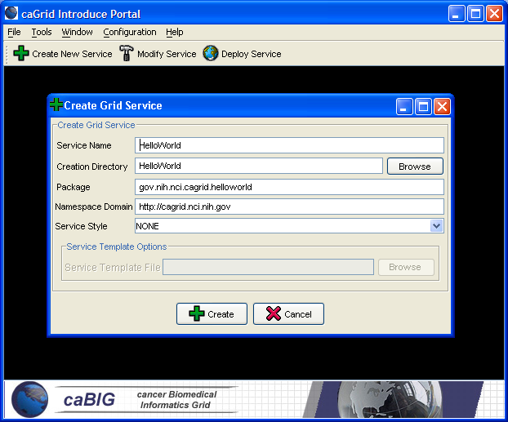
Introduce Portal Service Creation
Populate required variables for service creation
  Name = published service name
  Creation Direction = directory to create the skeleton
  Package = the java package you wish to use for your service
  Namespace Domain = the namespace to be used to define the service interface and types

Slide 17
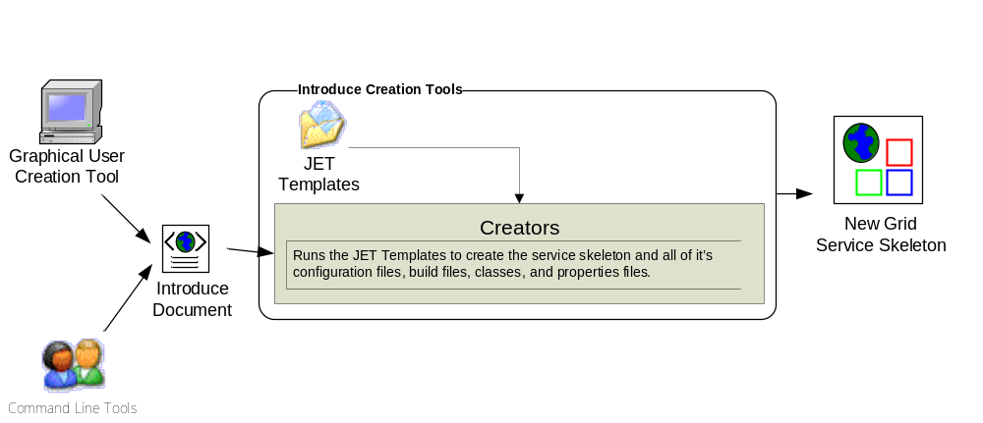
Introduce Service Creation Architecture

Slide 18
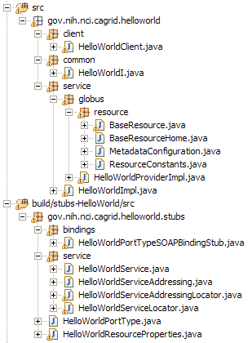
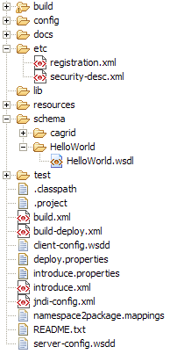
Created Skeleton Layout
= generated
= built
= developers
contribution

Slide 19
Created Skeleton Layout (cont)
= implements the developer
defined interface and calls into
the generated client port type
stub.
= the developer defined grid
service interface
= manages the resources
of this grid service
= implements the port type
and calls into the actual
clean unboxed interface
the developer defined.
= developers implementation
of the defined interface.

Slide 20
Created Skeleton Layout (cont)
= service metadata registration configuration
= describes the services security configuration
= services WSDL file for axis
= configuration files for eclipse development
= ant build files
= client configuration file for axis
= deployment time service properties
= introduce representation of service
= JNDI service resources configuration
= namespace mappings for axis
= server configuration file for axis

Slide 21
Introduce Command Line Service Modification
run the command “ant resync” from the top level of the analytical skeleton
  will read in the “introduce.xml” document and determine the changes between the developers new description of the service and the actual code
  will then modify the skeleton appropriately:
    Modify all source files
    Modify all security configuration files
    Modify the wsdl for the service

Slide 22
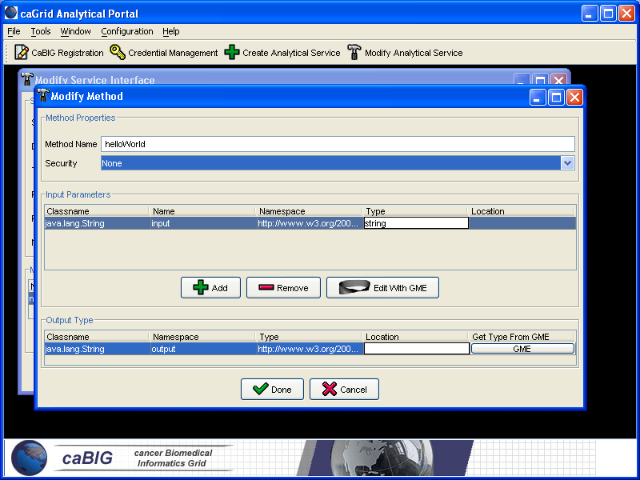
Introduce Portal Service Modification
Graphical tool to automatically create source code, configuration files, and build process for new analytical services
Developer defines the operations of the service and just has to focus on the implementation of them
Generated service is caBIG compliant in its mechanisms to register, advertise, and secure

Slide 23
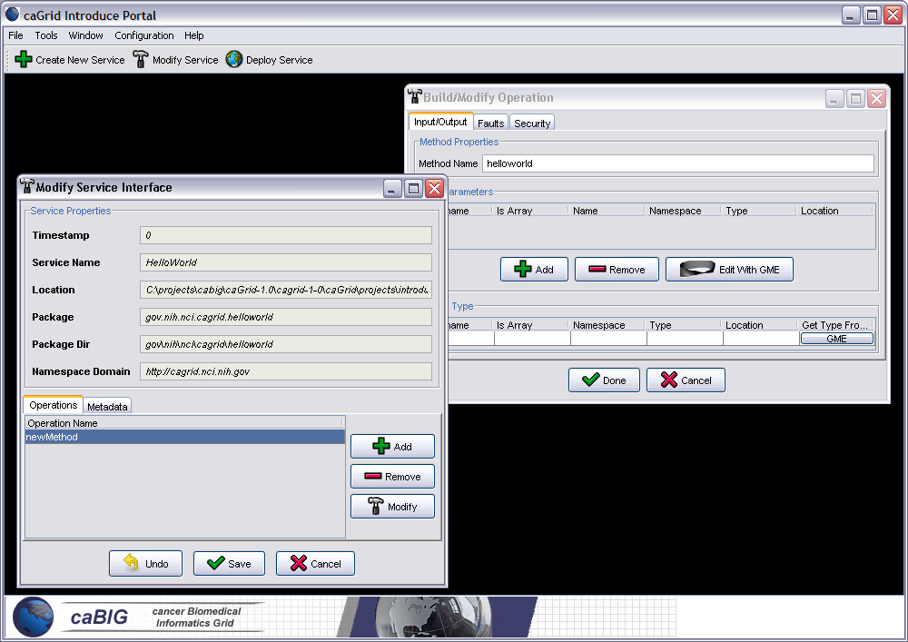
Introduce Service Modification Tool cont.
Input and output parameters can be discovered from GME
Schema types can be automatically downloaded and configured as operation parameters
Specified types are used to create necessary Java Objects using Globus behind the scenes

Slide 24
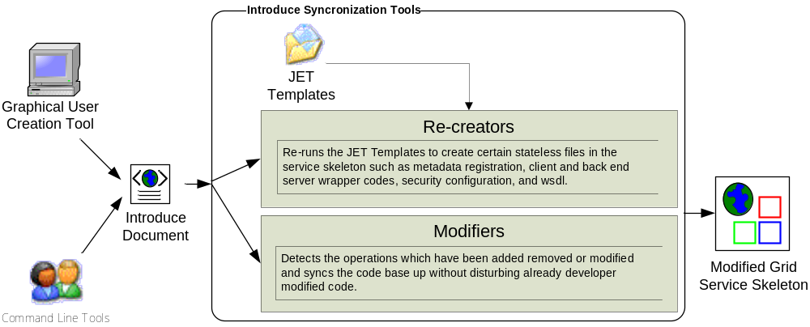
Introduce Service Modification Architecture

Slide 25
Command Line Creation
run the command “ant createService”
This will prompt the user for several variables which need to be defined:
  Destination directory for this new service skeleton
  Service name
  Namespace domain (the namespace to use for the services messages etc.)
  Package (the java package for the service to use)
  Package dir (same as above except written as a relative directory

Slide 26
Command Line Creation (cont)
Variables can be preset in a properties file to use non-interactively
  call the ant target and set the introduce.properties variable to point to this properties file:
    ant –Dintroduce.properties=myAnalytical.properties createService
An example properties file:
introduce.skeleton.destination.dir=C:\RProteomics
introduce.skeleton.service.name=RProteomics
introduce.skeleton.namespace.domain=http\://analysis.cabig.duke.edu
introduce.skeleton.package=edu.duke.cabig.analysis.rproteomics
introduce.skeleton.package.dir=edu/duke/cabig/analysis/rproteomic

Slide 27
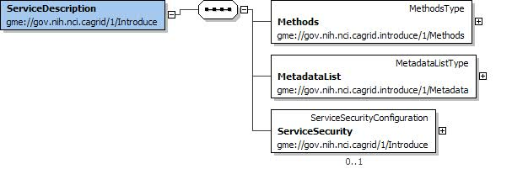
The Methods Document
XML document used to describe the service interface and it’s security requirements
Introduce Toolkit uses it for code generation and skeleton synchronization

Slide 28
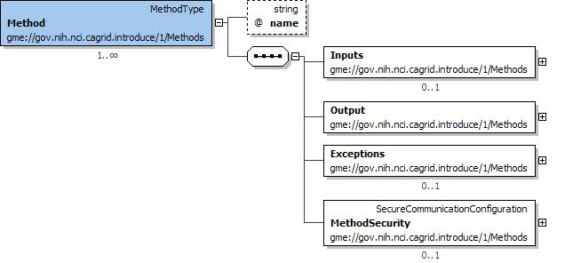
The Methods Document (cont)
A method describes information about the service operation so that the syncronization tools can edit all aspects of the service necessary in order for the service to reflect the description

Slide 29
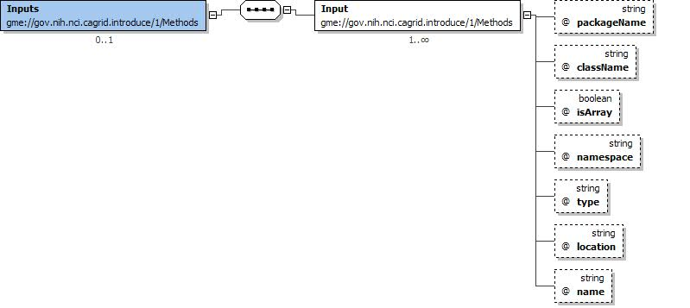
The Methods Document (cont)
Inputs

Slide 30
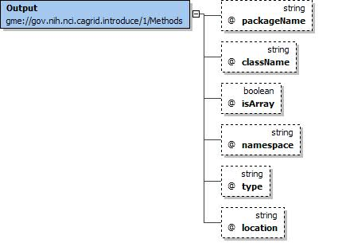
The Methods Document (cont)
Output
Faults

Slide 31
Inside the Introduce created service
Services have many moving and configurable parts which support features such as:
  Advertisement
  Discovery
  Invocation
  Security
The Introduce Toolkit can keep all these features in sync as the developer creates and modifies his/her grid service

Slide 32
Conclusion
Requirements
  Basic strongly typed grid requirements plus semantically interoperable caBIG requirements
Architecture
  Grid service framework which is encapsulated and layered on Globus
Introduce Toolkit
  Enables easy development of caBIG compliant grid service
Introduce Service Layout
  Simple grid service layout making it easy to locate and manage pieces of the implementation

