Slide 1
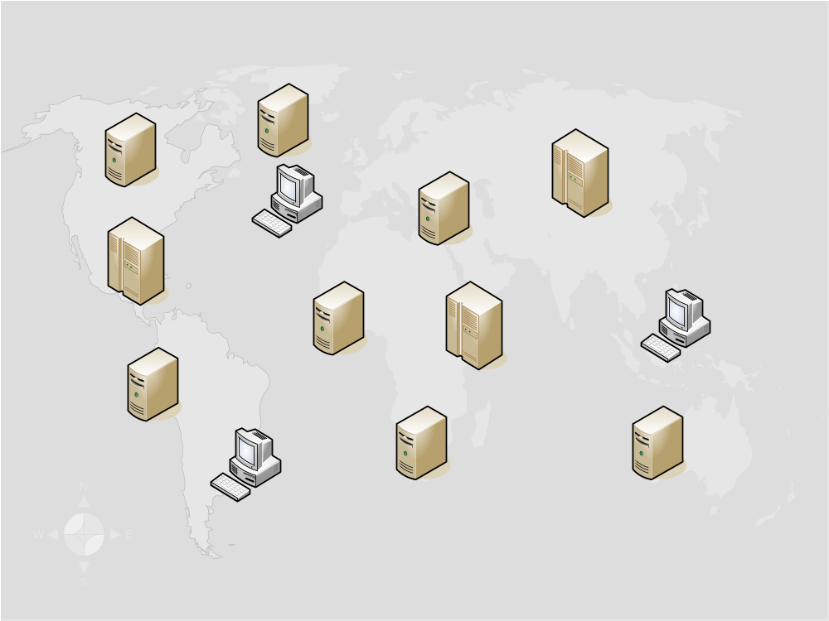
Trust Group B
Trust Group C
Trust Group D
Trust Group A

