Slide 1
caGrid 1.0 Data Services
BMI Work in Progress
September 28, 2006

Slide 2
Agenda
Addressing the problem
  Strongly typed data
  Moving existing systems to the grid
  Metadata (GME, caDSR, Domain Model)
  Advertisement and Discovery (Index service)
Data services
  Architecture
  CQL
    Example Query
  Implementation Details
    Generic data service client
    Provided query(..) method
    Pluggable CQLQueryProcessor
    caCORE SDK Query Processor
    Query validation (syntax and semantics)
Introduce Toolkit
  Demo of service creation process
    Exposing data types
    caCORE SDK considerations
    Introduce generated code (Client API, etc)

Slide 3
Strongly Typed Data
All data on the caBIG grid is strongly typed
  UML Models stored in caDSR
  XML Models stored in GME
Enables uniform exchange of information
  Ensures interoperability
Enabled discovery based on methods and their input / output data types

Slide 4
Existing Systems
Lower levels of caBIG compliance:
  Legacy: local data files, no data access API, free text data fields, no metadata, no electronic model
    Example: Storing data in flat text files, Excel spreadsheets
  Bronze: programmatic data access from external resource, controlled vocabularies, content definitions, metadata, data definitions used
    Example: Hibernate ORM system

Slide 5
Existing Systems (cont.)
Higher levels of compliance:
  Silver: caBIG reviewed and approved APIs for data objects and formats, vocabularies from caBIG sources, common data elements from caDSR, UML domain models
    Example: caCORE SDK generated data sources
  Gold: Everything from Silver, plus: Service oriented architecture with XML interchange, advertised metadata, models harmonized across caBIG domain workspaces.

Slide 6
Metadata
UML Models describe groups of classes (packages)
  Classes contain attributes and associations to other classes
GME houses XML schemas representing classes

Slide 7
Metadata (cont.)
Domain Model
  Metadata extracted from caDSR
  Describes classes exposed by a data service
  Discoverable through index service

Slide 8
Architecture
Specialization of caGrid services
  Expose data through a common query interface
Queries made with CQL Query objects
Results returned nested within a CQL Query Result Set

Slide 9
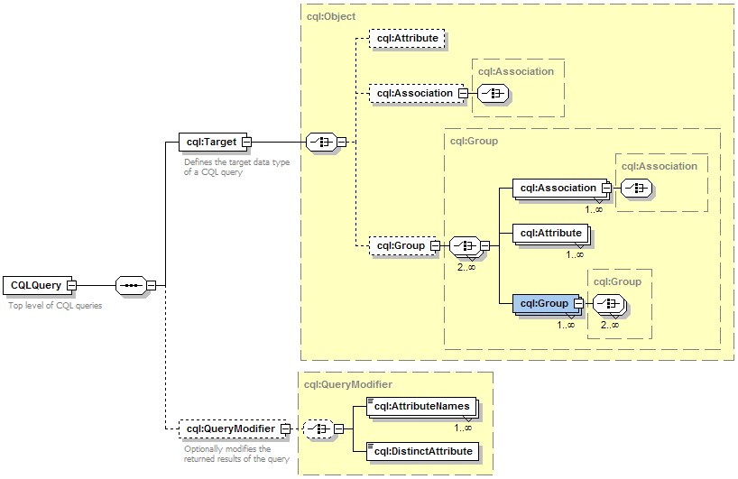
Common Query Language
Specifies a target object (result) type and selects the instances which satisfy the specified properties and nested object properties
Allows path navigation
Provides logical grouping
Provides name/predicate/value filtering on properties of objects
Allows queries for attributes and result set count
Recursively defined

Slide 10
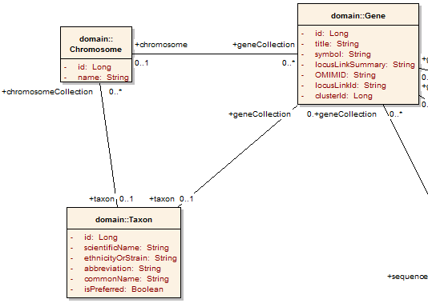
Example CQL Query
Return all Genes with a symbol beginning with BRCA and have an associated Taxon with an id equal to 6:

Slide 11
Example CQL Query
Return all Genes with a symbol beginning with BRCA and have an associated Taxon with an id equal to 6:
<CQLQuery xmlns="http://CQL.caBIG/1/gov.nih.nci.cagrid.CQLQuery"> <Target name="gov.nih.nci.cabio.domain.Gene"> </Target> </CQLQuery>

Slide 12
Example CQL Query
LIKE “BRCA%”
Return all Genes with a symbol beginning with BRCA and have an associated Taxon with an id equal to 6:
<CQLQuery xmlns="http://CQL.caBIG/1/gov.nih.nci.cagrid.CQLQuery"> <Target name="gov.nih.nci.cabio.domain.Gene"> <Attribute name="symbol" predicate="LIKE“ value="BRCA%"/> </Target> </CQLQuery>

Slide 13
Example CQL Query
LIKE “BRCA%”
Return all Genes with a symbol beginning with BRCA and have an associated Taxon with an id equal to 6:
<CQLQuery xmlns="http://CQL.caBIG/1/gov.nih.nci.cagrid.CQLQuery"> <Target name="gov.nih.nci.cabio.domain.Gene"> <Group logicRelation="AND"> <Attribute name="symbol" predicate="LIKE“ value="BRCA%"/> <Association roleName="taxon“ name="gov.nih.nci.cabio.domain.Taxon"> </Association> </Group> </Target> </CQLQuery>

Slide 14
Example CQL Query
LIKE “BRCA%”
Return all Genes with a symbol beginning with BRCA and have an associated Taxon with an id equal to 6:
<CQLQuery xmlns="http://CQL.caBIG/1/gov.nih.nci.cagrid.CQLQuery"> <Target name="gov.nih.nci.cabio.domain.Gene"> <Group logicRelation="AND"> <Attribute name="symbol" predicate="LIKE“ value="BRCA%"/> <Association roleName="taxon“ name="gov.nih.nci.cabio.domain.Taxon"> <Attribute name="id" predicate=“EQUAL“ value="6"/> </Association> </Group> </Target> </CQLQuery>
= 6

Slide 15
Implementation
Data Service infrastructure provides a generic query client
  Made possible by provided and therefore consistent service implementation
Iterator for returned result sets provided
  Capable of deserializing XML results to Java Objects.

Slide 16
Implementation (cont.)
public abstract CQLQueryResults processQuery(CQLQuery cqlQuery)
throws MalformedQueryException, QueryProcessingException;
Data Service infrastructure provides:
  Query validation facilities
  Configuration and invocation of query processor
Service Developer provides:
  Implementation of CQL against their data source

Slide 17
Implementation (cont.)
CQL Query Processor
  Selectable implementation to retrieve data from backend data source
  Loaded via reflection at runtime
  Configurable by service parameters
    Editable with Introduce data services extension

Slide 18
Implementation (cont.)
Gold compliance creates the G in caBIG
  Gold => Grid => connecting Silver Systems
SQK Query Processor
  CQL implementation against caCORE systems
  Translates CQL to Hibernate Query Language

Slide 19
Implementation (cont.)
Query validation is provided by Data Service infrastructure
  Optional feature, can be configured
  Syntax validation for CQL
    Ensures queries are well formed
  Semantic validation
    Ensures queries use classes and attributes from Domain Model
    Basic data type validation performed

Slide 20
Introduce Extension
An extension to the Introduce Toolkit
  Adds required data types
  Imports standard query method
  Allows selection of domain model
  Configuration of query processor
  Generation of metadata

Slide 21
caGrid 1.0 Data Services
BMI Work in Progress
September 28, 2006

