Slide 1
caGrid Data Services
End to end service creation and invocation

Slide 2
Overview
An existing silver level caCORE generated service must be moved to gold level compliance.
caGrid Data Services offer capability to expose silver systems to the Grid.
An extension to the Introduce Toolkit is used to create the new grid service.

Slide 3
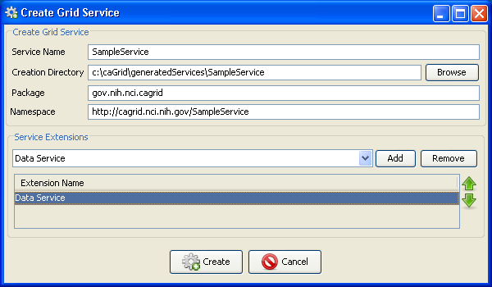
Service Creation
A new service is created with Introduce.
The service is given a name, directory, package, and namespace.
The Data Service extension is selected for use.

Slide 4
Service Creation (Cont.)
Data service extension adds the required query method.
  An implementation of the method is provided and the method is imported from a WSDL file.
The extension adds namespaces for the CQL query and result types.
Required Java libraries are copied in to the new service.

Slide 5
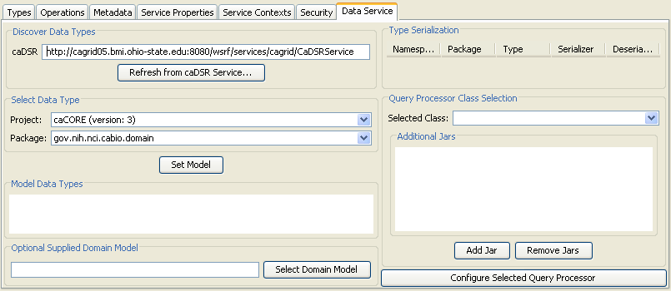
Service Modification
The service modification interface now includes a tab devoted to Data Service configuration.
  Using only this tab, a basic data service can be completely configured.

Slide 6
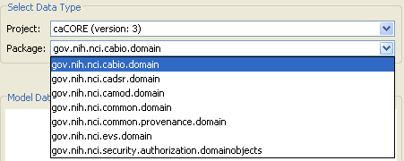
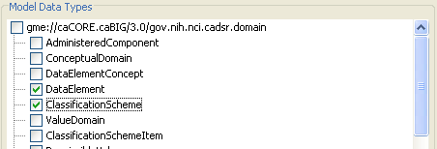
Service Modification (Cont.)
A project and package can be selected from the caDSR for the data service.
Data types to be used in queries are then selected from the model.

Slide 7
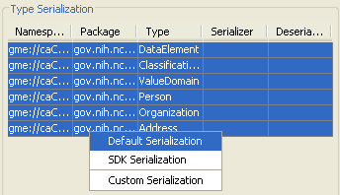
Service Modification (Cont.)
The selected data types appear in the types table, where serialization can be configured.
  A specialized serializer has been provided for types created with the caCORE SDK.

Slide 8
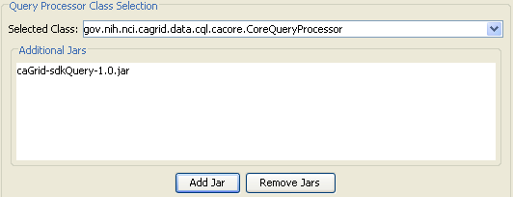
Service Modification (Cont.)
A query processor is selected by supplying the implementation Jar files and selecting a class from the drop down.
  Only classes in the Jar files which implement the base CQL query processor interface are shown in the drop down
  Other classes can be manually specified.

Slide 9
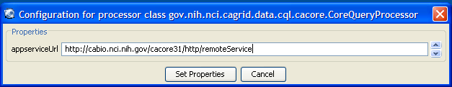
Service Modification (Cont.)
The selected query processor can be configured with the graphical interface as well.
  The configuration here appears as service properties available at runtime.

Slide 10
Service Modification (Cont.)
When the service is saved, both the standard Introduce provided synchronization operations, and the data service specific operations are performed.
  The domain model is built from the caDSR.
  Configuration of the query processor implementation is added and made available through JNDI at runtime.

Slide 11
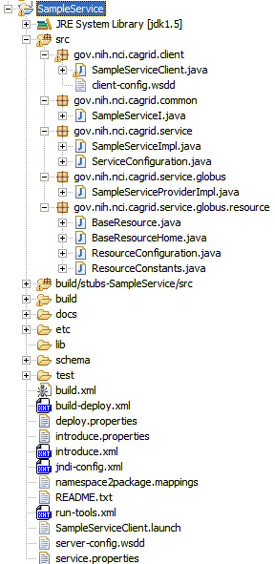
Invoking the Data Service
The service can be invoked with either the Introduce generated client class, or the provided data service client tooling.
  Data service project provides a DataServiceHandle class.
    Handle can query any standard data service.
    Handle abstracts iteration of query results.

Slide 12
Sample Code to Invoke the New Service
public static void main(String[] args) {
try {
InputStream configStream = ClassUtils.getResourceAsStream(
DataServiceInvoker.class, "client-config.wsdd");
DataServiceHandle handle =
new DataServiceHandle(new DataServiceClient(SERVICE_URL), configStream);
CQLQuery query = new CQLQuery();
Object targetObject = new Object();
targetObject.setName(Address.class.getName());
Attribute stateAttrib = new Attribute();
stateAttrib.setName("state");
stateAttrib.setPredicate(Predicate.EQUAL_TO);
stateAttrib.setValue("MD");
targetObject.setAttribute(stateAttrib);
query.setTarget(targetObject);
Iterator iter = handle.query(query);
while (iter.hasNext()) {
Address addy = (Address) iter.next();
System.out.println("--- Address ---");
System.out.println(addy.getAddressLine1());
System.out.println(addy.getAddressLine2());
System.out.println(addy.getCity());
System.out.println(addy.getState());
System.out.println(addy.getCountry());
System.out.println(addy.getPostalCode());
}
} catch (Exception ex) {
ex.printStackTrace();
System.exit(1);
}
}

