Slide 1
Federated Query Break-Out Session
Ian Fore, NCICBIIT
David Ervin, Ohio State University
Michael Keller, Booz Allen Hamilton
TBPT Face-to-Face Meeting
San Francisco, CA

Slide 2
Data Services Overview
Part 1: Introduction (30 min)
  CQL
  Current query capabilities provided by caGrid
Part 2: Team Assignments (2 hours)
  Develop use cases for federated queries on caGrid
    Detail specific queries to be performed over specific services
    Categorize these use cases by:
      Queries that can be currently performed on caGrid
      Queries that are difficult to currently perform on caGrid
      Queries that can not be currently performed on caGrid
Part 3: Team Briefings and Summary (30 min)

Slide 3
Data Services Overview
Specialization of caGrid grid services to expose data through a common query interface
Present an object view of data sources
Exposed objects are registered in caDSR and their XML representation in GME
Queries made with CQL Query objects
Results returned as objects (or identifiers) nested in a CQL Query Result Set

Slide 4
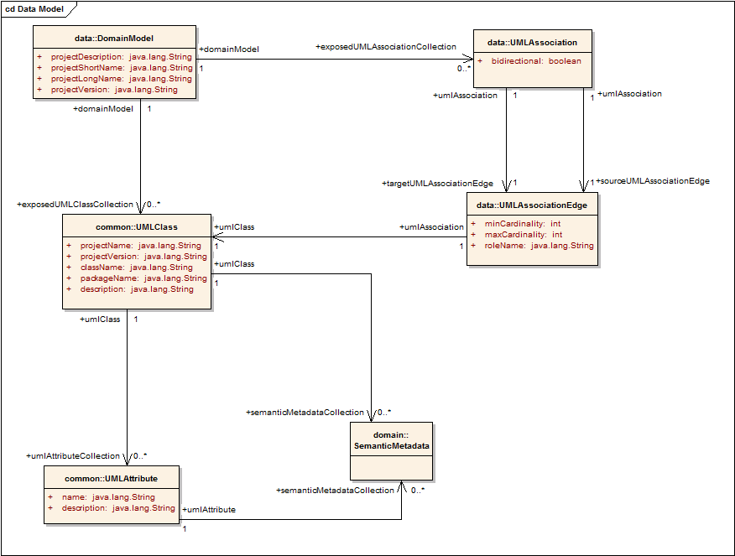
Data Services Overview (metadata)
Standard metadata exposed by all Data Services describes the UML model being exposed, and contains links to semantic underpinnings
  Expresses available targets, attributes, and associations between data types
Provides information needed to formulate the Object-Oriented Query (CQL)
Contains Semantic Information from EVS

Slide 5
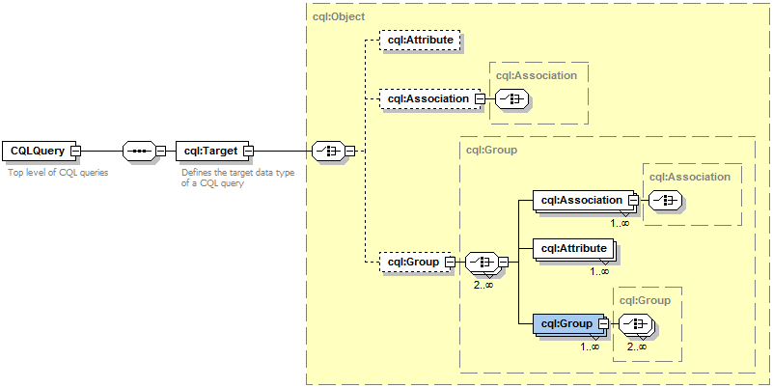
Data Services Overview (CQL)
Specifies a target object (result) type and selects the instances which satisfy the specified properties and nested object properties
Allows path navigation
Provides logical grouping
Provides name/predicate/value filtering on properties of objects
Recursively defined

Slide 6
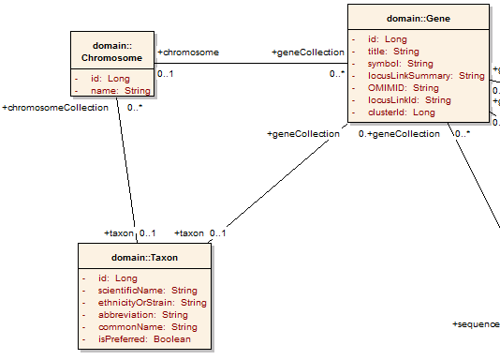
Data Services CQL Example
Return all Genes with a symbol beginning with BRCA and have an associated Taxon with an id equal to 6:

Slide 7
Data Services CQL Example
Return all Genes with a symbol beginning with BRCA and have an associated Taxon with an id equal to 6:
<CQLQuery xmlns="http://CQL.caBIG/1/gov.nih.nci.cagrid.CQLQuery"> <Target name="gov.nih.nci.cabio.domain.Gene"> </Target> </CQLQuery>

Slide 8
Data Services CQL Example
LIKE “BRCA%”
Return all Genes with a symbol beginning with BRCA and have an associated Taxon with an id equal to 6:
<CQLQuery xmlns="http://CQL.caBIG/1/gov.nih.nci.cagrid.CQLQuery"> <Target name="gov.nih.nci.cabio.domain.Gene"> <Attribute name="symbol" predicate="LIKE“ value="BRCA%"/> </Target> </CQLQuery>

Slide 9
Data Services CQL Example
LIKE “BRCA%”
Return all Genes with a symbol beginning with BRCA and have an associated Taxon with an id equal to 6:
<CQLQuery xmlns="http://CQL.caBIG/1/gov.nih.nci.cagrid.CQLQuery"> <Target name="gov.nih.nci.cabio.domain.Gene"> <Group logicRelation="AND"> <Attribute name="symbol" predicate="LIKE“ value="BRCA%"/> <Association roleName="taxon“ name="gov.nih.nci.cabio.domain.Taxon"> </Association> </Group> </Target> </CQLQuery>

Slide 10
Data Services CQL Example
LIKE “BRCA%”
Return all Genes with a symbol beginning with BRCA and have an associated Taxon with an id equal to 6:
<CQLQuery xmlns="http://CQL.caBIG/1/gov.nih.nci.cagrid.CQLQuery"> <Target name="gov.nih.nci.cabio.domain.Gene"> <Group logicRelation="AND"> <Attribute name="symbol" predicate="LIKE“ value="BRCA%"/> <Association roleName="taxon“ name="gov.nih.nci.cabio.domain.Taxon"> <Attribute name="id" predicate=“EQUAL“ value="6"/> </Association> </Group> </Target> </CQLQuery>
= 6

Slide 11
Data Service Creation
Data services can be built via an Introduce Toolkit extension
Extension adds functionality to both service creation and modification
  Creation adds query operation
  Modification adds CQL implementation, selected data model, and appropriate metadata
  Specialized client configured to support necessary custom serialization and security settings
    Generic Data Service Client can be used to communicate with ANY data service, but a service-specific client knows what security the service is configured with, and any non-default serialization it may make use of

Slide 12
Data Service Creation (styles)
Data Service creation can be further specialized with styles.
  Eg. caCORE SDK 3.2 style
Allows developers to add a creation wizard.
Further modification to Introduce service model
  Add methods and types
  Modify code as required
  Configure data service internals

Slide 13
Data Service Querying
Primary query method
  Required for all data services
  Takes single CQL query parameter
  Returns CQL Query Results instance
Alternate results delivery
  WS-Enumeration
    Returns enumeration context
    Allows client to consume results as it is able
  caGrid Bulk Data Transport (BDT)
    Returns BDT Reference
    Supports WS-Enumeration, WS-Transfer, and GridFTP

Slide 14
Federated Query
Distributed aggregations
  Broadcast queries to multiple services
  Identical data types on each service
Distributed joins
  Disparate data types on each service

Slide 15
Federated Query Language (DCQL)
DCQL derives from CQL
  Hierarchal approach
  Recursively defined
Data Model drives the query
  Underlying data service domain model used
CQL is context dependent
  Depend on data model of target service
DCQL identifies context
  Identifies service each part of the query targets

Slide 16
Federated Query Language (DCQL)
Foreign Association
  Describes a relationship between the containing object and an object on another data service
  Processing results in a new CQL subquery directed to the target data service
Join Condition
  Specifies attribute relationship
  Local and remote attribute names
  Predicate (EQUAL, LESS_THAN, etc)

Slide 17
Federated Query Engine
Requires no direct support from Data Services
Joining offloaded to FQP service
Engine may be reused in a client application
  Simplicity over efficiency
  Portability over optimization

Slide 18
Federated Query Engine
Three Core components
Federated Query Engine
  Client facing API accepts DCQL
  Orchestrates use of other components
Federated Query Processor
  Traverses the query, executes engine logic, handles intermediate aggregations
Data Service Executor
  Invokes standard CQL against data services

Slide 19
Federated Query Processor (Functionality)
Converts DCQL to standard CQL
  Traverses query recursively
Foreign Associations are resolved
  Processed against target data service
  Utilizes CQL Query Modifier to obtain attribute values from target
  Produces CQL Group based on result values

Slide 20
Federated Query Client
Three ways to invoke
Execute
  Blocks until processing is complete
  Results maintain information about source
executeAndAggregateResults
  Blocks until processing is complete
  Standard CQL Query Results
executeAsynchronously
  Creates resource to handle processing

Slide 21
Federated Query Security
May be deployed securely (TLS)
  Asynchronous processing uses resource security – Creator only, single gridmap entry
Security configured with Introduce
  Standard Introduce service
  Methods / service may be secured via Introduce
No delegated credentials
  Remote data services must trust FQP service

Slide 22
Part 2: Develop use cases for federated queries on caGrid
These use cases should include:
  The primary stakeholders (i.e. who is performing the queries)
  Specific queries to be performed
  Specific services these queries will be performed across
The use cases should be categorized by:
  Queries that can be currently performed on caGrid
  Queries that are difficult to currently perform on caGrid
  Queries that can not be currently performed on caGrid
Highlight potential issues impeding the execution of the proposed federated query use cases.
  Bandwidth issues?
  Response times?
  Others?

Slide 23
Part 3: Team Briefings and Summary
Summary of use cases developed
  Queries that can be currently performed on caGrid
  Queries that are difficult to currently perform on caGrid
  Queries that can not be currently performed on caGrid
Summary of issues identified
  Description of issue
  Next steps/action items to begin addressing issues

