Slide 1
caGrid Portal
Homepage UI alternatives and icon concepts
November 07, 2007
Prepared By: Gayatri Sathe, Apara Ranjan
Persistent Systems Ltd

Slide 2
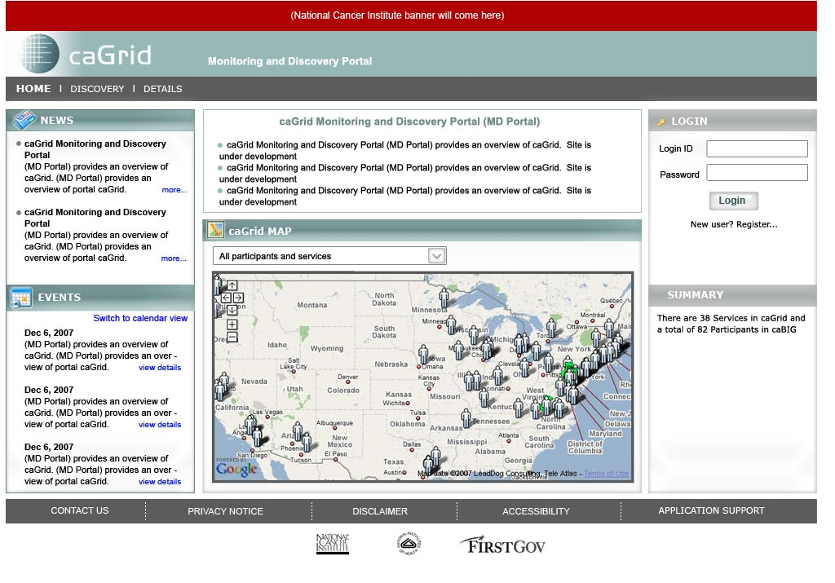
Homepage_v2

Slide 3
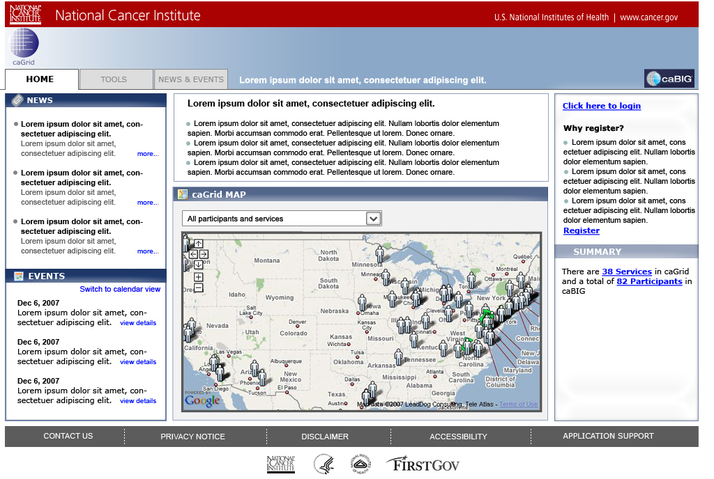
Homepage_v3

Slide 4
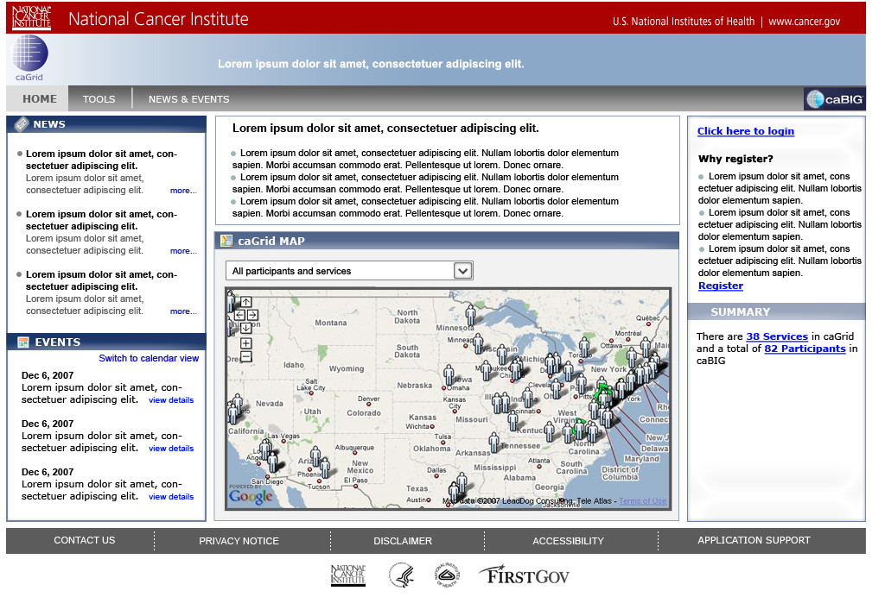
Homepage_v4

Slide 5
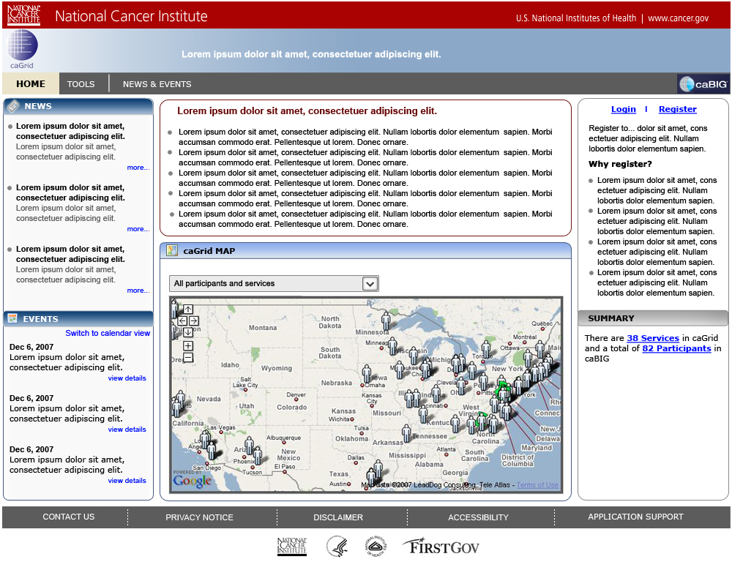
Homepage_v5

Slide 6
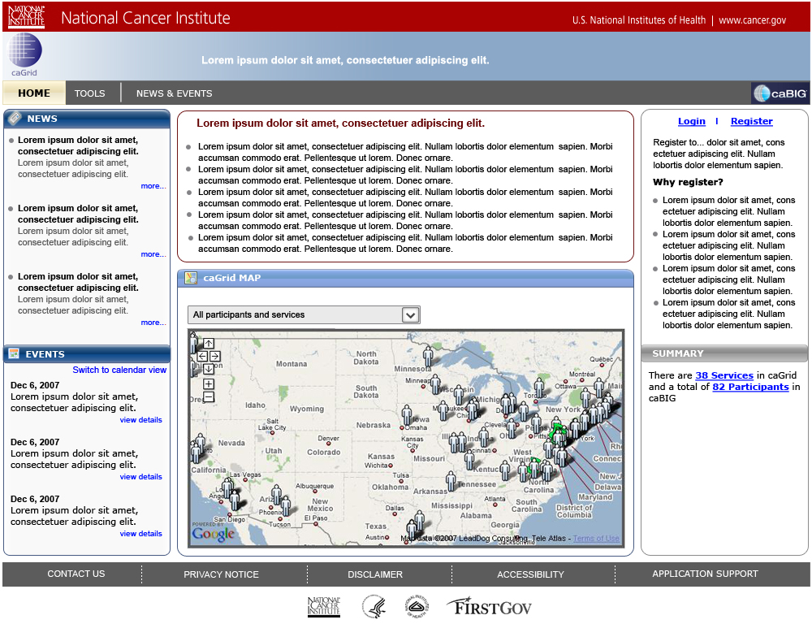
Homepage_v5a

Slide 7





Icon concepts
Participant individual
or a point of contact
Participant institute
Data service
Analytical service
Hosting research center

Slide 8

Thank You.

