Slide 1
caGrid Portal
Design Evaluation
December 21, 2007
Prepared By: Persistent Systems Ltd

Slide 2
Contents
Homepage: existing design analysis
Homepage: design recommendations
Homepage: proposed design
Discovery flow: existing (Steps involved.)
Discovery flow: proposed (Steps involved.)

Slide 3
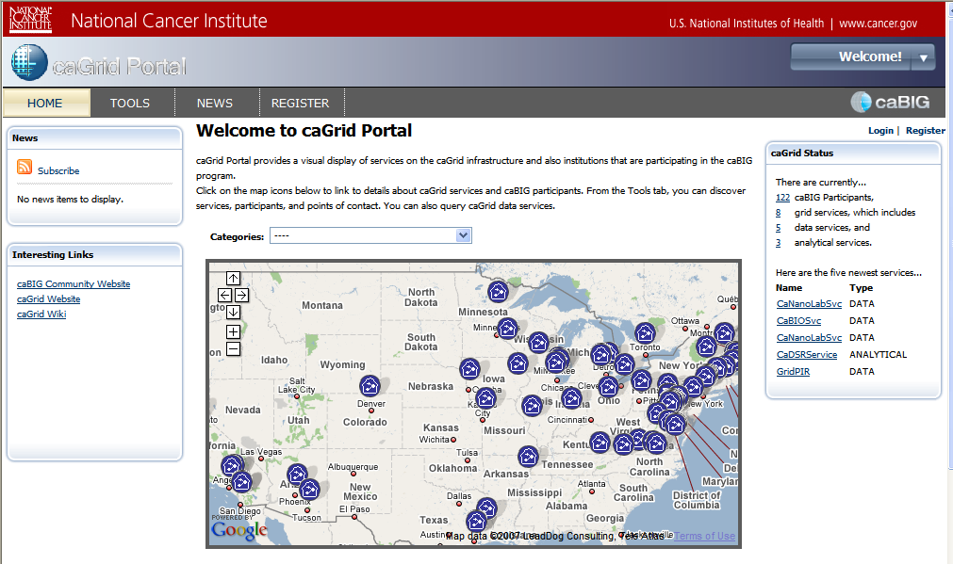
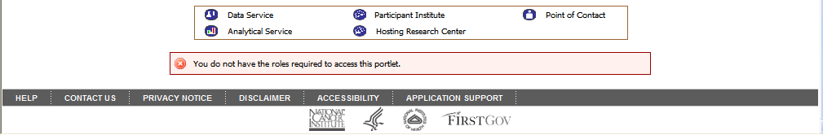
Homepage: existing
1
Comments:
The logo is pixilated and not visible.
The left hand side panel has lost its purpose. The term interesting link is too ambiguous. The ‘Subscribe’ link in news section does not convey its purpose properly.
The purpose of the categories filter is lost. The map, category filter and the legend do not seem connected. The category drop down seems to be a part of the above content.
The map legend is an important piece of information for viewing the map. It is going in vertical scroll .
The login and information on ‘why register’ were given space in the upper right hand side panel. But currently it appears to be links outside the panel.
The panel is not taking the complete screen length and hence visually the screen looks unbalanced and panel looks hanging.
The list of latest services in caGrid seems to be an important piece of information which is placed at the bottom of the screen.
5
2
3
6
7
4

Slide 4
Design Recommendations
Logo: Try logo with darker colours like black.
A snapshot of latest happenings at caGrid should prelude the ‘subscribe’ link in the ‘News’ section.
The category dropdown , map and the legend should be clubbed together by making them appear in one portlet. Proximity of map and category dropdown should be reduced to make it look related.
Once the user clicks the login link the screen should not refresh rather a pop up should appear for logging in and the background still has the homepage.
The list of latest services can be part of news rather than summary.

Slide 5
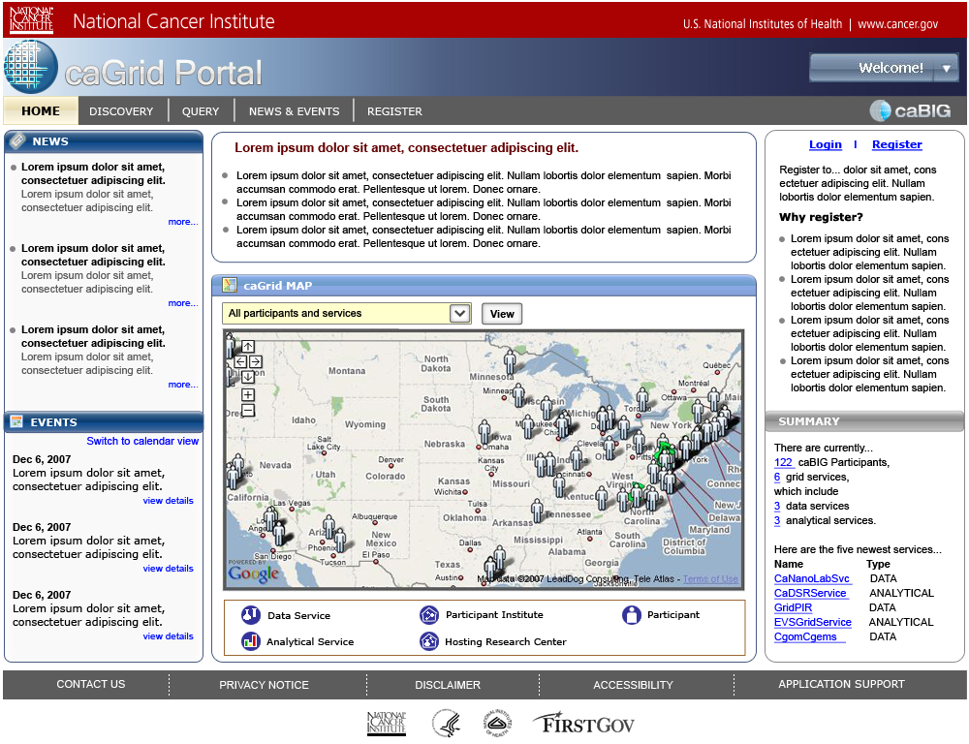
Homepage: proposed

Slide 6
Discovery: Existing flow
Tasks:
Optional step
Search for an entity ( service, participant or point of contact) and view search results
View details of a chosen entity. ( Service, participant or POC)
Select a service to proceed for query building.
4a
5a
Page refresh
Directory tab
Select category to view
(Open by default)
(‘All services’ open by default)
3a
Discovery portlet
Select an entity: services, participants or POCs
5b
6
7
1
2
4b
Type in keyword
Click on ‘Search’ button
A
Homepage
Tools
Search tab
Results
(click to open tab)
(‘All services’ open by default)
6.1
Select fields
(‘1 click = 1 condition.
Ctrl + click = select multiple)
B
8
Click on ‘More details’
Details
9
C
Browse details
Select a UML class to query
3b
Data service Query portlet

Slide 7
Observations
The nomenclature ‘TOOLS’ is not intuitive enough for a new user to understand the purpose the section serves.
The action of browsing caGrid entities (services, participants and points of contacts) is hidden in ‘directory’ tab. The user needs to read the long list of objects in the dropdown to understand the scope of the search.
There are two ways of discovering information: browsing the directory & keyword search. The sub-tabs within these two main tabs are not consistent. ‘Keyword search’ has three sub-levels of searches across services, participants and POCs. On the other hand, the ‘Directory’ offers two ways (List view and Map view) of viewing the same information as sub-tabs.
The user can select multiple fields in step ,by pressing ‘Ctrl’ key selecting fields one by one. This is not conveyed clearly in the current portal.
Viewing the details of a chosen service / participant/ POC is a secondary step after result view. But still, it is placed at the same level of ‘Directory’ and ‘Search’.

Slide 8
Discovery: Proposed flow
Tasks:
Optional step
Search for an entity ( service, participant or point of contact) and view search results
View details of a chosen entity. ( Service, participant or POC)
Select a service detail to query
Choose a category type
4a
3
1
2
Select Entity service/ participant /POCs
5
A
Homepage
Discovery
Click on ‘GO’ button
Results
Type in keyword
4b
6
Click on ‘View details’
4b.1
(‘1 click = 1 condition.
Ctrl + click = select multiple)
Details
(browse)
B
Select fields
C
Select UML class to query

Slide 9
Advantages of proposed flow:
The key tasks of the user: ‘Discovery’ and ‘Query’ are brought at the higher level navigation, instead of keeping them embedded in the ‘Tools’ tab. It caters to the users’ need at the very first screen (Homepage).
The sub-tabs - services, participant or POCs narrow down the process of searching for information, simplifying the task for the user.
Browsing the caGrid directory is essentially looking for information in predefined categories. The current design allows user to directly search for information under a predefined category.
Linear flow of current design removes the redundancy of steps and reduces the time required to complete a task.
Users can easily select multiple fields by checking the boxes.
The page displaying details of a chosen service / participant/ POC opens on top of the search results, but under the same tab. User can easily go back to the search results by following a simple link.

Slide 10

Thank You.

