Slide 1


openMDR:
Generating Semantically
Annotated Grid Services
Rakesh Dhaval
Shannon Hastings

Slide 2
Topics
Overview
caCORE and OpenMDR Workflows
OpenMDR Components
OpenMDR Usage Walkthrough
Project Status and Future Direction

Slide 3
What is openMDR?
Suite of software that provides caGrid-compatible Semantic Metadata Management capabilities
The suite includes four different components:
    MDR Core (ISO 11179 database and web frontend to curate and browse)
    MDR Query (caGrid grid service which provides query functionality to multiple registries.
    MDR EA Plugin (uses mdrQuery to provide model annotation).
    MDR DomainModelGenerator (consumes XMI generated by openMDR EA plugin and generates a Domain Model file required for caGrid to create the grid data service.

Slide 4
What are we trying to solve?
Currently caGrid tools use the caDSR, caCORE SDK, SIW, etc. (“caCORE”) to create semantically annotated grid services.
User groups who want to create a local metadata resource during development have no options.
Give groups in Local Institutional Environment other choices for managing semantic metadata and still give them the ability to create caGrid semantically annotated grid services.
In addition, OpenMDR can be used in CTSA’s, Cooperative Groups, Regional Health Groups and other domain.

Slide 5
Current caBIG Semantics Utilization Limitations
No support for “local” metadata or terminologies/ontologies
Local user groups cannot (or not intended to) stand up a “local” caDSR .
No support to copy content from NCI caDSR to one’s local instance of caDSR
The annotation tools (SIW) and caDSR can’t annotate or store a model that is annotated by more than one metadata registry
caGrid tools currently can only create grid data services that use models which have gone through the SIW – so NCI source of metadata approach is the ONLY current path.

Slide 6
Topics
Overview
caCORE and OpenMDR Workflows
OpenMDR Components
OpenMDR Usage Walkthrough
Project Status and Future Direction

Slide 7
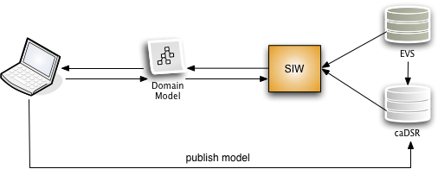
caBIG Semantic Workflow

Slide 8
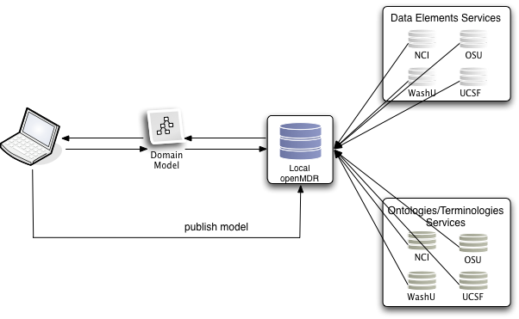
OpenMDR-based Federated WorkFlow
caDSR, OpenMDR
LexEVS

Slide 9
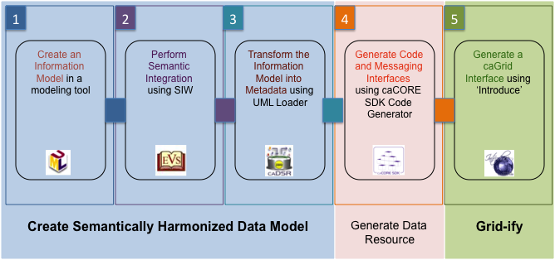
Development Process Using caDSR to Generate a Data Resource

Slide 10
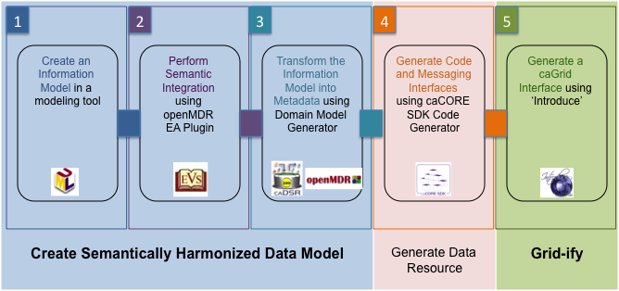
Development Process using OpenMDR to Generate a Data Resource

Slide 11
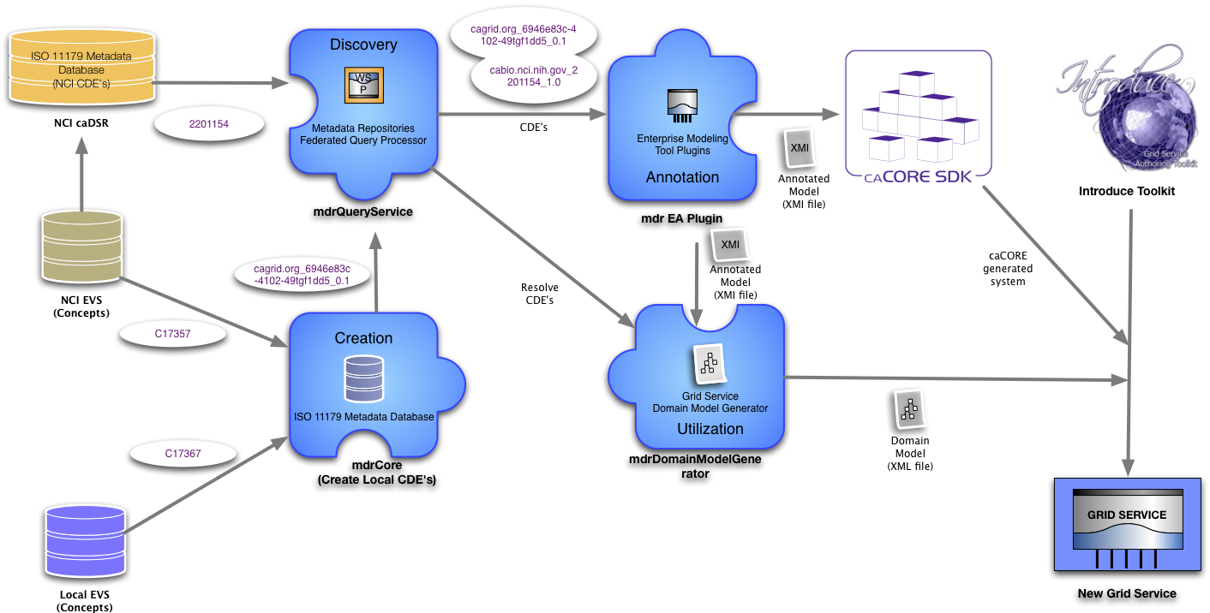
openMDR Based Service Creation Workflow

Slide 12
Topics
Overview
caCORE and OpenMDR Workflows
OpenMDR Components
OpenMDR Usage Walkthrough
Project Status and Future Direction

Slide 13
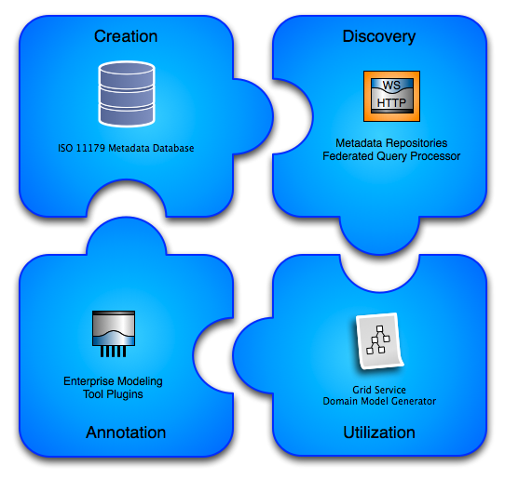
openMDR: Components

Slide 14
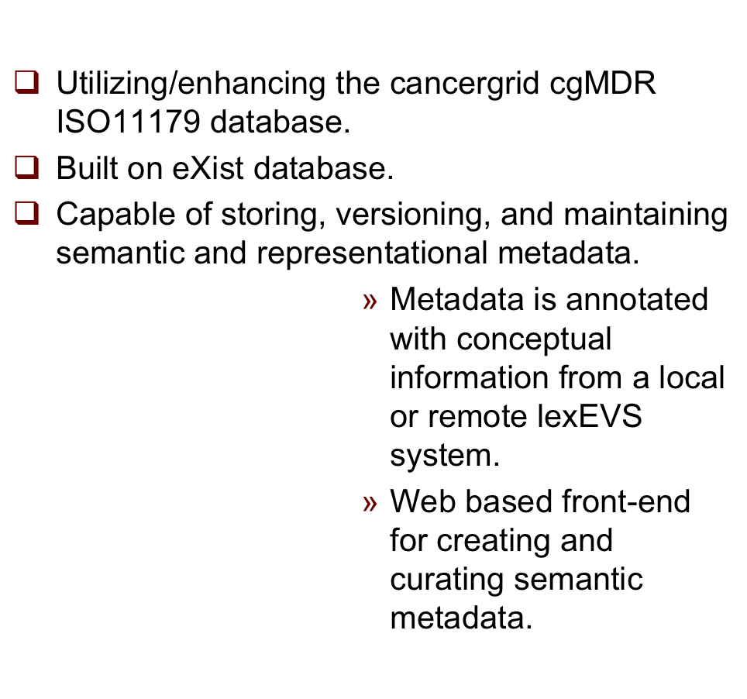
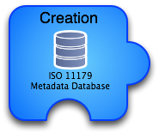
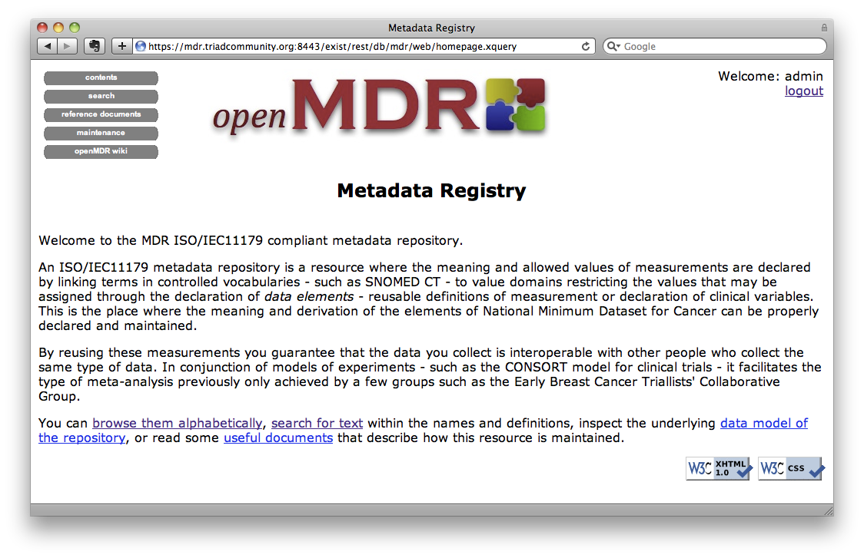
openMDR:mdrCORE

Slide 15
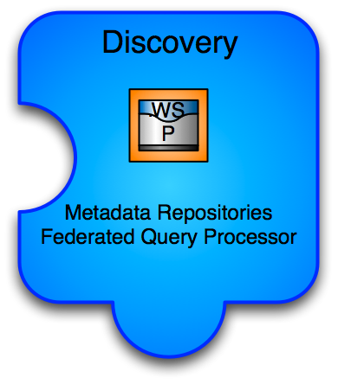
openMDR:mdrQuery
API and Grid Service for querying across many disparate semantic metadata repositories
  caGrid grid service - capable of talking to caDSR and many openMDR systems enabling federated query of common data elements.
  Enhances and wraps the cgMDR mdrConnector in order to parse the received information into a common format.
  caGrid service enables it to be deployed in any local or production grid environment and can be configured and modified to talk to many semantic metadata systems.

Slide 16

openMDR:mdrEAPlugin
EA Plugin
  Enables semantic annotation of federated semantics
  Utilizes MDRQuery service for locating and utilizing CDE’s from multiple semantic metadata sources
  Options for Search Filters
  Enables Search within “Context”
  Tags are created that identify CDE via local unique id
  No need to leave the EA environment

Slide 17
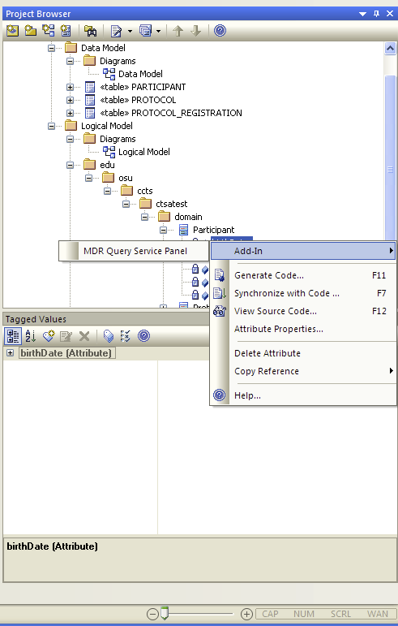
openMDR:mdrEAPlugin

Slide 18
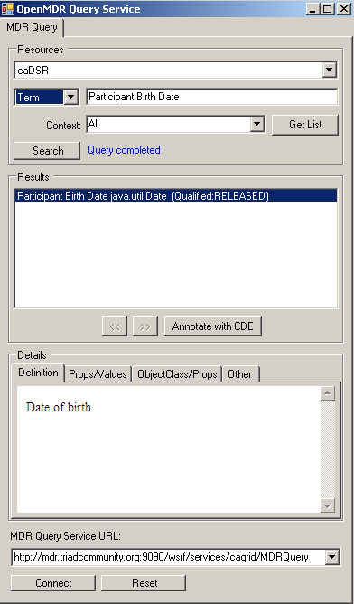

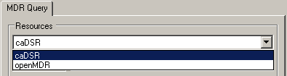
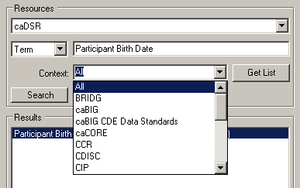
openMDR:mdrEAPlugin

Slide 19
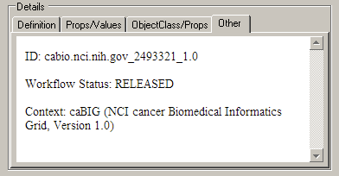
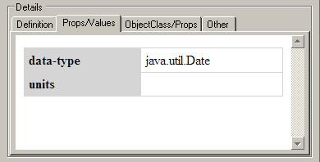
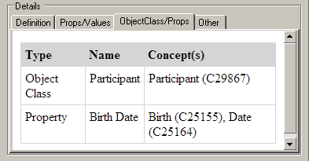
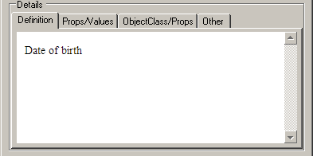
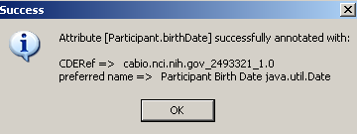

openMDR:mdrEAPlugin

Slide 20
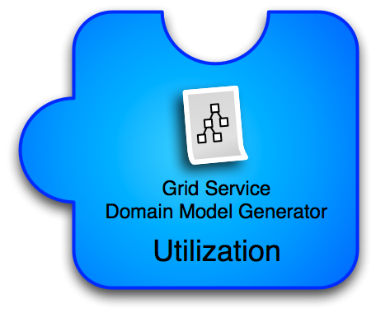
openMDR:mdrDomainModelGenerator
Process an MDR Plugin annotated model and create service metadata which will enable the service to be a semantically annotated grid service and easily discovered
  The metadata can be used to generate a data service using the Introduce Data Service Wizard which prior to this tool would only be able to utilize the caDSR, can now generate data services annotated with data models from almost anywhere.

Slide 21
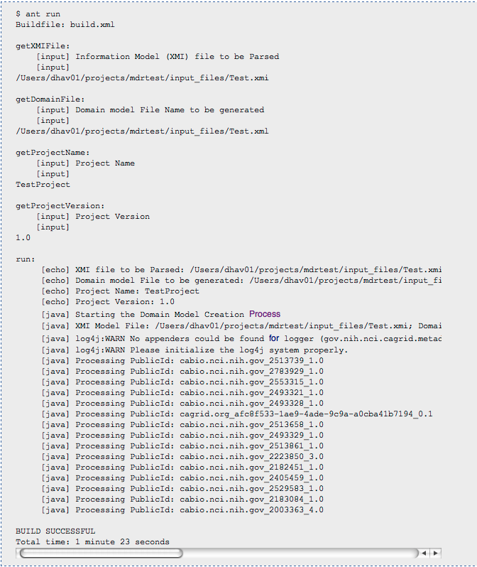
openMDR:mdrDomainModelGenerator

Slide 22
Topics
Overview
caCORE and OpenMDR Workflows
OpenMDR Components
OpenMDR Usage Walkthrough
Project Status and Future Direction

Slide 23
OpenMDR Service Creation Phases
CDE curation in Local instance of openMDR - using concepts from Local or Remote (NCI) LexEVS instance
Create an information model - create logical model, data model and Mapping Object Model to Data Model in Enterprise Architect (EA)
Annotate logical model with CDE's in EA - using openMDR EA plugin. The plugin makes use of the mdr Query Service that queries multiple metadata registries (openMDR, caDSR)
Export annotated XMI
Create domain model file (XML file) with grid service metadata
Generate a system using caCORE SDK 4.X by supplying your UML model as input
Create Grid Service - Use Introduce grid Service Authoring Toolkit

Slide 24
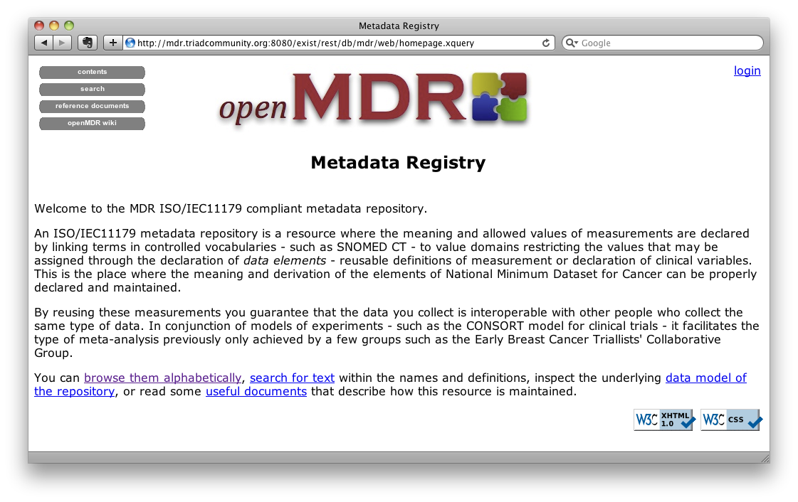
1: OpenMDR CDE Curation

Slide 25
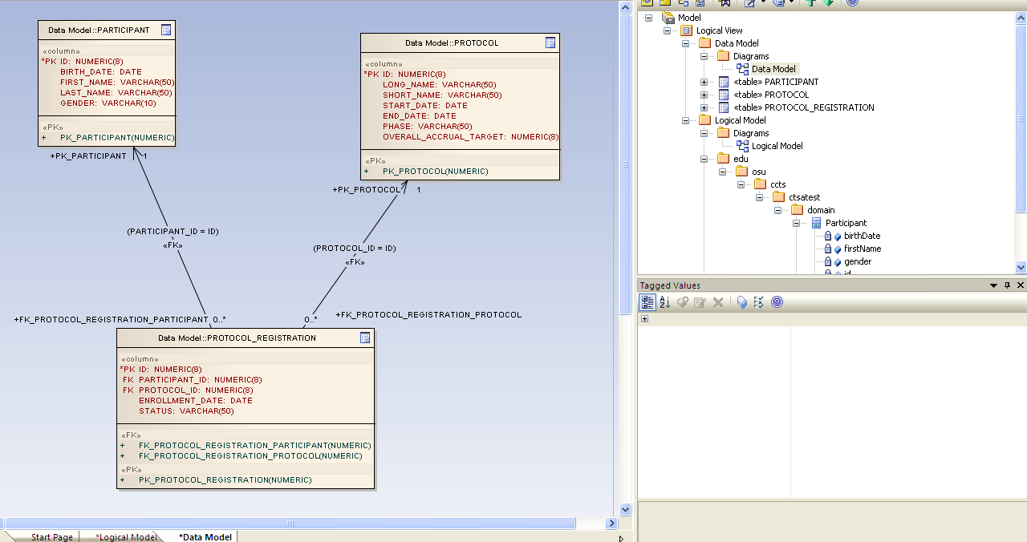
2: Create Information Model

Slide 26
3A: Semantically Annotate Model

Slide 27
3B: Semantically Annotate Model

Slide 28
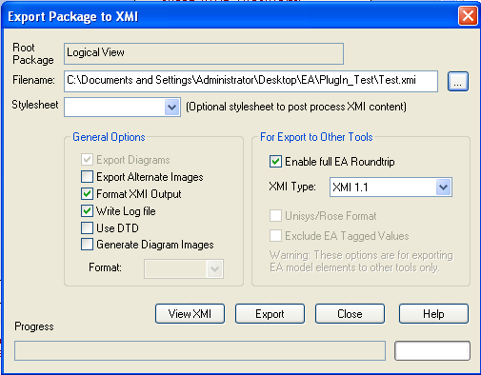
4: Export Annotated XMI

Slide 29
5: Create Domain Model File

Slide 30
6: Generate System
using caCORE SDK 4.X
Input: Semantically Annotated UML Model

Slide 31
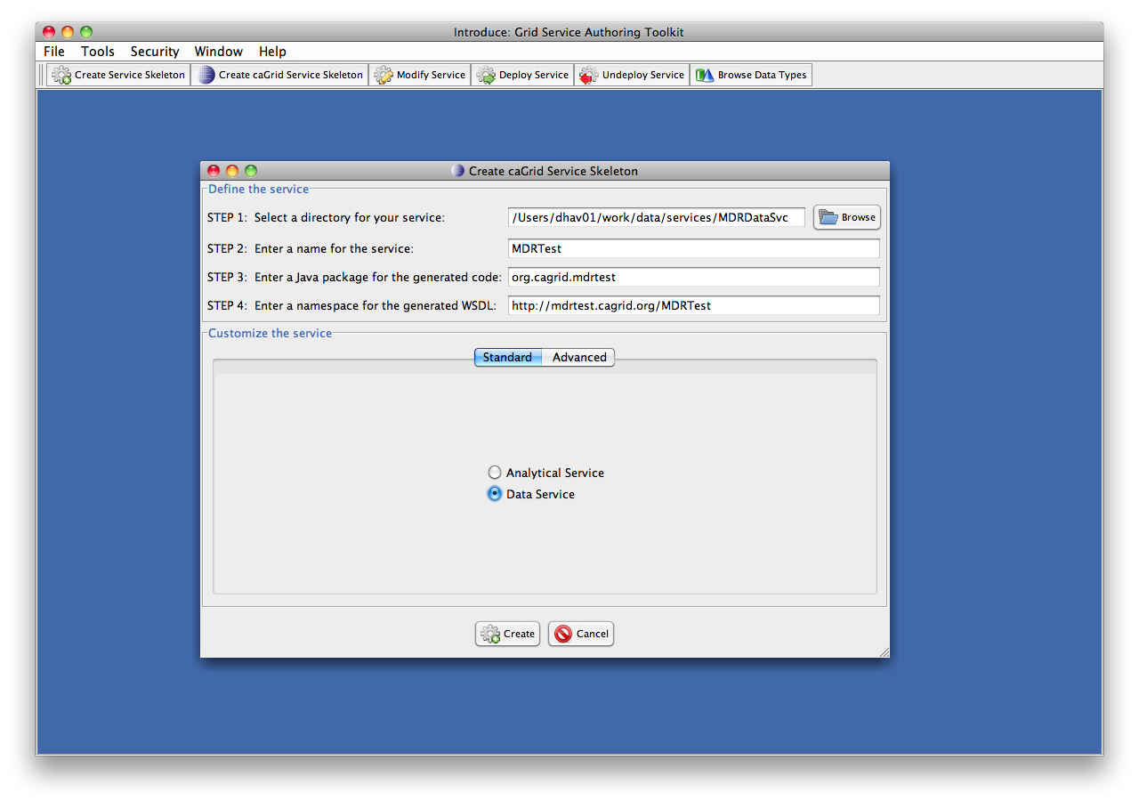
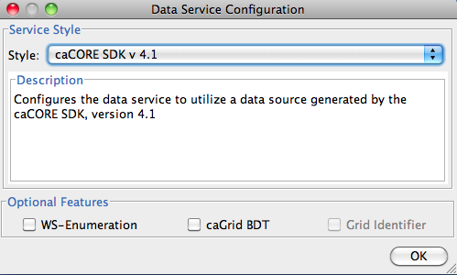
7A: Use Introduce: Create Service

Slide 32
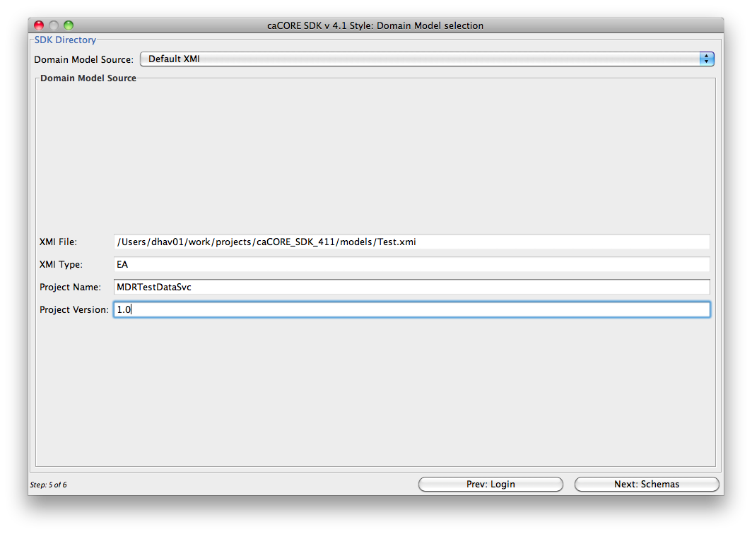
7B: Use Introduce: Choose Domain Model

Slide 33
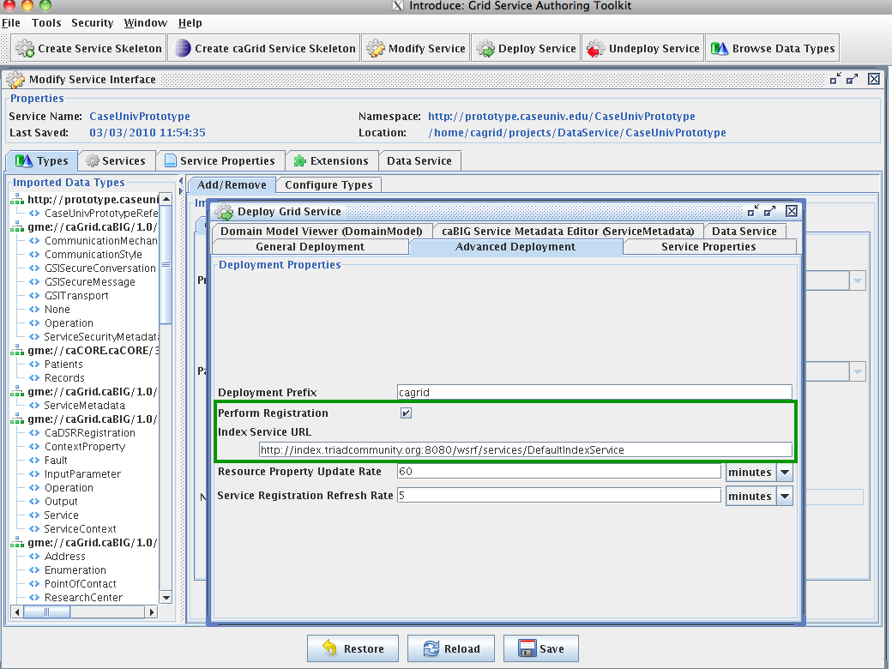
7C: Use Introduce: Register Service

Slide 34
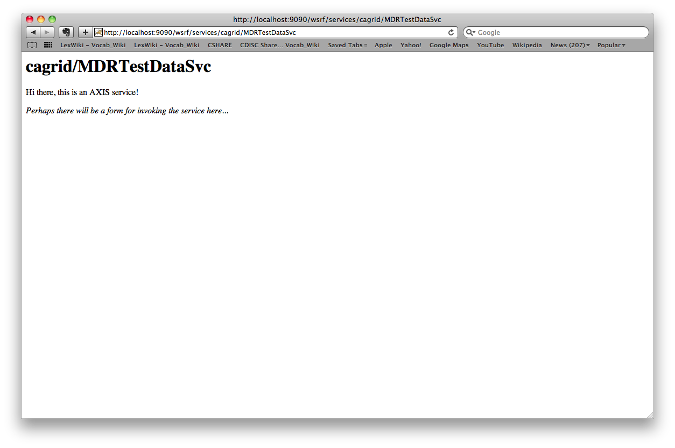
7D: Use Introduce: Deploy Service

Slide 35
Discover & Query Data Service
Discovery
  Portal
  Grid Discovery Client
Query & Testing
  Update the Service Client Class
  Create own Grid Client Application
    Domain model object based Queries
    File-based CQL Queries

Slide 36
Topics
Overview
caCORE and OpenMDR Workflows
OpenMDR Components
OpenMDR Usage Walkthrough
Project Status and Future Direction

Slide 37
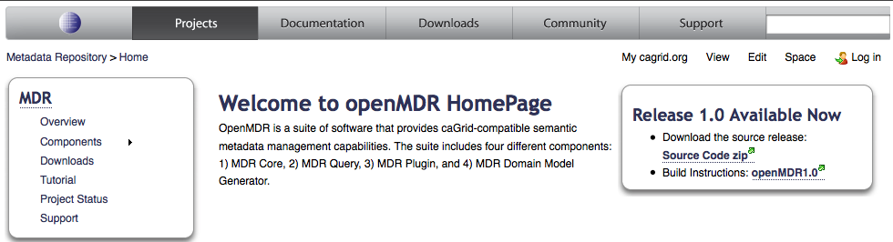
OpenMDR Community Project
http://cagrid.org/display/MDR/Home

Slide 38
Accomplishments To Date
Refactored cgMDR source to enable the following capabilities.
  openMDR is not tied specifically to any version of eXist.
  Broke project up into 3 sub projects and added a 4th.
    MDR Core - ISO 11179 database and web frontend to curate and browse
    MDR Query - refactored mdrConnector in cgMDR with a caGrid grid service which provides this query functionality
    MDR EA Plugin - currently an EA plugin which uses mdrQuery to provide model annotation
    MDR DomainModelGenerator - consumes XMI generated by openMDR EA plugin and generates a Domain Model file required for caGrid to create the grid data service.
  Ivy based project build system consistent with caGrid project build and development processes.
  Code in caGrid Community Projects
OpenMDR Tutorial
http://cagrid.org/display/MDR/Tutorial

Slide 39
Looking Ahead
The evolving wiki site can be found here:
https://cagrid.org/display/MDR/Home
Next Release
  Store UML Models and Provide Search/Browse Functionality
  Search/Browse and Re-use UML Models via EA Plugin
  Identity Management via Dorian
  Automated Testing
  Import/Export a set of CDE's from caDSR
Contact Information: rakesh.dhaval@osumc.edu

Slide 40


What Questions Do You Have?

