Slide 1
Building on Distributed Access Management
From a caBIG Perspective
Stephen Langella
Ohio State University
langella@bmi.osu.edu

Slide 2









Cancer Biomedical Informatics Grid (caBIGTM)
The cancer Biomedical Informatics Grid (caBIG™), is a voluntary network or grid connecting individuals and institutions to enable the sharing of data and tools, creating a World Wide Web of cancer research. The goal is to speed the delivery of innovative approaches for the prevention and treatment of cancer. The infrastructure and tools created by caBIG™ also have broad utility outside the cancer community.
  National Cancer Institute Initiative
  Over 800 Participants
  Over 80 Organizations
  Over 70 Projects

Slide 3
caGrid
Grid Infrastructure for caBIG
Focuses on providing middleware for enabling the interoperability between caBIG applications.
caGrid Components
  Grid Service Graphical Development Toolkit (Introduce)
  Metadata
  Advertisement and Discovery
  Semantic Services
  Data Service Infrastructure
  Analytical Service Infrastructure
  Identifiers
  Workflow
  Security Infrastructure (GAARDS)

Slide 4
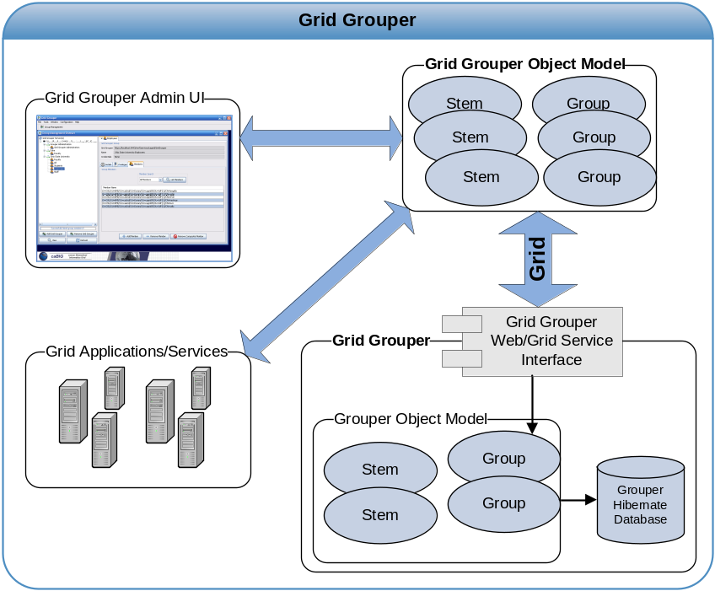
Grid Grouper
Grid Grouper grid enables Grouper
  WSRF Compliant Web Service
  Enables Grid access to Groups
  Allows management of Groups from the Grid
Grid Grouper Object Model
  Java API for accessing and managing groups over the grid.
  Similar to Grouper’s Object Model
  Applications/Service leverage Grid Grouper Object model in a similar fashion to leveraging the Grouper Object Model.
Grid Grouper Admin UI
  Graphical User Interface for accessing and administrating groups in Grid Grouper.

Slide 5
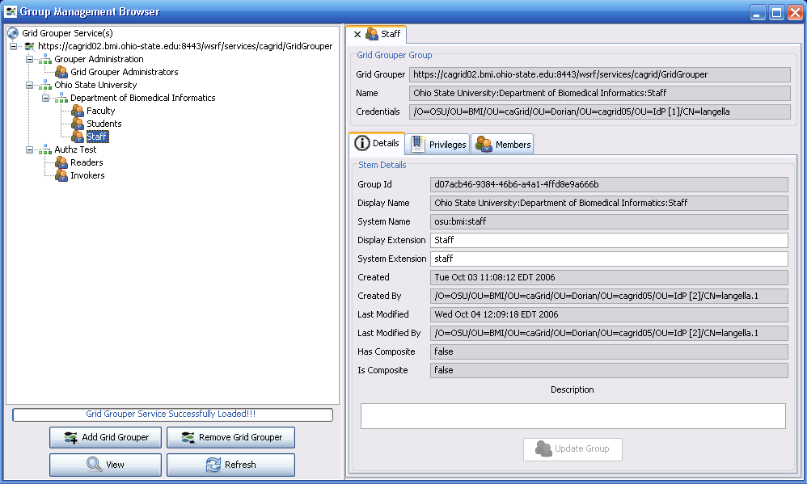
Grid Grouper Admin UI

Slide 6
caBIG Wish List for Groups
Group Lifetime
  Assign lifetime to both memberships and privileges
  Group Auditing / Versioning
    Evaluation of membership and privileges at any point in time.
  Valuable for meeting regulatory requirements for caBIG.
    We need to know who had access to what and when.
API Standardization
  Standard java interfaces that Grouper, Grid Grouper, and etc. can implement, allowing different implementation to be interchanged.
Dynamic Groups
  Ability to express Groups based on abstract membership
    Based on Attributes
    Complicated Business Logic
Federated Groups
  Allowing groups to have another group in a federation as a member.
  Currently more related to GridGrouper than Grouper.

Slide 7
Leveraging Attributes in caBIG
Leveraging of institution provide attributes has been VERY LIMITED in caBIG.
  Only leveraged in a limited manner in our “authentication process”.
This will most likely be a future focus in caBIG.
Issues (S = Social Problem, T = Technical Problem)
  Attribute Standardization
    What is the process for standardizing attributes? (S)
    What attributes are required for all users? (S)
  Attribute Provisioning
    Who will be responsible for persisting user attributes? caBIG? Each Institution? Indications are there will be a need for both. (S, T)
    How and when will attributes be created? What if they already exist? (S, T)
    We need to be able to create/update attributes through the Grid. (T)
    A user will most likely have multiple attribute authorities. (T,S)

Slide 8
Leveraging Attributes in caBIG
Issues (Cont.)
  Attribute Discovery and Resolution?
    How will a service provider determine where to get a particular attribute from? (T,S)
    This can get very complicated if users have multiple attribute authorities. (T,S)
  Access Control / Attribute Release Policies.
    Very complicated in a grid environment. (T,S)
At this point this just as much a social problem as it is a technical problem.

Slide 9
caBIG Wish List for Attributes
Standard Web Service Interface for Attribute Management
  Provides access to user attributes to service providers
  Full administration of attributes
    Creation of Attributes
    Update Attributes
    Delete Attributes
    Administration of Attribute release policies.
  Varying Identity Providers could be supported behind the interface.
    Shibboleth, CAMS, etc.
  Identity Providers only need to implement the features they support.
Discovery and Resolution Services
  Provide the ability to determine who are the trusted attribute authorities for a given user and attribute.
  Once discovered service providers can access the attributes using the standard web service interface.

Slide 10
Questions?

