Slide 1
caGrid
Grid Service Security
Communication, Authentication and Authorization
caGrid Knowledge Center
knowledge@osu-citih.org
June 17, 2010

Slide 2
Topics
Introduction
Communication, Authentication and Authorization Overview
Authorization Details
Deployment Considerations
Additional Resources

Slide 3
The Challenge
To provide a selection of container and service security options that will meet a variety of security policy criteria
  Open access
    Use cases: Anonymized data sharing and openly accessible analytical services
    Solution: Non-secure Grid services provide an option to openly share non-PHI data or for development purposes.
  Restricted access
    Sharing or analysis of de-identified data, limited data sets, PHI
    Data sharing policy: Choose appropriate level of assurance!
    https://cabig-kc.nci.nih.gov/DSIC/KC/index.php/Data_Sharing_and_Security_Framework
    caGrid Options: communication, authentication and authorization criteria

Slide 4
caGrid “Knobs”
Configuration of security requirements
  Service level
  Operation level
Communication
  Encryption and checksums at various levels
Authentication requirements
  Identity verification
  Anonymous access vs. required identity
Authorization
  Grid Grouper
  CSM

Slide 5
Topics
Introduction
Communication, Authentication and Authorization Overview
Authorization Details
Deployment Considerations
Additional Resources

Slide 6
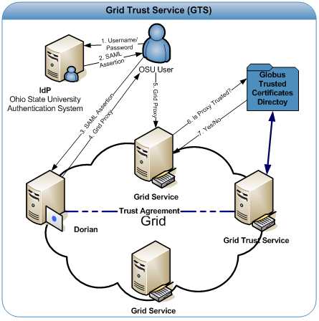
Foundation
caGrid leverages Public Key Infrastructure (PKI) for authentication as implemented by Globus Grid Security Infrastructure (GSI). Every user and service uses an X.509 certificate to prove their identity in a process known as mutual authentication.
More information: http://www.globus.org/security/overview.html

Slide 7
Communication Options
Transport Layer Security
  TLS (HTTPS) with authentication via X.509 certificates
Secure Conversation
  WS-SecureConversation to apply security on a session
  Slower performance
Secure Message
  WS-Security to apply security on individual SOAP messages
  Slowest performance

Slide 8
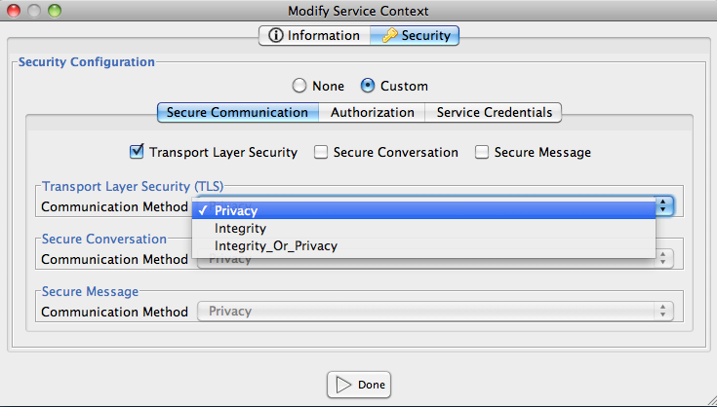
Secure Communication Options
Privacy and Integrity options for all 3 security viewpoints
  Integrity: eavesdropper can read communication but not alter it (checksums)
  Privacy: eavesdropper cannot read communication (encryption)
  Both

Slide 9
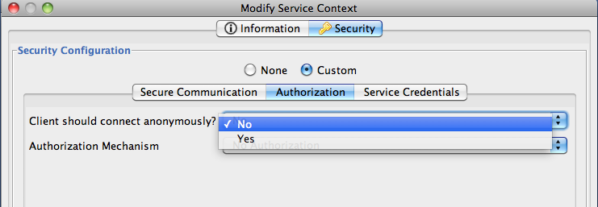
Authentication Options
Authentication requirements
  Identity verification (credential required)
  Anonymous access
On/Off switch on the service
  Anonymous connection or authentication with X.509 certificates
caGrid Client Configuration
  Default connection mode (anonymous or X.509 cert) depends on the service configuration
  Client can choose to connect anonymously (or not) as an override

Slide 10
Authorization Options
Pluggable Authorization Framework
  Configuration Policy Decision Points
Available Policy Decision Options
  No Authorization: Disable authorization
  Gridmap: Globus GSI functionality where a file contains entries that map certificate subjects to local user names
  Custom PDP Chain: Provides the developer with the ability to not use the Introduce Authorization Framework and configure the service to use a custom PDP chain.
  Common Security Module: Provides the ability to integrate service authorization with CSM.
  Enforce Authentication: Require that the grid user invoking the service provides a valid grid credential.
  Grid Grouper: Require grid users to belong to a specific Grid Grouper group in order to invoke service operations.

Slide 11
Topics
Introduction
Communication, Authentication and Authorization Overview
Authorization Details
Deployment Considerations
Additional Resources

Slide 12
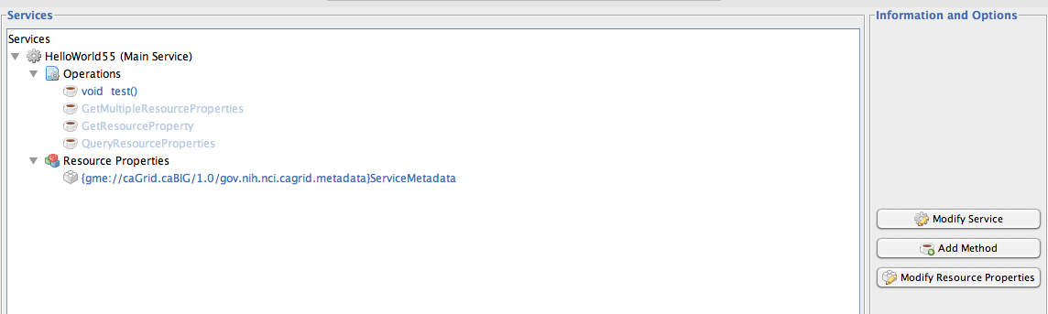
Service Level Security Options
Two levels of security options
  Service level
  Operation level
    If not specified, inherits service level settings

Slide 13
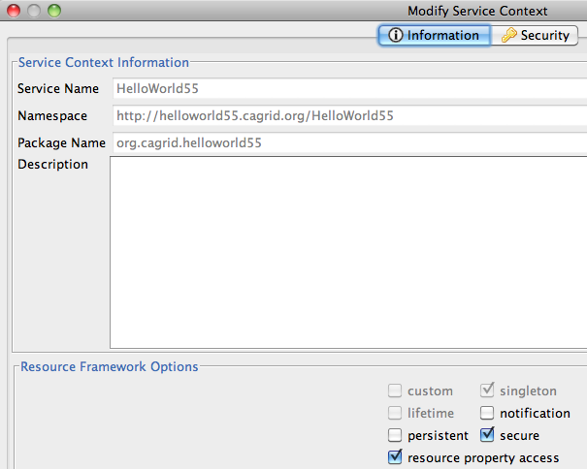
Context Security Options
Options on resource instances
“Secure” enables a “caller-only” authorization policy

Slide 14
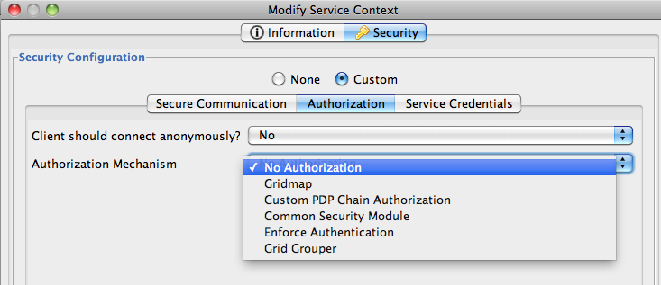
Service Authorization
Introduce supports several ways to authorize users.
More information on Introduce Extensions
  https://cagrid.org/display/introduce13/Extensions

Slide 15
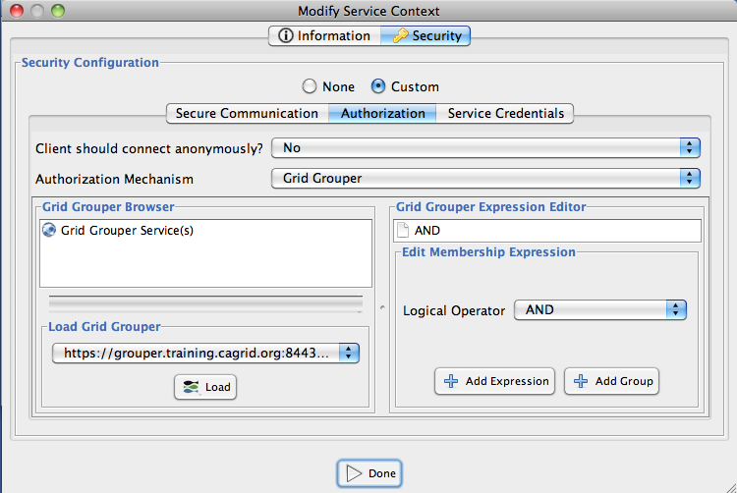
Grid Grouper
Group Management Service
Hierarchy of stems and groups
Authorization policy based on group membership, with powerful set expression capabilities

Slide 16
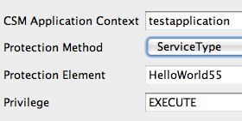
CSM
CSM permissions check of the triplet (Grid user identity, protection element, privilege)
Specify CSM application context, protection element, and privilege
Protection method choice determines name of PE in the CSM database
  “ServiceType”: <ServiceName> or <ServiceName>:<MethodName>
  ServiceURI: <ServiceDeploymentURL> or <ServiceDeploymentURL>:<MethodName>
  Custom: enter PE manually
Details: https://cagrid.org/display/introduce13/csmAuthorizationExtension_1_3

Slide 17
Topics
Introduction
Communication, Authentication and Authorization Overview
Authorization Details
Deployment Considerations
Additional Resources

Slide 18
Container Security Configuration
Container security configuration for both Tomcat and JBoss:
Non-secure container
  Container uses HTTP
  Cannot deploy secure services (no host certificate to use for security options)
  SyncGTS is deployed by caGrid Installer
Secure Container
  Container uses HTTPS.
  Deployed services use the container X.509 certificate as the service identity
  Mutual authentication can be performed
  Communication settings use the container certificate
  SyncGTS is deployed by caGrid Installer

Slide 19
Common Problems
Clocks out of sync
Client or Host Certificate expired
Unknown CA
  Remote service doesn’t trust client
  Client doesn’t trust remote service

Slide 20
Topics
Introduction
Communication, Authentication and Authorization Overview
Authorization Details
Deployment Considerations
Additional Resources

Slide 21
Additional Resources
Globus GT 4.0 Security Documentation
  http://www.globus.org/toolkit/docs/4.0/security/
Introduce Design Guide
  http://cagrid.org/display/introduce13/Design
Introduce Developer’s Guide
  http://cagrid.org/display/introduce13/Developers+Guide
Introduce Extensions
  http://cagrid.org/display/introduce13/Extensions
Grid Grouper
  http://cagrid.org/display/gridgrouper/Home
CSM
  https://cabig.nci.nih.gov/tools/CSM/
Tutorials
  http://cagrid.org/display/documentation/Home

