Slide 1
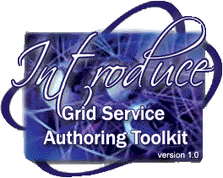
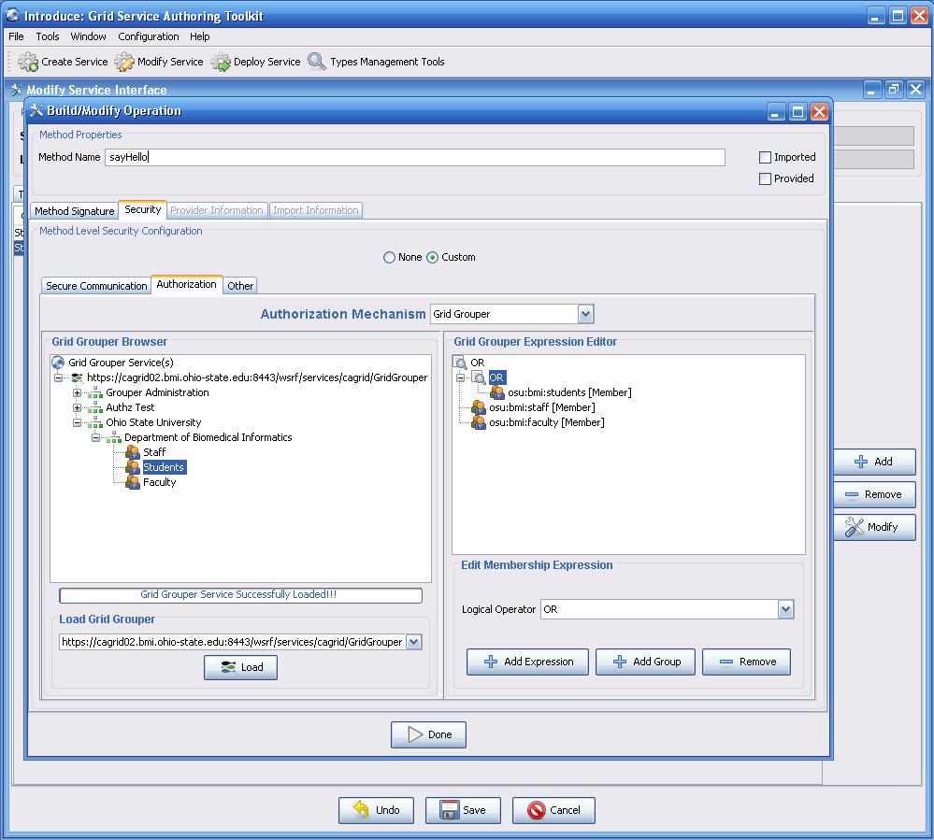
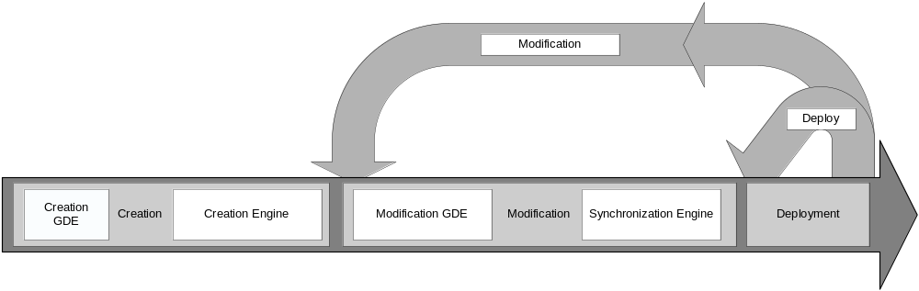
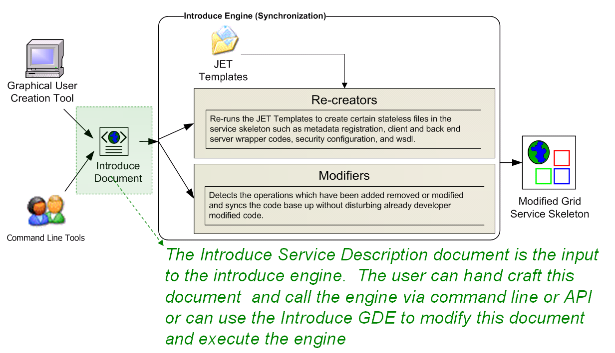
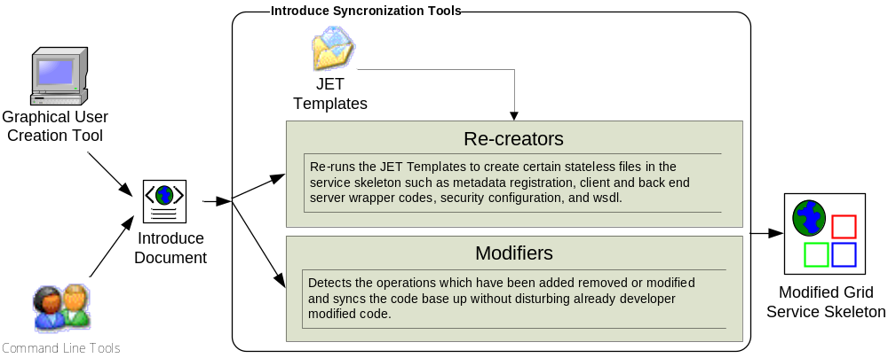
Introduce: Grid Service Authoring Toolkit
Development of Strongly Typed and Interoperable Grid Services
Shannon Hastings, Scott Oster, Stephen Langella, David Ervin, Tahsin Kurc, Joel Saltz
Introduce: an open-source, extensible toolkit to support easy development and deployment of WS/WSRF compliant Grid services. Introduce aims to reduce the service development and deployment effort by hiding low level details of the Globus Toolkit and to enable the implementation of strongly-typed Grid services. We expect that enabling strongly typed grid services while lowering the difficulty of entry to the Grid via toolkits like Introduce will have a major impact to the success of the Grid and its wider adoption as a viable technology of choice, not only in the commercial sector, but also in other areas such as academic, medical, and government research.
Service-oriented architectures, standards, and applications have gained wide acceptance in the Grid computing community. A number of tools and middleware systems have been developed to support application development using Grid Services frameworks. Most of these efforts, however, have focused on the low-level support for management and execution of Grid services, management of Grid-enabled resources, and deployment and execution of applications that make use of Grid services. Simple-to-use service development tools, which will allow a Grid service developer to leverage Grid technologies without needing to know low-level details, are becoming increasingly important. Moreover, support for development of strongly-typed services, in which data types consumed and produced by a service are well-defined and published in the Grid, is necessary to enable syntactic interoperability so that two Grid endpoints can interact with each other programmatically and correctly.
Features
Dynamic discovery and use of published data types
Creates WSDL2.0 / WSRF Compliant Services
Supports Creating Multiple Resource/Services using the WSRF
Supports configuring Grid Security
Built in Authorization Support
  Grid Grouper
  Common Security Module (CSM)
  Grid Map
Resource Property Configuration and Index Service Registration
Rich extension/plug-in framework for creating custom services or adding custom functionality.
Architecture
Service Model maintains the complete representation of the services, methods, resources, resource properties, data types, security configuration. Index service registration, etc.
Graphical Development Environment modifies service model and passes the modified model to the engine.
Introduce Engine re-syncs the service with changes with the modified model.
Use of Java Emitter Templates (JET) for creation and modification of source code and configuration files required in the service
Auto generation of unboxed complete client and stubbed service implementation.
Questions or Comments?
Please send email to:
Shannon Hastings at hastings@bmi.osu.edu

