Slide 1
caGrid 1.0
Beta Release
caBIG Architecture/VCDE Workspaces
Joint Face to Face
July 12-14, 2006
Scott Oster (oster@bmi.osu.edu)
Ohio State University

Slide 2
Agenda
caGrid High Level Overview
caGrid Project Plan and Timeline
Beta Release Features
Anatomy of the Beta Release
caGrid 1.0 Official Release Plan

Slide 3
What is caGrid?
Development project of Architecture Workspace, aimed at helping define and implement Gold Compliance
No requirements on implementation technology will be necessary for Gold compliance
  Specifications will be created defining requirements for interoperability
  caGrid provides core infrastructure, and tooling to provide “a way” to achieve Gold compliance
Gold compliance creates the G in caBIG
  Gold => Grid => connecting Silver Systems

Slide 4
What is Grid?
A lot of different things to a lot of different people
Evolution of distributed computing to support sciences and engineering
Some common themes prevail:
  Sharing of resources (computational, storage, data, etc)
  Secure Access (global authentication, local authorization, policies, trust, etc)
  Open Standards
  Virtualization
“The real and specific problem that underlies the Grid concept is coordinated resource sharing and problem solving in dynamic, multi-institutional virtual organizations.”
  I. Foster, C. Kesselman, S. Tuecke. International J. Supercomputer Applications, 15(3), 2001.
A good general overview can be found here: http://gridcafe.web.cern.ch/gridcafe/

Slide 5
caGrid Overview
Requirements:
  Support scientific requirements: Use cases from cancer research community
  Support functional requirements: identifiers, workflow, query, etc
  Support non-functional requirements: security, reliability, performance, etc
Principles:
  Driven by cancer research community requirements
  caBIG Principles
    Open Source, Open Access, Open Development
    Federated
    Syntactic and Semantic Interoperability
  Services-Oriented Architecture
  Metadata driven and implements Virtualization
  Standards based

Slide 6
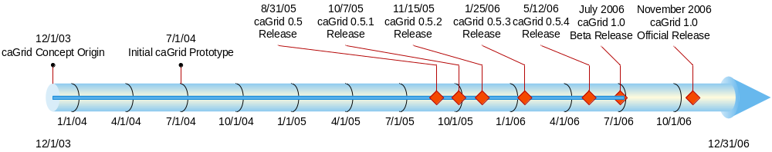
History of caGrid

Slide 7
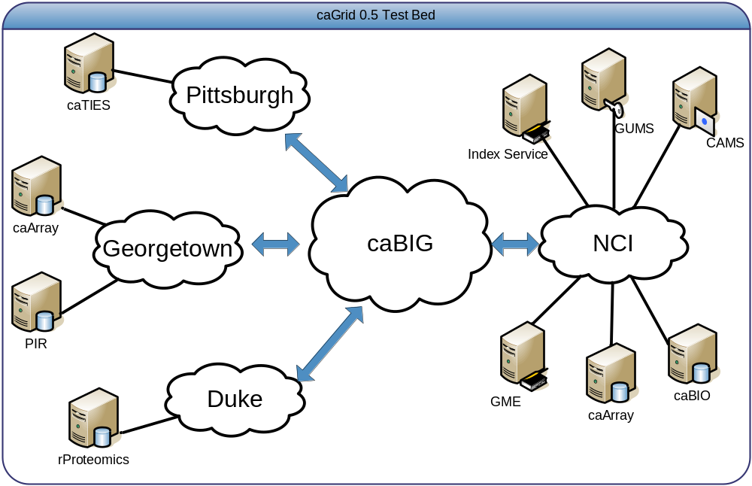
caGrid Status
caGrid 0.5.x is current stable, supported, grid environment for caBIG
  Current Release: caGrid 0.5.4

Slide 8
caGrid Status cont.
caGrid 1.0 is a revolutionary release of the caGrid infrastructure
It is generally not compatible with caGrid 0.5.x releases, though conceptually, it plays the same role with increased stability, functionality, and scope
caGrid 1.0 is intended future production release
  Current Release: (this fall)
caGrid 1.0 Beta is evaluation of coming 1.0 production release
  Current Release: caGrid1.0 Beta (next week)

Slide 9
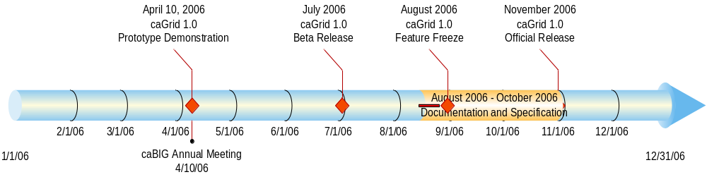
caGrid 1.0 Timeline
Initial Demonstrations at the caBIG Annual Meeting in April
Beta Release available imminently
Official Release this fall

Slide 10
caGrid Components
Leverage existing technologies:
  caDSR, EVS, Mobius GME: Common data elements, controlled vocabularies, schema management
  Globus Toolkit (currently version 4.0.2)
    Core grid services infrastructure
    Service deployment, service registry, invocation, base security infrastructure
Additional Core Infrastructure
  Higher-level security services
  Grid service access to metadata components (caDSR, GME, etc)
  Workflow, Identifier services
Service Provider Tooling (Introduce)
  Graphical service development and configuration environment
  Abstractions from service infrastructure for Data and Analytical services
  Deployment wizards
Client Tooling
  High-level APIs for interacting with core components and services
  Graphical Tools

Slide 11




caGrid 1.0 Conceptual View
Security
Analytical Service
Metadata Management
Dorian
GTS
Common Data
Elements
Vocabularies
and Ontologies
Grid Data Service
Tool 1
Tool 2
Gene
Database
GME Schema
Management
SNPlex
Workflow
Research
Group
Workflow
Management
Service
Protein Database
Grid Data Service
Grid Services Infrastructure
(Secure Communication,
Service Invocation,
Data Transfer)
NCBI
Security
Grid-Enabled
Client
Dorian
GTS
Federated Query
Security
Federated
Query
Service
Microarray
Dorian
GTS
Research
Center 1
Index
Service
Grid Data Service
Tool 2
Grid Data Service
Advertisement/Discovery
Tool 3
Analytical
Service
Image

Slide 12
caGrid 1.0 Beta Components
The caGrid 1.0 Beta does not provide working versions of all 1.0-targeted components
  Differing development timelines
  New components introduced, uniquely for 1.0
Nevertheless, in the release many components are stable and demonstrable
  Quickly enumerated here and covered in detail in later talks

Slide 13
Introduce
Introduce is the caGrid service creation toolkit
It provides the capability to create both analytical and data services
Several caGrid Beta components install themselves into Introduce as extensions

Slide 14
Data Services
Re-useable service infrastructure and client tooling for query access to data in caGrid
Data Service creation is done using Data Service specific extensions in Introduce
Client tooling and APIs provide uniform access to data in the grid

Slide 15
Dorian
Dorian is the caGrid identity federation solution
It provides the capability to integrate with institutional identity management systems, as well as create a local user management solution
It consists of both a service and client APIs and tools

Slide 16
GTS
GTS is the caGrid trust management service
The Grid Trust Service (GTS) is a WSRF compliant grid service framework for the creation, management, and provisioning of a federated grid trust fabric
It consists of both a service and client APIs and tools

Slide 17
SyncGTS
SyncGTS is a mechanism used synchronize a Globus installation with the trust fabric maintained in a GTS deployment
It consists of both a service (to dynamically synchronize a service container with the trust fabric) and client APIs and command line tools

Slide 18
Discovery APIs
The Discovery client API provides a high-level API to discover advertised services in the grid
A command line client (which makes use of the API) is provided solely for demonstration purposes

Slide 19
Globus Index Service
The Globus Index Service is used as the grid service registry, white pages, and yellow pages
When caGrid services start up, they register their existence and metadata to the Index Service, and the Discovery API allows clients to discovery services in the registry
caGrid uses an unaltered version of the Globus Index Service, and provides convenience mechanisms to deploy it
The Globus clients can be used to query the Index Service directly

Slide 20
caDSR Grid Service
The caDSR grid service provides grid service access to UML-like information in items registered in caDSR
Additionally, it provides the ability to generate caGrid metadata instances for grid services
Finally, it is integrated into Introduce to provide UML model browsing and type discovery
It consists of both a service and client APIs and tools

Slide 21
Global Model Exchange (GME)
The GME grid service provides grid service access to the XML Schemas used by the caGrid infrastructure
It is integrated into Introduce to provide XML Schema model browsing, upload, and type discovery
It consists of both a service and client APIs and tools

Slide 22
Workflow Management Service
The Workflow Management grid service provides the ability for clients to submit BPEL-defined workflows over caGrid services and have them executed
It consists of both a service and client APIs and tools

Slide 23
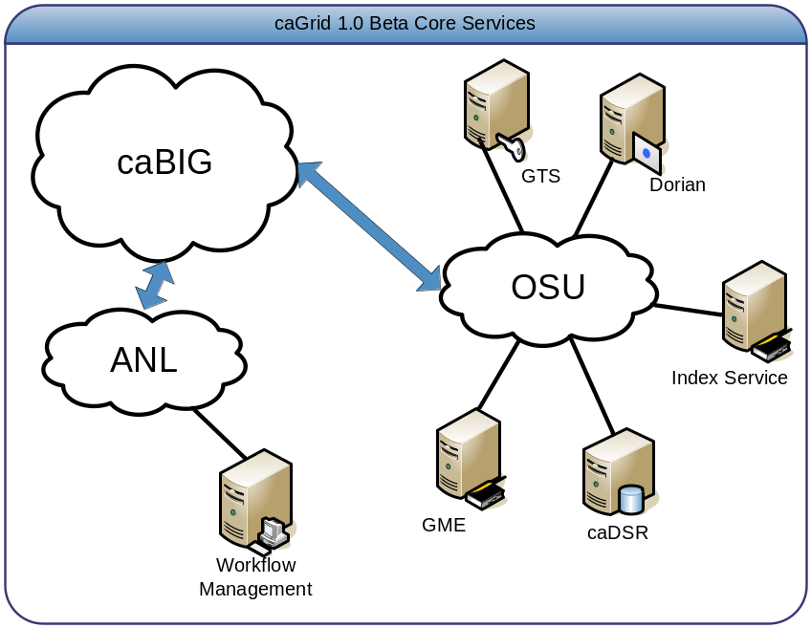
caGrid 1.0 Beta Provided Service Instances
For demonstration purposes, a stable deployment of core services will be provided
Local installations can also be stood up using the release if desired

Slide 24
Beta Release Details
Beta release is a source only release
Prerequisites must be manually installed and configured, and source must be built prior to its use
Apache Ant used to build, test, and run
Future release of caGrid will provide binary distributions with a graphical installer to install prerequisites and caGrid

Slide 25
Getting the Beta Release
Will be…
  Available as a downloadable archive
    http://gforge.nci.nih.gov/frs/?group_id=25
  Available directly from CVS
    cvs -d:ext:anonymous@cbiocvs2.nci.nih.gov:/share/content/gforge/cagrid-1-0 export -r caGrid-1_0_beta_final -d caGrid-1.0beta/caGrid cagrid-1-0/caGrid
    More information on Wiki
      http://gforge.nci.nih.gov/plugins/wiki/index.php?id=25&type=g

Slide 26
Anatomy of the release
Top level directory contains the main build files, information (license, readme, release notes), and a projects directory
Each modular component/service of caGrid is implemented as a project in the projects directory
Once caGrid is built, each project is completely isolated from the overall distribution and can be individually used, moved, or repackaged
  All components provide their own Ant build process, and Eclipse project files
  Details available in the build process documentation

Slide 27
caGrid Projects Directory
Projects providing deployable grid services:
  cadsr (built with released version of Introduce)
    Grid service access to caDSR information and capability to generate metadata instances
  dorian (built with released version of Introduce)
    caGrid identity federation solution
  fqp
    Eventual home of the Federated Query Service
  gme
    Global Model Exchange, providing management of XML Schemas
  gts (built with released version of Introduce)
    caGrid trust management service
  index
    Globus Index Service
  syncgts (built with released version of Introduce)
    used synchronize a Globus installation with the trust fabric maintained in a GTS deployment
  workflow
    Workflow Management Service and several services for testing it

Slide 28
caGrid Projects Directory
Projects providing tools or reusable components:
  cabigextensions
    Introduce extensions
  core
    Common caGrid library
  cql2xpath
    Prototype library used to convert CQL queries into XPath queries
  data
    Data Services code base (actual Data Services are built using Introduce)
  discovery
    Service discovery library
  graph
    UML graphing library
  gridca
    Libraries and tools for working with grid credentials
  installer
    caGrid graphical instraller
  introduce
    caGrid service creation toolkit
  metadata
    caGrid standard service metadata
  opensaml
    repackaged version of opensaml (to avoid conflicts)
  portal
    caGrid Monitoring web portal
  sdkQuery
    CQL implementation against caCORE SDK data resources

Slide 29

Using the release
ant -p
  Display list of available build targets
all Builds the entire application
build-cabigextensions Builds the caBIG Introduce extensions
build-cadsr Builds the cadsr project
build-core Builds the core
build-cql2xpath Builds caGrid Cql2Xpath utility
build-data Builds caGrid Data Services components
build-discovery Builds the common metadata
build-dorian Builds the dorian project
build-fqp Builds the Federated Query Processor
build-gme Builds caGrid GME
build-graph Builds graph
build-gridca Builds the gridca project
build-gts Builds the GTS project
build-installer Builds caGrid Installer
build-introduce Builds Introduce
build-introduceServiceSecurity Builds Introduce's ServiceSecurity Operation Provider
build-metadata Builds the common metadata
build-opensaml Builds opensaml
build-portal Builds the portal project
build-sdkQuery Builds caGrid SDK Query processor
build-syncgts Builds the syncgts project
clean Cleans all projects.
dorian Run the Dorian Administrative GUI
experimental Tests all the projects, and publishes results to the testing dashboard.
gts Run the GTS Administrative GUI
introduce Run the Introduce Grid Service Authoring Toolkit
javancss Generates an HTML report of code metrics
syncWithTrustFabric Syncs With Trust Fabric
test Test all the projects.
Default target: all

Slide 30
Building caGrid 1.0 Beta
ant
  Calls default all target (equivalent to ant all) which builds all of caGrid
  This must be done at least once prior to using any other tool or component of caGrid

Slide 31
Additional Highlighted Targets
ant introduce
  Launches the graphical service creation toolkit, Introduce
  Can be used to examine/edit several caGrid services (cadsr, dorian, gts, syncgts)
ant dorian
  Launches the Dorian Administrative GUI
  Can be used to manage a Dorian installation, or create/view grid credentials

Slide 32
Additional Highlighted Targets
ant gts
  Launches the GTS Administrative GUI
  Can be used to manage the trust fabric controlled by a GTS installation
Many additional targets are available within each project
  Consult release notes and project documentation
  Run ant -p in directory of project of interest

Slide 33
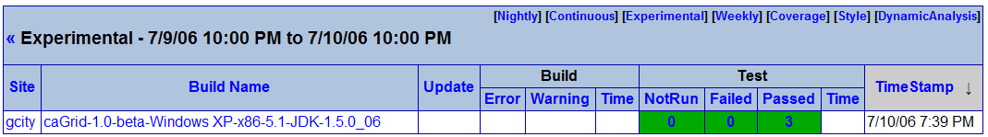
Testing caGrid 1.0 Beta
ant clean test
  Performs a clean build and test cycle
ant clean experimental
  Performs a clean build and test cycle against current code base, submitting test results to Quality Dashboard

Slide 34
caGrid Quality
Testing
  Unit, System, and Integration (in the works)
Automated Builds/Tests on multiple nodes
  Nightly (on a schedule)
  Continuous (every CVS check in)
Quality Dashboards
  DART (multi-site, historical archive of quality)
    http://vandelay.bmi.ohio-state.edu:8081/caGrid-1.0/Dashboard/
  CruiseControl
Code Test Coverage

Slide 35
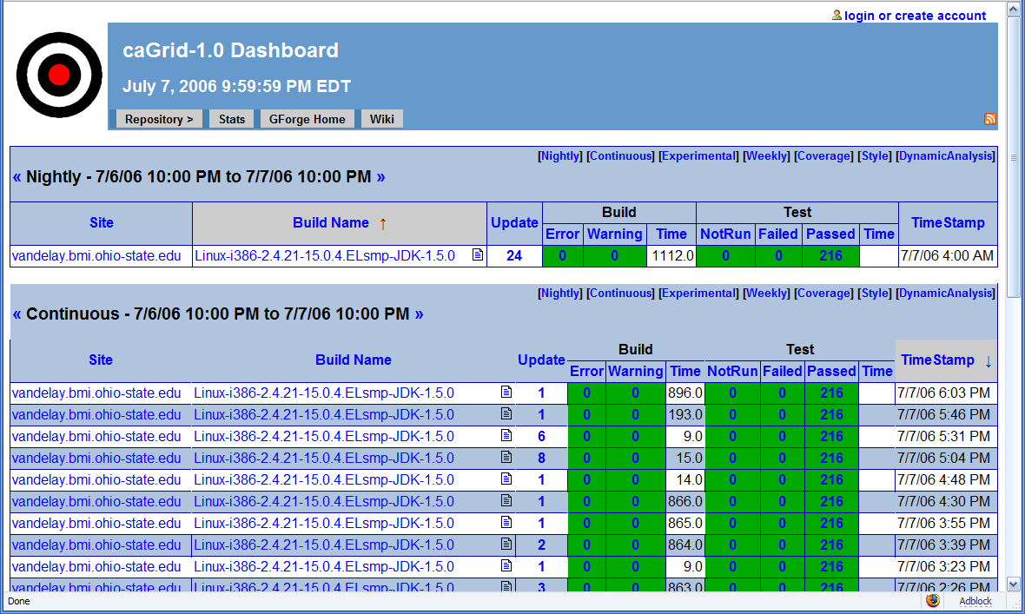
caGrid Quality Dashboard

Slide 36
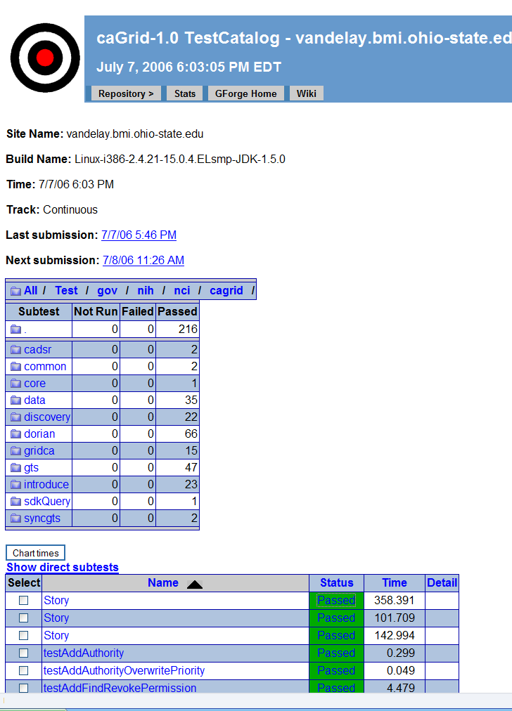
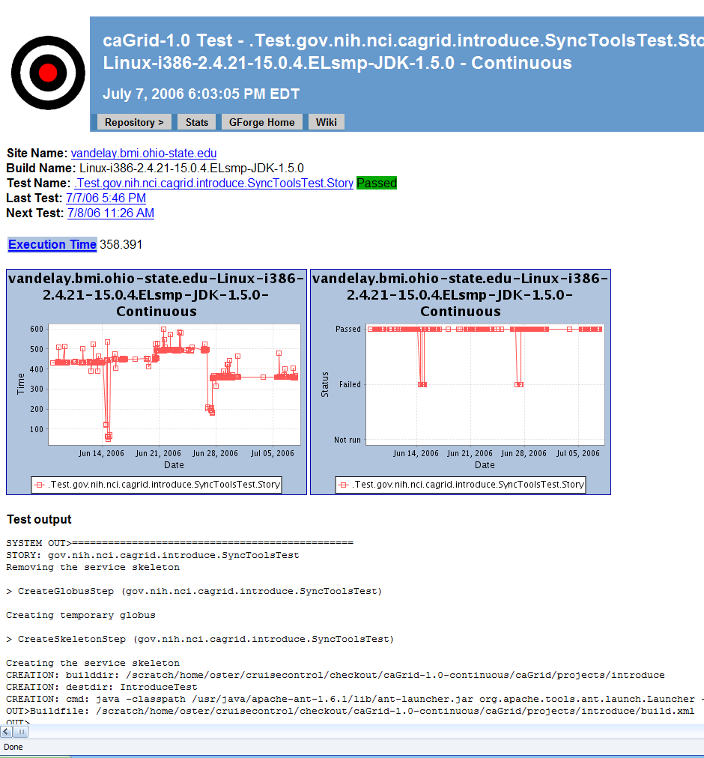
caGrid Quality Dashboard cont.

Slide 37
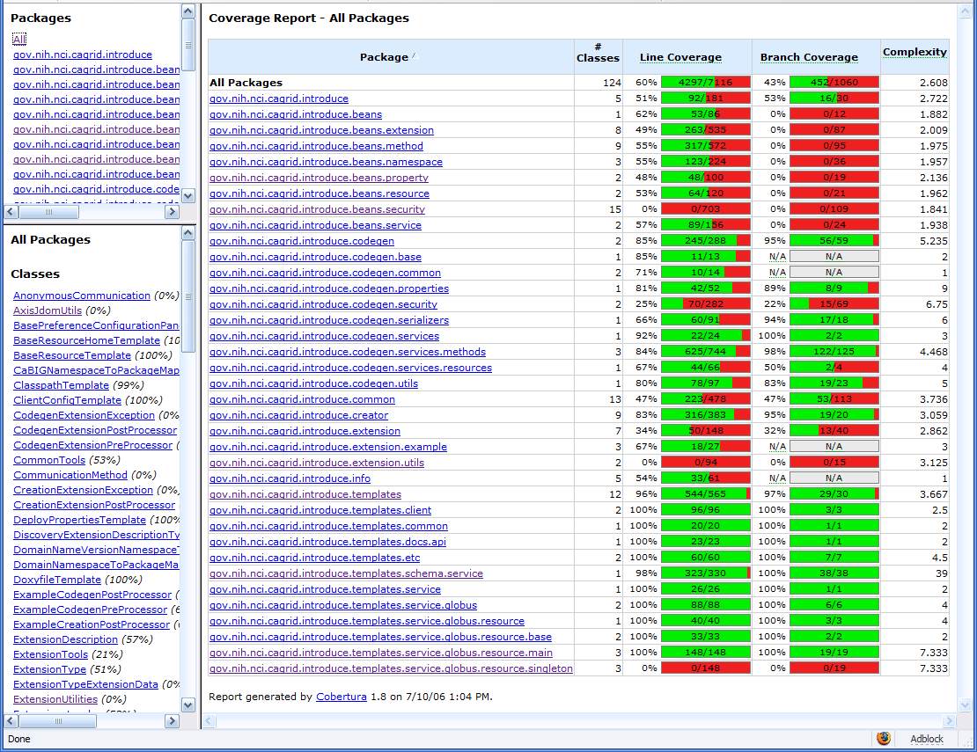
Example caGrid Testing Coverage

Slide 38
caGrid 1.0 Official Release
Targeted for early this fall, the official production release of caGrid 1.0 will offer increased stability and many additional features
Details of most components are provided in later talks

Slide 39
Coming caGrid 1.0 Features
Not Demonstrated in Beta
Grid Identifiers Infrastructure
Federated Data Query Service
WS-Enumeration support (service-side iteration)
Stateful Data Services
Additional Security Support
Grid Monitoring Portal and Migrated caGrid browser
Enhanced Workflow Management support
Extremely user friendly Installation and Deployment Process
New Reference Implementations

Slide 40
Project Resources and Communication
caGrid 1.0 GForge Home:
  Feature Requests
  Bug Reports
  Discussion Forums
  Public Wiki
  Downloads / Source Repository
  http://gforge.nci.nih.gov/projects/cagrid-1-0/
caGrid Users Mailing List
  https://list.nih.gov/archives/cagrid_users-l.html
  cagrid_users-l@list.nih.gov
Architecture Workspace
  Community direction from Working Groups
  Report out and feedback during WS calls

Slide 41
caGrid 1.0
Beta Release
caBIG Architecture/VCDE Workspaces
Joint Face to Face
July 12-14, 2006
Scott Oster (oster@bmi.osu.edu)
Ohio State University

