Slide 1
caGrid:
Future Direction Planning
Author
Institution
Email address
Month Day, Year

Slide 2
Agenda
Current 2.0 Scope Review (20 min)
  Scope from post 1.0 planning, with adjustments from caGrid 1.1 changes
New Use Cases/Features (20 min)
  Gathered from community outreach
  Issues identified by Working Groups
Discussion/Feedback (20 min)

Slide 3
What will be in the next caGrid release?
Not yet finalized timeline or scope
It depends on the community
  Feedback from adopters
  Input from User’s Group / User Workshops
  Workspaces’ priorities
  Working Groups’ features/issues
  NCI priorities
  Use cases solicited by scientific liaison
Items which missed caGrid 1.1
Items identified as gaps by the team

Slide 4
Post caGrid 1.1
Some items we would have liked in 1.1 won’t be there, and may be released individually before the next major release
Distribution mechanism(s) not yet finalized (caGrid 1.2, patch, separate release, automated update, etc)
Currently identified:
  CLM, CSM, SDK 4.0 support in data services
  New unified portal (web application)

Slide 5
Current Plans
The following are the current list of potential scope items for the next major release; not likely all will be included, and some new items are likely to be added

Slide 6
Technology Stack Upgrade
JDK 1.5
Ant 1.7
Globus 4.0.4 / 4.2 (depending on timeline)
Tomcat 5.5
JBoss 4.0
MySQL 5.0
caCORE 4.0

Slide 7
caGrid Portal Plans
Integrated Portlet-based application
  Replaces current browser and portal
  User customizable
Built from reusable portlets and components (usable by other teams/applications)
Reusable security components
  Single Sign On (SSO)
  Delegation / Delegation Policy
  Authentication/login
    Support institutional login (WAYF – where are you from)

Slide 8
caGrid Portal Plans cont.
Discovery (similar functionality to current portal)
Data service query (FQP support)
  Ideally graphical and metadata driven, but not wanting to reinvent functionality provided by other applications
Analytical invocation
Workflow Execution
Static content/metadata augmentation
  Integrate content similar to caBIG “tools page” for services; allow service owners to augment
  Goal is to have wealth of information on discovered services

Slide 9
caGrid Portal Plans cont.
Enhanced map view with overlays
  Discovery results
  Workflow process
  Semantic linkages between services
More usable service directory
Administrative interfaces

Slide 10
Metadata Plans: General
Updates and enhancements of standard metadata formats
Working with caDSR team to formalize and register UML/XSD binding information
  Leverage information in Introduce (model selection, metadata generation, data services)
  Possible to leverage in workflow creation GUI (auto-generation of XML information and XPath from logical model)

Slide 11
Metadata Plans: GME
Current GME is a wrapper for existing Mobius product
  Create service with Introduce so easier to maintain
  Simplify by removing features not in use by caGrid
  Abstract backend system (currently requires MySQL, and doesn’t work with latest version)
Plan to better support service development lifecycle
  Add ability to track “workflow status” as does caDSR; and have different policies based on status
    Should be able to update and delete schemas that are in development
    Don’t want to delete or update published schemas which are in use
  Complete removal of current restrictions
    No namespace restrictions
    Allow cyclic dependencies (make a policy point)
    Support includes
    Verifiable complete support for XML Schema (xerces)
  Batch upload/download
  Support Authorization and Policy enforcement

Slide 12
Metadata Plans: Advertisement
As Gold certification begins, changes may be required to support identification of Gold services
Support for secure Index Service
  Authorization policy on service
  Credentialed advertisement
Investigate Index hierarchy

Slide 13
Metadata Plans: Discovery
Support semantic based discovery (details later)
Support for gold service discovery
Integrate discovery into UI components
  Currently services are “preference-based” with specific service addresses
  Example: Should be able to use security UI and specify you want to manage GridGrouper service “from OSU”

Slide 14
Metadata Plans: caDSR Service
Support grid service access to UML/XSD binding information
Update metadata generation to make use of UML/XSD binding information
Migrate to new caDSR models (likewise for EVS service)

Slide 15
Security Plans
Security Web Components and changes to core services to better support them
Changes to services or development of new services/components to support Security Working Group policies (including LOA3 and LOA4)
Delegation
Auditing
Directory/Attribute Service?
Tools for Adoption/Integration

Slide 16
Workflow Plans
Integrated graphical environment for workflow authoring, submission, and monitoring
Delegation support for secure invocation of services requiring authorization
Notification support for status monitoring
Investigate enhancements for high performance/long running workflows
Investigate auditing/provenance support

Slide 17
Identifier Plans
Implement framework and policy for leveraging Handle and WS-Naming design
  creation of custom naming authorities for domain/application specific uses
  general naming authority for dynamic use such as in workflows or data services
  ws-transfer based retrieval
ws-naming based grid resolution service
Higher-level APIs for retrieval
APIs for creation/management

Slide 18
Introduce Plans: General
Additional enhancements for services with resources (factory pattern, etc)
General support for notification
Additional usability enhancements
Investigate remote service deployment
Investigate support for client bindings in other languages (non-Java)
Work with caDSR team looking at procedures for registering and annotating services; create additional tooling necessary to produce or consume such annotations
Enhancements to extension framework

Slide 19
Introduce Plans: Security
Support for “security profiles”
  Ability to use graphical interface to develop multiple profiles for security
  Selectable at deploy time
  Ability to develop a profile for an existing service without modifying it
Enable security configuration at deploy time
  Customization of authorization policies, security profiles, credentials, etc
Better support for authorization on resources
  Selection of common patterns (e.g. “caller-only” on factory pattern)

Slide 20
Data Service Plans: General
CQL/DCQL enhancements
  returning associated objects
  populating associations of targets
  typed attribute values for queries
Identifiers support (when not in data model)
Tighter integration with caCORE SDK development
  Leverage common components (CQL processing, Castor utilities, etc)
  Synchronize release schedules; support plans

Slide 21
Data Service Plans: FQP
Delegation support for secure invocation of services requiring authorization
Support for Bulk Data Transfer return of data
Support for notification of query status
Investigate approaches for fault tolerance with respect to remote data services failures

Slide 22
Bulk Data Transfer
Add appropriate metadata to the Bulk Data Transfer resources to describe the data types and semantics of the data they represent
Develop/Adopt a scheme for describing binary representations of data objects, as transmitted by GridFTP, such that they are described just as XML objects are described (DFDL, etc as potentials)
Bulk Data Upload for sending data to a service

Slide 23
New Use Cases/Features
Approach
Who?
  Scientific Liaison: specifically tasked with reaching out to the community
  caGrid team: participates in a variety of caBIG forums
Gathered from community outreach
  Various caBIG forums (e.g. ICR, VCDE, Imaging, etc.)
  Various caBIG projects (e.g. caTRIP, caB2B, etc.)
Issues identified by working groups
  Analytical Services Best Practices (ICR)
  Workflow (ICR)
  High Throughput Data (ICR)
  caGrid/TeraGrid Integration (Architecture)
  Gold Compatibility Guidelines (Architecture)

Slide 24
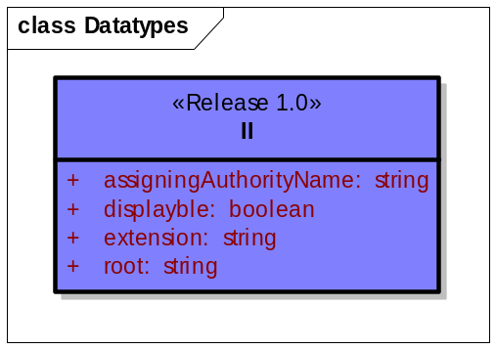
New Use Cases/Features
Community outreach: CCTS
caBIG Clinical Trials Suite
  Suite of interoperable applications in CTMS WS
Single Sign-on (SSO)
  Need to be able to move between applications without re-logging in
  Example 1: user logs into PSC then links over to LabViewer
Delegation
  Need to be able to delegate other systems to act on your behalf
  Example 1: user logs into C3PR and then moves to caAERS
  Example 2: user logs into C3PR, message sent to ESB then forwarded to PSC
Querying complex datatypes
  HL7 defines a number of complex datatypes, and BRIDG utilizes a subset of these
  CCTS models are BRIDG derived, so there may be a need to provide support for CQL-style queries into complex datatypes
Enterprise Service Bus (ESB)
  Core component that handles data transformation and message routing
  Will act on the behalf of many users – security issues?

Slide 25
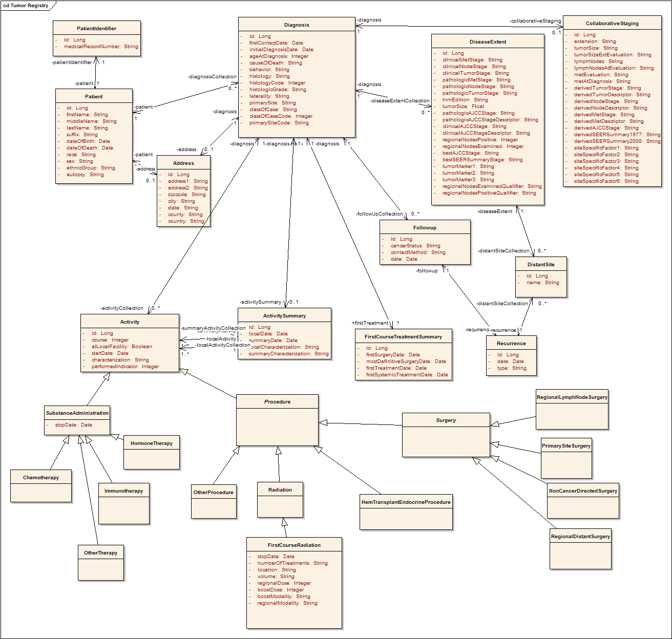
New Use Cases/Features
Community outreach: caTRIP
Cancer Translational Research Informatics Platform
  Application for querying across federated data services
Select attributes, objects, and associations to return
  Users must be able to select which attributes of which objects should be returned
  Example 1: user builds a query against the Tumor Registry and wants some attributes from Patient and some from Diagnosis
  Example 2: user builds a query against CAE and caTissue CORE and wants to return some attributes from CAE and some from caTissue CORE

Slide 26
New Use Cases/Features
Community outreach: Analytical Services BP
Analytical Services Best Practices Working Group
  Chartered to identify BPs for creating and interacting with analytical services
Tuning parameter wrappers
  Analytical services typically have many tuning parameters that are not particularly reusable
  It is burdensome to register all of these parameters in the caDSR
  An alternative is to create a general purpose parameter object that would carry with it some of the metadata you would find in the caDSR
Identify parts of a model used
  Analytical services typically reuse models from other services
  The services don’t need to reuse the entire model
  It would be useful to identify which parts of the model clients can expect to get back and should send in
  Example 1: MAGE and BioDataCube
  Example 2: caBIO

Slide 27
New Use Cases/Features
Community outreach: Workflow
Workflow Working Group
  Chartered to investigate how ICR can leverage workflow to meet scientific goals
Workflow authoring tool
  It would be useful for researchers to have a graphical tool for authoring workflows
  This tool should abstract the user from BPEL
Workflow sharing service
  Researchers typically share workflows once they are constructed
  Building workflows of workflows can be a powerful concept
  These use cases could be enabled by a service that stores and exposes workflows
Generic data cache
  It is important for researchers to have access to intermediate results of a workflow
  Beyond workflow, it would be useful to have a generic service that data objects can be stored and retrieved later

Slide 28
New Use Cases/Features
Community outreach: HTP
High Throughput Data Working Group
  Chartered to identify use cases and evaluate technologies for efficiently exchanging large data objects (e.g. microarray and proteomics data)
Metadata for BDT
  Given an Bulk Data Transfer EPR, a client should be able to determine the associated metadata of the data it represents (e.g Class information and semantics)
Referencing large data
  Many data objects are too large to pass around in “workflows” by value
  There needs to be a way for clients to pass data “by reference”
  This could be accomplished via EPRs to BDT resources, caBIG identifiers, or some other mechanism

Slide 29
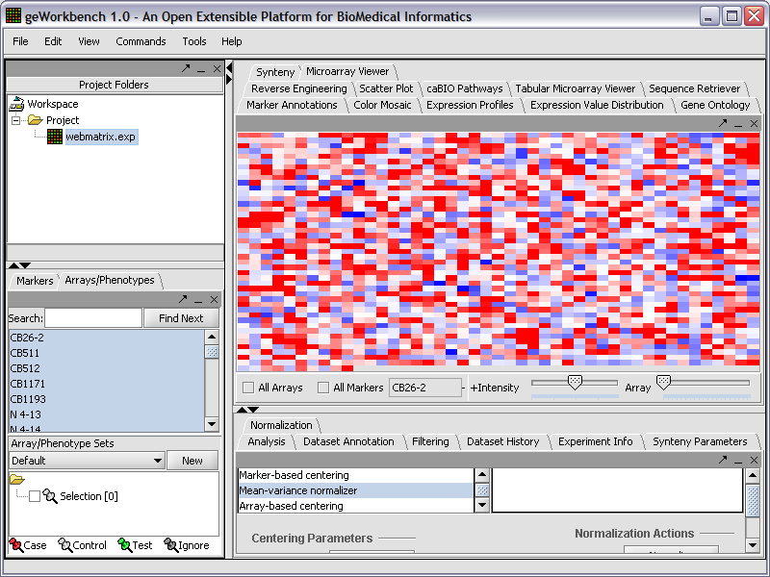
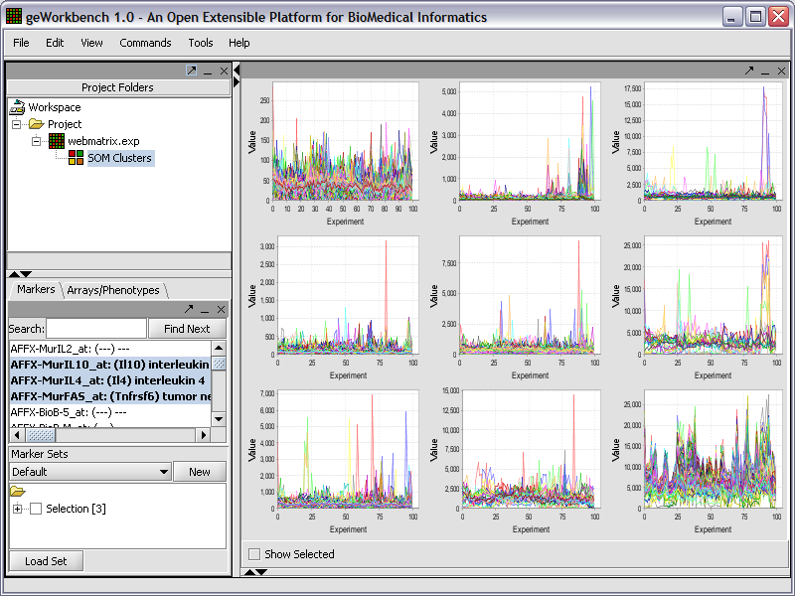
New Use Cases/Features
Community outreach: ICR
Integrative Cancer Research Workspace
  Workspace dedicated to sharing and analyzing biological data
Generic service client
  Some tools provide a generic interface for running methods on analytical services
  This could be enabled with a generic service client that accepts generic objects as parameters
  This could also be accomplished via workflow

Slide 30
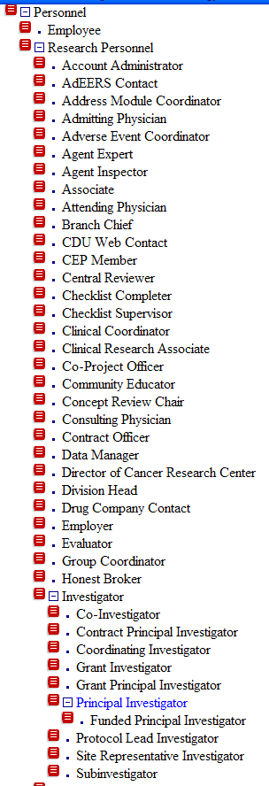
New Use Cases/Features
Community outreach: VCDE
Vocabularies and Common Data Elements Workspace
  Workspace dedicated to ensuring the semantic nature
  of caBIG
Ontologically structured discovery
  caGrid supports discovering services by the semantic
  concepts they expose
  Discovery could take into account the hierarchical
  nature of the semantic concepts
  Example1: service exposes Principle Investigator and a
  client wants to discover via Investigator
  Example 2: service exposes Personnel and a client
  wants to discover via Research Personnel

Slide 31
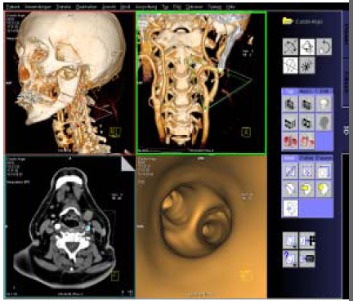

New Use Cases/Features
Community outreach: Imaging
In Vivo Imaging Workspace
  Workspace dedicated the sharing and analysis of imaging data
Discover by alternate names
  Equivalence of CDEs between different standards is often encoded in the Alternate Name of the CDE in the caDSR
  caGrid metadata could expose alternate names to enhance discovery
  Example 1: the DICOM Tag CDE has alternate name “DICOM Tag”, which is used to determine the value, such as “0008,0008”

Slide 32
Discussion
  Prioritization
  Other use cases/features not mentioned?

