Slide 1
caGrid
Identifiers
Architecture
caBIG™ Arch VCDE Face 2 Face
August 6-8th, 2007
Shannon hastings(hastings@bmi.osu.edu) - Ohio State University

Slide 2
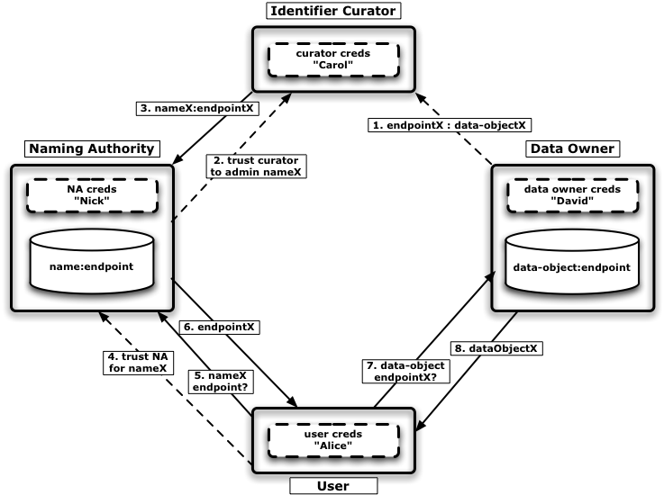
Identifiers Service Concept Architecture

Slide 3

CaGrid Identifier Framework

Slide 4
caGrid
Identifiers
Architecture
caBIG™ Arch VCDE Face 2 Face
August 6-8th, 2007
Shannon hastings(hastings@bmi.osu.edu) - Ohio State University

