Slide 1
caGrid
2007 AMIA Spring Congress
May 22, 2007
Orlando, FL
Stephen Langella
Ohio State University
langella@bmi.osu.edu

Slide 2
caBIG Overview
Common, widely distributed infrastructure that permits the cancer research community to focus on innovation
Shared, harmonized set of terminology, data elements, and data models that facilitate information exchange
Collection of interoperable applications developed to common standards
Cancer research data is available for mining and integration

Slide 3
Interoperability
The ability of multiple systems to exchange information
and to be able to use the information that has been exchanged.
Semantic
interoperability
Syntactic
interoperability

Slide 4
caBIG Compatibility
Compatibility Guidelines:
  Interoperability can be defined as the ability of a system to access and use the parts of another system. The caBIG program has made interoperability between data and software components a primary strategic goal.
Compliancy Levels
  Bronze – System is remotely available
  Silver – Syntactic and Semantic Interoperability
  Gold – Grid Interoperability

Slide 5
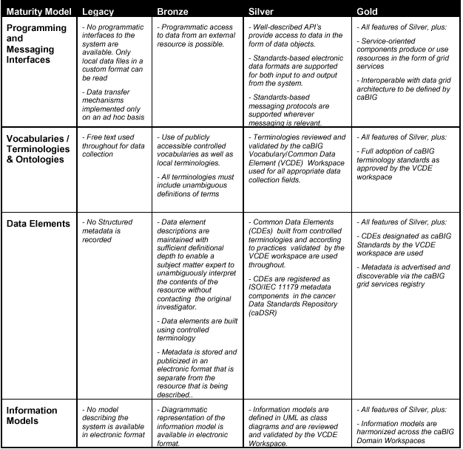
caBIG Compliance
SYNTACTIC
SEMANTIC
SEMANTIC
SEMANTIC

Slide 6
caBIG Data Modelling Services
Cancer Data Standards Repository (caDSR)
  caBIG projects register their data models as Common Data Elements (CDEs) which are semantically harmonized and then centrally stored and managed the caDSR
  The caDSR grid service provides:
    Model discovery and traversal
    caGrid standard metadata generation capabilities
Enterprise Vocabulary Services (EVS)
  EVS is set of services and resources that address the need for controlled vocabulary
  The EVS grid service provides:
    Query access to the data semantics and controlled vocabulary managed by the EVS
Global Model Exchange (GME)
  GME is a DNS-like data definition registry and exchange service that is responsible for storing and linking together data models in the form of XML schema.
  The GME grid service provides:
    Access to the authoritative structural representation of data types on the grid

Slide 7
What is caGrid?
Grid Infrastructure for caBIG
Enterprise Level Grid Components
caGrid provides “a way” of achieving Gold Compliance
caGrid Components
  Grid Service Graphical Development Toolkit (Introduce)
  Metadata
  Advertisement and Discovery
  Semantic Services
  Data Service Infrastructure
  Analytical Service Infrastructure
  Identifiers
  Workflow
  Security

Slide 8
caGrid exposing Silver Systems
Object Oriented APIs and data resources are developed using Object types and information models registered in the caDSR
These “silver systems” are grid-enabled by defining a grid service interface that defines the functionality to be exposed to the grid
The grid service interface uses the same Object types as the existing system, but leverages a platform and language neutral representation (XML) of them
The grid service implementation maps service invocations to API calls or queries into the existing system

Slide 9
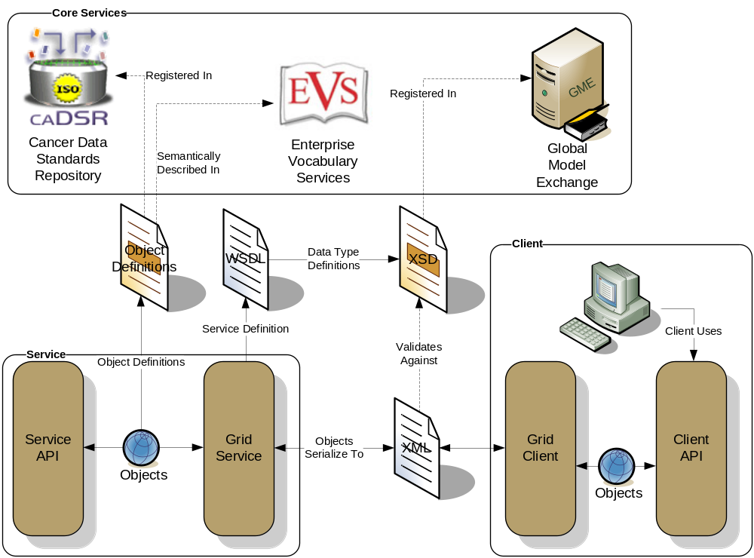
caGrid Data Description Infrastructure
Client and service APIs are object oriented, and operate over well-defined and curated data types
Objects are defined in UML and converted into ISO/IEC 11179 Administered Components, which are in turn registered in the Cancer Data Standards Repository (caDSR)
Object definitions draw from controlled terminology and vocabulary registered in the Enterprise Vocabulary Services (EVS), and their relationships are thus semantically described
XML serialization of objects adhere to XML schemas registered in the Global Model Exchange (GME)

Slide 10
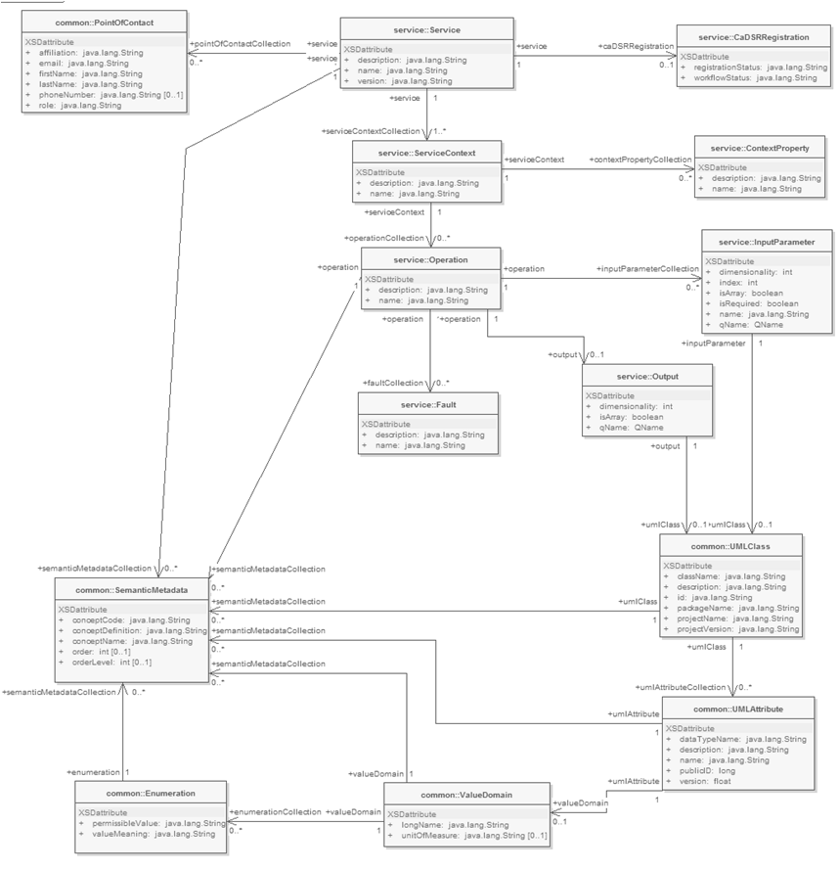
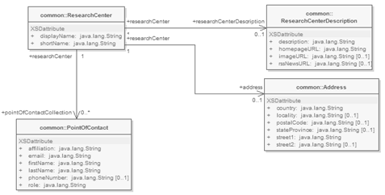
Service Metadata
Common Service Metadata
  Provided by all services
  Details service’s capabilities, operations, contact information, hosting research center
  Service operation’s inputs and outputs defined in terms of structure and semantics extracted from caDSR and EVS
Service Security Metadata
  Provided by all services
  Details the service’s requirements on communication channel for each operation
  Can be used by client to programmatically negotiate an acceptable means of communication
Data Service Metadata
  Provided by all data services
  Describes the Domain Model being exposed, in terms of a UML model linked to semantics
  Provides information needed to formulate the Object-Oriented Query
  As with common metadata, data types defined in terms of structure and semantics extracted from caDSR and EVS

Slide 11
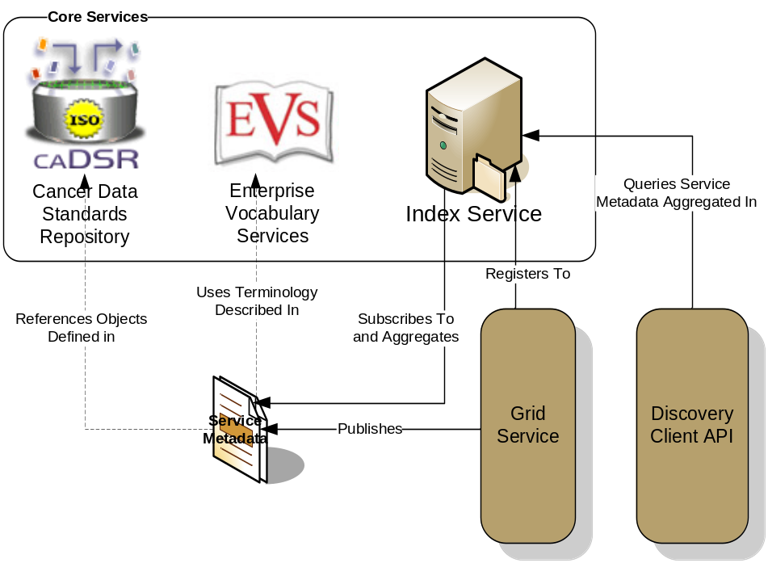
Advertisement and Discovery Process
All services register their service location and metadata information to an Index Service
The Index Service subscribes to the standardized metadata and aggregates their contents
Clients can discover services using a discovery API which facilitates inspection of data types
Leveraging semantic information (from which service metadata is drawn), services can be discovered by the semantics of their data types
  “Find me all the services from Cancer Center X”
  “Which Analytical services take Genes as input?”
  “Which Data services expose data relating to lung cancer?”

Slide 12
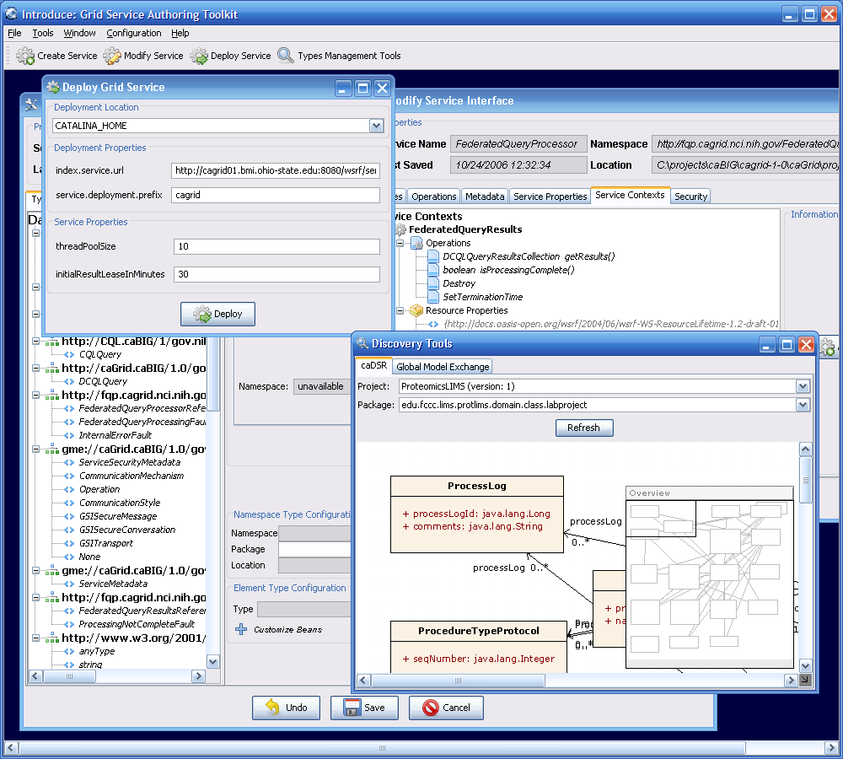
caGrid Service Development
  Introduce - toolkit for the graphical creation of caBIG Gold compliant services.
  Removes the complexity of developing grid services, allowing application developers to focus on the application.
Automatic code generation of complete WSRF compliant grid service which is configured to provide:
  Security
  Advertisement
  Discovery
  Client API
  Metadata

Slide 13
Data Service Overview
caGrid Data Services provide capability to expose silver data resources to the Grid
Specialization of caGrid grid services to expose data through a common query interface
  Meet all base service requirements of caGrid services
Present an object view of data sources
  Exposed objects are registered in caDSR and their XML representation in GME
  Data Service Metadata describes information model
  Queries made with CQL Query objects
    Results returned as objects nested in a CQL Query Result Set
Graphical Development tool, implemented as an extension to the Introduce Toolkit, is used to create the new grid service

Slide 14
Data Service Query Language
Specifies a target object (result) type and selects the instances which satisfy the specified properties and nested object properties
  Allows path navigation
  Provides logical grouping
  Provides name/predicate/value filtering on properties of objects
Recursively defined
Ability to return full Objects, Set of attributes, count of results, or distinct attribute values

Slide 15
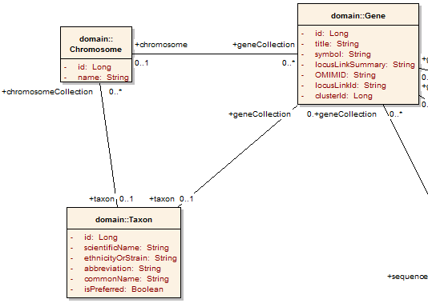
Example CQL Query
Return all Genes with a symbol beginning with BRCA and have an associated Taxon with a scientificName equal to “Homo sapiens”:
<CQLQuery xmlns="http://CQL.caBIG/1/gov.nih.nci.cagrid.CQLQuery"> <Target name="gov.nih.nci.cabio.domain.Gene"> </Target> </CQLQuery>

Slide 16
Example CQL Query
LIKE “BRCA%”
Return all Genes with a symbol beginning with BRCA and have an associated Taxon with a scientificName equal to “Homo sapiens”:
<CQLQuery xmlns="http://CQL.caBIG/1/gov.nih.nci.cagrid.CQLQuery"> <Target name="gov.nih.nci.cabio.domain.Gene"> <Attribute name="symbol" predicate="LIKE“ value="BRCA%"/> </Target> </CQLQuery>

Slide 17
Example CQL Query
LIKE “BRCA%”
Return all Genes with a symbol beginning with BRCA and have an associated Taxon with a scientificName equal to “Homo sapiens”:
<CQLQuery xmlns="http://CQL.caBIG/1/gov.nih.nci.cagrid.CQLQuery"> <Target name="gov.nih.nci.cabio.domain.Gene"> <Group logicRelation="AND"> <Attribute name="symbol" predicate="LIKE“ value="BRCA%"/> <Association roleName="taxon“ name="gov.nih.nci.cabio.domain.Taxon"> </Association> </Group> </Target> </CQLQuery>

Slide 18
Example CQL Query
LIKE “BRCA%”
Return all Genes with a symbol beginning with BRCA and have an associated Taxon with a scientificName equal to “Homo sapiens”:
<CQLQuery xmlns="http://CQL.caBIG/1/gov.nih.nci.cagrid.CQLQuery"> <Target name="gov.nih.nci.cabio.domain.Gene"> <Group logicRelation="AND"> <Attribute name="symbol" predicate="LIKE“ value="BRCA%"/> <Association roleName="taxon“ name="gov.nih.nci.cabio.domain.Taxon"> <Attribute name=“scientificName" predicate=“EQUAL_TO” value=“Homo sapiens"/> </Association> </Group> </Target> </CQLQuery>
= “Homo sapiens”

Slide 19
Federated Query Processor
Provides a mechanism to perform basic distributed aggregations and joins of queries over multiple data services
As caGrid data services all use a uniform query language, CQL, the Federated Query Infrastructure can be used to express queries over any combination of caGrid data services
Federated queries are expressed with a query language, DCQL, which is an extension to CQL to express such concepts as joins, aggregations, and target services
Implemented as a stateful grid service, queries may be executed asynchronously and results retrieved at a later time
  Supports secure deployments wherein result ownership is enforced
Coupled with semantic discovery capabilities of caGrid, provides a powerful framework for data discovery, mining, and integration

Slide 20
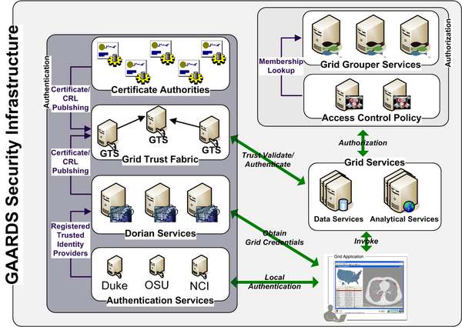
caGrid Security Infrastructure (GAARDS)
Dorian
  Grid User Account Management
  Enables Identity Management and Federation
Authentication Service
  Provides a uniform authentication interface in which applications can be built on such that they may easily integrated with Dorian.
Grid Trust Service (GTS)
  Supports applications and services in deciding whether or not signers of digital credentials/user attributes can be trusted.
Grid Grouper
  Grid Group / VO Management
  Enables Group/VO Based Authorization
Authorization Support
  Pluggable Authorization framework with built in support for CSM and Grid Grouper.

Slide 21
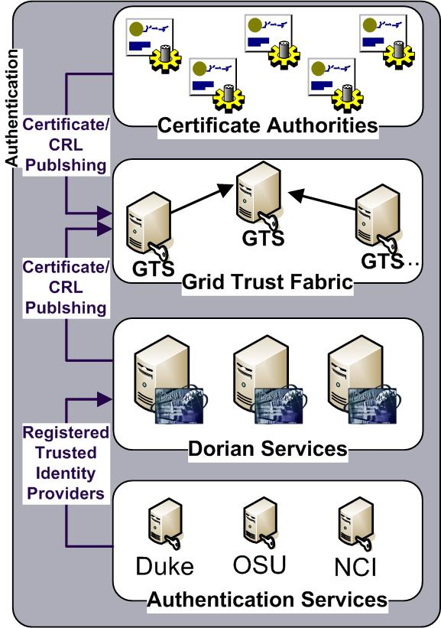
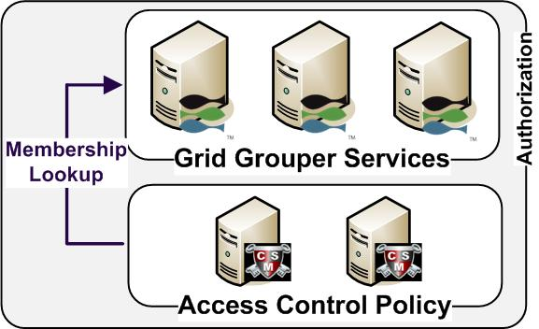
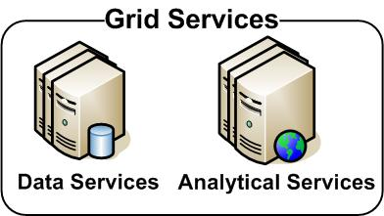
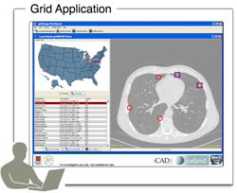
GAARDS in Action

Slide 22
GAARDS in Action
Authenticate with
Local Credential Provider
User authenticates to local credential provider using your everyday user credentials
SAML Assertion

Slide 23
GAARDS in Action
SAML Assertion
Application obtains grid credentials from Dorian using SAML provided by the local provider.
Grid
Credentials

Slide 24
GAARDS in Action
Application uses grid credentials to invoke secure grid services.
Grid
Credentials

Slide 25
GAARDS in Action
Should I trust the
credential signer?
Grid Service authenticates the user by asking the GTS whether or not the signer of the credential should be trusted.

Slide 26
GAARDS in Action
Authorization
Grid Service asks CSM or their access control policy enforcer whether or not the user can perform X and resource Y.
Is
Authorized?

Slide 27
GAARDS in Action
Is member of?
Authorization
Alternative
Grid Service can enforce local policy based on user membership to groups maintained in Grid Grouper.

Slide 28
Workflow
Provides capability to describe “orchestrations” of service invocations and data movement
  Uses existing defacto standard language: Business Process Execution Language (BPEL)
    Interoperability with other clients, editors, engines
Implemented as a stateful grid service, workflows can be created, stopped, paused, resumed, and cancelled and results retrieved at a later time
Coupled with semantic discovery, service metadata, and registration of data type structures in caGrid, provides a powerful framework for analyzing data
  Services can be dynamically discovered and federated queries can be invoked as part of a workflow

Slide 29
Project Resources and Communication
www.cagrid.org
  Download Software
  Documentation
  Tutorials
  Technical Paper and Presentations
caGrid 1.0 GForge Home
  Feature Requests
  Bug Reports
  Downloads / Source Repository
  http://gforge.nci.nih.gov/projects/cagrid-1-0/
caGrid Users Mailing List
  https://list.nih.gov/archives/cagrid_users-l.html
  cagrid_users-l@list.nih.gov

