Slide 1
caGrid 1.0
Introduce Overview
caBIG™ Arch VCDE Face 2 Face
August 6-8th, 2007
Shannon hastings(hastings@bmi.osu.edu) - Ohio State University

Slide 2
Introduce Overview
A framework which enables fast and easy creation of strongly typed and highly interoperable grid services
Provides a powerful extension system wherein specific functionality can be added to the service or service editing process
  Support for caDSR, GME, caGrid metadata, Data Services, and caGrid authorization services are all added this way
Abstracts all the details of the grid from the developer, allowing them to focus on the business logic being exposed
Provides a graphical environment

Slide 3
Service Development Process
Service developers first create a service using a simple wizard to specify information (target directory, type of service, service name, etc)
Next developer locate the data types they will use for inputs or outputs
  Can be discovered from the caDSR, GME, file system, etc
Operations are then defined that take some number of the data types as input, and produce some number as output
Metadata and Service Properties can be added and configured
The service’s security can be completely configured
Some or all of these steps may be automatically handled by extensions

Slide 4
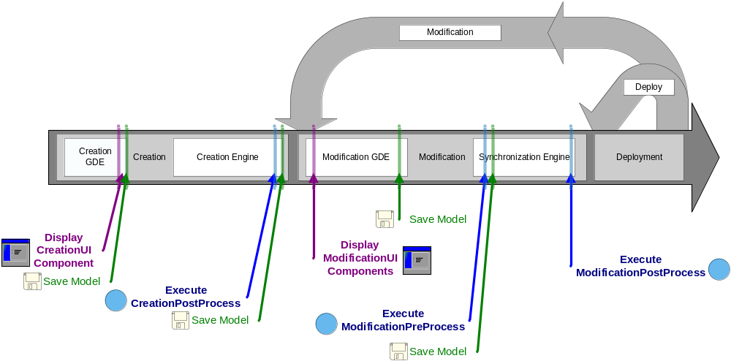
Introduce Service Lifecycle
The extension framework allows for all steps of the process to be extended or specialized

Slide 5
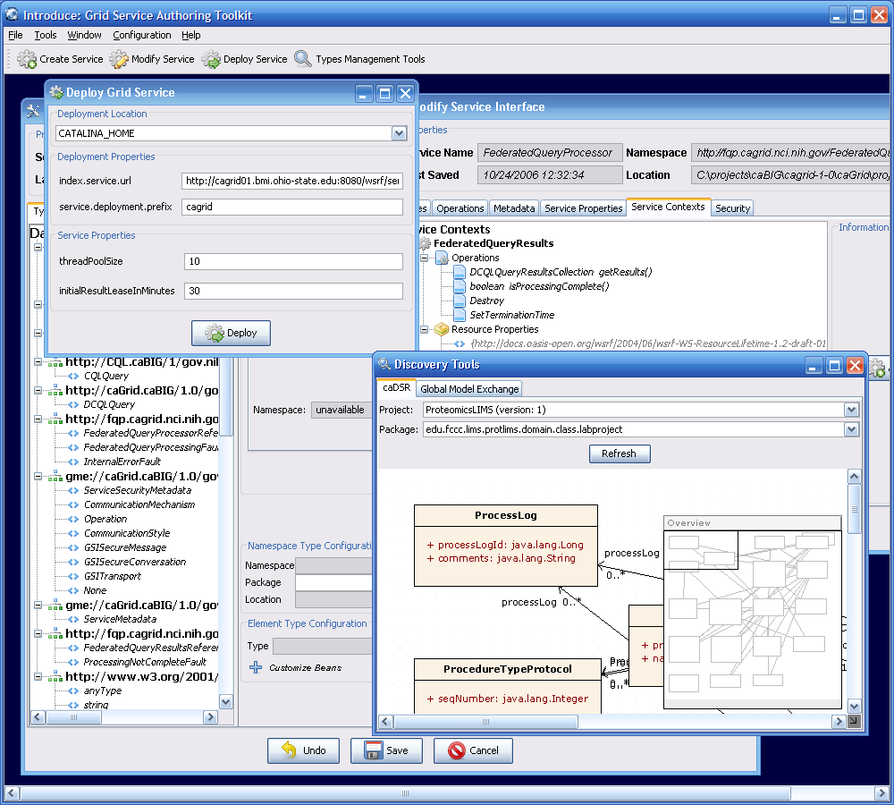
Introduce Graphical Development Environment
GUI for creating and manipulating a grid service
  Provides means of simple creation of service skeleton that a developer can then implement, build, and deploy
  Automatic code generation of complete caBIG compliant grid service which is configured to provide:
    Advertisement
    Standard Metadata
    Security
    Complete Client API

Slide 6
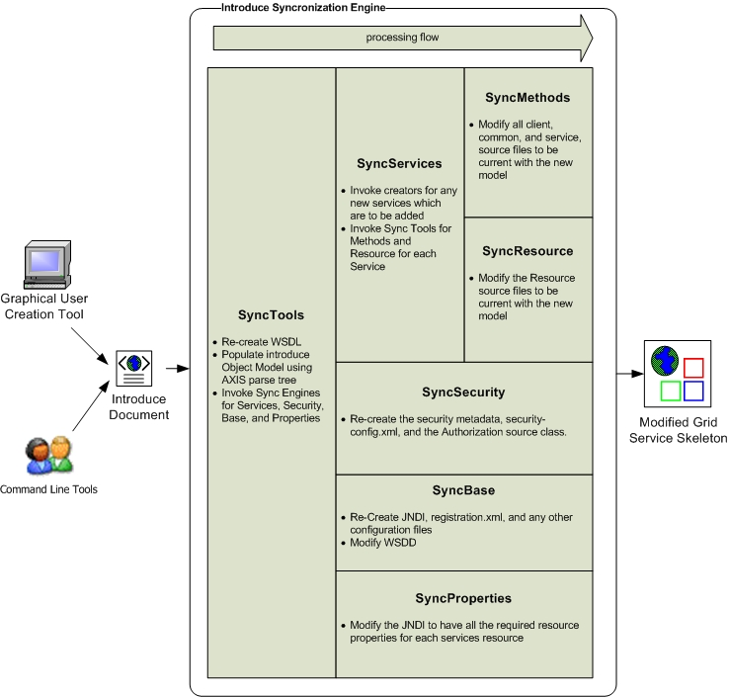
Introduce Backend
Driven from an service information model
  Graphical Environment simply facilitates editing of this model, and drives the backend
  Can also be externally created and driven from command line
Leverages code generation to create and edit service’s files

Slide 7
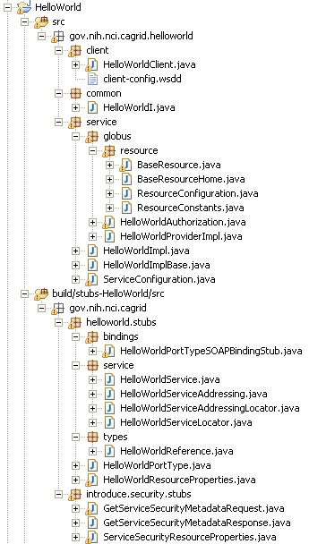
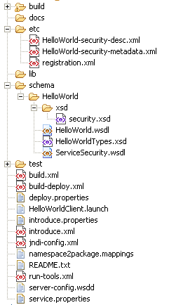
Introduce Created Service
= Introduce generated
= Globus generated
= Developer edits

Slide 8
caGrid 1.0
Introduce Overview
caBIG™ Arch VCDE Face 2 Face
August 6-8th, 2007
Shannon hastings(hastings@bmi.osu.edu) - Ohio State University

