Slide 1


caGrid Federated Query

Slide 2

What is caGrid?
A grid based software infrastructure consisting of services, toolkits, APIs, and applications
Production grid deployments of the core services provided by that infrastructure
A community of developers leveraging those deployments and infrastructure to provide applications and services to their research communities
Notes:
Overview of the three main areas of caGrid as a program.

Slide 3
What is caGrid?
A grid based software infrastructure consisting of services, toolkits, APIs, and applications
Production grid deployments of the core services provided by that infrastructure
A community of developers leveraging those deployments and infrastructure to provide applications and services to their research communities
Notes:
Highlighting that in this talk focus will be on the software it self and more specifically the distributed query capabilities.

Slide 4

caGrid Releases
Version | Release Date
caGrid 1.3 | 31st March 2009
caGrid 1.2 | 31st March 2008
caGrid 1.1 | 17th September 2007
caGrid 1.0 | 15th December 2006
caGrid 1.0 Beta | 17th July 2006
caGrid 0.5.4 | 12th May 2006
caGrid 0.5.3 | 25th January 2006
caGrid 0.5.2 | 15th November 2005
caGrid 0.5.1 | 7th October 2005
caGrid 0.5 | 31st August 2005
Notes:
History of the project. Stated in late 2005 and every release has been a new evolution and revolution of the one before it continually adding new capabilities addressing new use cases and more features to lower the barrier to entry.

Slide 5
Infrastructure Focus Areas
Leveraging Grid technologies and standards as an interoperability platform
Metadata Infrastructure
  Surfacing wealth of existing caBIG data-oriented metadata on the grid
  Providing new service-oriented metadata
Security
  Integrating existing systems and applications with Grid security
  Lowering burden of implementation of grid-wide and local policy
Service Developer Tooling
  Powerful platform for bringing applications and data to the grid
Facilitating Grid wide operations
  Federated query, workflow execution, resource discovery
Making the Grid more accessible
  Graphical installation and configuration, higher-level object-oriented APIs, web portals, graphical administrative applications
Quality
  Comprehensive testing infrastructure, automated builds and test execution on multiple platforms, dashboard with historical archive
Notes:
caGrid major focus areas related to what we strive for at a high level and how we achieve those goals.

Slide 6
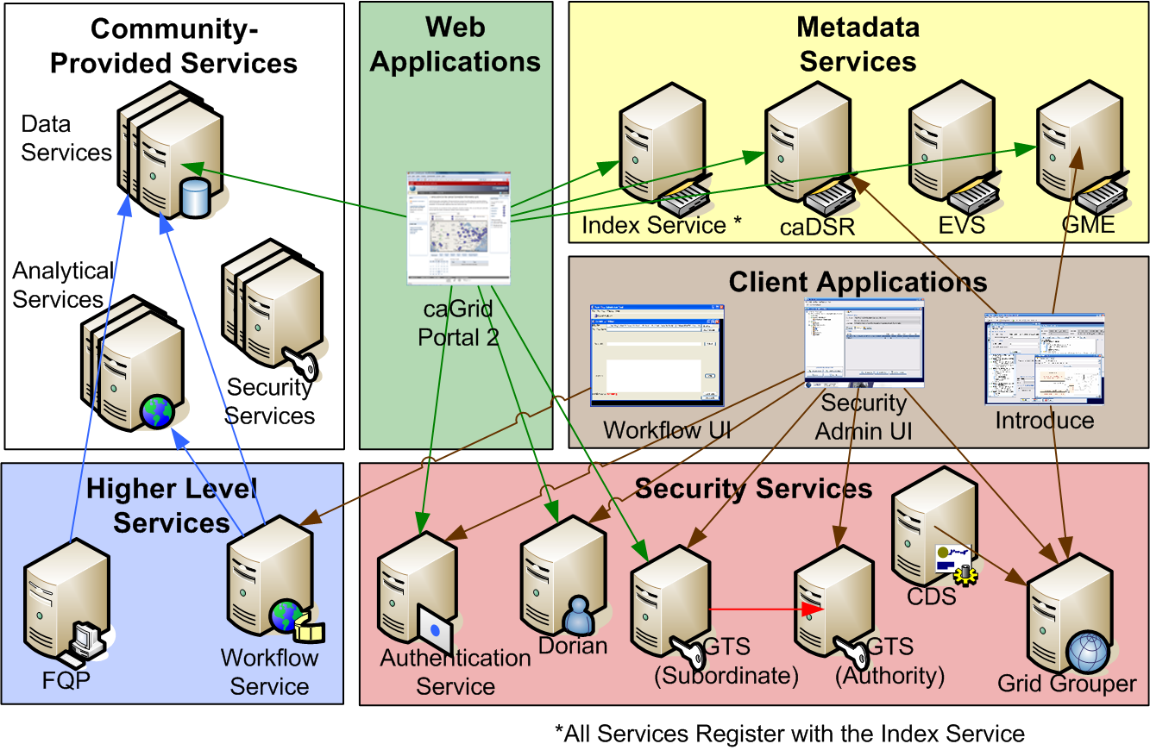
Example Production Environment
Notes:
Sample grid deployment showing the core services such as the Security and Metadata which provide commonly required functionality in an SOA and are the core services as the backbone for clients, application, other services, to build on top up.

Slide 7

Introduce Vision
Become the one stop shop for grid service development
  Provide a simple, yet powerful, graphical user interface (GUI) to encapsulate complexities of grid service development
  Provide an extensible toolkit with which grid services can be created and modified programmatically
Notes:
Moving into a phase now where we will begin to address building data services and then how we can then leverage there common interfaces in federating queries. This all starts with Introduce as the tool for generating all the code the developer needs to begin to enable the data to be queryable in the grid.

Slide 8
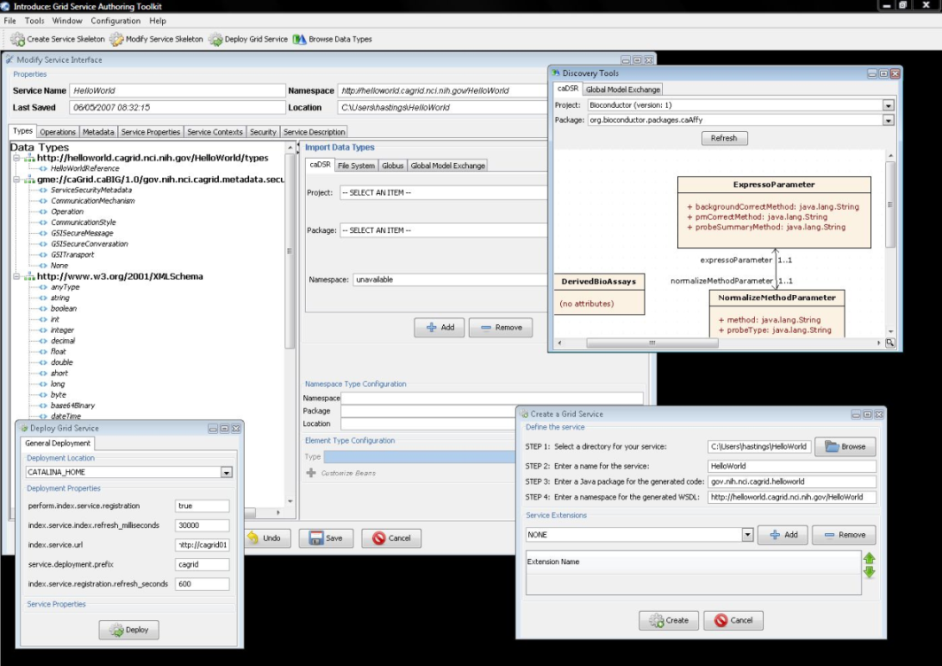
Introduce Features
Supports modification of operations
  Adding operations
  Removing Operations
  Updating Operations
  Importing Operations
Graphical Configuration
  Advertisement
  Security
  Service Metadata Specification
  Service Metadata Editing
  Service Configuration Properties
Auto Generates Code for Service
Auto generates a client API for service.
Graphical Deployment of Service
  Globus
  Tomcat
  JBoss
Notes:
Introduce at its core enables describing the operations of the service as well as the security and configuration constraints the service may need to have.

Slide 9
Data Service Overview
caGrid Data Services provide capability to expose data resources to the Grid
Specialization of caGrid grid services to expose data through a common query interface
  Meet all base service requirements of caGrid services
Present an object view of data sources
  Exposed objects are registered in caDSR and their XML representation in GME
  Data Service Metadata describes information model
  Queries made with CQL Query objects
    Results returned as objects nested in a CQL Query Result Set
Graphical Development tool, implemented as an extension to the Introduce Toolkit, is used to create the new grid service
Notes:
Now, more specifically than the services Introduce can build is the Data Service. The data service is grid service who implements a common interface and provides the “query” method. The extension to introduce called the Data Services Extension enables users to create there grid data service in introduce like anything else, however, this data servcie extension will enable the chose the semantically annotated domain model which represents the data in there DB and will also automatically generate the wrappers needed to hook into that DB (don’t support everything but we do support caCore, and Soon I2B2 ontomapper, and latter redCap.

Slide 10
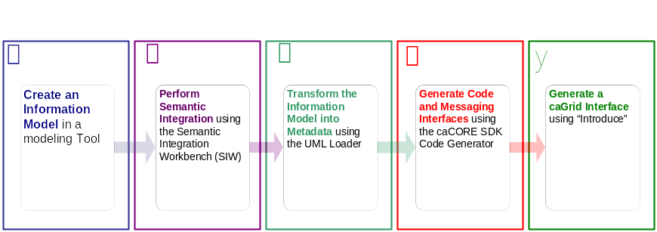




An example service development process (0 lines of developer code)
Create Semantically Harmonized Data Model
Generate
Data Resource
Grid-ify
Notes:
Description of this overal process of creating a grid data service.

Slide 11
Pre-grid
A caCORE SDK (or soon an i2b2 ontomapper) generated data resource which is not connected to the grid.
Grid
caBIO

Slide 12

Exposing the Resource:
We will use the Introduce data service wizard to describe our data resource and generate a grid service.
Grid
caBIO

Slide 13


Exposing the Resource:
Introduce will enable the user to browse data model in the caDSR and chose the ones which they are going to be exposing.
GME
Grid
CQL query
processor
caBIO

Slide 14

Exposing the Resource:
Then they will locate the schemas which describe the data models and will provide the wire protocol for transferring data instances.
GME
Grid
CQL query
processor
caBIO

Slide 15

Exposing the Resource:
Lastly the user will have to provide a CQL query processor to enable CQL query to be executed against the data resource. If the resource is a caCore or I2B2 these processors already exist and the user will simple choose the one required.
GME
Grid
CQL query
processor
caBIO

Slide 16


Exposing the Resource:
Introduce will create a grid service which can expose the data resource we described to the grid
Grid
caGrid
Data
Service
caBIO
caCORE CQL query
processor

Slide 17
Data now available.
Now that our service is generated we can deploy it so that the resource can be used.
Grid
GridService
caBIO
Grid
Service
caGrid
Data
Service
caBIO
caCore CQL query
processor

Slide 18
How will users find me
We need to expose metadata to a registry so that a user/service can locate and use our service
Grid
GridService
caBIO
Grid
Service
caGrid
Data
Service
caBIO
caCore CQL query
processor

Slide 19
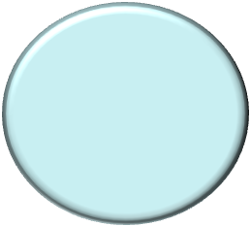
How will users find me
We will send our metadata to an index service that can be queried by grid users.
Grid
GridService
caBIO
Grid
Service
caGrid
Data
Service
caBIO
caCore CQL query
processor
Index Service

Slide 20
Data Service Query Language
Simple, “minimum entry” for data providers
Specifies a target object (result) type and selects the instances which satisfy the specified properties and nested object properties
  Allows path navigation
  Provides logical grouping
  Provides name/predicate/value filtering on properties of objects
Recursively defined
Ability to return full Objects, Set of attributes, count of results, or distinct attribute values

Slide 21
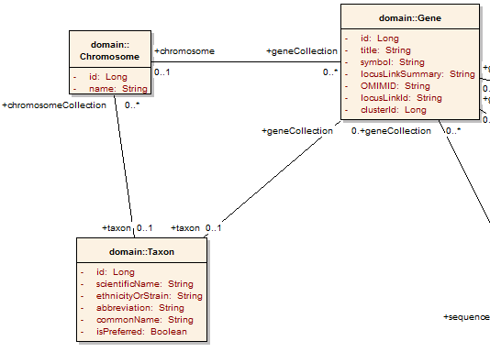
Example CQL Query
Return all Genes:
<CQLQuery xmlns="http://CQL.caBIG/1/gov.nih.nci.cagrid.CQLQuery"> <Target name="gov.nih.nci.cabio.domain.Gene"> </Target> </CQLQuery>
Notes:
This next phase runs through developing a query for a data service showing how the domain model describes the queryies that can be generated and the CQL language lets you express the query. This example is showing a simple model where all we want to do is qeury the DB for all Genes.

Slide 22
Example CQL Query
LIKE “BRCA%”
Return all Genes with a symbol beginning with BRCA:
<CQLQuery xmlns="http://CQL.caBIG/1/gov.nih.nci.cagrid.CQLQuery"> <Target name="gov.nih.nci.cabio.domain.Gene"> <Group logicRelation="AND"> <Attribute name="symbol" predicate="LIKE“ value="BRCA%"/> </Group> </Target> </CQLQuery>
Notes:
Now we get more specific and add some more filtering to our query buy having it only return genes that have a symbol “LIKE” BRCA and a wildcard

Slide 23
Example CQL Query
LIKE “BRCA%”
Return all Genes with a symbol beginning with BRCA and have an associated Taxon:
<CQLQuery xmlns="http://CQL.caBIG/1/gov.nih.nci.cagrid.CQLQuery"> <Target name="gov.nih.nci.cabio.domain.Gene"> <Group logicRelation="AND"> <Attribute name="symbol" predicate="LIKE“ value="BRCA%"/> <Association roleName="taxon“ name="gov.nih.nci.cabio.domain.Taxon"> </Association> </Group> </Target> </CQLQuery>
Notes:
Net we will get even more specific and say I we only want those same genes from before but only if they have an associated Taxon instance.

Slide 24
Example CQL Query
LIKE “BRCA%”
Return all Genes with a symbol beginning with BRCA and have an associated Taxon with a scientificName equal to “Homo sapiens”:
<CQLQuery xmlns="http://CQL.caBIG/1/gov.nih.nci.cagrid.CQLQuery"> <Target name="gov.nih.nci.cabio.domain.Gene"> <Group logicRelation="AND"> <Attribute name="symbol" predicate="LIKE“ value="BRCA%"/> <Association roleName="taxon“ name="gov.nih.nci.cabio.domain.Taxon"> <Attribute name=“scientificName" predicate=“EQUAL_TO” value=“Homo sapiens"/> </Association> </Group> </Target> </CQLQuery>
= “Homo sapiens”
Notes:
And lastly we will even futher specify our search to say not only do we want a taxon to exist but that taxon needs to be from the homo sapiens genus.

Slide 25
Federated Query Processor
Provides a mechanism to perform basic distributed aggregations and joins of queries over multiple data services
As caGrid data services all use a uniform query language, CQL, the Federated Query Infrastructure can be used to express queries over any combination of caGrid data services
Federated queries are expressed with a query language, DCQL, which is an extension to CQL to express such concepts as joins, aggregations, and target services
Implemented as a stateful grid service, queries may be executed asynchronously and results retrieved at a later time
  Supports secure deployments wherein result ownership is enforced
Coupled with semantic discovery capabilities of caGrid, provides a powerful framework for data discovery, mining, and integration
Notes:
Now that we have a common mechanish for querying any caGrid data service through a standand interface and operation. We can leverage that capability in a federated means to make a larger multi site query be broken down into subqueries and filter and join the results.

Slide 26
FQP 1.3 Enhancements
Added configurable query execution parameters to allow control over behavior in the face of failure
  Ability to return partial results, specify retries, or fail
Added new results metadata which gets updated during query execution containing:
  Overall processing status (waiting, working, done, etc)
  Details of each target service (range of data in results, faults, etc)
Support WS-Notification
  Client can be notified of changes in execution status for example
Support for delegation via integration with Credential Delegation Service (CDS)
  Client can use CDS to delegate to FQP, and request FQP to query data services using the delegated credential
Support for using caGrid Transfer to obtain query results
Performance enhancements, included multi-threaded queries
Notes:
Enhancements in this last release that make it even easier. You can now submit a large query to a FQP service and go away and wait on the notification that the query is complete. You can also use Transfer to move the data back to the client if the data is too large to simple requires of soap and be expected to DOM the resulting data.

Slide 27
DCQL Example
Return all the Genes in my local database that have a symbol beginning with “BRC“ and also exist in the caBIO database.
<DCQLQuery>
<TargetObject name="gov.nih.nci.cabio.domain.Gene">
<Group logicRelation="AND">
<ForeignAssociation targetServiceURL="http://cabio-gridservice.nci.nih.gov:80/wsrf-cabio/services/cagrid/CaBIOSvc">
<JoinCondition localAttributeName="fullName" foreignAttributeName="fullName" predicate="EQUAL_TO"/>
<ForeignObject name="gov.nih.nci.cabio.domain.Gene">
<Attribute name="fullName" value="BRCA%" predicate="LIKE"/>
</ForeignObject>
</ForeignAssociation>
<Attribute name="fullName" value="BRCA%" predicate="LIKE"/>
</Group>
</TargetObject>
<targetServiceURL>http://localhost:8080/wsrf/services/cagrid/CaBIO</targetServiceURL>
</DCQLQuery>
Notes:
A DCQL (Which is just distributed CQL) can be used to make queries that are federated and require sub queries to be issues to other data services in order to dertime the result set. The main addition here is the ability to describe Forieng association which intern create remote joins to happen in the FQP Service.

Slide 28
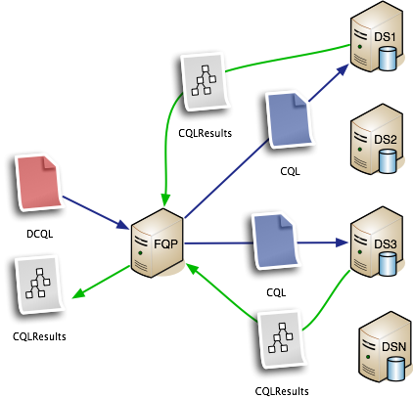
Sample Execution Scenario
Notes:
Just showing how issuing a DCQL query to an FQP Service can be broken down different CQL queries that are required to do the joins or aggregation described in the query and the results are returned.

Slide 29
Resources
caGrid Community Site :
  http://cagrid.org
caGrid Knowledge Center: https://cabig-kc.nci.nih.gov/CaGrid/KC/index.php/Main_Page
Notes:
A DCQL (Which is just distributed CQL) can be used to make queries that are federated and require sub queries to be issues to other data services in order to dertime the result set. The main addition here is the ability to describe Forieng association which intern create remote joins to happen in the FQP Service.

Slide 30


Questions?

