Slide 1
Analytical Services
Best
Practice
caGrid Team Suggested Development Process
Shannon Hastings, Ohio State University
January 28-30, 2008

Slide 2
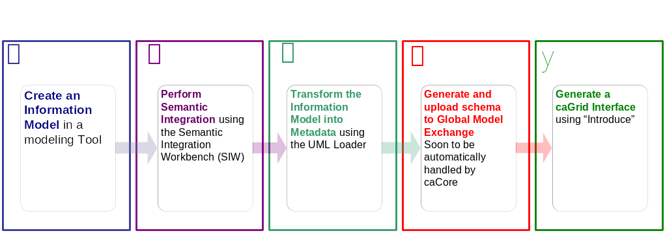





Getting Connected:
The development process.
Create Semantically Harmonized Data Model
Generate Analytical Grid Service
GME

Slide 3
Getting Connected:
The development process.
Create Semantically Harmonized Data Model
Generate Analytical Grid Service
GME

Slide 4
Getting Connected:
The development process.
Create Semantically Harmonized Data Model
Generate Analytical Grid Service
GME

Slide 5
Getting Connected:
The development process.
Create Semantically Harmonized Data Model
Generate Analytical Grid Service
GME

Slide 6
Getting Connected:
The development process.
Create Semantically Harmonized Data Model
Generate Analytical Grid Service
GME

Slide 7
Getting Connected:
The development process.
Create Semantically Harmonized Data Model
Generate Analytical Grid Service
GME

Slide 8

Demonstration
Grid
algorithm A

Slide 9

Exposing the Algorithm:
We will use the Introduce to describe the API of our algorithm and expose it to the grid.
Grid
algorithm A

Slide 10

Exposing the Algorithm :
Introduce will enable the user to browse data models in the caDSR and chose the ones which they are going to be using in the API.
GME
Grid
algorithm A

Slide 11

Exposing the Algorithm :
Then they will locate the schemas which describe the data models and will provide the wire protocol for transferring data instances.
GME
Grid
algorithm A

Slide 12

Exposing the Algorithm :
Introduce will create a grid service which can expose the data resource we described to the grid
Grid
caGrid
Analytical
Service
algorithm A

Slide 13

Exposing the Algorithm :
Developer will provide glue code which will map the calls from the grid client to calls on their algorithm
Grid
caGrid
Analytical
Service
Algorithm invocation code
algorithm A

Slide 14
Algorithm now available as Grid Service.
Now that our service is generated we can deploy it so that the resource can be used.
Grid
GridService
caGrid
Analytical
Service
Algorithm invocation code
algorithm A

Slide 15
How will users find me
We need to expose metadata to a registry so that a user/service can locate and use our service
Grid
GridService
caGrid
Analytical
Service
Algorithm invocation code
algorithm A

Slide 16

How will users find me
We will send our metadata to an index service that can be queried by grid users.
Grid
GridService
caGrid
Analytical
Service
Algorithm invocation code
algorithm A
Index Service

