Slide 1
caGrid 1.0
Introduce
Gold Service Creation Tool
Architecture/VCDE Workspaces
Joint Face to Face
February 1st-2nd, 2006

Slide 2
Introduce Service Creation Framework
Goal:
  Enable easy path to caBIG gold compatible service creation.
Basic Features:
  Supports creation of custom caBIG compatible grid services
    Including analytical, data, as well as purely custom.
  Provides graphical service creation environment.
  Takes user from service creation through deployment.
  Enforces strongly typed interfaces via GME type discovery.
  Enables easy configuration for security, registration, and metadata publication.

Slide 3
Introduce Features
Creates Globus based grid service
  Handles the creation and synchronization of:
    Service Interface
    Client implementation
    Sever stubbed implementation
    Resource Properties for Service Metadata
    Index service registration configuration
    Method level and service level security configuration as well as client side security configuration
    Deployment configuration parameters
  Can be modified even after implementation
  Deployment scripts and configuration files
  Graphical and command line tools for all aspects.
  Creates an eclipse project for quick and easy implementation

Slide 4
Analytical Services?
Introduce is the core framework for building ANY services in caGrid.
It can be used to generate Analytical , Data, or Completely Custom services such as core services.
The core service framework that Introduce creates for caGrid services handles all the basic core requirements that are expects of any grid service such as
  Service advertisement
  Service metadata registration
  Security configuration
  Strongly typed interfaces

Slide 5
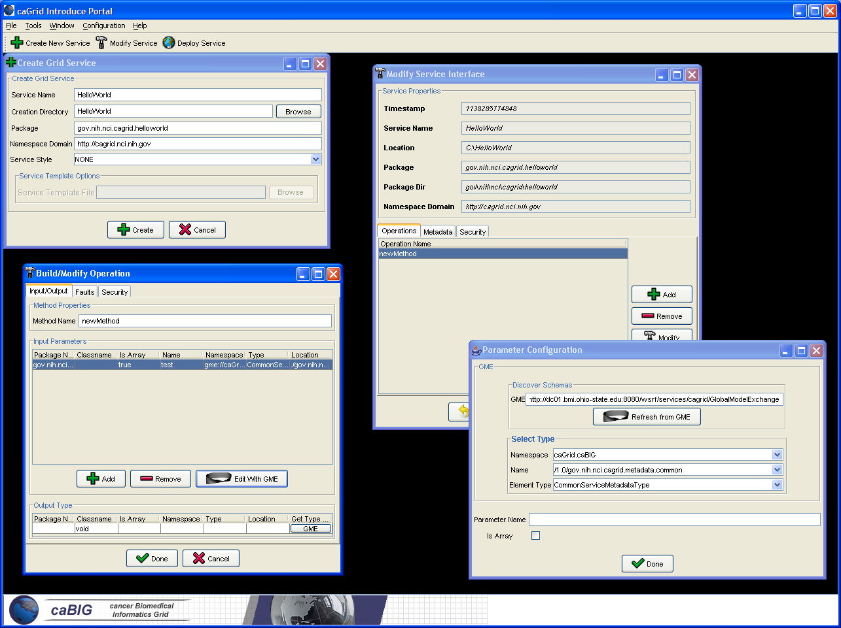

Slide 6
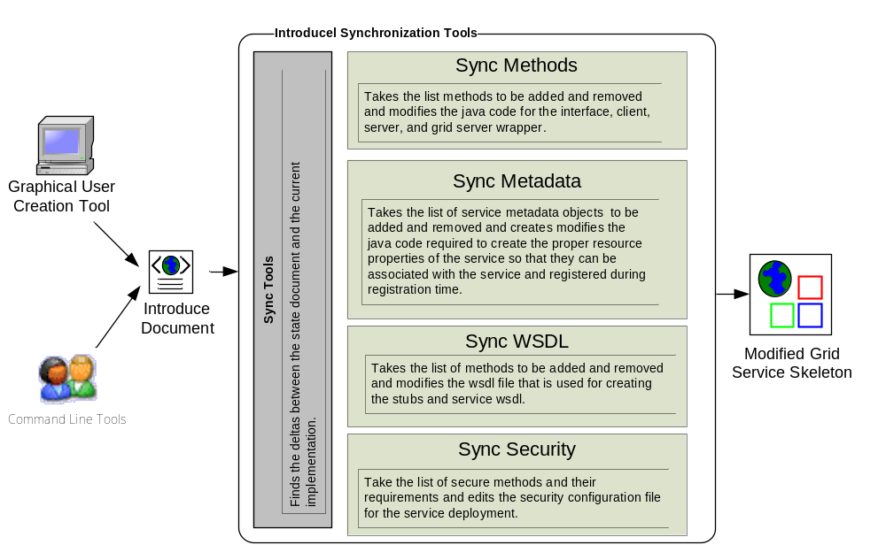
Overview of Current Introduce Framework

