Slide 1
caGrid 1.0 Trust Service
Overview and Design
Stephen Langella
langella@bmi.osu.edu
Department of Biomedical Informatics
The Ohio State University

Slide 2
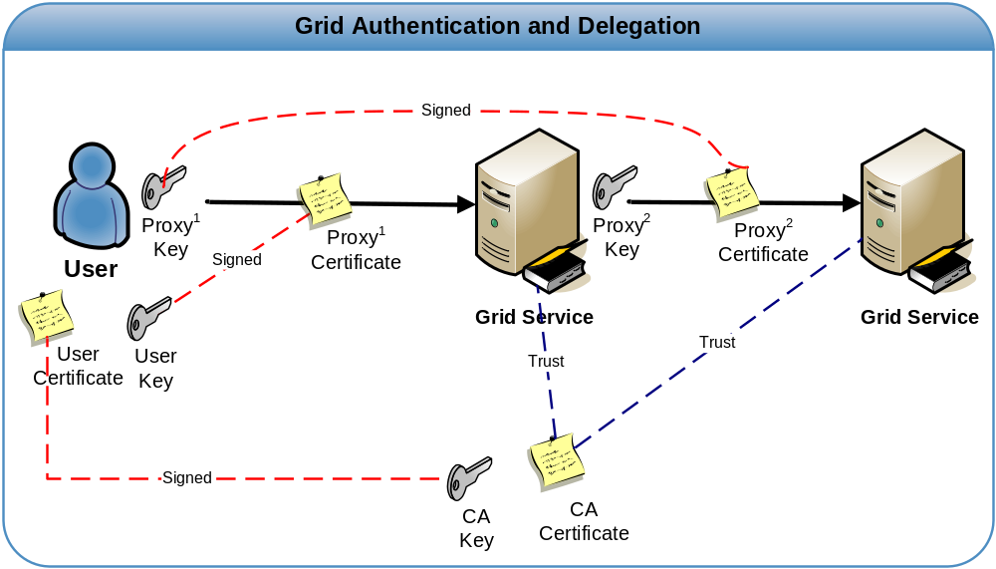
Grid Security Infrastructure
Proxy Certificates
GSI Extension to X.509 Identity Certificates
Short Term Certificate
Enables single sign-on
Delegation
  Allow user to dynamically assign identity and rights to service
  Users allow service to act on there behalf
What is effectively happening is the user is creating their own trust domain of services
  Services trust each other with user acting as the trust root

Slide 3
Problem
How does the grid clients/services know which CA certificates to trust?
?????
?????

Slide 4
Certificate Validation Profiles
Locally Stored Locally Validated Profile (LSLV)
  Trusted Certificates are locally stored.
  Revocation Lists Store Locally
  Certificates received are validated against locally stored trusted certificates.
  Equivalent to XKMS Tier 0
  Pros
    Almost no infrastructure required
  Cons
    Impossible to keep trusted CA list current
    Trust Fabric in the hands of users
    Potential Serious Security Risk

Slide 5
Certificate Validation Profiles
Remotely Retrieved Locally Validated Profile (RRLV)
  Trusted Certificates exist and are managed by a Trust Service
  Certificates received are validated against trusted certificates retrieved from a trust service
  Equivalent to XKMS Tier 1
  Pros
    Authentication performed against the current trust fabric
    Validation done locally, specialized validation requirements can be enforced.
  Cons
    Validation done locally, poor enforcement could lead to a potential security risk.

Slide 6
Certificate Validation Profiles
Remotely Retrieved Remotely Validated Profile (RRRV)
  Trusted Certificates exist and are managed by a Trust Service
  Certificates received are sent to a Trust Service to be validated
  Equivalent to XKMS Tier 1
  Pros
    Authentication performed against the current trust fabric
    Validation done remotely and enforced globally.
    Local deployment no longer responsible for validation
  Cons
    Validation done remotely, additional validation requirements cannot be enforced.

Slide 7
Questions
Which profiles are currently supported in the Grid?
What would it take to implement profiles currently not supported in the grid?
What profiles should caGrid Support?

Slide 8
Certificate Validation Profiles – Supported Today
Globus 4.0.1 employs the Locally Stored Locally Validated Profile (LSLV)
  Directory(s) of Trusted Certificates
    Contains Certificate and Certificate Revocation List (CRL) for each trusted CA
  Certificate Validation
    Certificates are validated if they are signed by a certificate contained in the Globus Trusted Certificate Directory.

Slide 9
Certificate Validation Profiles – Adding Support
Supporting Remotely Retrieved Locally Validated Profile (RRLV) in Globus
  Use trust service to obtain trusted CA certificates and CRLS and store them in the Globus Trusted Certificate directory.
  Trust Service client manages the Globus Trusted Certificate directory for Globus, keeping it up to date.
  No changes to Globus required, just run the Trust Service Client for syncing Globus with the Trust Service.

Slide 10
Certificate Validation Profiles
Supporting Remotely Retrieved Remotely Validated Profile (RRRV) in Globus
  Globus contacts Trust Service during authentication to determine if the credentials in question are signed by a Trusted CA/
  Trust Service performs all validation and enforces revocation lists.
  Support requires source changes to the Globus Toolkit
    Several changes need to be made in the Globus communication layers
    Changes need to be made in the Proxy validation layer
  Using a modified version of Globus is not recommended for caGrid
    Makes it difficult to role forward to newer versions of Globus as they are released.

Slide 11
caGrid Trust Service Recommended Approach
Work toward providing support for the Remotely Retrieved Locally Validated Profile (RRLV) in the caGrid 1.0 time frame.
Work with Globus team to develop a validation interface abstracting validation in Globus.
  Future versions of Globus can be configured with a custom validation interface
In the future (post caGrid 1.0 release) and after Globus is released with a custom validation interface, add support for supporting the Remotely Retrieved Remotely Validated Profile (RRRV)
Design with the plan on supporting the Retrieved Remotely Validated Profile (RRRV)

