Slide 1

Introduce
Grid Service Authoring Toolkit
Shannon Hastings, Scott Oster,
Stephen Langella, David Ervin
Ohio State University
Software Research Institute
{hastings,oster, langella,ervin}@bmi.osu.edu
OGF 21 Oct 2007

Slide 2
Agenda
Introduce Goals
Overview of Introduce
  Timelines
  Requirements
  Graphical Editing Environment
  Service Synchronization Engine
  Future Work
Introduce Service Creation Demonstration

Slide 3
One stop shop for grid service development
Provide a graphical user interface (GUI) and high-level functions that encapsulate and hide the common complexities and low level command-line tools of the GT for generating a suitable service layout. These include
  client and server wrappers to encapsulate the “boxed” document literal Grid service calls,
  functions to create configurable service properties,
  functions to specify resource properties and register metadata,
  functions to specify the security configurations of the service operations of the service, and
  support to deploy a service to commonly used Grid service containers.
The service developer can create and modify Grid service interfaces using a GUI. Developers can also write their own service description documents, which the Introduce toolkit can use to create and modify a service programmatically.

Slide 4
One stop shop for grid service development
Enable development of strongly-typed services.
  Using plug-ins, Introduce enables discovery of data types from virtually any style of data type providers.
Customizable and extensible via the use of extension plug-ins.
  Plug-ins allow for Introduce to be customized and its base functionality to be extended 1) for custom and common service types in an application domain and 2) to employ customized discovery mechanisms for common data types for creating strongly-typed services.
Allow for implementation of secure services.
  It leverages aspects of the Globus security framework in order to provide customizable service-, method-, and resource- level security.
Manage all the service-specific files and directories required by the GT for correct compilation and deployment.
  It also generates appropriate, object-oriented client APIs which can be used by client applications to interact with the service.

Slide 5
One stop shop for grid service development
Utilize best practice layered grid service architecture.
Handle all core service architecture requirements for strongly typed and highly interoperable grid services.
Utilizes other core grid services and architecture components
  caDSR and GME for schemas of registered data types
  Security service architecture (Dorian, GridGrouper, CSM)
  Advertisement and Registration configuration and
  Index Service for discovery

Slide 6
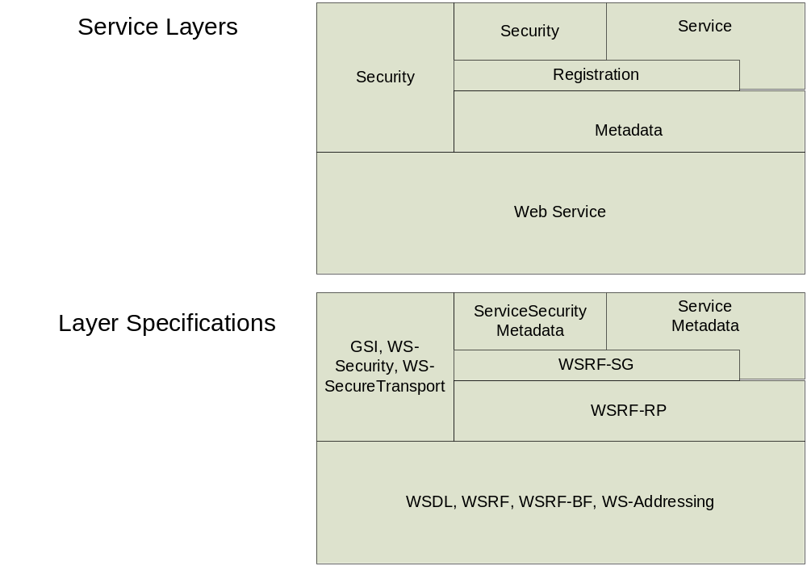
Addressing the Requirements
Grid Services
  Introduce uses the Globus Toolkit and Axis for creating, registering, discovering, and invoking these service operations as grid services
    Client uses the operation through a grid service interface and does not need to be aware of any implementation specific details of the grid service

Slide 7
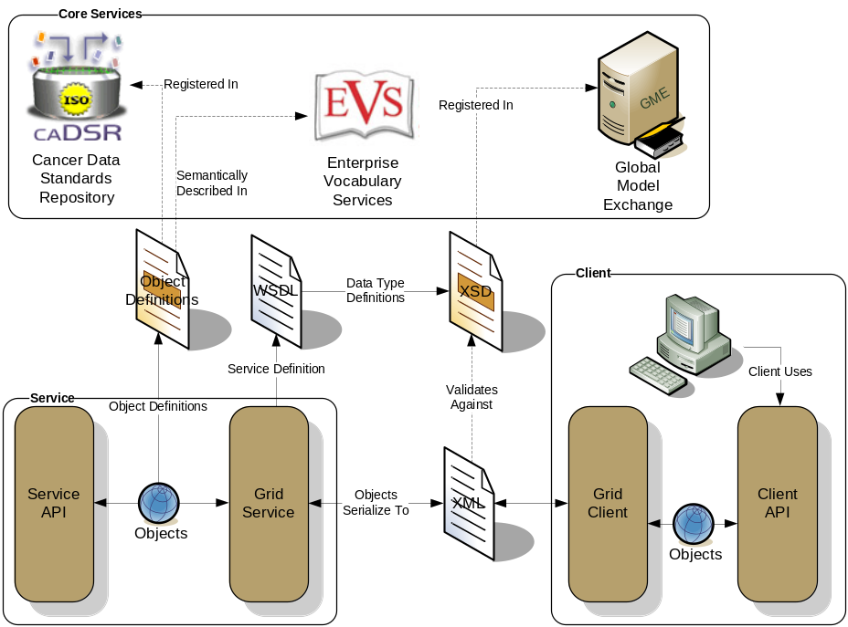
Addressing the Requirements (cont)
Strongly typed interfaces:
  Introduce enables schema extraction from a GME or any other data model registry service so that the wsdl, beans, and service metadata can be automatically populated and the service will be using strongly typed with publicly accessible data types.
  Data model schema, and any referenced schemas, are extracted and placed in the schema directory of the services build skeleton and imported into the services WSDL.
    types can be used at service build time to automatically generate the objects and create strongly-typed grid service interfaces
Example from caGrid

Slide 8
Addressing the Requirements (cont)
Providing Service Metadata:
  Leverage Globus’ use of Java Naming and Directory Interface (JNDI) in order to support WSRF.
  Service metadata is provided as resource properties on the base service’s singleton resource.
  These resource properties are defined by xml schema.

Slide 9
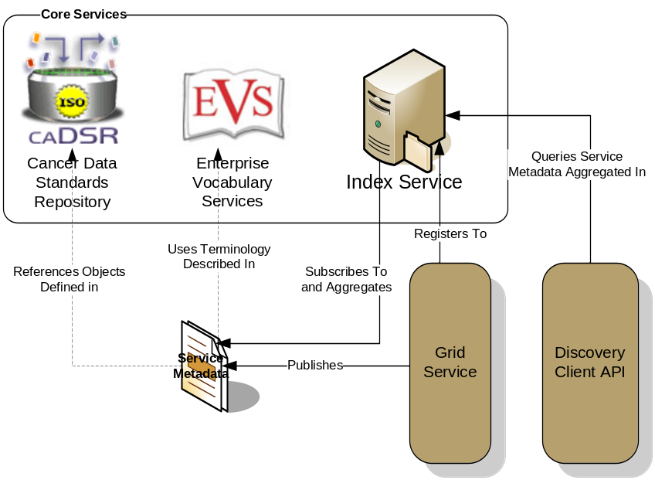
Addressing the Requirements (cont)
Index Service Registration
  Leverage Globus MDS in order to configure properties on the base resource of the service to be published to an MDS based Index Service.
  Provide configuration options for registration of static and dynamic service metadata which can then be used at runtime for service discovery.
Example from caGrid

Slide 10
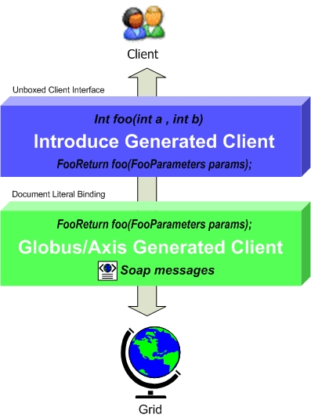
Addressing the Requirements (cont)
Providing Client Side Object Oriented API
  Globus/Axis build process will automatically generate a client side object oriented API
  Introduce generates a wrapper for this API which matches the service designers interface to make a clean mapping from client to service.
    This wrapper will handle auto boxing/unboxing of the parameters into and out of document literal form.

Slide 11
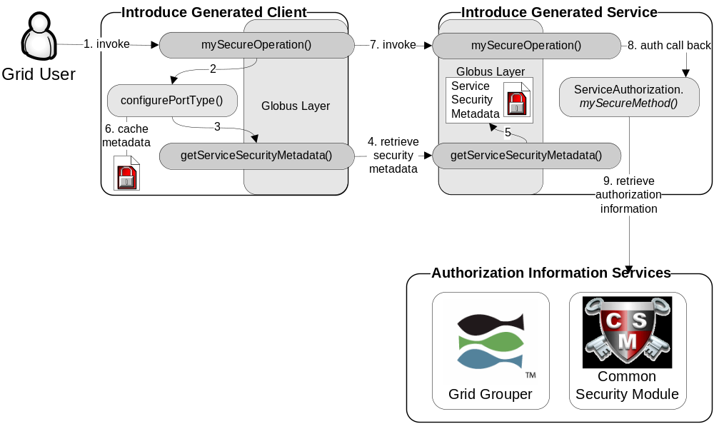
Addressing the Requirements (cont)
Security:
  Enable configuration for each service and for each method in a service.
  Support complete GSI security configuration for authentication and support for an authorization plug-in framework.
  Require service security metadata to be available anonymously via the grid service interface (getServiceSecurityMetadata()) or the grid service’s resource properties.

Slide 12
Recap Core Service Architecture
Base service is a GT4 based WSRF capable grid service.
Utilize compositional inheritance (in lieu of non-standard port type extensions) to enable the service to inherit required features such as providing service security metadata and access to resource properties.
Utilize JNDI for registration configuration, server side configuration properties, and resources and resource properties.
Provide client and service side wrappers which implement the service designers interface as opposed to the document literal interface generated by Axis.
Provide metadata registration to the index service by configuring the Resource to register it’s service groups to a predefined MDS based Index Service.
ServiceSecurityMetadata and it’s access operation enables programmatic bootstrapping of connection security configuration.

Slide 13
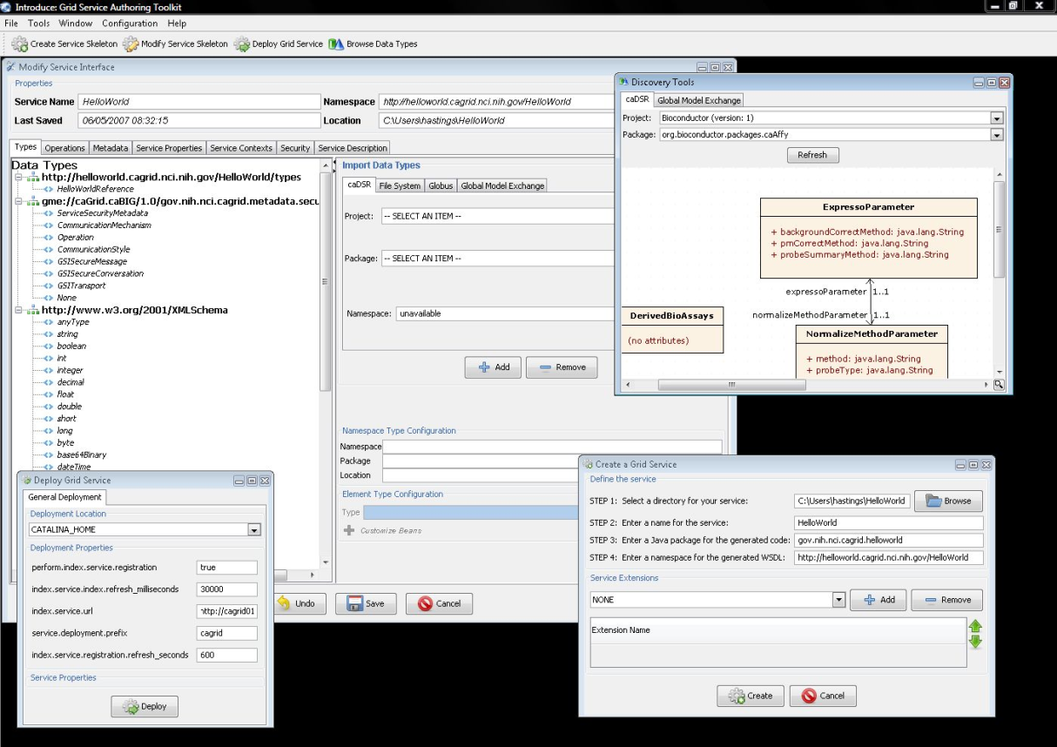
Introduce
The Introduce Application and Service Synchronization Engine.

Slide 14
Introduce Graphical Development Environment (GDE)
GUI for creating and manipulating a grid service
  Provides means of simple creation of service skeleton that a developer can then implement, build, and deploy
  Automatic code generation of complete WSRF compliant grid service which is configured to provide:
    Security
    Advertisement
    Discovery
    Complete UnBoxed Client API
  Provides a set of tools which enable the developer to add/remove/modify/import methods of the service as well create sub-services/resources.
    Automatic code generation of all the required code, Globus grid service code/configuration, service configuration, implementation of the client, and stubbed implementation of the service

Slide 15
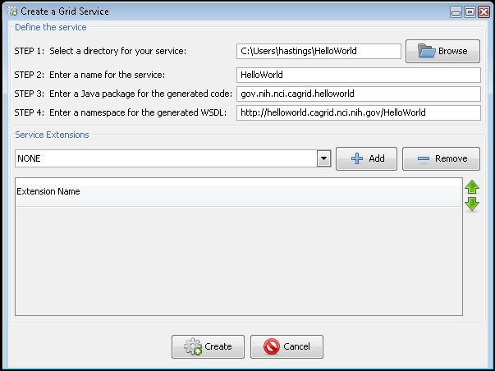
Service Creation
Populate required variables for service creation
  Name = published service name
  Creation Direction = directory to create the skeleton
  Package = the java package you wish to use for your service
  Namespace Domain = the namespace to be used to define the service interface and types
Choose any extensions which are needed for the service

Slide 16
Service Creation Demonstration
Service Creation Demonstration
create a stock quote grid service

Slide 17
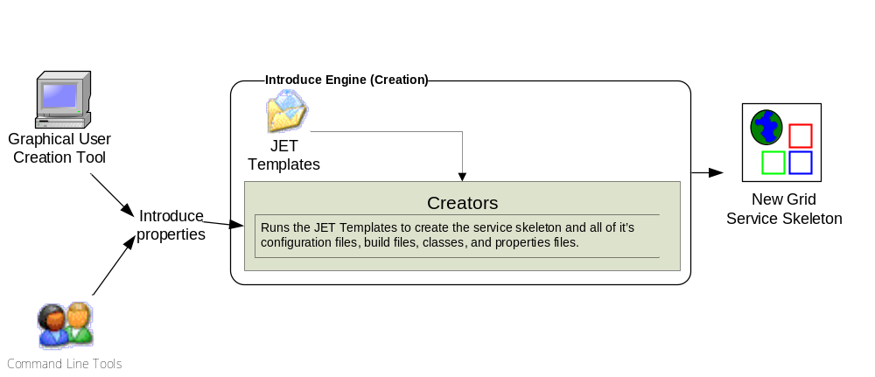
Introduce Service Creation Architecture
The Introduce Service Properties are a set if base properties
required for creating this service such as desired location to
create the service, namespace to use, package name to use,
and service name.

Slide 18
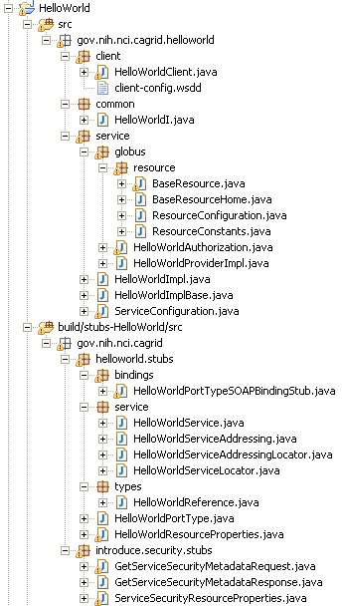
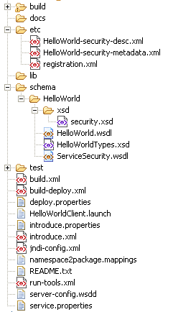
Created Skeleton Layout
= introduce managed
= globus/axis managed
= developer implements

Slide 19
Created Skeleton Layout (cont)
= implements the developer
defined interface and calls into
the generated client port type
stub.
= the developer defined grid
service interface
= manages the resources
of this grid service
= implements the port type
and calls into the actual
clean unboxed interface
the developer defined.
= developers implementation
of the defined interface.

Slide 20
Created Skeleton Layout (cont)
= service metadata registration configuration
= describes the services security configuration
= services WSDL file for axis
= introduce properties for this service
= ant build files
= client configuration file for axis
= deployment time service properties
= introduce representation of service
= JNDI service resources configuration
= namespace mappings for axis
= server configuration file for axis

Slide 21
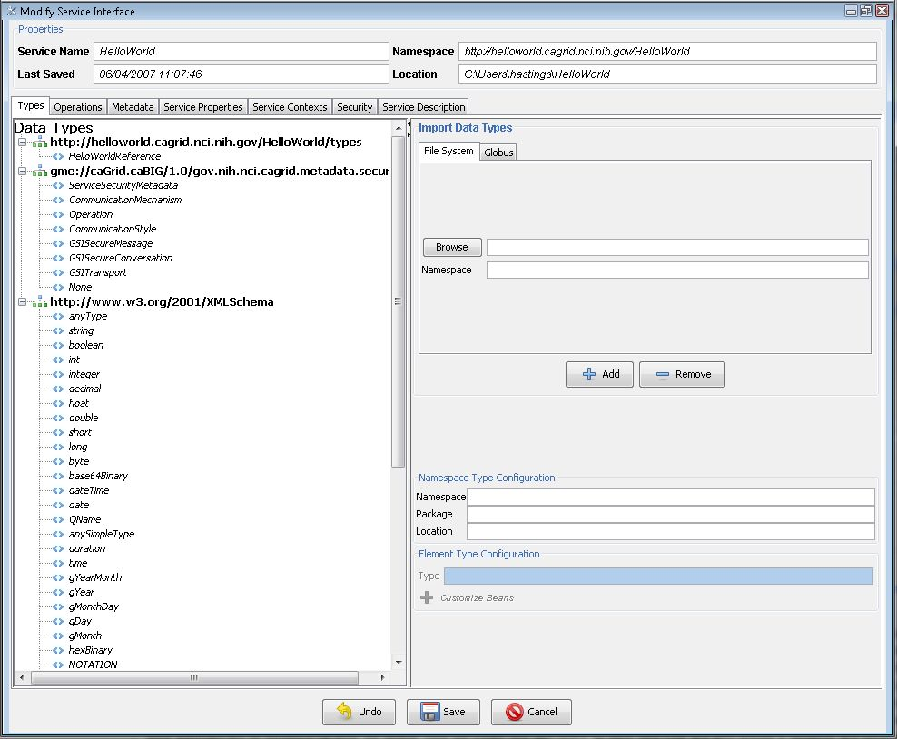
Modification
Add/Remove/Modify
Operations
Resource properties
Service properties
Service contexts (services and resources)
Service, method, and resource level security settings

Slide 22
Service Modification Demonstration
Service Modification Demonstration
add stock quote data types
add operation for obtaining stock quote.
implement method for obtaining a stock quote

Slide 23

Inside the Introduce created service
Services have many moving and configurable parts which support features such as:
  Advertisement
  Discovery
  Invocation
  Security (Authentication/Authorization)
  Stateful Resources
The Introduce Toolkit can keep all these features in sync as the developer creates and modifies the grid service

Slide 24
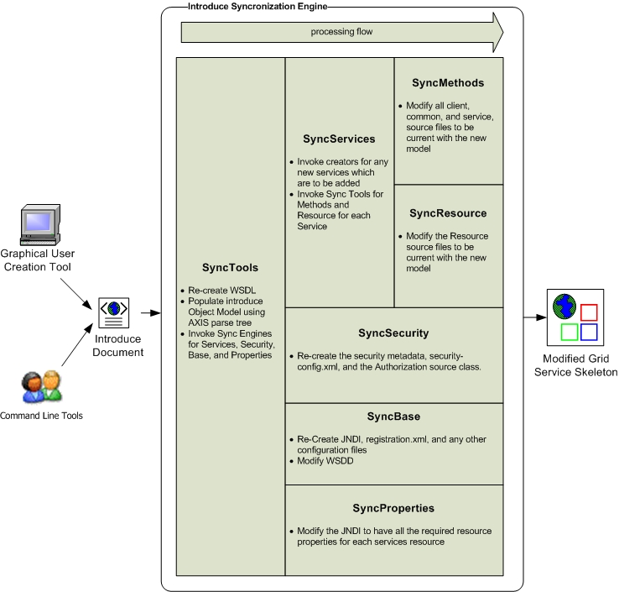
Introduce Service Modification Architecture
The Introduce Service Description document is the input to the introduce engine. The user can hand craft this document and call the engine via command line or API or can use the Introduce GDE to create and modify this document and execute the synchronization engine

Slide 25
Service Deployment and Invocation Demonstration
Service Deployment and Invocation Demonstration
Implement client test function
Deploy stock quote service
Start up service container
Invoke client to retrieve stock quote

Slide 26
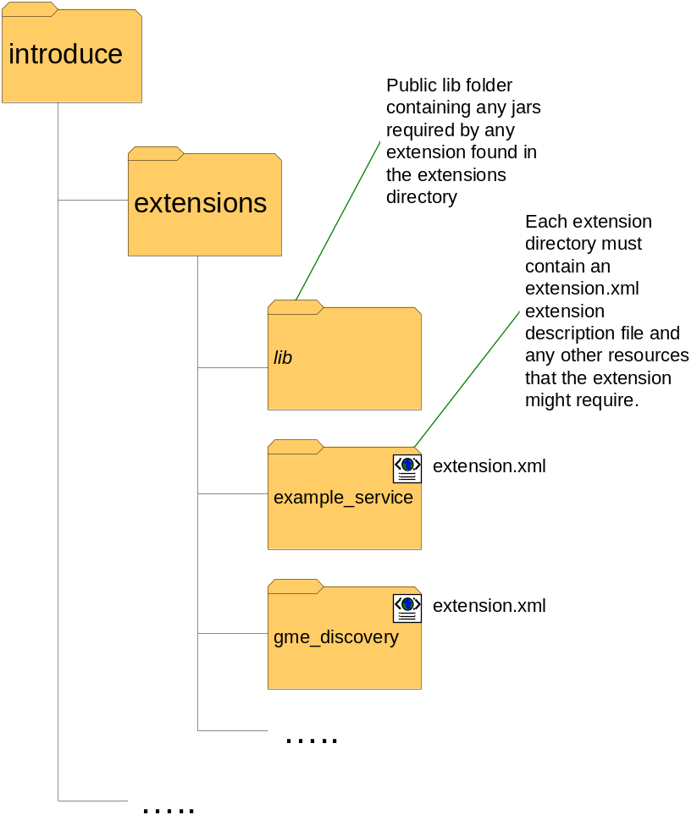
Introduce Extension Framework
Introduce provides an extension framework where it’s core functionality can be extended to provide customized solutions by leveraging the introduce toolkit.
There are currently two types of extensions in Introduce
  Service
  Types Discovery
Extensions provide an “extension.xml” extension description and configuration. The “extensions” directory of introduce hold the extensions in separate folders enabling them to easily be added and removed from the Introduce toolkit.

Slide 27
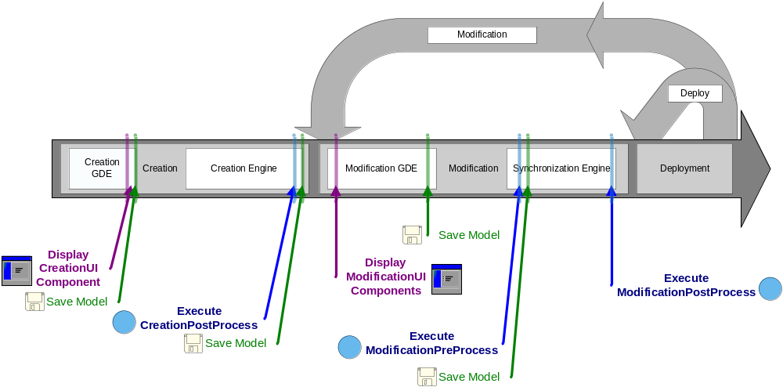
Service Development Extensions
Flow of execution for service extension components.

Slide 28
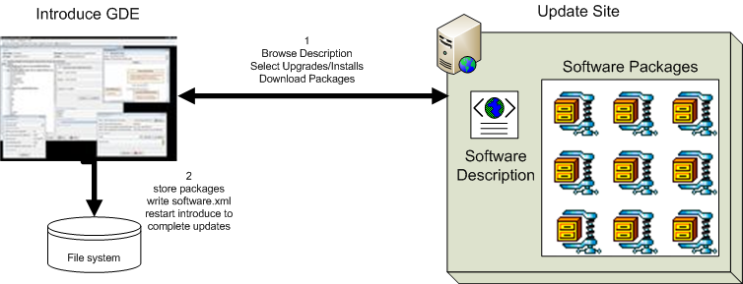
Introduce 1.1 Software Updater
New update support enables introduce to role updates out and move to newer versions of itself and it’s extensions.

Slide 29
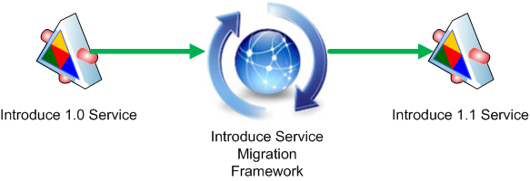
Introduce 1.1 Service Migration
New Introduce Service Migration Framework enables introduce and it’s extensions to provide upgraders which can run against services built with older versions of introduce and/or it’s extensions and migrate the services forward.
  1.0 services and forward will now be able to be migrated to work with newer versions of introduce with very little effort on the developers part.

Slide 30
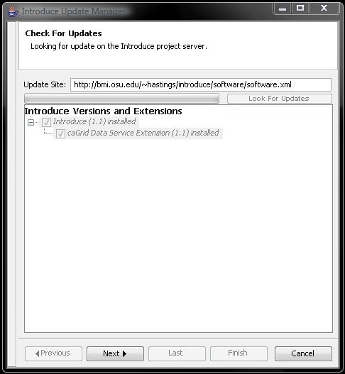
Introduce 1.1 Software Updates
Introduce is now capable of downloading and installing new extensions, upgrades to older extensions, and newer versions of itself. In the GDE there is a Help menu. In this menu there is a Check for Updates button. This button will take the user to a wizard which will walk them through looking for any software updates or new packages which they may want to download and install.

Slide 31
Introduce 1.1 Service Security
Now using Globus Policy Decision Point (PDP) based authorization.
  Introduce by default will generate the PDP authorization class from the requirements selected by the service creator using GridGrouper and/or CSM.
  Developer has the choice to use a custom PDP class which will enable them to create custom authorization login and use other external attribute or group authorities.
  Much more flexible and actually enables authorization policy to be applied to imported operations which 1.0 did not as well as directly to dynamically created resources.

Slide 32
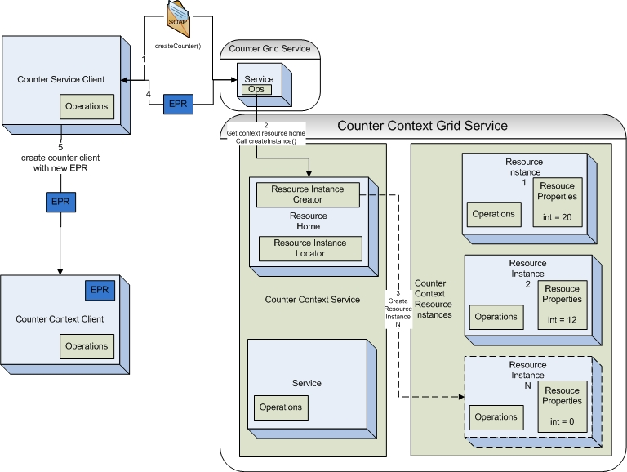
Introduce 1.1 Service Resource Contexts
Enhanced Resource Pattern Support
  now supports automated code generation of resource creation.
  Many bug fixes to support dynamic factory patterns to be created for creating and managing resources.

Slide 33
Introduce 1.1 Service Documentation
Introduce now enables descriptions and or comments to be added to virtually every aspect of the service.
  Descriptions are used to comment the generated API and to describe better the service metadata.

Slide 34
Timelines
Analytical Service Toolkit (2005)
  basic globus 4.0 service development, add operations and data types
Introduce 1.0 (Dec 2006)
  high level of service development support for globus 4.0 including security metadata, better hiding of globus toolkit code, basic resource patterns, extensions for supporting custom add-ons, service properties, custom resources, index service registration.
Introduce 1.1 (Sept 2007)
  enhanced graphical environment, more complex resource pattern support, axis fixes for supporting custom serialization of beans, PDP based authorization, grid grouper and csm authorization plug-ins, more custom control of service by developer, ws-lifetime support, control of service registration, service migration, introduce software updater.
Introduce 1.2 (Planned Feb – Mar 2008)
  ws-notification support, automated resource persistence, deployment time security configuration,

Slide 35
Get the Software and More Information
http://www.cagrid.org
http://www.cagrid.org/mwiki/index.php?title=Introduce
http://dev.globus.org/wiki/Incubator/Introduce

