Slide 1
Introduce
Grid Service Authoring Toolkit
DIALOGUE Workshop 3
February 26, 2006
Vienna, Austria
Multiscale Computing Laboratory
Department of Biomedical Informatics
The Ohio State University

Slide 2
Introduce Goals
A framework which enables the graphical creation of Globus based grid services.
Abstracts the Grid from the Application developer allowing application developers to rapidly develop applications and bring them to the grid.
Leverage other architectural components to handle all core service architecture requirements for the creation of strongly typed and highly interoperable grid services.
  Security
  Metadata
  Advertisement
  Discovery
  Error Handling
  Client Generation
  Service Configuration and Deployment

Slide 3
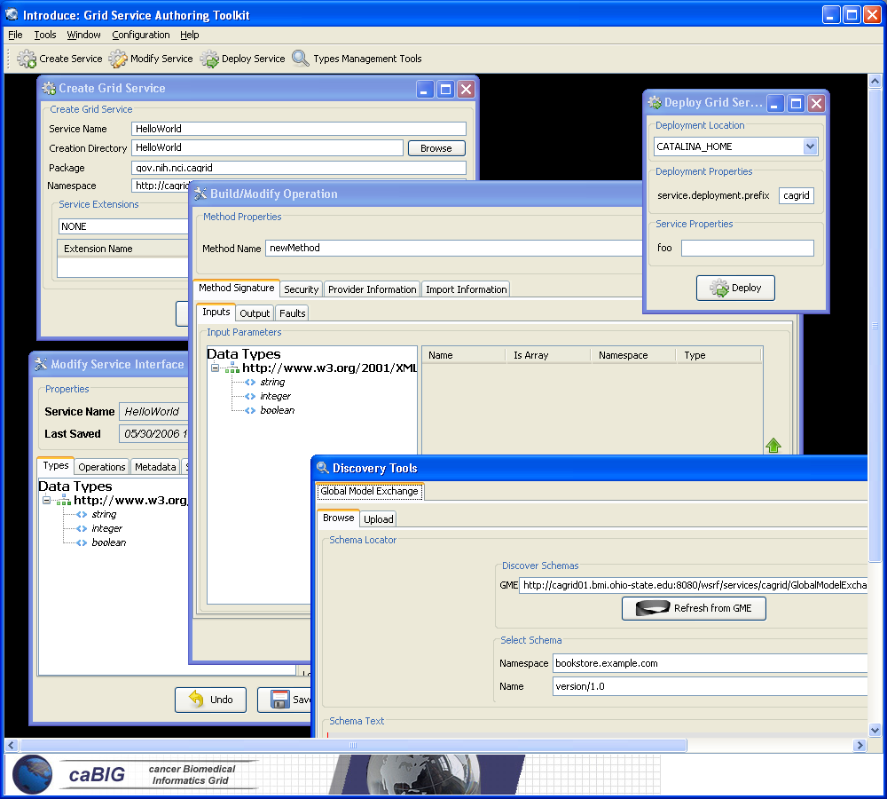
Introduce Graphical Development Environment (GDE)
GUI for the Development of Grid Services
Provides means of simple creation of service skeleton that a developer can then implement, build, and deploy
Automatic code generation of complete WSRF compliant grid service which is configured to provide:
  Security
  Advertisement
  Discovery
  Client API
Provides a set of tools which enable the developer to add/remove/modify/import methods of the service as well create sub-services/resources.
  Automatic code generation of all the required code, Globus grid service code/configuration, service configuration, implementation of the client, and stubbed implementation of the service

Slide 4
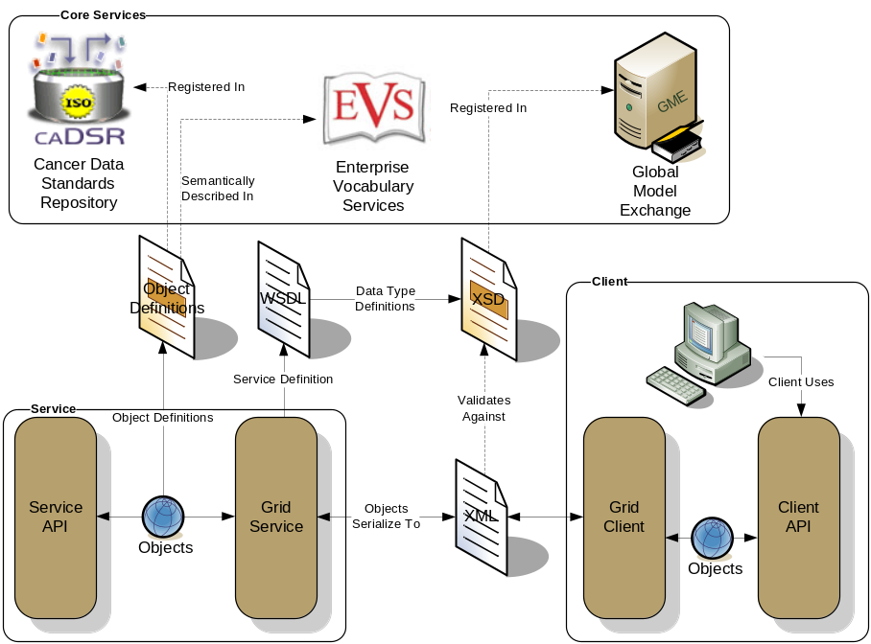
Strongly Typed Grid Services
Introduce create well defined strongly type services.
  Input Types
  Output Types
  Exception Types
Types are defined by XML schemas
Type Discovery
  Mobius Global Model Exchange (GME)
  Cancer Data Standards Repository (caDSR)
  File System
  Pluggable data model registry services.
Introduce uses models to generate
  WSDL
  Beans
  Service Metadata
Types are used at build time to automatically generate the objects and create strongly-typed grid service interfaces
Example from caGrid

Slide 5
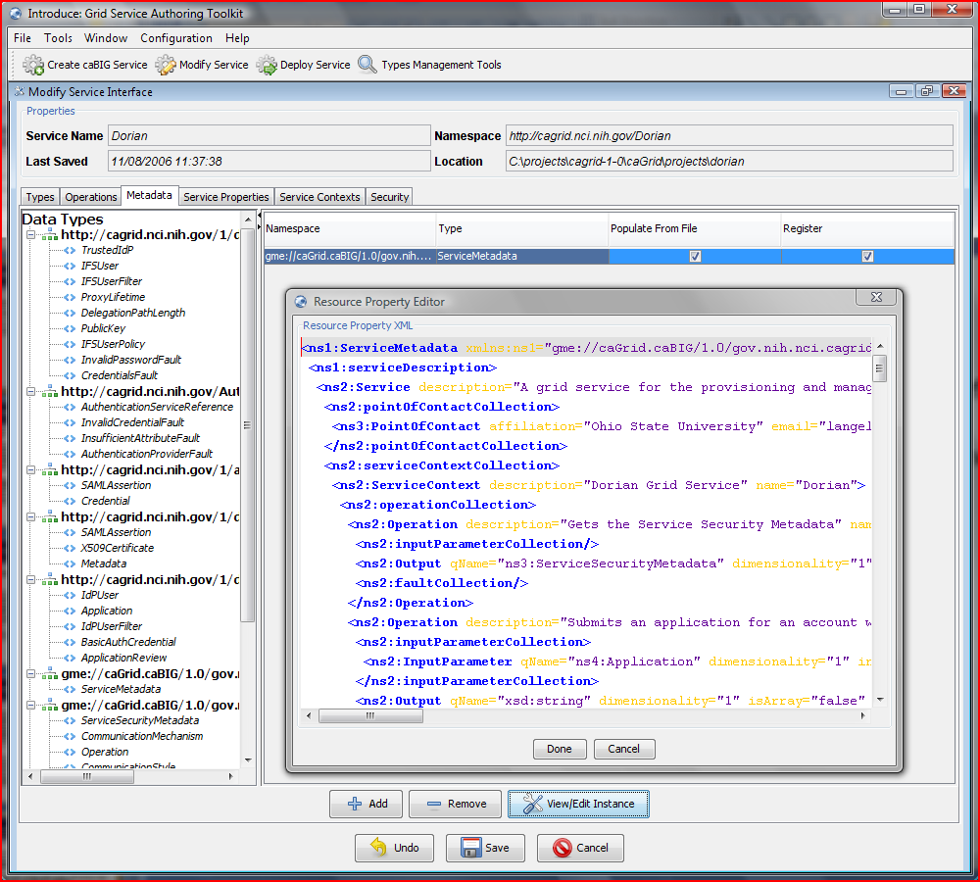
Service Metadata
Service Metadata
  Leverage Globus’ use of Java Naming and Directory Interface (JNDI) in order to support WSRF.
  Service metadata is provided as resource properties on the base service’s singleton resource.
  These resource properties are defined by xml schema.

Slide 6
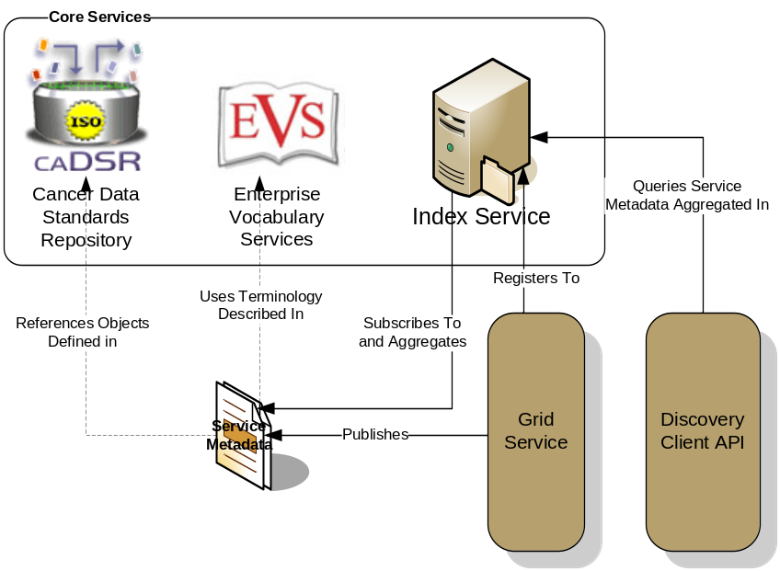
Service Advertisement and Discovery
Index Service Registration
  Leverage Globus MDS in order to configure properties on the base resource of the service to be published to an MDS based Index Service.
  Provide configuration options for registration of static and dynamic service metadata which can then be used at runtime for service discovery.
Example from caGrid

Slide 7
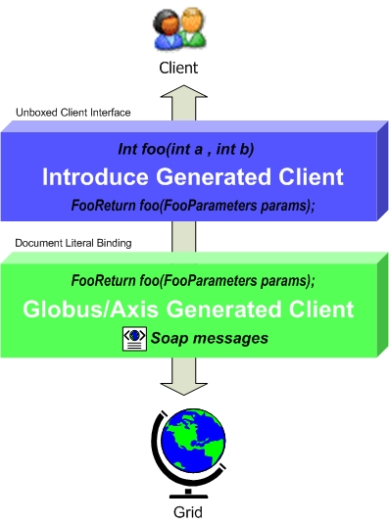
Service Client API
Client Side Object API
  Globus/Axis build process will automatically generate a client side object oriented API
  Introduce generates a wrapper for this API which matches the service designers interface to make a clean mapping from client to service.
    This wrapper will handle auto boxing/unboxing of the parameters into and out of document literal form.

Slide 8
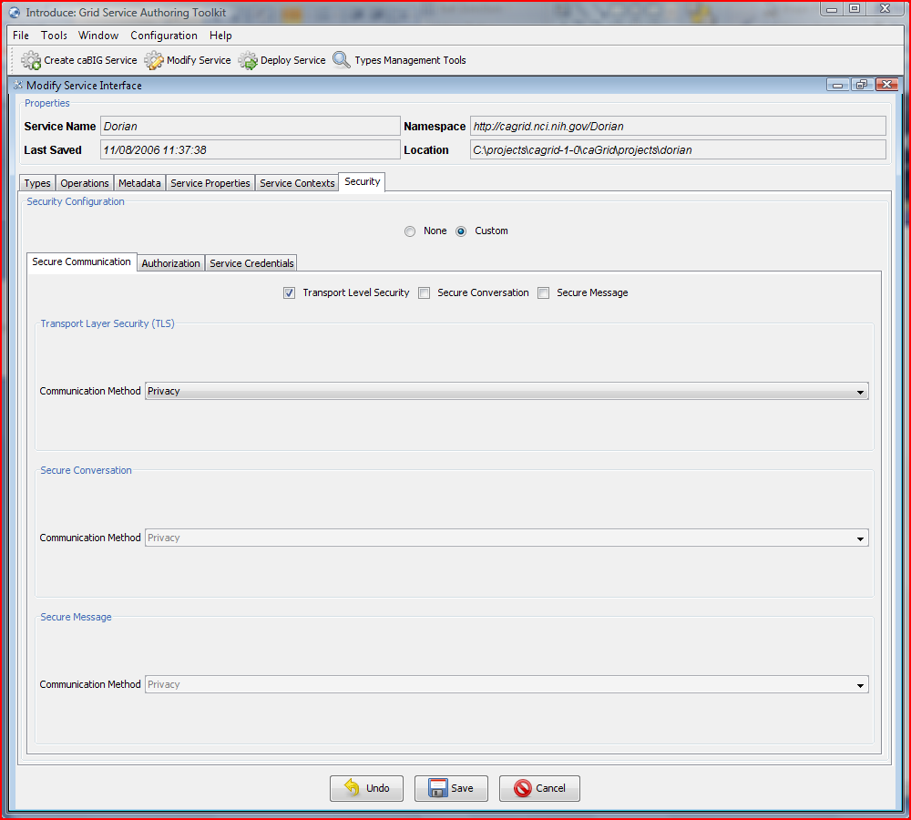
Security
Introduce Security
  Service Level Security
    Communication Chanel
    Service Credentials
    Authorization
  Method Level Security
    Communication Chanel
    Authorization
Communication Channel
  Secure Transport
  Secure Conversation
  Secure Message

Slide 9
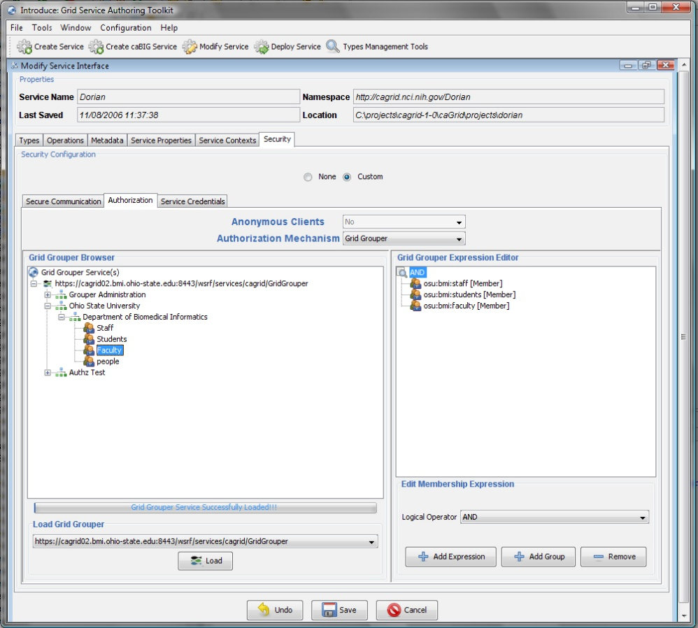
Security
Authorization
  Grid Grouper
    A group based authorization solution for the grid.
    Groups are defined and managed at the grid level.
    Grid services/applications enforce authorization policy based on membership to groups.
    Grid Grouper is built on top of Internet2’s Grouper.
  Common Security Module (CSM)
    Provides a centralize approach to managing and enforcing access control policy.

Slide 10
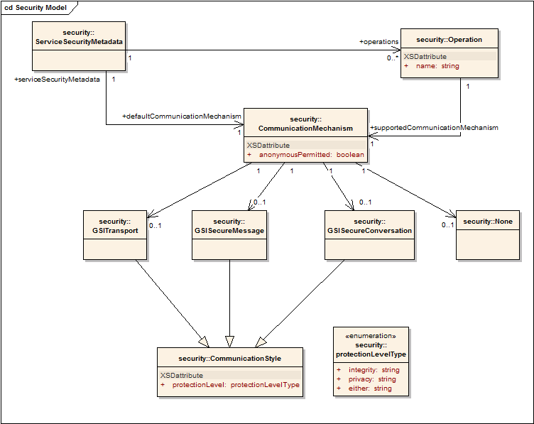
Security
Secure Communication Metadata
  In order to ensure communication interoperability between grid services, all grid services should publish security metadata.
  Security Metadata provides information on a service’s communication requirements.
  Security Metadata is obtained by invoking the getSecurityMetadata operation on a grid service.
    getSecurityMetadata operation cannot have any communication requirements.
  Clients use the Security Metadata to determine how to communicate with the service.
Introduce Support for Security Metadata
  All Introduce created services automatically support making Security Metadata available.
  Introduce clients automatically obtain the security metadata from the service and use it to determine how to communicate with the service.

Slide 11
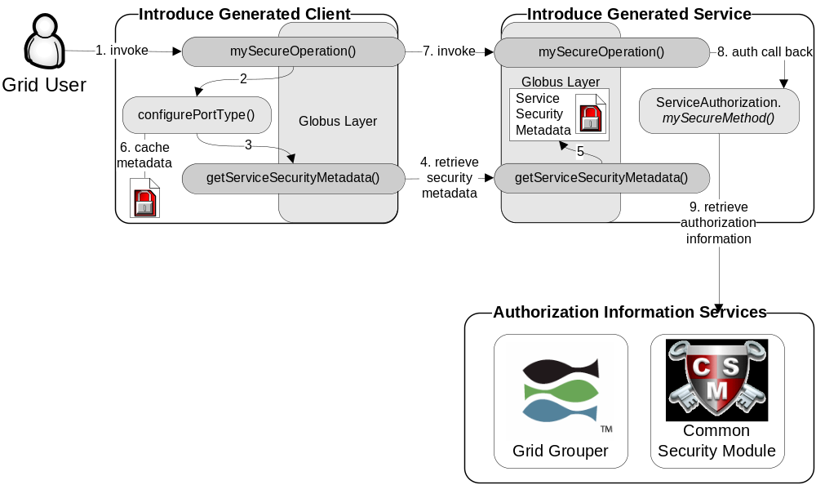
Security

Slide 12
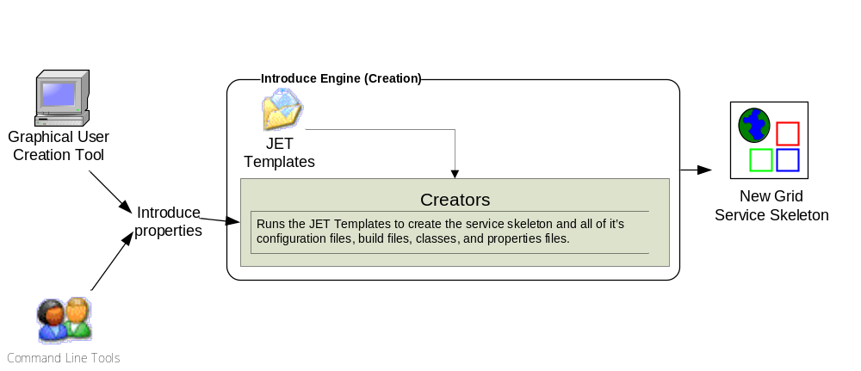
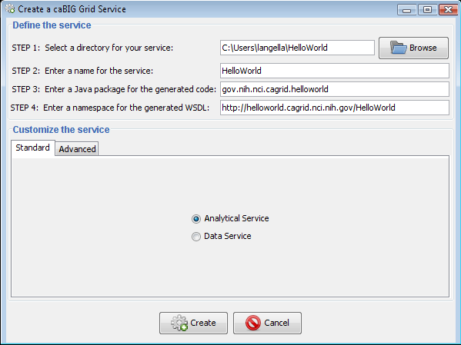
Introduce Service Creation Architecture
The Introduce Service Properties are a set if base properties required for creating this service such as desired location to create the service, namespace to use, package name to use, and service name.

Slide 13
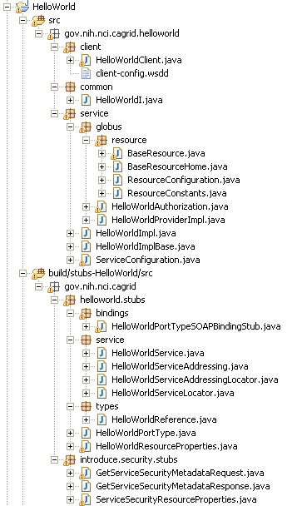
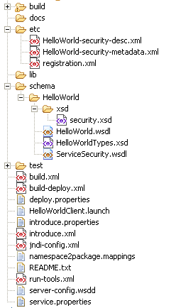
Created Skeleton Layout
= introduce managed
= globus/axis managed
= developer implements

Slide 14
Created Skeleton Layout (cont)
= implements the developer
defined interface and calls into
the generated client port type
stub.
= the developer defined grid
service interface
= manages the resources
of this grid service
= implements the port type
and calls into the actual
clean unboxed interface
the developer defined.
= developers implementation
of the defined interface.

Slide 15
Created Skeleton Layout (cont)
= service metadata registration configuration
= describes the services security configuration
= services WSDL file for axis
= introduce properties for this service
= ant build files
= client configuration file for axis
= deployment time service properties
= introduce representation of service
= JNDI service resources configuration
= namespace mappings for axis
= server configuration file for axis

Slide 16

Inside the Introduce Created Service
Services have many moving and configurable parts which support features such as:
  Advertisement
  Discovery
  Invocation
  Security
  Stateful Resources
The Introduce Toolkit can keep all these features in sync as the developer creates and modifies the grid service

Slide 17
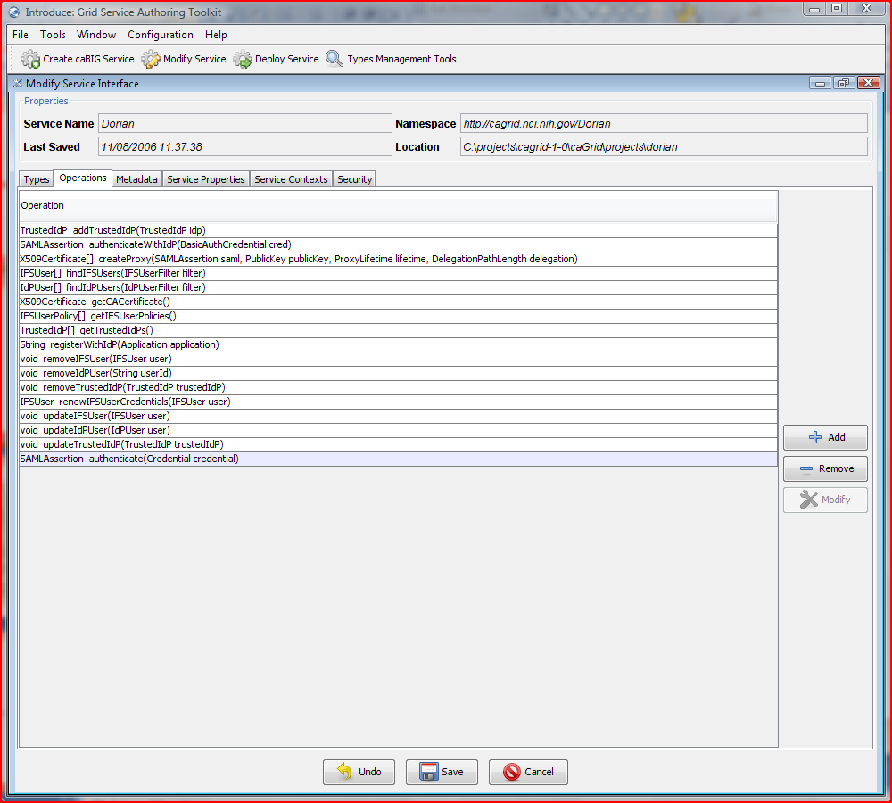
Introduce Service Modification

Slide 18
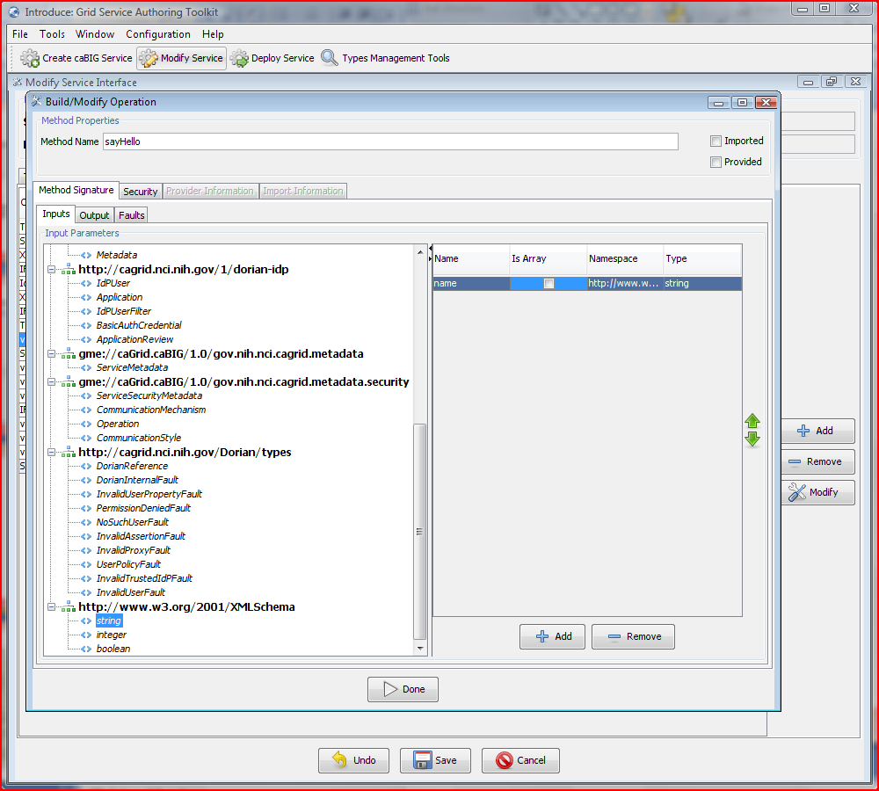
Add a Method to a Grid Service

Slide 19
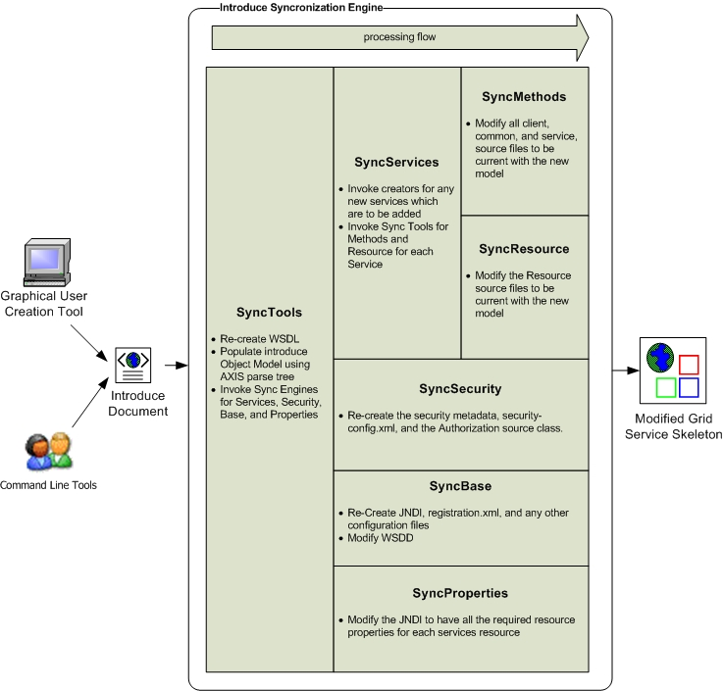
Introduce Service Modification Architecture
The Introduce Service Description document is the input to the introduce engine. The user can hand craft this document and call the engine via command line or API or can use the Introduce GDE to create and modify this document and execute the synchronization engine

Slide 20
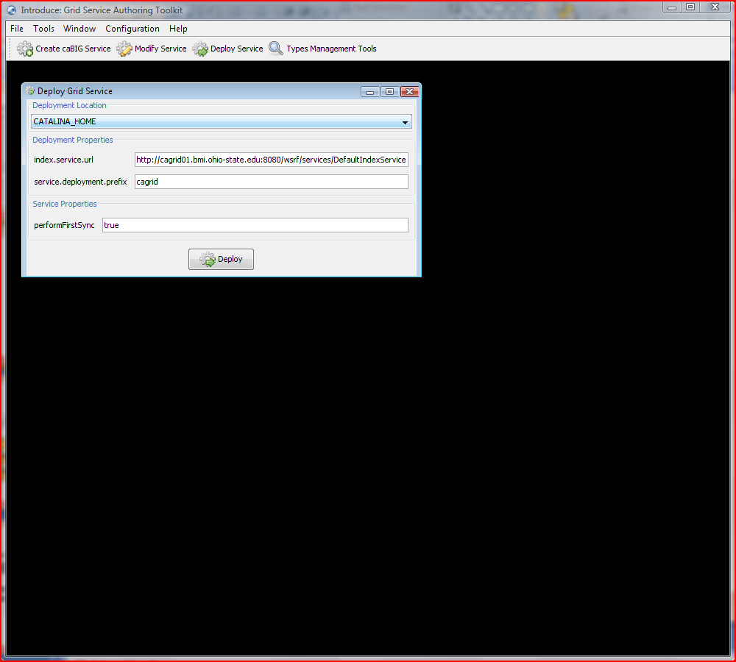
Deploying a Grid Service

Slide 21
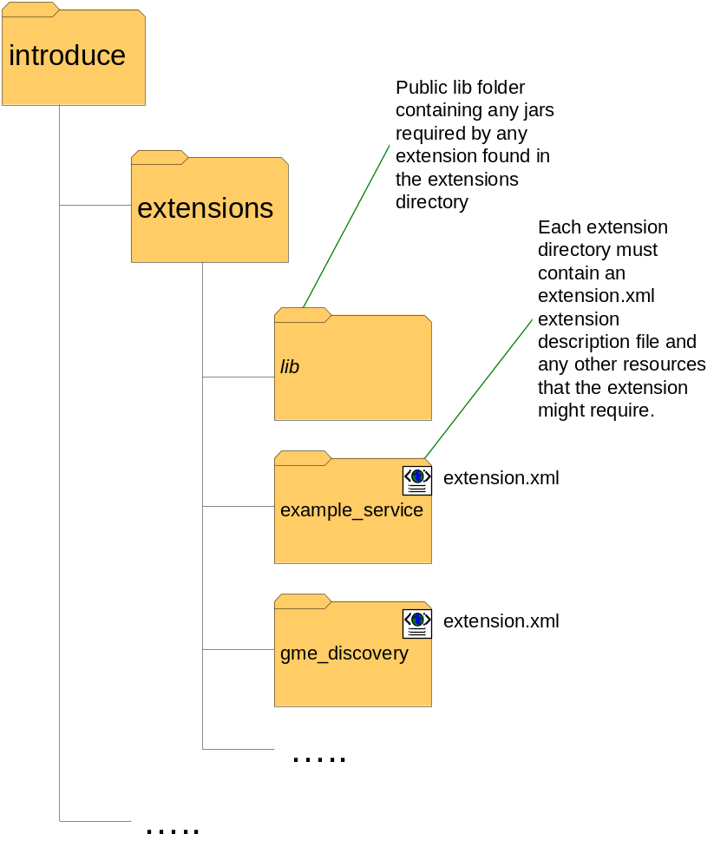
Introduce Extension Framework
Introduce provides an extension framework where it’s core functionality can be extended to provide customized solutions by leveraging the introduce toolkit.
There are currently two types of extensions in Introduce
  Service
  Types Discovery
Extensions provide an “extension.xml” extension description and configuration. The “extensions” directory of introduce hold the extensions in separate folders enabling them to easily be added and removed from the Introduce toolkit.

Slide 22
Additional Information
Introduce Website
  Downloads
  Documentation
  http://www.cagrid.org/mwiki/index.php?title=Introduce
Introduce Online Tutorial
  http://www.cagrid.org/mwiki/index.php?title=CaGrid:Tutorials:Services
Introduce is a Globus Incubator Project
  http://dev.globus.org/wiki/Incubator/Introduce

Slide 23
Introduce Team
Shannon Hastings
Scott Oster
Stephen Langella
David Ervin
Ravi Madduri
Tahsin Kurc
Joel Saltz

