Slide 1
caGrid 1.0 Workflow
Patrick McConnell
Duke Comprehensive Cancer Center

Slide 2

Workflow demo overview
CQL
5x
Argonne
Data Service
Duke
5x
5x
interpolate
removeBG
denoise
align
normalize
plot
iterate
10x
10x
OSU
10x
5x
5x
interpolate
removeBG
denoise
align
normalize
iterate
5x
Notes:
This is an overview of a demo of the workflow engine using the RProteomics data service and analytical service. The data service is deployed by Argonne National Labs at the University of Chicago, and the analytical service is deployed both at Duke and OSU. The first step is a query to the data service, which returns 10 mass spectrometry spectra. These data objects are divided into two sets and run through each of the analytical services where a number of analytical methods (interpolate, background removal, denoising, alignment, and normalization) are invoked. This demonstrates the ability for workflows to perform work in parallel. The results of the pipelines are joined, and the pre- and post-analyzed data are plotted with another grid call. The resulting JPEG image is returned to the user.

Slide 3
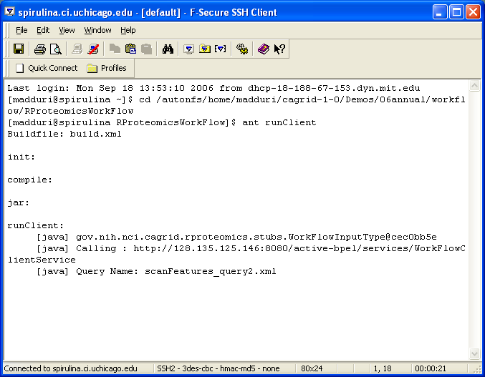
Notes:
The workflow process is kicked off using a command-line tool. The caGrid team envisions sophisticated drag-and-drop graphical clients to be built by the domain workspaces. The caB2B project is currently considering leveraging the workflow engine in this fashion.

Slide 4
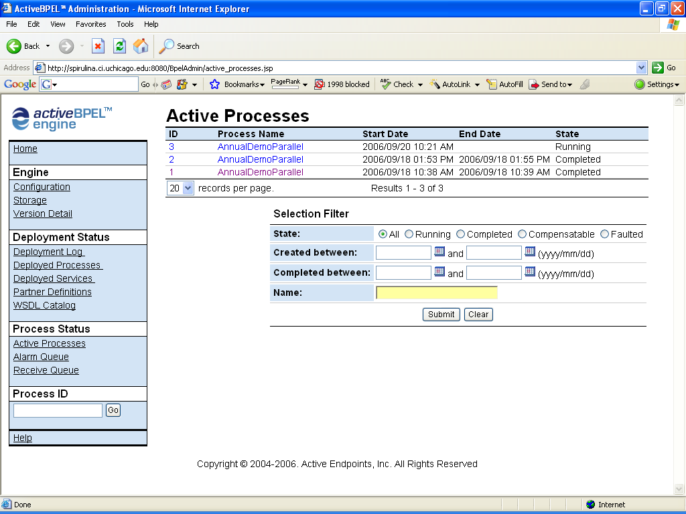
Notes:
The caGrid team has extended the Active BPEL workflow engine to work with the grid infrastructure. This is the Active BPEL interface, which can be used to interrogate running workflows, though it is not expected that caBIG end-users will access this interface.

Slide 5
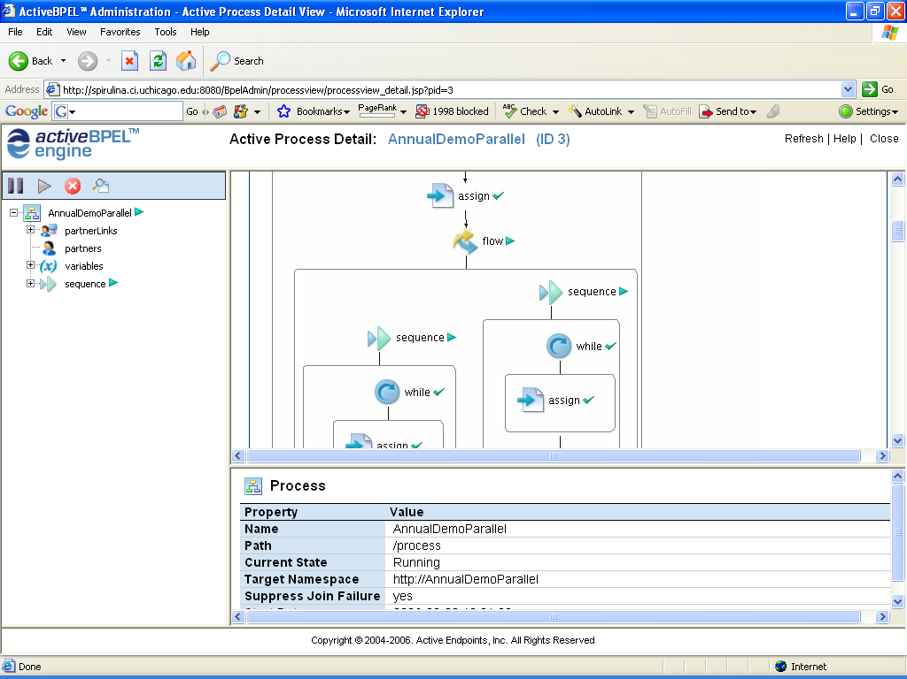
Notes:
Here we see the workflow running at the point where it diverges to parallel execution between the Duke and OSU RProteomics grid services.

Slide 6
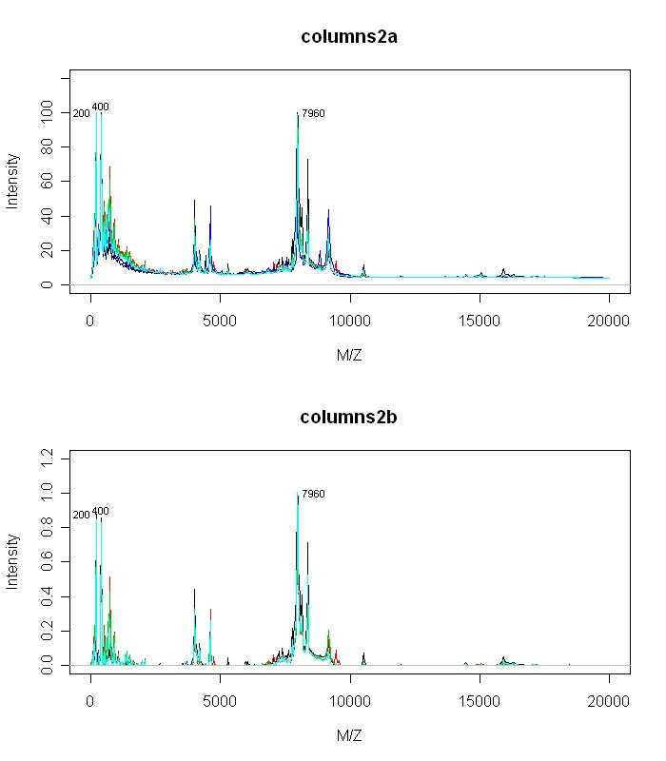
Notes:
The resulting image is returned from the workflow, showing the results before and after processing using the RProteomics analytical services.

