Slide 1
Analytical and Data Services Guidelines
Architecture/VCDE Workspaces
Joint Face to Face
February 1st-2nd, 2006
Scott Oster
Ohio State University
oster@bmi.osu.edu
Patrick McConnell
Duke University
patrick.mcconnell@duke.edu

Slide 2
Overview
Overview of Data and Analytical Services
  Distinction between Analytical Tool and Analytical Service
  Metadata definition and usage
Current UML model for service metadata (Patrick)
  Need for harmonization
  Plan to consensus
Leveraging existing data standards in caBIG (Patrick)
  Defacto standards into UML (Patrick)
Bridging caDSR and GME
  Namespace issues (existing standards)
  Connecting CDEs and Schema types

Slide 3






caBIG Services
Analytical Service
Grid-Enabled Client
Gene
Database
Tool 1
caArray
Tool 2
Research
Center
NCICB
Grid Services Infrastructure
(Metadata, Registry, Query,
Invocation, Security, etc.)
Protein Database
Grid Data Service
Tool 3
Tool 4
Image
Grid Portal
Microarray
Tool 2
Research
Center
Tool 3

Slide 4
caBIG Services
Data Services
  Data services present an object view of data sources
  Objects exposed as data services comply with common data elements registered in the caDSR/EVS, and transported as XML using schema types registered in GME
  Currently “Query only” (no update, insert, or delete)
Analytical Services
  Analytical Services are base Globus services
  Required to be strongly-typed with respect to input and output
    Analytical services input and output objects conforming to registered classes in caDSR, and schema types registered in GME
  Graphical tool to automatically create source code, configuration files, and build process for new analytical services
    Input and output parameters can be discovered from GME

Slide 5
Analytical Tool vs. Analytical Service
Patrick: add slides

Slide 6
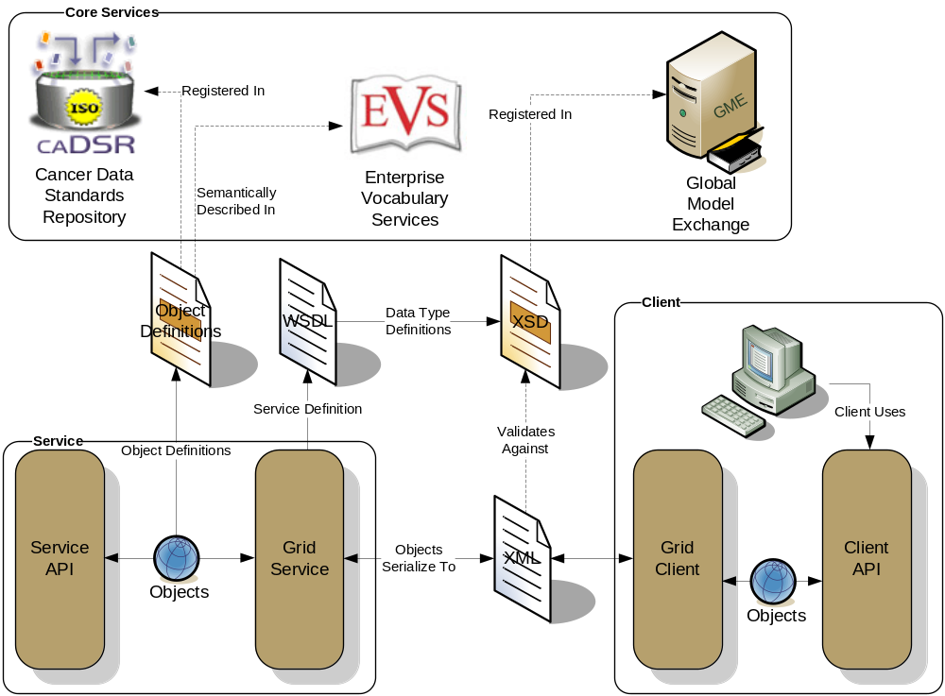
caBIG Service Description
Client and service APIs are object oriented, and operate over well-defined and curated data types
Objects are defined in UML and converted into Administered Components, which are in turn registered in the Cancer Data Standards Repository (caDSR)
Object definitions draw from vocabulary registered in the Enterprise Vocabulary Services (EVS), and their relationships are thus semantically described
XML serialization of objects adhere to XML schemas registered in the Global Model Exchange (GME)
  All data in caGrid travel between services and between client and services as XML documents that conform to well-defined schemas stored in GME

Slide 7
Current Metadata
Metadata and Registry Services
  Support for Advertisement and Discovery processes
  Metadata and registry services maintain metadata associated with data and analytical services
  All services register information to an Index Service
    Services can be discovered using semantics of their data types
Three types of Service Metadata
  Common Metadata describes generic information about service providing Cancer Center
  Data Service Metadata describes the data exposed using terminology and objects from caDSR/EVS
  Analytical Service Metadata describes the supported operations and their inputs and outputs using terminology and objects from caDSR/EVS

Slide 8
Patrick: add slides on:
Need for metadata
Proposed UML model
Path to consensus (working group, etc)

Slide 9
Patrick: add slides on:
Using existing XSDs

Slide 10
From caDSR to GME
In caDSR, each project (application) will have its own Classification Scheme (e.g. caCORE). A Classification Scheme may define a subproject, which is represented as a Classification Scheme Item (CSI) (e.g. caBIO). For this phase of caBIG is seems reasonable to assume that each CSI will have its own schema.
Each XML schema will be published into the caGrid GME service. As the caDSR ensures semantic interoperability, the GME ensures programmatic data exchange (syntactic) interoperability.
OLD SLIDES… need to update with the issues

Slide 11
From caDSR to GME (cont)
The recommendation for assigning schema namespaces for caBIG objects is shown below:
For example
  gme://caTIES.caBIG/3.0/edu.upmc.opi.cabig.caties.document.domain
OLD SLIDES… need to update with the issues
<Classification Scheme>.<Context>/<Classification Scheme Version>/<Classification Scheme Item>

Slide 12
Patrick: add slides on:
Need for richer linking between caDSR and schema types

