Slide 1


caGrid Adoption Challenges for CTSA
(openMDR)

Slide 2



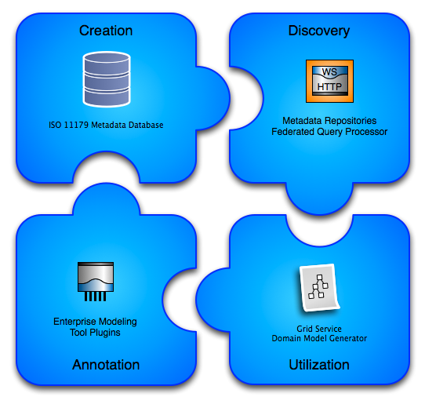
openMDR

Slide 3
openMDR
What are we trying to solve?
  Give groups other choices for managing semantic metadata and still give them the ability to create caGrid semantically annotated grid services.
    Currently caGrid tools can only use the caDSR, caCore, and SIW etc.
    User groups that don’t want for whatever reason to use the NCI caDSR or want to create a non authoritative metadata resource during development have no options.

Slide 4
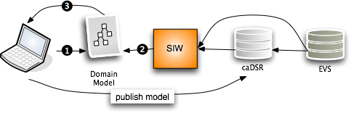

openMDR
Current caBIG Issues:
No support for “local” metadata or terminologies/ontologies.
Can’t or not intended to stand up a “local” caDSR .
The annotation tools and caDSR cant annotate or store a model that is annotated by more that one metadata registry.
Hard to or can’t copy content from NCI caDSR to your own caDSR.
caGrid tools currently can only create grid data services that use models which have gone through the SIW so currently need to use the above NCI source of metadata approach.

Slide 5
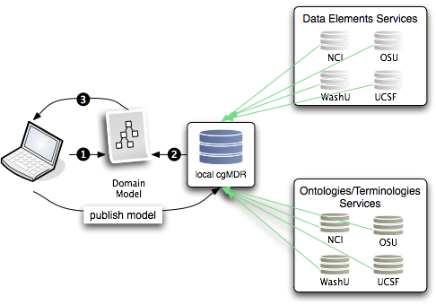
openMDR
Federated semantic metadata management utilizing and enhancing UK CancerGrid cgMDR.

Slide 6
What have we done so far?
  Refactor of cgMDR source to enable the following capabilities.
    Pulled code out of exist source tree so that openMDR is not tied specifically to any version of exist.
    Broke project up into 3 sub projects and added a 4th.
      mdrCore (iso 11179 database and web frontend for curation and browse)
      mdrQuery (refactored mdrConnector in cgMDR with a caGrid grid service which provides this query functionality
      mdrTools (currently EA plugin which uses mdrQuery to provide model annotation.
      mdrDomainModelGenerator (consumes XMI generated by cgMDR EA and generates a Domain Model file required for caGrid to create the grid data service.
    Create a ivy based project build system which is consistent with the caGrid project build and development processes.
    All code is in the caGrid incubator project in the ESN.

Slide 7
Questions you may have asked Justin already or wanted to?
Why did you not just work with cgMDR to provide enhancements?
  Our team did attempt to enagenge the cgMDR team, however, due to timelines, repository access, other reasons we decided to simply begin?
Why are you not working with NCI or with WashU?
  Good News! We are all working together to create a plan which unifies our projects into one product offering. This will require support from all parties and working closely to make sure funded project timelines can be met and still continue to provide one open community set of tools.

Slide 8
This is a work in progress but we have a real community that is looking for a solution.
shannon.hastings@osumc.edu for more information until we get a mailing list set up.
The evolving wiki site can be found here:
  https://cagrid.org/display/MDR/Overview

Slide 9

Questions?
shannon.hastings@osumc.edu

