Slide 1


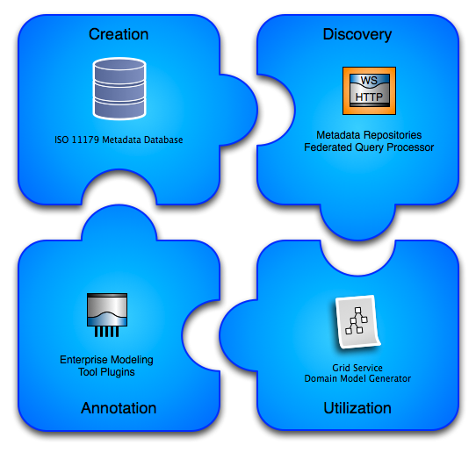
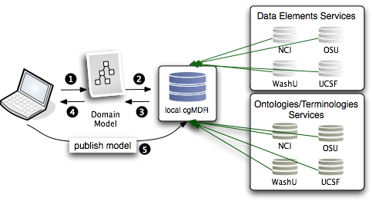
Abstract
Implementation
The openMDR project is an adaptation of the UK cgMDR project. It enables smaller groups or institutions to easily stand up local metadata registries and curate semantic metadata. This metadata can then be used to annotate data model generated using Enterprise Architect tool. The model can then be used to generate the required semantic metadata used by caBIG grid services. This alternative process enables more agile knowledge management and evolution of knowledge over time without limitations of the currently available software that can only leverage the caDSR. The openMDR and it's accompanying tools make it possible to create and stand up semantically annotated grid services by utilizing more light weight and decentralized data model repositories, new mechanisms for model annotation, tools for caBIG required semantic metadata generation, and a process for publishing metadata at a later date to caDSR once conformance or acceptance of the model has been reached.
The openMDR project is composed of several different subprojects:
MDR Core - ISO11179 Databas
  Utilizing/enhancing cgMDR iso11179 database.
  Built on the Exist XML database.
  Capable of storing, versioning, and maintaining semantic metadata.
  Metadata is annotated with conceptual information from a local or remote lexEVS system.
  Web based frontend for creating and curating semantic metadata.
MDR Query - An API and Grid Service for querying across many disparate semantic metadata repositories and using the information for data model annotation.
  caGrid grid service capable of talking to caDSR, many lexEVS and many openMDR systems enabling federated query of common data elements or concepts.
  Enhances and wraps the cgMDR mdrConnector in order to parse the received information into a common format.
  caGrid service enables it to be deployed in any local or production grid environment and configured and modified to talk to many semantic metadata systems.
MDR Plugins - A series of tools that can be used in different commercial modeling tools, such as Enterprise Architect, to enable the semantic annotation of federated semantics.
MDR Domain Model Generator - A tool that can process an MDR Plugin annotated model and create service metadata which will enable the service to be an semantically annotated grid service which can be more easily discovered
Design
Makes use of the federated semantic metadata management platform provided by the UK CancerGrid’s cgMDR project, which provides a lightweight ISO 11179 standards compliant metadata repository.
Comprises of tools that enable semantic annotation from its own metadata repository, and can also resolve metadata and terminologies from remote resources
Provides choice to groups for managing semantic metadata and also give them the ability to create caGrid semantically annotated grid services
Provides for user groups that don’t want for whatever reason to use the NCI caDSR or want to create a non authoritative metadata resource during development.
http://cagrid.org

